Slide 1
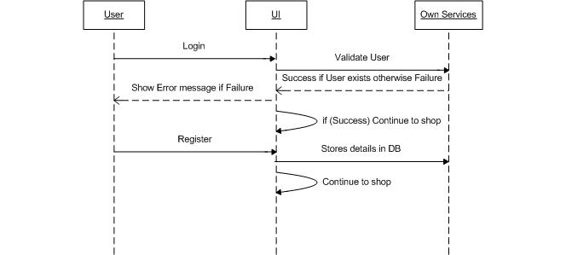
Sequence Diagram login/register

Slide 2
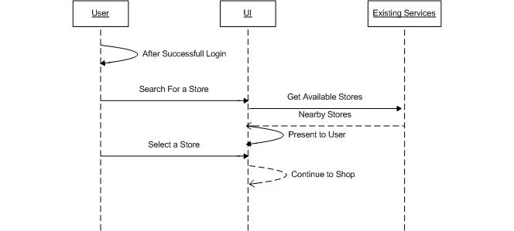
Sequence Diagram for Selecting a Store

Slide 3
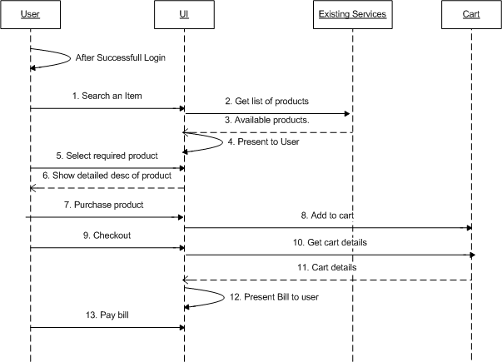
Sequence Diagram for Shopping

