Slide 1
RNN code statistics: GPU-04
training using whole data:
run time: ~ 1hr 15 mins/ iteration
prediction using whole data:
prediction time: ~ 1hr 5 mins/ iteration
training while cross validation:
run time: ~ 1hr 10 mins/ iteration

Slide 2
Running two iterations steps 1: training step 2: prediction

Slide 3
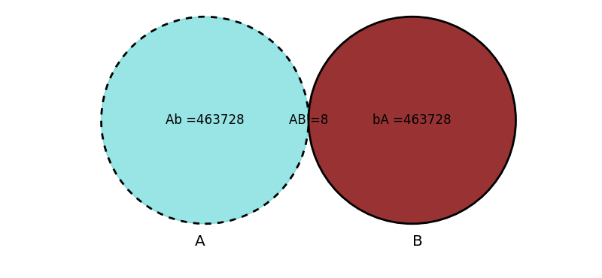
Output comparison
Venn diagram to show predictions that showed identical ranks in two iterations.
Iteration 0
Iteration 1

Slide 4
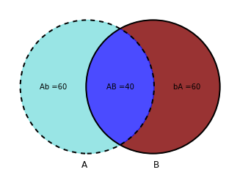
Common sequences between iteration 0 and 1 (top 100 predictions)

Slide 5
Running two iterations step 2: prediction
*** previously generated checkpoints were read and the prediction step was carried out.
referred as trials.

Slide 6
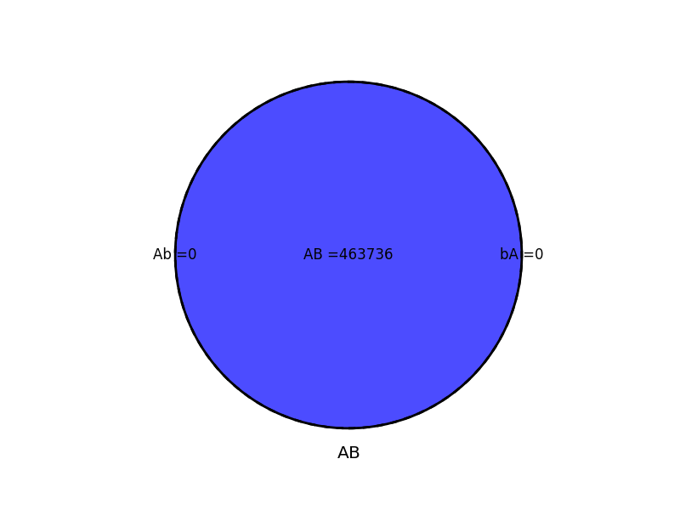
Comparison of iteration 0 from two prediction (only) trials
Comparison shows no stochastic issue when prediction is made from same model.

Slide 7
Comparison of iteration 1 from two prediction (only) trials
Comparison shows no stochastic issue when prediction is made from same model.

