Slide 1
Global measurement (protein / protein)
Principle axis
SASA (interface contacts)??
Local measurement (segments based)
Contact frequency
Interface residue
Atom type contact…
Helix (beta strand) angles
Helix (beta strand) distance
Need to think how to include beta
Interface residues chi1 angle ??
Water counts?? Water bridge?? Potential water-mediate HB??
PIA2
Binding site chi1 angle/distance
TMs angle/distance
Bio-related measurement
RMSD
…
Correlation in between observations???? (Pearson R)
to find stronger signal
Unit tests
Notes:
Correlation?? (Pearson R)
Zhao, C., S. Stolzenberg, L. Gracia, H. Weinstein, S. Noskov and L. Shi (2012). "Ion-controlled conformational dynamics in the outward-open transition from an occluded state of LeuT." Biophys J 103(5): 878-888.

Slide 2
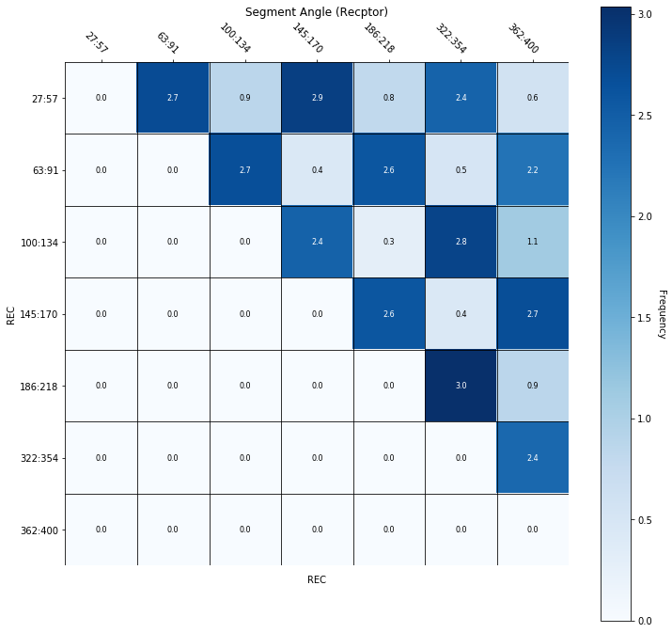
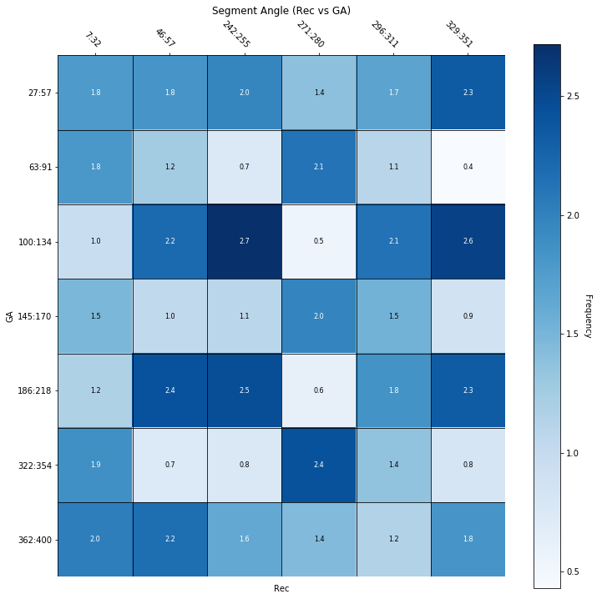
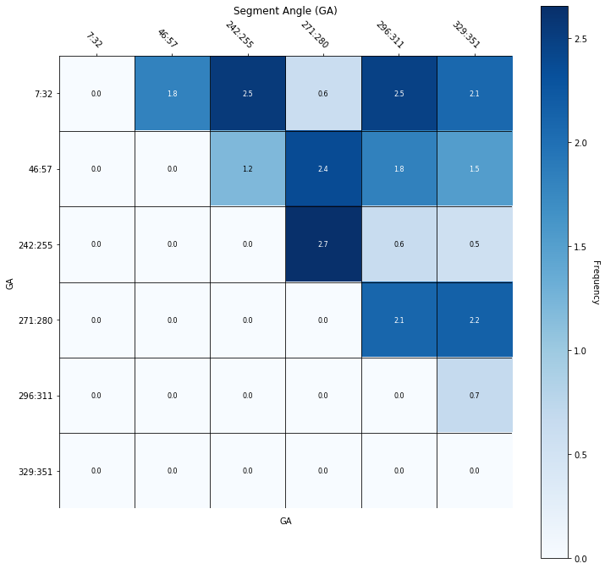

Slide 3
To do:
Check pdb/dcds….
Toy model to ensure helix angle is right…

