Slide 1

Running python tools with PyCharm
— Moritz Schiel
Notes:
<number>

Slide 2
Topics
GitHub Overview
SSH/PAT
Cloning a repository
PyCharm basics
Running the tool
31.05.2022
Reiner Lemoine Institut
1

Slide 3
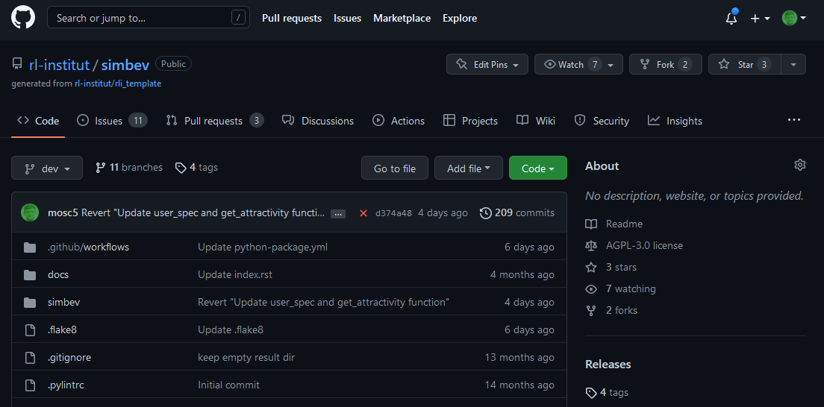
1. GitHub Overview
https://github.com/rl-institut/simbev
Submit bug reports here
Select branch
Clone link
31.05.2022
Reiner Lemoine Institut
1

Slide 4
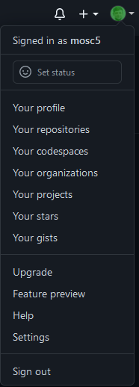
2. Creating a Personal Access Token
Recommended for Windows users
Log in to GitHub and go to Settings
Scroll down and select “Developer Settings”
Choose “Personal access tokens”
https://docs.github.com/en/authentication/keeping-your-account-and-data-secure/creating-a-personal-access-token
31.05.2022
Reiner Lemoine Institut
1

Slide 5
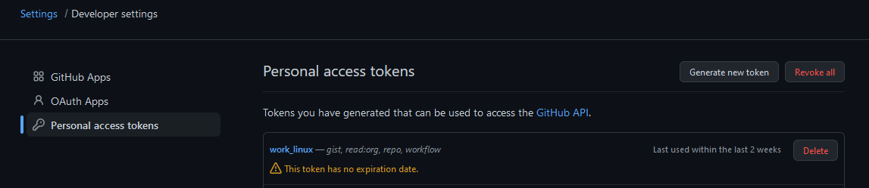
2. Creating a Personal Access Token
Click “Generate new token”
Necessary scopes: gist, read:org, repo, workflow
Save the token in a text file
31.05.2022
Reiner Lemoine Institut
4

Slide 6
2. Creating an SSH key
Recommended for Linux users
Open the terminal and input:
mkdir /home/<user name>/.ssh
cd .ssh/
ssh-keygen -t ed25519 -C "your_email@example.com"
Press Enter to save the file to the default location
31.05.2022
Reiner Lemoine Institut
5

Slide 7
2. Creating an SSH key
Add your SSH key to ssh-agent
eval "$(ssh-agent -s)"
ssh-add ~/.ssh/id_ed25519
Copy your public key via Terminal or by opening the file
clip < ~/.ssh/id_ed25519.pub
Go to GitHub => Settings => SSH and GPG keys
Click „New SSH key“ and paste your copied key
31.05.2022
Reiner Lemoine Institut
6

Slide 8
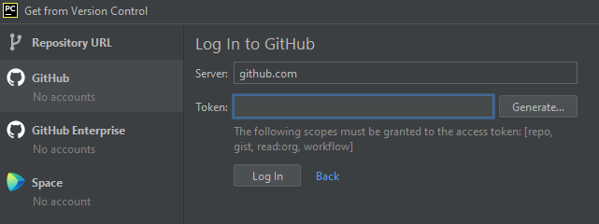
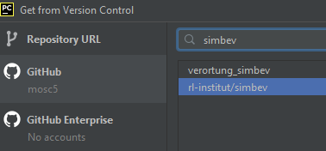
3. Cloning a repository
Open PyCharm
Go to VCS => Get from Version Control or Git => Clone
Log in via token
Choose your desired repository from the list
For this exercise, choose rl-institut/simbev
31.05.2022
Reiner Lemoine Institut
7
Notes:
Why is python good for these things?
<number>

Slide 9
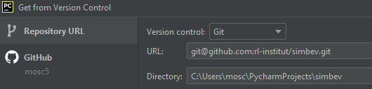
3. Cloning a repository
For repositories that are not in your organization or if you want to use ssh:
Log in via GitHub or token
Choose “Repository URL”
31.05.2022
Reiner Lemoine Institut
8
Notes:
Why is python good for these things?
<number>

Slide 10
4. PyCharm overview
Environment, Projects, Terminal, VCS etc
31.05.2022
Reiner Lemoine Institut
<number>

Slide 11
5. Running the tool
Run Config, Console, Results
31.05.2022
Reiner Lemoine Institut
<number>

