Slide 1

Running python tools with PyCharm
— Moritz Schiel
Notes:
<Foliennummer>

Slide 2
Topics
GitHub Overview
SSH/PAT
Cloning a repository
PyCharm basics
Running the tool
01.06.2022
Reiner Lemoine Institut
1

Slide 3
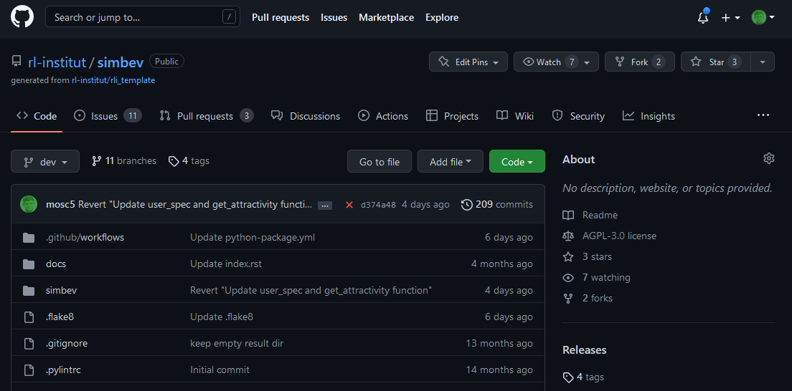
1. GitHub Overview
https://github.com/rl-institut/simbev
Submit bug reports here
Select branch
Clone link
01.06.2022
Reiner Lemoine Institut
1

Slide 4
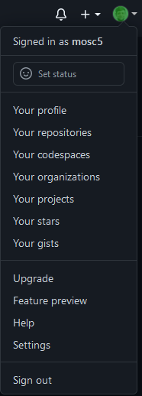
2. Creating a Personal Access Token
Recommended for Windows users
Log in to GitHub and go to Settings
Scroll down and select “Developer Settings” from the sidebar
Choose “Personal access tokens”
https://docs.github.com/en/authentication/keeping-your-account-and-data-secure/creating-a-personal-access-token
01.06.2022
Reiner Lemoine Institut
1

Slide 5
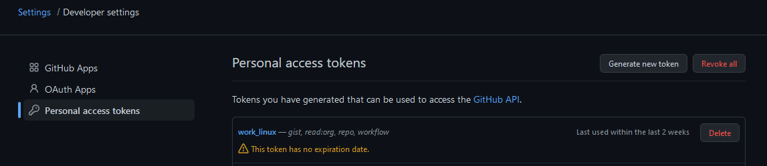
2. Creating a Personal Access Token
Click “Generate new token”
Necessary scopes: gist, read:org, repo, workflow
Save the token in a text file
01.06.2022
Reiner Lemoine Institut
4

Slide 6
2. Creating an SSH key
Recommended for Linux users
Open the terminal and input:
mkdir /home/<user name>/.ssh
cd .ssh/
ssh-keygen -t ed25519 -C "your_email@example.com"
Press Enter to save the file to the default location
01.06.2022
Reiner Lemoine Institut
5

Slide 7
2. Creating an SSH key
Add your SSH key to ssh-agent
eval "$(ssh-agent -s)"
ssh-add ~/.ssh/id_ed25519
Copy your public key via Terminal or by opening the file
clip < ~/.ssh/id_ed25519.pub
Go to GitHub => Settings => SSH and GPG keys
Click „New SSH key“ and paste your copied key
01.06.2022
Reiner Lemoine Institut
6

Slide 8
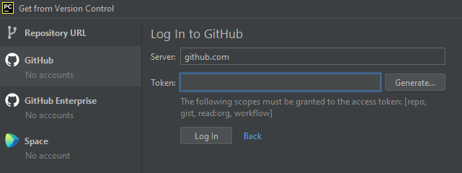
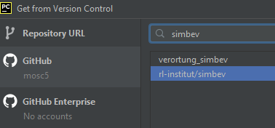
3. Cloning a repository
Open PyCharm
Go to VCS => Get from Version Control or Git => Clone
Log in via token
Choose your desired repository from the list
For this exercise, choose rl-institut/simbev
01.06.2022
Reiner Lemoine Institut
7
Notes:
Why is python good for these things?
<Foliennummer>

Slide 9
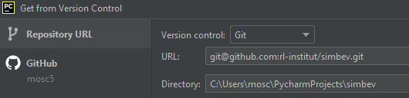
3. Cloning a repository
For repositories that are not in your organization or if you want to use ssh:
Log in via GitHub or token
Choose “Repository URL”
01.06.2022
Reiner Lemoine Institut
<Foliennummer>
Notes:
Why is python good for these things?
<Foliennummer>

Slide 10
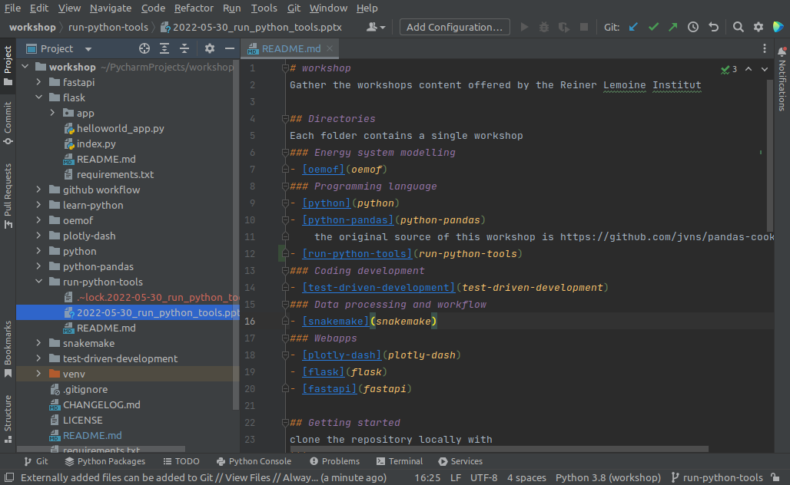
4. PyCharm overview
Projects & Settings
Git/VCS settings
Run configuration
Git shortcuts
Select your environment
Select your branch
01.06.2022
Reiner Lemoine Institut
<Foliennummer>

Slide 11
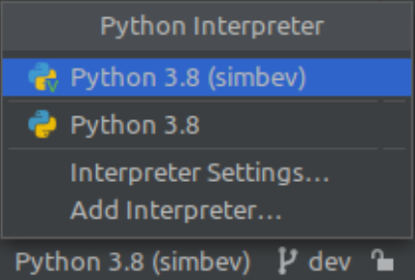
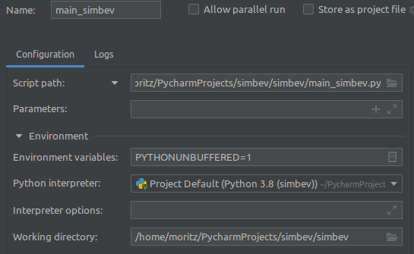
5. Running the tool
Set your environment
Create a run configuration easiest way: right click in script and select „run“
01.06.2022
Reiner Lemoine Institut
<Foliennummer>

Slide 12
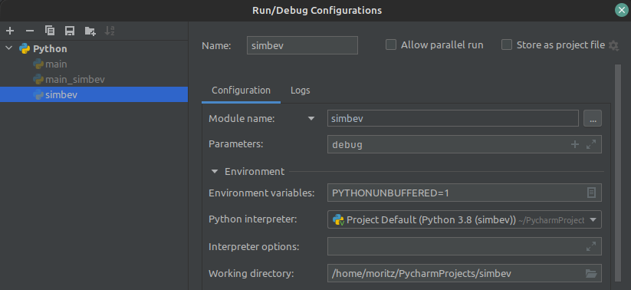
5. Running the tool
Advanced run config example: SimBEV 2.0
01.06.2022
Reiner Lemoine Institut
<Foliennummer>

