Slide 1


Oemof Workshop Week Setup of oemof
Martha Hoffmann
Session 1
RLI, 16.09.2019
© Reiner Lemoine Institut

Slide 2
Aim of this session
Setup of all necessary programms and tools for this workshop
All workshop contents at: https://github.com/smartie2076/oemof_workshop
Notes:
Erhöhte Versorgungssicherheit durch Reduzierung der starken Abhängigkeit von fossilen Brennstoffimporten
Effizienzsteigerung durch Lastoptimierung der Dieselgeneratoren → Vermeidung von Teillast
Erhöhte Versorgungssicherheit durch Reduzierung der starken Abhängigkeit von fossilen Brennstoffimporten
Senkung der Stromgestehungskosten durch kompetitive und zuverlässige Technologien

Slide 3
Agenda of this session
Miniconda installation
Oemof installation and test
Cbc-solver setup
Pycharm installation
Optional: Pycharm features

Slide 4
Agenda of this session
Miniconda installation
Oemof installation and test
Cbc-solver setup
Pycharm installation
Optional: Pycharm features

Slide 5
Installation of miniconda
Installing miniconda*
Installation of python3 on OS
Provides tool for generating virtual environments, which makes package use during programming transperent
Provides a terminal for the execution of python scripts („Anaconda prompt“)
https://docs.conda.io/en/latest/miniconda.html
Choose according to OS, and Python 3.X
*(alternative: virtualenv)

Slide 6
New virtual environments with Anaconda Prompt
Open Anaconda Prompt
List all existing environments with:
Create environment with specific name and python version with:
Activate environment:
Now, only packages specifically installed for your env_name are active. Install from requirements.txt:
conda env list
conda create -n [env_name] python=X.X
activate [env_name]
pip install –r requirements.txt

Slide 7
Todays agenda
Miniconda installation
Oemof installation and test
Cbc-solver setup
Pycharm installation
Optional: Pycharm features

Slide 8

Installing Pycharm
Pycharm...
Is a GUI for programming
Can process, validate and highlight many file and programming styles
Includes file versioning and git features
To use pycharm with the version control system git (recommended), install:
https://git-scm.com/download
Install from: https://www.jetbrains.com/pycharm/download/
Logo from: JetBrains - https://www.jetbrains.com/company/press/, Gemeinfrei, https://commons.wikimedia.org/w/index.php?curid=53185677

Slide 9
Agenda of this session
Miniconda installation
Oemof installation and test
Cbc-solver setup
Pycharm installation
Optional: Pycharm features

Slide 10
Installation of cbc-solver (Windows)
Recommended solver for oemof is coin-or-cbc*: https://projects.coin-or.org/Cbc
Download cbc-solver:
64bit: http://ampl.com/dl/open/cbc/cbc-win64.zip
32bit: http://ampl.com/dl/open/cbc/cbc-win32.zip
Unzip into chosen path
Add solver path to system environment variables, as described on following slides
→ Local admin rights required
*(alternatives: CPLEX, Gurobi, GLPK)

Slide 11
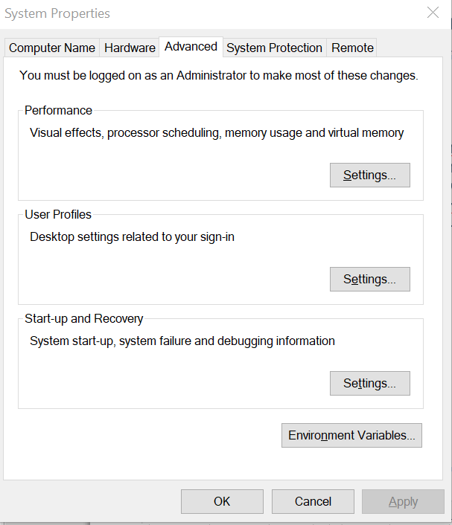
Windows: Add to system environment variables (I)
Open “System Properties” --> ”Advanced”--> “Environment Variables”

Slide 12
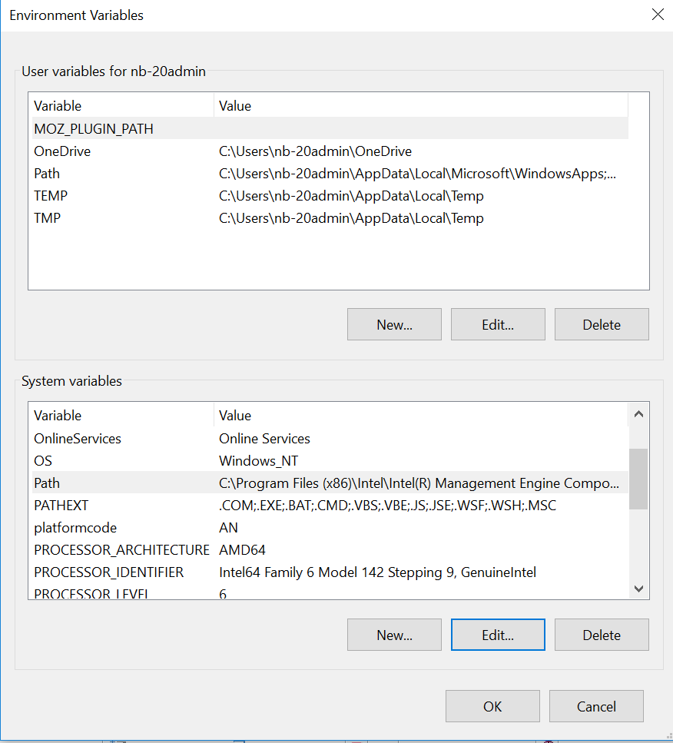
Windows: Add to system environment variables (II)

Slide 13
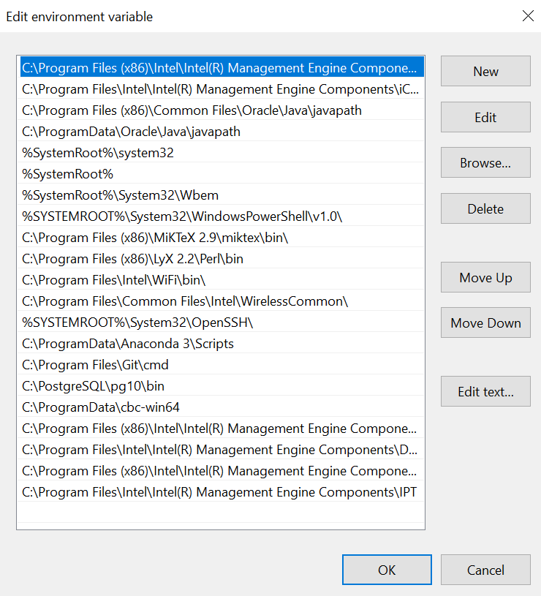
Windows: Add to system environment variables (III)

Slide 14
Installation of cbc-solver (Linux)
coinor-cbc
Open terminal and execute:
sudo apt-get install coinor-cbc

Slide 15
Agenda of this session
Miniconda installation
Oemof installation and test
Cbc-solver setup
Pycharm installation
Optional: Pycharm features

Slide 16
Oemof installation
Installation via anaconda prompt:
Testing oemof installation:
activate [env_name]
pip3 install oemof
oemof_installation_test

Slide 17
Agenda of this session
Miniconda installation
Oemof installation and test
Cbc-solver setup
Pycharm installation
Optional: Pycharm features

Slide 18
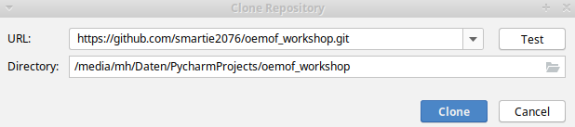
Create a pycharm project: Clone git reprository
Install gitbash from https://git-scm.com/download/win
Start pycharm and copy link to git reprository and insert, choose path:

Slide 19
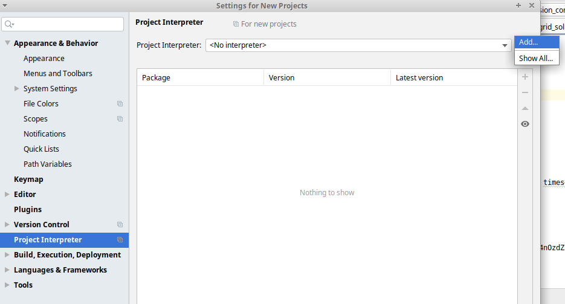
Setup of a project interpreter (I)
File → Settings → Project: [your project] →Project interpreter
Choose existing interpreter or create new:

Slide 20
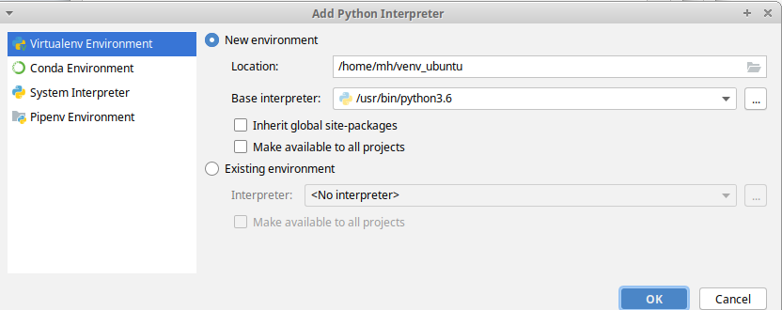
Setup of a project interpreter (II)
Add interpreter with your package management tool (virtualenv/miniconda)
Choose location, environment name and python version

Slide 21
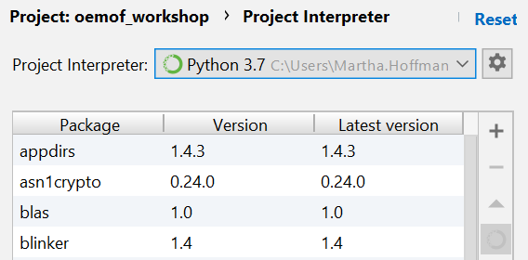
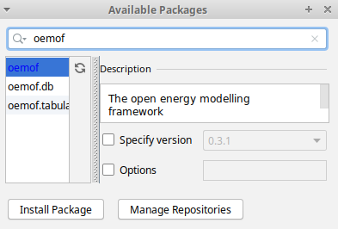

Installation of packages
Installation via pycharm in your specific project:
File → Settings → Project: [your project] →Project interpreter
Alternative: Use pycharm terminal to install packages manually or with requirements.txt

Slide 22
THANK YOU FOR YOUR ATTENTION !
How to follow Oemof’s activities?
Website: https://oemof.org/
Github: https://github.com/oemof
Or join our mailing list!
License
Except where otherwise noted, this work and its content (texts and illustrations) are licensed under the Attribution 4.0 International (CC BY 4.0)
See license text for further information.
Tel: +49 (0)30 1208 434 88
E-Mail: martha.hoffmann@rl-institut.de
Web: http://www.rl-institut.de
Twitter: @rl_institut
Please quote as: “PRESENTATION TITLE” © Reiner Lemoine Institut | CC BY 4.0

