Slide 1


Oemof Workshop Week Component Models
oemof v0.3.1
Sarah Berendes
Session 3
RLI, 17.09.2019
© Reiner Lemoine Institut

Slide 2
Agenda
Basic Components
Discussion
Introduction
Components
Custom Components
Current Development

Slide 3
Intro: Components (Models)
We define all technologies (e.g. power plants), energy carriers (e.g. diesel) and demands (e.g. electricity demand) of the physical energy system as components. A component model describes an abstract representation of a component in the physical system.

Slide 4

Intro: oemof Characteristics
Modularity and generalization have been key principles behind oemof

Slide 5
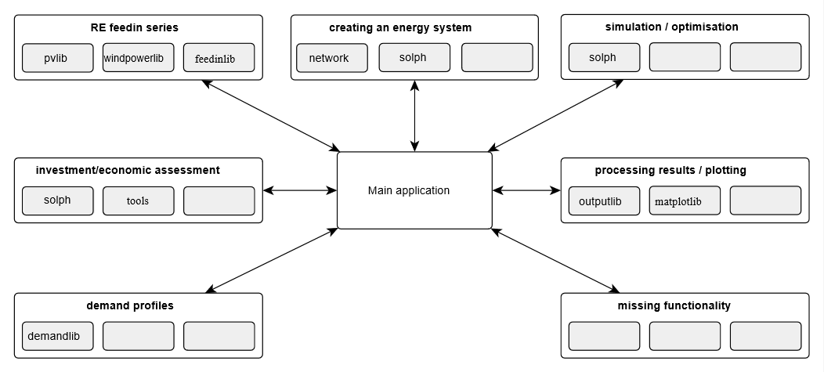
Intro: oemof Package Structure

Slide 6
Package Structure: oemof.solph
Relevant modules that contain components:
network (basic components)
components
custom
generic
For developers
Reduced to a common model concept
specific
For users
Concrete for a specific use case
basic
components
custom
own elaboration, © Reiner Lemoine Institut | CC BY 4.0

Slide 7
Reminder: oemof Modelling Principles
(Mixed Integer) Linear Programming + Graph Theory
Models composed of Nodes and Edges
Node / Bus or Component (oemof)
Edge / Flow (oemof)
2 Components can’t be directly connected, Bus required in between
Bus balance (example)

Slide 8
Overview Basic Components
Sink
Module: oemof.solph.network
API-Documentation: https://oemof.readthedocs.io/en/stable/api/oemof.solph.html#module-oemof.solph.network
Note! See example and further information here:
https://github.com/smartie2076/oemof_workshop/tree/master/Day_2_Components_Oemof/03_oemof_basic_component.ipynb
Source
Transformer

Slide 9
Overview Components
GenericStorage
Module: oemof.solph.components
API-Documentation: https://oemof.readthedocs.io/en/stable/api/oemof.solph.html#module-oemof.solph.components
GenericCHP
ExtractionTurbineCHP
OffSetTransformer

Slide 10
Components.GenericStorage
Description | Model class to model basic characteristics of (energy) storages
Input(s)/Output(s) | n/m
Bases | Transformer
Balance | Linear
Parameterization (not complete) | nominal_storage_capacity, initial_storage_level, balanced, loss_rate, inflow_conversion_factor, outflow_conversion_factor, min_storage_level, max_storage_level
Examples | Battery Energy System, Pumped Hydro Storage, etc

Slide 11
Components.GenericCHP
Description | Component GenericCHP to model combined heat and power plants.
Input(s)/Output(s) | n/m
Bases | Transformer
Balance | Mixed Integer Linear
Parameterization (not complete) | fuel_input, électrical_output, heat_output, beta (power loss index) back_pressure
Examples | Combined Cycle, Back pressure turbines

Slide 12
Components.ExtractionTurbineCHP
Description | Model combined heat and power plant with extraction turbine
Input(s)/Output(s) | n/m
Bases | Transformer
Balance | Linear
Parameterization (not complete) | conversion_factor, conversion_factor_full_condensation (no tapped flow extraction)
Examples | Simplified CHP model, Extraction Turbine

Slide 13
Components.OffsetTransformer
Description | Model Transformers with an offset
Input(s)/Output(s) | n/m
Bases | Transformer
Balance | Mixed Integer Linear
Parameterization (not complete) | conversion_factor, conversion_factor_full_condensation (no tapped flow extraction)
Examples | Diesel Generator,

Slide 14
Components.OffsetTransformer
Description | Model Transformers with an offset
Input(s)/Output(s) | n/m
Bases | Transformer
Balance | Mixed Integer Linear
Parameterization (not complete) | coefficients (y-intersection and slope)
Examples | Diesel Generator, CAES

Slide 15
Overview Customs
Link
Module: oemof.solph.custom
API-Documentation: https://oemof.readthedocs.io/en/stable/api/oemof.solph.html#module-oemof.solph.customs
ElectricalLine
ElectricalBus
GenericCAES

Slide 16
Custom.Link
Description | To directly link two nodes Buses
Input(s)/Output(s) | n/m
Bases | Pyomo
Balance | Linear
Parameterization (not complete) | conversion_factors
Examples | Transshipment Link
Note!
Experimental
Needs improvment

Slide 17
Custom.ElectricalLine
Description | To do linear optimal power flow calculations based on angle formulation.
Input(s)/Output(s) | either in or out
Bases | Flow
Balance | Mixed Integer Linear
Parameterization (not complete) | reactance
Examples | Grid model
Note!
connected buses need to be of the type ElectricalBus.
It does not work together with flows that have set the attr.`nonconvex`
Input and output of this component are set equal, therefore just use either only the input or the output to parameterize.
Default attribute min of in/outflows is overwritten by -1 if not set differently by the user

Slide 18
Custom.ElectricalBus
Description | Bus object to be used with Electrical Line for LOPF
Input(s)/Output(s) | n/m
Bases | Bus
Balance | Mixed Integer Linear
Parameterization (not complete) | slack max_voltage_angle min_voltage_angle
Examples | Grid model

Slide 19
Custom.GenericCAES
Description | To model a arbitrary compressed air energy storage
Input(s)/Output(s) | n/m
Bases | Transformer
Balance | Mixed Integer Linear
Parameterization (not complete) | electrical_input, fuel input, electrical_output,
Examples | -
Note!
Set of equations can be found in Kaldemeyer, C.; Boysen, C.; Tuschy, I.
A Generic Formulation of Compressed Air Energy Storage as Mixed Integer Linear Program – Unit Commitment of Specific Technical Concepts in Arbitrary Market Environments Materials Today: Proceedings 00 (2018)
experimental

Slide 20
Components- Current Developments
oemof-tabular.facades
provide energy specific access; provide interface to tabular data sources that models can be created easily. Map technology specific parameterization to energy system model principles in oemof.solph using oemof.tabular.facades .
Link: https://github.com/oemof/oemof-tabular/
Project: oemof_heat
Heat components for oemof e.g. heat pump, solar thermal collector, hot water storage, concentrating solar
Link: https://reiner-lemoine-institut.de/en/oemof_heat/
https://github.com/oemof-heat
Project: oemof_mobility
Non-linear Transformer, Timestep approach rather than Perfect Foresight.

Slide 21
Discussion
Questions?
Comments?

Slide 22
THANK YOU FOR YOUR ATTENTION !
How to follow Oemof’s activities?
Website: https://oemof.org/
Github: https://github.com/oemof
Or join our mailing list!
License
Except where otherwise noted, this work and its content (texts and illustrations) are licensed under the Attribution 4.0 International (CC BY 4.0)
See license text for further information.
Tel: +49 (0)30 1208 434 0
E-Mail: sarah.berendes@rl-institut.de
Web: http://www.rl-institut.de
Twitter: @rl_institut
Please quote as: “oemof Component Models” © Reiner Lemoine Institut | CC BY 4.0

