Slide 1


Oemof Workshop Week Constraints
Martha Hoffmann
Session 4
RLI, 18.09.2019
© Reiner Lemoine Institut

Slide 2
Introducing words
Inner workings of oemof:
Linear optimization and constraints
All workshop contents at: https://github.com/smartie2076/oemof_workshop
Todays jupyter notebooks are stored in ./Day_3_Custom_Constraints_for_Oemof
Notes:
Erhöhte Versorgungssicherheit durch Reduzierung der starken Abhängigkeit von fossilen Brennstoffimporten
Effizienzsteigerung durch Lastoptimierung der Dieselgeneratoren → Vermeidung von Teillast
Erhöhte Versorgungssicherheit durch Reduzierung der starken Abhängigkeit von fossilen Brennstoffimporten
Senkung der Stromgestehungskosten durch kompetitive und zuverlässige Technologien

Slide 3
Agenda
Introduction to linear optimization
Introducing own constraints
Further examples for constraints
In-build oemof constraints
Linear equation systems of oemof models

Slide 4
Agenda
Introduction to linear optimization
Introducing own constraints
Further examples for constraints
In-build oemof constraints
Linear equation systems of oemof models

Slide 5
An introduction to linear optimization
Example: ./3_LP_general_example.ipynb
Linear Problem (LP) / Mixed Integer (Linear) Problem (MI(L)P) consists of :
a target function
a set of constraints and balances
Solver searches on the edges of the solutions space for the optimal solution
Available solvers: CBC, GLPK, Gurobi, …
Time steps adjustable (e.g. 15 mins, hourly)

Slide 6
Agenda
Introduction to linear optimization
Introducing own constraints
Further examples for constraints
In-build oemof constraints
Linear equation systems of oemof models

Slide 7
Linear equation system generated by oemof
A set of linear equations fully describes an energy system model as a whole
Notes:
Erhöhte Versorgungssicherheit durch Reduzierung der starken Abhängigkeit von fossilen Brennstoffimporten
Effizienzsteigerung durch Lastoptimierung der Dieselgeneratoren → Vermeidung von Teillast
Erhöhte Versorgungssicherheit durch Reduzierung der starken Abhängigkeit von fossilen Brennstoffimporten
Senkung der Stromgestehungskosten durch kompetitive und zuverlässige Technologien

Slide 8
The „lp-file“
Linear equation system describes energy system fully
generated using Pyomo package
can be stored in „lp-file“
The „lp-file“ is transferred to solver for optimization
Recommended solver: coinor-cbc
Same file can be optimized with different solvers
Lp-file can help to verify and debug your code
Example: ./micro_grid_fixed_cap_basic.ipynb

Slide 9
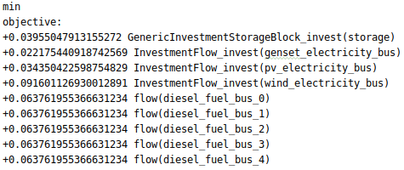
The „lp-file“: Objective value
The objective value should be minimized:

Slide 10
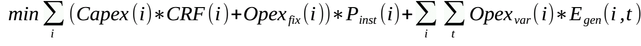
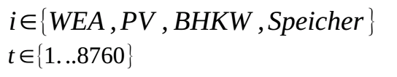
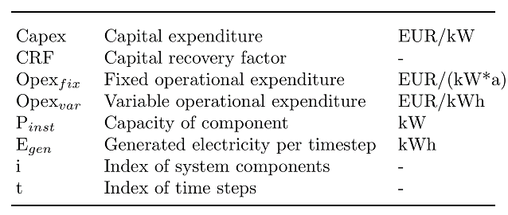
Optimizing with oemof – Objective value
Oemof generates a linear equation system describing the energy system model
Solves for the minimal objective value (costs)
Target function:

Slide 11

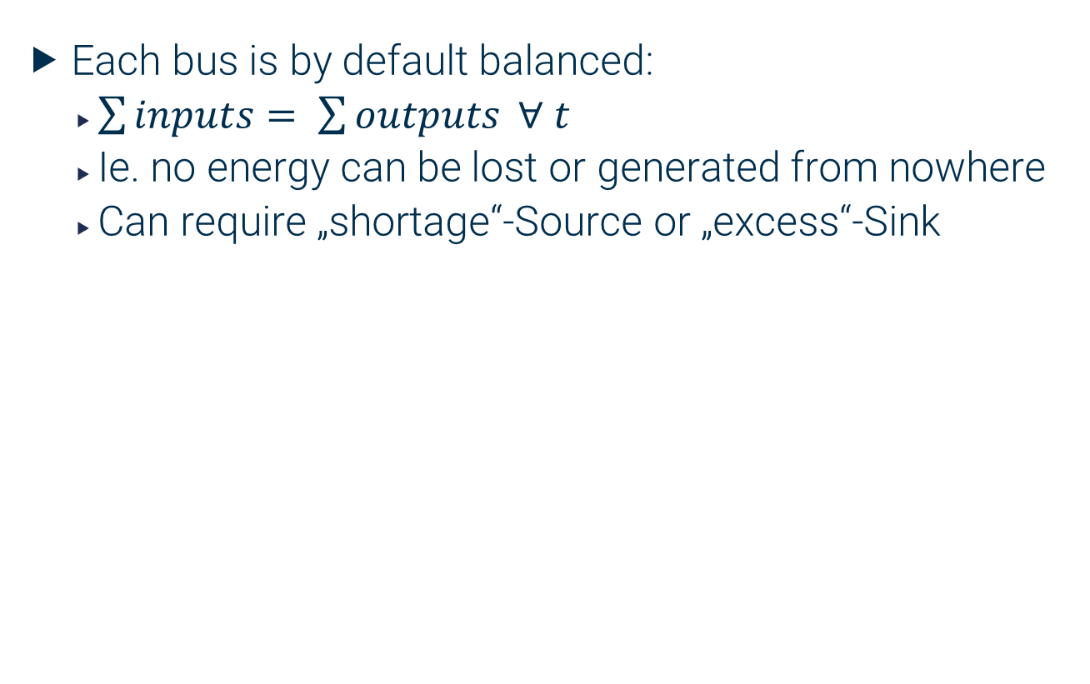
The „lp-file“: Bus balances
Each bus is by default balanced:
$\sum{inputs= \sum{outputs}} ∀ t$
Ie. no energy can be lost or generated from nowhere
Can require „shortage“-Source or „excess“-Sink

Slide 12


The „lp-file“: Bus balances
Each bus is by default balanced:
$\sum{inputs= \sum{outputs}} ∀ t$
Ie. no energy can be lost or generated from nowhere
Can require „shortage“-Source or „excess“-Sink

Slide 13
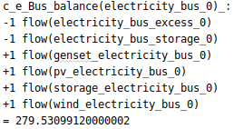

The „lp-file“: Bus balances
Each bus is by default balanced:
$\sum{inputs= \sum{outputs}}$ $∀ t$
Ie. no energy can be lost or generated from nowhere
Can require „shortage“-Source or „excess“-Sink

Slide 14
Agenda
Introduction to linear optimization
Introducing own constraints
Further examples for constraints
In-build oemof constraints
Linear equation systems of oemof models

Slide 15
In-build bounds of flows
Bounds limit Flows to an interval
Decreases search area for valid optimization results
Examples:
Component parameters: min_storage_capacity, max_storage capacity
Flow parameters: nominal_value
Investment parameters: maximum
Example: ./micro_grid_system_inbuilt_bounds.ipynb

Slide 16
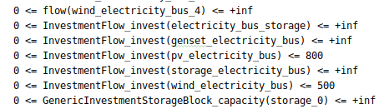
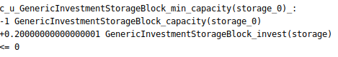
The „lp-file“: Bounds

Slide 17
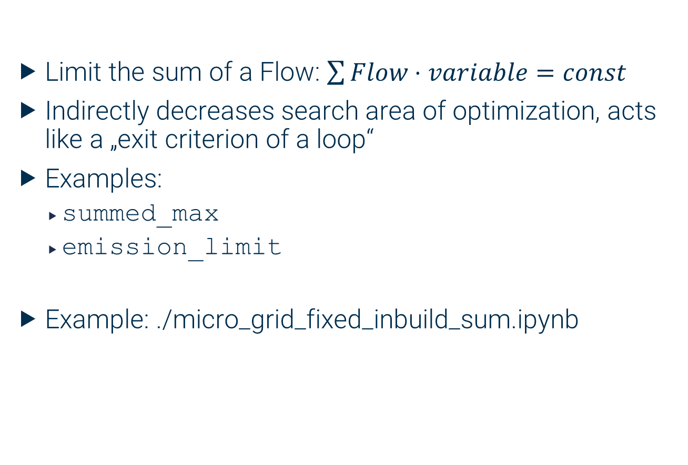
In-built constraints
Limit the sum of a Flow: $\sum{Flow⋅variable=const}$
Indirectly decreases search area of optimization, acts like a „exit criterion of a loop“
Examples:
summed_max
emission_limit
Example: ./micro_grid_fixed_inbuild_sum.ipynb

Slide 18
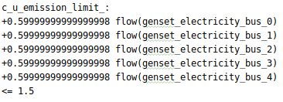
The „lp-file“: Constraints

Slide 19
Agenda
Introduction to linear optimization
Introducing own constraints
Further examples for constraints
In-build oemof constraints
Linear equation systems of oemof models

Slide 20
Guidelines for own constraints
Rules for own constraints:
Linearized behaviour
No no „if-then-relation“ with other decision variables
If-then relations can be implemented when accessing a definite timeseries of actual_value

Slide 21
Process of writing constraints
Simplify real-world boundary to valid constraint
Determine structure of constraint:
Does the constraint have to be applied each time step individually?
Does the constraint concern Investment objects?
Create a constraint with a constraint rule, add directly to the linear model of the energy system using Pyomo
Verify your constraint by checking…
…the lp-file (for few timesteps)
…the results (fow a higher number of timesteps)

Slide 22
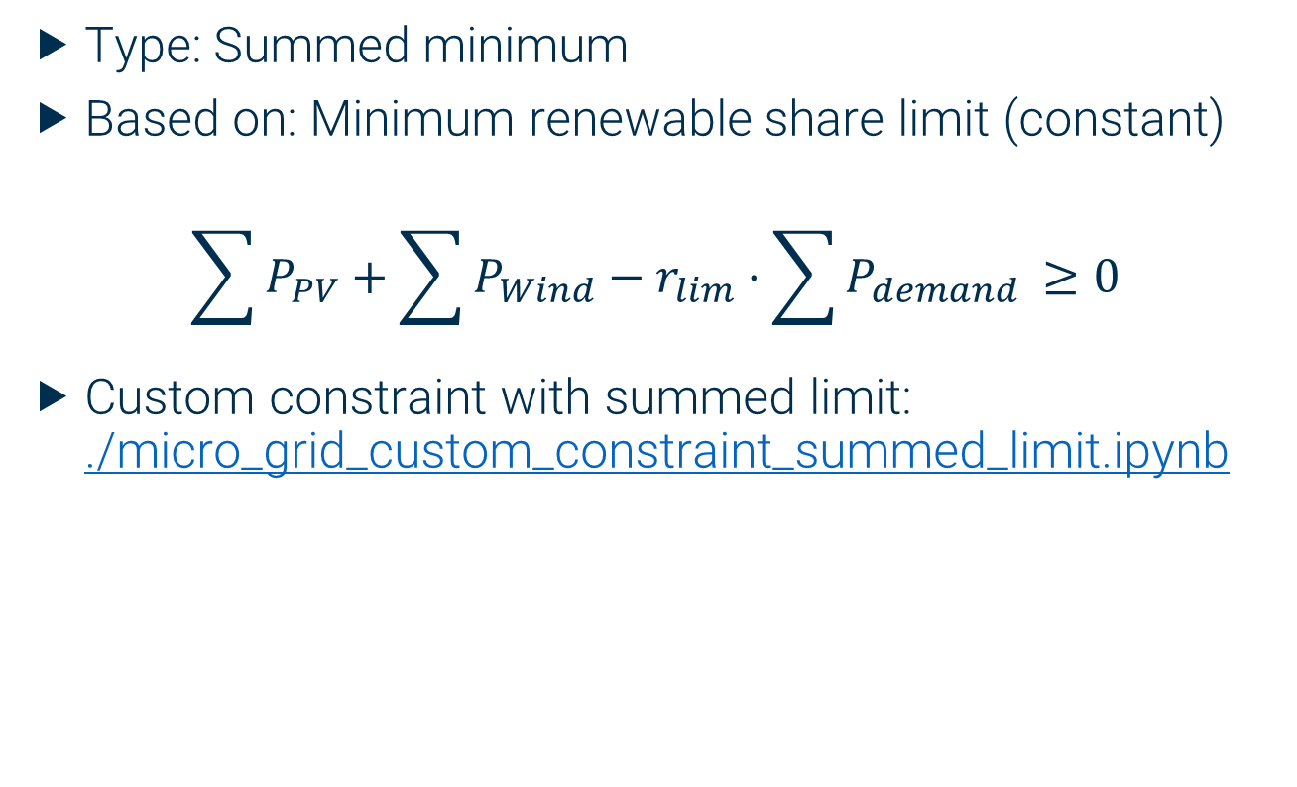
Renewable share constraint
Type: Summed minimum
Based on: Minimum renewable share limit (constant)
$$\sum{P_{PV}}+\sum{P_{Wind}}−r_{lim}⋅\sum{P_{demand }}≥0$$
Custom constraint with summed limit: ./micro_grid_custom_constraint_summed_limit.ipynb

Slide 23

Micro grid stability constraint
Type: Minimum bound per timestep
Based on: Minimum stability limit (constant)
Custom constraint with bounded flows:
./micro_grid_custom_constraint_flows.ipynb

Slide 24
Agenda
Introduction to linear optimization
Introducing own constraints
Further examples for constraints
In-build oemof constraints
Linear equation systems of oemof models

Slide 25
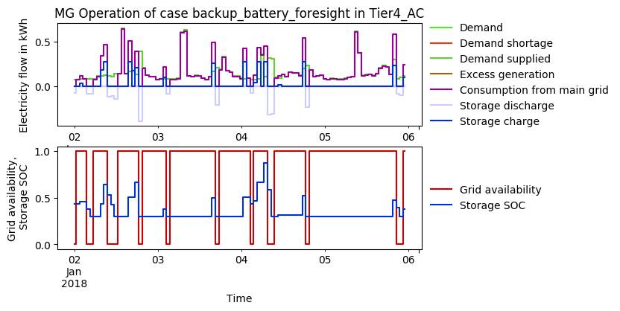
Intermittantly switching off a component
Type: Setting flow value in timesteps
Based on: External boolean timeseries

Slide 26
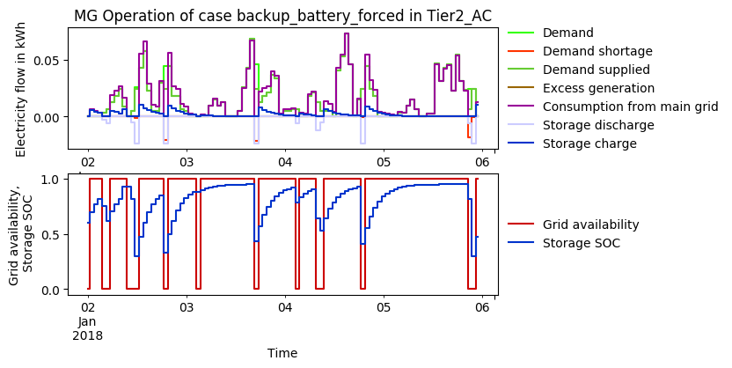
Forced battery charge
Type: Setting flow per timestep
Based on:
External boolean timeseries
Linerarized formular for value of flow

Slide 27
THANK YOU FOR YOUR ATTENTION !
How to follow Oemof’s activities?
Website: https://oemof.org/
Github: https://github.com/oemof
Or join our mailing list!
License
Except where otherwise noted, this work and its content (texts and illustrations) are licensed under the Attribution 4.0 International (CC BY 4.0)
See license text for further information.
Tel: +49 (0)30 1208 434 88
E-Mail: martha.hoffmann@rl-institut.de
Web: http://www.rl-institut.de
Twitter: @rl_institut
Please quote as: “PRESENTATION TITLE” © Reiner Lemoine Institut | CC BY 4.0

