Slide 1




Slide 2
CHAPTER 6
EVENTS

Slide 3
WHAT IS AN EVENT?

Slide 4
WHAT IS AN EVENT?
An event is an occasion that is of importance
Event-Driven system involve having mechanisms for
“event detection”, that’s a way to know that the event happen
“notification”, that’s notifying whoever is interested that it happen
“event handling”, that’s to allow some code to be executed in response

Slide 5
Events are the browser’s way of saying, “Hey, this just happened.”

Slide 6
When an event fires, your script can then react by running code (e.g. a function).

Slide 7
By running code when an event fires, your website responds to the user’s actions.
It becomes interactive.

Slide 8
DIFFERENT EVENT TYPES

Slide 9
load unload error resize scroll
USER INTERFACE EVENTS

Slide 10
keydown keyup keypress
KEYBOARD EVENTS

Slide 11
click dblclick mousedown mouseup mouseover mouseout
MOUSE EVENTS

Slide 12
focus / focusin blur / focusout
FOCUS EVENTS

Slide 13
input change submit reset cut copy paste select
FORM EVENTS

Slide 14
HOW EVENTS TRIGGER JAVASCRIPT CODE

Slide 15
1

Slide 16
1
Select the element node(s) the script should respond to

Slide 17
2
1
Select the element node(s) the script should respond to

Slide 18
2
1
Select the element node(s) the script should respond to
Indicate the event on the selected node(s) that will trigger a response

Slide 19
3
1
2
Select the element node(s) the script should respond to
Indicate the event on the selected node(s) that will trigger a response

Slide 20
1
2
3
Select the element node(s) the script should respond to
Indicate the event on the selected node(s) that will trigger a response
State the code you want to run when the event occurs

Slide 21
BINDING AN EVENT TO AN ELEMENT

Slide 22
There are three ways to bind an event to an element:
- HTML event handler attributes
- Traditional DOM event handlers
- DOM Level 2 event listeners

Slide 23
The following examples show a blur event on an element that triggers a function called checkUsername().

Slide 24
HTML EVENT HANDLER ATTRIBUTES
(DO NOT USE)
<input type=“text” id=“username”
onblur=“checkUsername()”>

Slide 25
HTML EVENT HANDLER ATTRIBUTES
(DO NOT USE)
<input type=“text” id=“username”
onblur=“checkUsername()”>
ELEMENT

Slide 26
HTML EVENT HANDLER ATTRIBUTES
(DO NOT USE)
<input type=“text” id=“username”
onblur=“checkUsername()”>
EVENT

Slide 27
HTML EVENT HANDLER ATTRIBUTES
(DO NOT USE)
<input type=“text” id=“username”
onblur=“checkUsername()”>
FUNCTION CALL

Slide 28
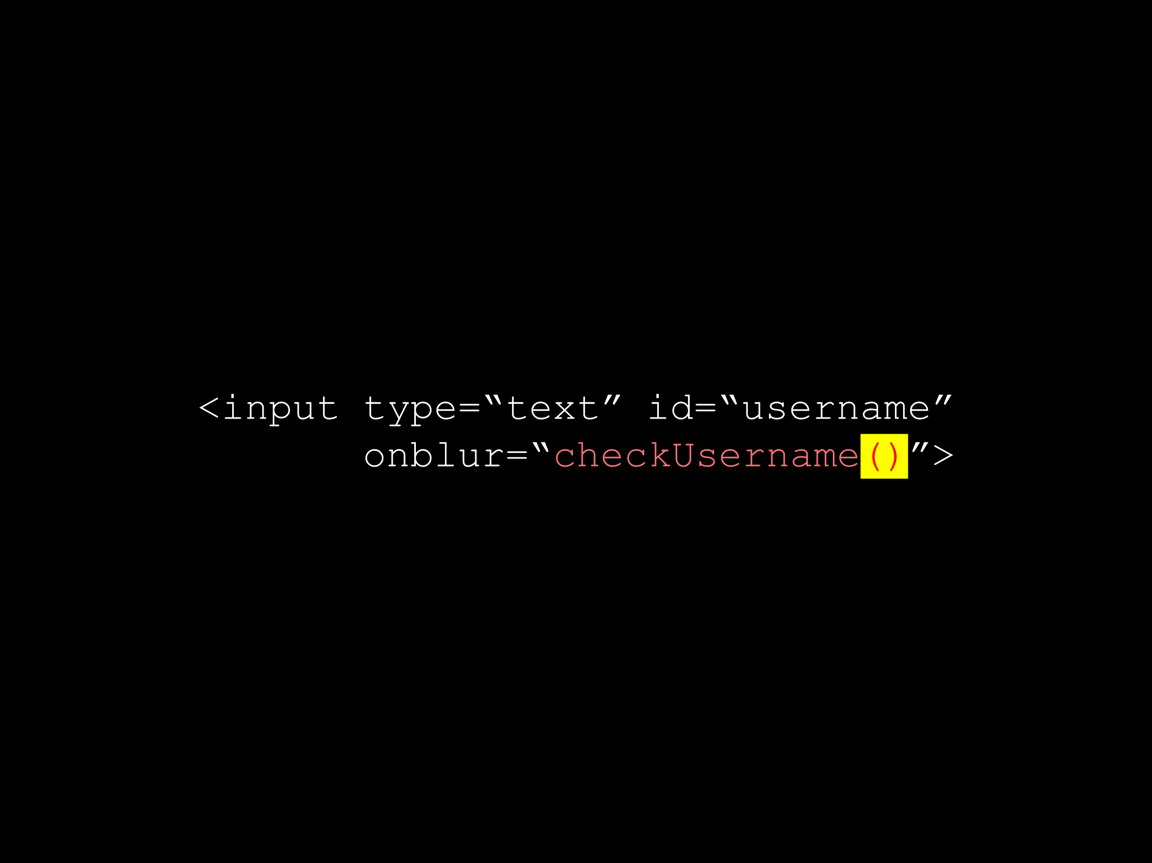
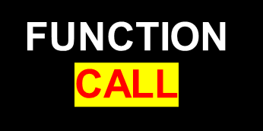
HTML EVENT HANDLER ATTRIBUTES
(DO NOT USE)

Slide 29
TRADITIONAL DOM EVENT HANDLERS
//el is the name of the binding that refers to the element’s object
el.onblur = checkUsername;

Slide 30
TRADITIONAL DOM EVENT HANDLERS
el.onblur = checkUsername;
ELEMENT

Slide 31
TRADITIONAL DOM EVENT HANDLERS
el.onblur = checkUsername;
EVENT

Slide 32
TRADITIONAL DOM EVENT HANDLERS
el.onblur = checkUsername;
The binding name that refers to the function

Slide 33
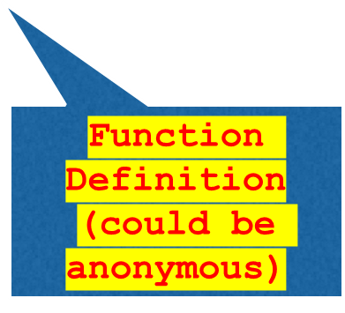
TRADITIONAL DOM EVENT HANDLERS
el.onblur = checkUsername;
The binding name that refers to the function

Slide 34
el.addEventListener(‘blur’, checkUsername);
EVENT LISTENERS

Slide 35
el.addEventListener(‘blur’, checkUsername);
EVENT LISTENERS
ELEMENT

Slide 36
el.addEventListener(‘blur’, checkUsername);
EVENT LISTENERS
EVENT

Slide 37
el.addEventListener(‘blur’, checkUsername);
EVENT LISTENERS
FUNCTION

Slide 38
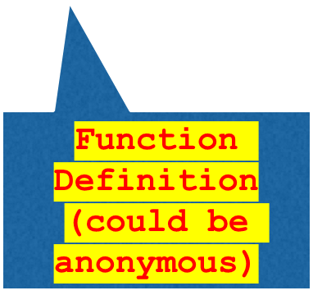
el.addEventListener(‘blur’, checkUsername);
EVENT LISTENERS
FUNCTION

Slide 39
Because you cannot have parentheses after the function names in event handlers or listeners, passing arguments requires a workaround.

Slide 40
PARAMETERS WITH EVENT LISTENERS
el.addEventListener(‘blur’, function() { checkUsername(5);
});

Slide 41
PARAMETERS WITH EVENT LISTENERS
el.addEventListener(‘blur’, function() {
checkUsername(5);
});
An anonymous function is used as the second argument.

Slide 42
PARAMETERS WITH EVENT LISTENERS
el.addEventListener(‘blur’, function() {
checkUsername(5);
});
Inside the anonymous function, a named function is called.

Slide 43
THE EVENT OBJECT

Slide 44
When an event occurs,the event object can tell you information about it and which element it happened upon.

Slide 45
target type
PROPERTIES

Slide 46

target type
PROPERTIES
The element that received the event

Slide 47
target type
PROPERTIES
The type of the event

Slide 48
ELEMENT AN EVENT OCCURRED ON
1: EVENT LISTENER CALLS FUNCTION
function checkUsername(e) {
var target = e.target;
}
var el = document.getElementById(‘username’);
el.addEventListener(‘blur’, checkUsername);

Slide 49
ELEMENT AN EVENT OCCURRED ON
2: EVENT OBJECT PASSED TO FUNCTION
function checkUsername(e) {
var target = e.target;
}
var el = document.getElementById(‘username’);
el.addEventListener(‘blur’, checkUsername);

Slide 50
ELEMENT AN EVENT OCCURRED ON
3: ELEMENT THAT EVENT HAPPENED ON
function checkUsername(e) {
var target = e.target;
}
var el = document.getElementById(‘username’);
el.addEventListener(‘blur’, checkUsername, false);

Slide 51


