Slide 1

Neural Adaptive IoT Streaming Analytics with RL-Adapt
Bonan Shen, Chenhong Cao, Tong Liu, Jiangtao Li, Yufeng Li
Presented by Bonan Shen
Notes:
Hello everyone, my name is Bonan Shen. Today, Neural Adaptive IoT Streaming Analytics with RL-Adapt. This work was done when I was in Shanghai University and I am currently pursing master’s degree in University of Southern California.

Slide 2
Trends in IoT Devices
30 percent CAGR
Cisco estimates that by 2023 half of the networked devices will be IoT devices
Notes:
Recent years have witnessed a rapid increase in the number of IoT devices, one form of evidence is in the global mobile machine to machine growth. Globally, mobile machine-to-machine connections will grow from 1.2 billion in 2018 to 4.4 billion by 2023, it is a 30 percent CAGR—nearly four-fold growth.
(Click) Besides, Cisco estimates that by 2023 half of the networked devices will be IoT devices.

Slide 3


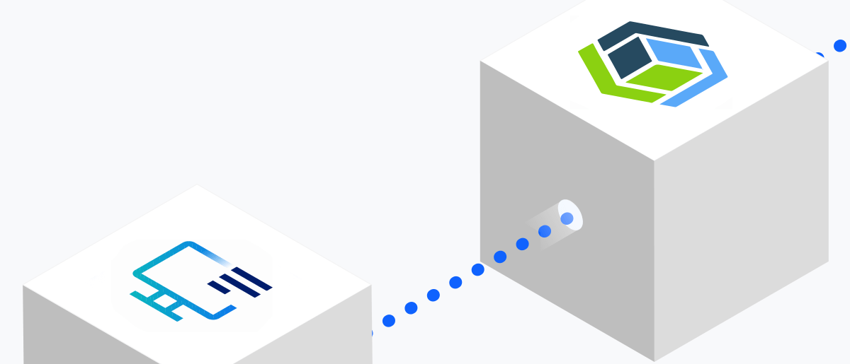

Advanced IoT Streaming Analytic Applications
AI-Based Video Surveillance
Vehicular cloud applications
Intelligent Log Analysis
Augmented Reality in City
Notes:
As a result, many advanced IoT streaming analytic applications have emerged to adapt to highly increased data streams.
For example AI-Based Video Surveillance will be deployed everywhere in the streets, at train stations, workplaces, factories in the future.
(Click) Augmented Reality in City is going to help travelers getting familiar with a new city very in a intuitively approach.
(Click) Intelligent Log Analysis will provide immediate analysis reports for network manager to do better decisions.
(Click) And Vehicular cloud applications allow vehicles to interact and collaborate with each other, to sense the environment, process the data, propagate the results and, more generally share resources.

Slide 4
Huge Volume of Data Streams
Video Surveillance
178 Mbps for each camera (1080p, 30fps)
Augmented Reality
A high frame rate with at least 60 frames per second (FPS)
and require less than 25ms motion-to-photon latency
Machine Logs
Bytedance’s ClickHouse has total amount of management
data exceeds 600PB(2021.9)
Automatous Cars
Autonomous cars generate more than 300 TB of data per year
How can we analyze data streams in a timely and resource-efficient manner?
Notes:
So Analyzing data streams in a timely and resource-efficient manner is of critical importance, but current IoT Stream applications is not able to load huge volume of data in real time.
For Video Surveillance cameras, each camera requires 178Mbps for streaming a 1080p, 30fps video.
For Augmented Reality Applications, typical AR applications usually have a high frame rate and require less than 25ms motion-to-photon latency.
For Machine Logs, today’s big internet companies generate huge amount of data in real time.
For Automatous Cars, it is estimated that each car generate more than 300 TB of data per year.
(click) So here comes the question, How can we analyze data streams in a timely and resource-efficient manner? This depends on both the upload ability of IoT Devices and the computing ability of cloud processing devices.

Slide 5



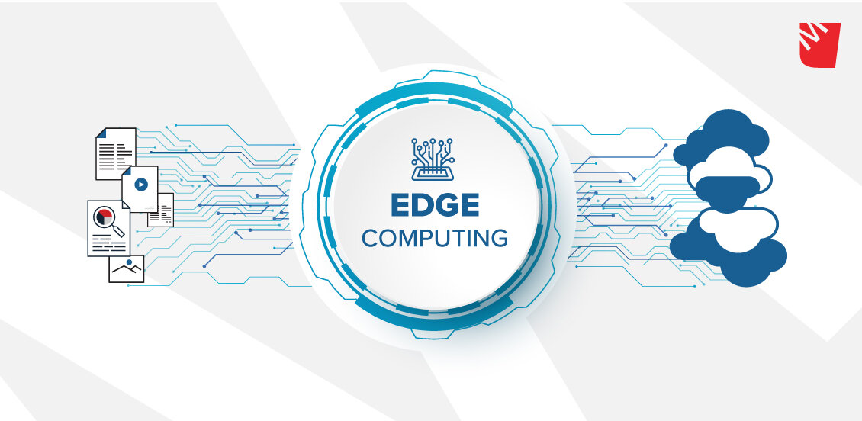

Trade-Off Bandwidth with Latency
Big data analytic frameworks at cloud servers.
Edge computing improves performance and efficiency of streaming.
IoT devices usually employ wireless networks that are born naturally with scarce and dynamic bandwidth, making it impractical to backhaul all potentially useful data to a central location.
Notes:
Researchers tried to solve this issue from many aspects.
In the cloud end, big data analytic frameworks such as Storm, Spark and Flink utilizing large-scale distributed processing powers at cloud servers.
What's more, Edge computing further improves the performance and efficiency of streaming by offloading the tasks to edge servers instead of the cloud servers.
However, IoT Devices are often deployed in wireless networks which are born naturally with scarce and dynamic bandwidth. So sometimes it is impractical to backhaul all potentially useful data to a central location.

Slide 6
Motivation for Adaptive Streaming
Take pedestrian detection as an example, when we lower the frames per second by 50 percent, we still get a 90% performance, but when we lower the resolution by 50% percent, we get only 60% performance.
Application Name | Adaption Method | Data Reduced | Final Performance
Pedestrian Detection | N/A | 0% | 100%
Pedestrian Detection | Reduce 50% Fps | ~50% | 90%
Pedestrian Detection | Reduce 50% Resolution | ~50% | 60%
Pedestrian Detection | Reduce 25% Fps, 25% Resolution | ~50% | 95%
Notes:
In reality, we find out that the final performance of application is not linearly related with absolute volume of data streamed, but with how much information is contained in these data.
Take pedestrian detection as an example, when we lower the frames per second by 50 percent, we still get a 90% performance, but when we lower the resolution by 50% percent, we get only 60% performance. Which when we dive deep into the surveillance video, we find out that due to pedestrian’s slow movement, consecutive frames contain nearly the same information, so lowering frame rate does not harm final performance.

Slide 7
Adaptive Streaming Approaches
Native TCP: high latencies
Native UDP: data loss
JetStream[NSDI '14]: Expert Knowledge, Can’t Generalize
AWStream[SIGCOMM '18]: Small Action Space, Discard Better Policy
Our Approach: Learns policy decisions from the observations and interactions.
Notes:
So we want to solve this problem through adaptive streaming.
When using native TCP or UPD, latencies or data loss are inevitable due to the confliction of network demand and actual available network resources.
Some researchers tried to using adaptive streaming analysis. JetStream let users manually develop such adaptation policies to ensure real-time analysis under poor network conditions
AWStream[SIGCOMM '18]: provides APIs for users to develop a set of possible degradation policies and selects optimal policies through exhaustive search.
However, both these approaches have their drawbacks and cannot achieve an optimal quality of objectives. We then proposed a method that is able to address the issues above.
We can see that our approach performs better than other two approaches, JetStream and AWStream. This is because JetStream rely heavily on developer’s knowledge on particular applications and Awstream can discard good adaptive policies due to under-generalizing of training dataset. Instead of wasting ”unworkable” cases, RL model takes advantage of those cases to guide improved policies. Each time, RL model stores its current policy with its reward and tries to find a behavior to maximize its reward as well as to judge whether its current behavior lies in the circle of a good reward.

Slide 8
Let Reinforcement Learning Do All the Work
Main Parts: Developing, RL Model Training, Runtime
Developing: Using declarative APIs and supporting libraries to build a RL model
RL Model Training: System automatic trains a RL model
Runtime: Generate adaption policy using RL model in the runtime
Notes:
Here is the system overview. In a nutshell, we let Let Reinforcement Learning Do All the Work. The system has three main parts——Corresponds to the three phases——Developing, RL Model Training and Runtime.
(Click) In the developing phase, user uses declarative APIs and supporting libraries to build an RL model
(Click) Then, the system start training the RL model using a simulated environment. This environment ensure that model leads to better performance in all bandwidth ranges provided by user.
(Click) In the runtime phase, the system generates adaption policy using RL model in the runtime according to its current bandwidth.

Slide 9
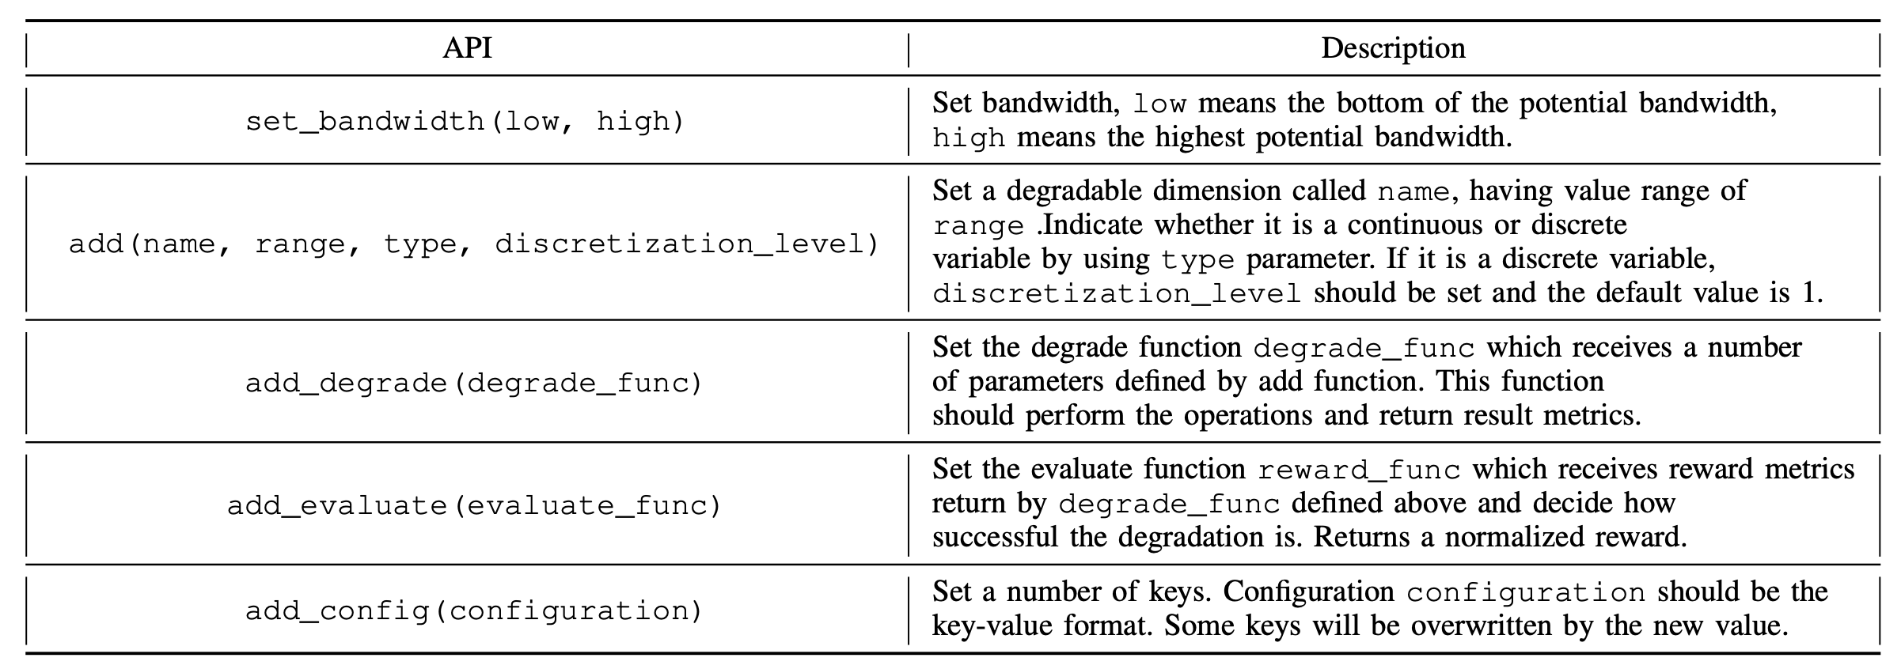
Declarative APIs
a = AdaptModel(0,40)
.add("resolution",(0.15,1),"continuous")
.add("frame rate",7,"discrete")
.add("quantization",50,"discrete")
.add_degrade(degrade_func)
.add_evaluate(evaluate_func)
.build()
.train()
Notes:
Declarative programming is a programming paradigm that expresses the logic of a computation without describing its control flow. Therefore, we developed declarative APIs to better describe different aspects of the application’s environment and streaming data.
A typical configuration should look like Listing 1. The code created an adaptive model with a potential bandwidth range of 0Mbps to 40Mbps. The streaming data has three dimensions. ”resolution” continually distributed from 0.15 to 1. ”frame rate” discretely distributed in 7 pieces. ”quantization” discretely distributed in 50 values.

Slide 10
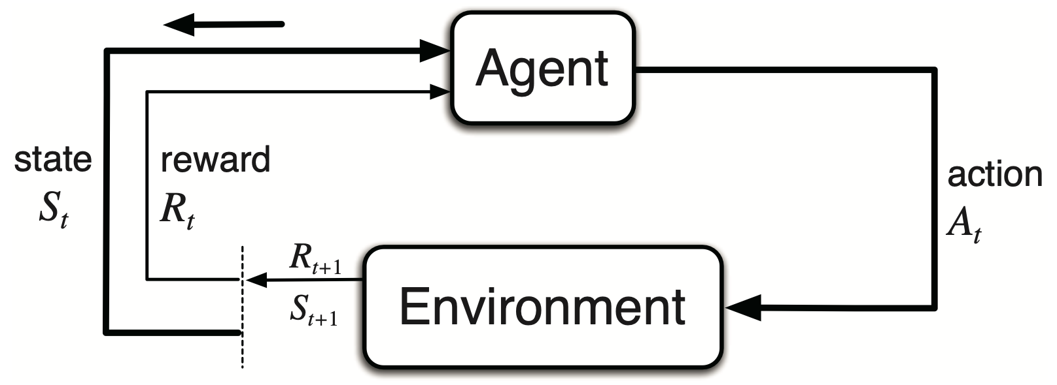
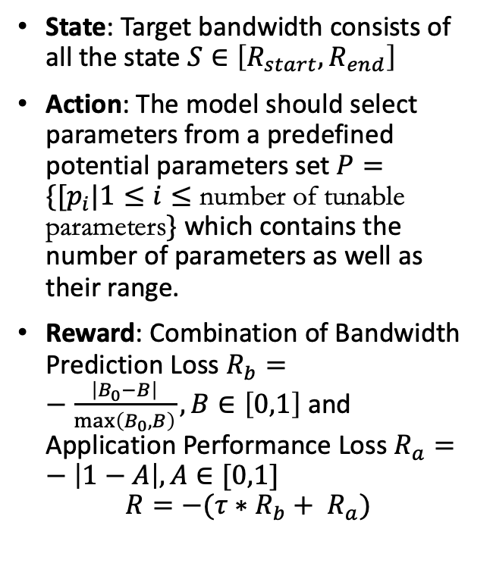
RL Algorithm for Parameter Adaptation
State: Target bandwidth consists of all the state $S∈\left[R_{start},R_{end}\right]$
Action: The model should select parameters from a predefined potential parameters set $P=\{{[p}_{i}|1≤i≤\text{number} \text{of} \text{tunable} \text{parameters}\}$ which contains the number of parameters as well as their range.
Reward: Combination of Bandwidth Prediction Loss $R_{b}=−\frac{\left|B_{0}−B\right|}{\max\left(B_{0}, B\right)}, B∈\left[0,1\right]$ and Application Performance Loss $R_{a}=−\left|1−A\right|,A∈[0,1]$
$$R=−(τ∗R_{b}+ R_{a})$$
Notes:
To decide the parameter used in adaptation, we use the model-free reinforcement learning algorithm to select the appropriate parameters. Different from methods that make presumptions about the stream data and the network environment in an analytical way, our approach solely learns policy decisions from the observations and interactions.
Reinforcement learning considers the paradigm of an agent interacting with its environment with the aim of learning reward-maximizing behavior [11]. The three important aspects in reinforcement learning is state s, action a and reward r.
(click) When the network is trained, we split the target bandwidth range with NR pieces. Each piece is generated with normally distributed random noise N (0, σ). With random noise we expect the state to cover all the target bandwidth range.
(click) To determine the best parameters from a specific application, the model should select parameters from a predefined potential parameters set which contains the number of parameters as well as their range.
(click) We have two loss functions for the reward, one is Bandwidth Prediction Loss: The output parameters are expected to approximate the input required bandwidth. Another is Application Performance Loss: Not only should we consider the network condition, we should also care about application performance after adaption. We expect the analysis accuracy to reach 100%.

Slide 11
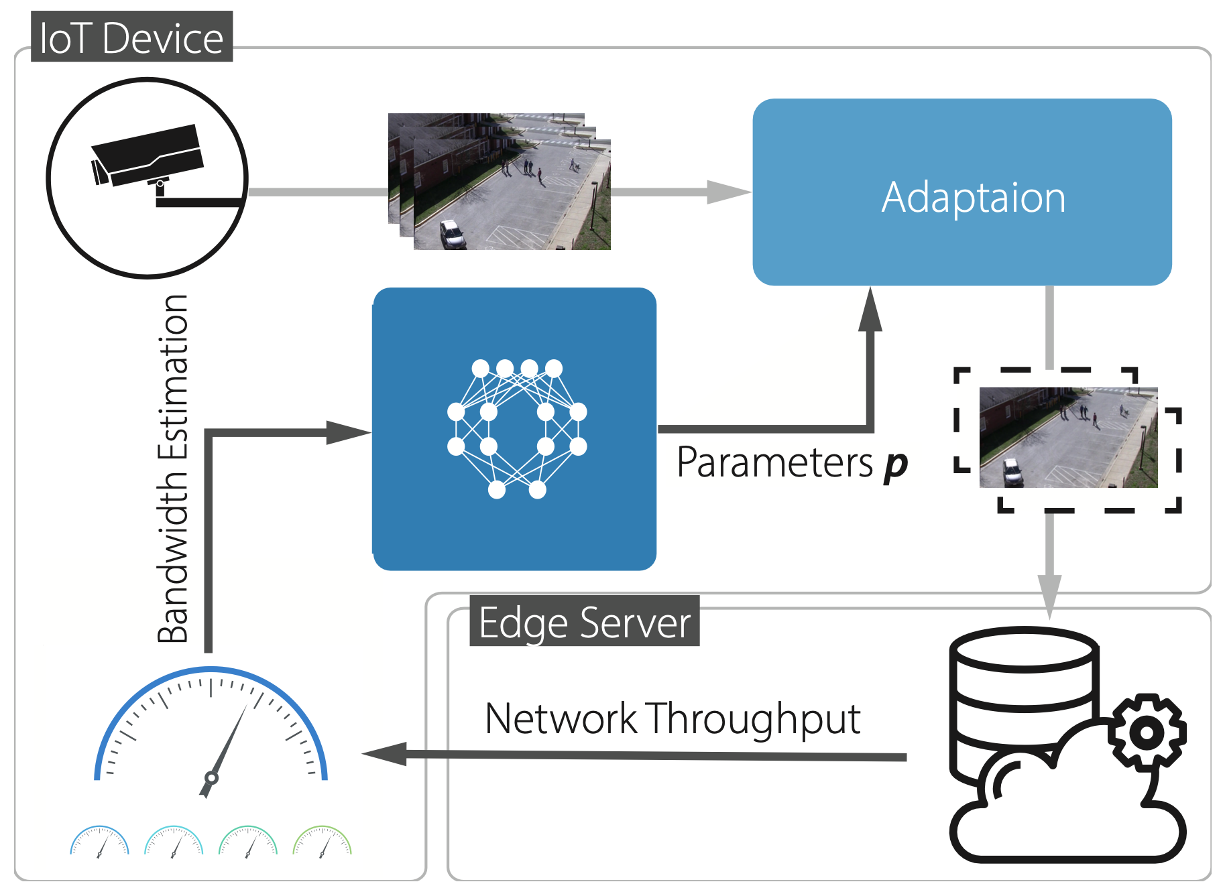
Runtime system
Notes:
Runtime module serves as the integration of RL model and adaptive data streaming. Modules of runtime system as well as their interactions are shown in Fig 2. Deploying on IoT devices, runtime system first receives source data from external devices such as a video camera(up-left corner). When dataflow comes to the adaptation module, an adaptation will be executed using parameters generated by RL model(up-right corner). Then the adapted data will be sent to the edge server where analysis applications will be performed. Edge server not only receives data from IoT devices but also sends back throughput information which will be collected by runtime system to estimate current bandwidth. An internal bandwidth is maintained to memorize the current bandwidth. The trained RL model will receive internal bandwidth once it is updated to predict applicable parameters.

Slide 12
Applications and Datasets
Application Name | Datasets | Evaluation Method | Evaluation standard
Pedestrian Detection | MOT Challenge | histogram of oriented gradients (HOG) with linear SVM classifier | F1score
Detection in Autopilot Cars | Self-filmed three- minute video on the highway road | YOLOv3 as detector | F1score
Distributed Top-K | EDGAR Log File Dataset provided by SEC.gov on a daily basis | Kendall’s τ | Kendall’s τ
Notes:
So we evaluated three different applications.
The pedestrian detection application aims at recognizing all the people in the image streamed by video surveillance system in a frame by frame manner.
Autonomous vehicles detect all objects in their front cameras to choose the right path as well as avoid accidents.
In Distributed Top-K application, the object is to collect the file names that is most frequently accessed on distributed servers.

Slide 13
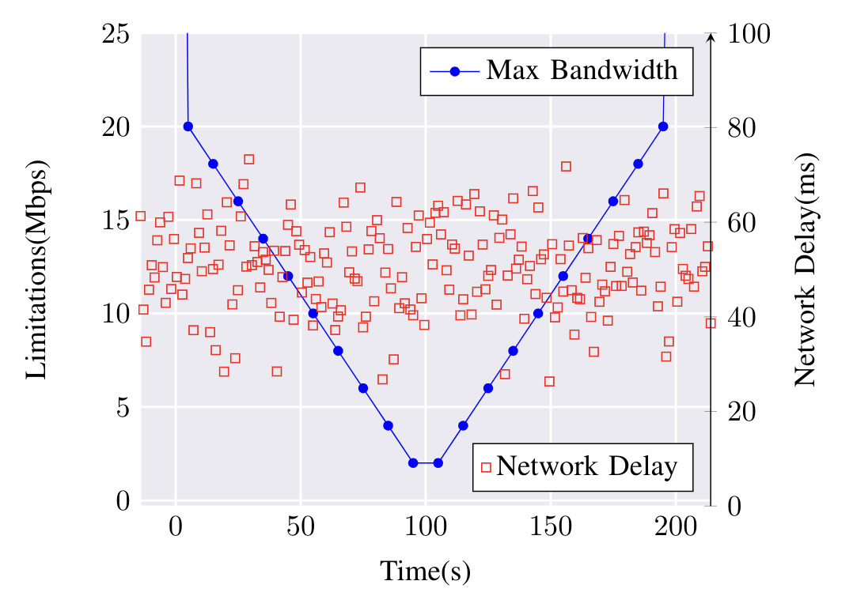
Implementation and Settings
Platform
IoT Device: Raspberry Pi 4, 1.5GHz Quad core Cortex-A72 (ARM v8) 64-bit SoC and 4GB memory, Linux system.
Edge Server: Personal computer(PC) with CPU of Intel i5-8500, GPU of Nvidia RTX 2070.
Network: We use 2.4 Gigahertz Wireless Local Area Network, theoretical bandwidth is 100Mbps.
RL model
RL Engine: Deep Deterministic Policy Gradient model (2 hidden layers, 128 units each).
Optimizer: Adam, learning rate of 0.001 and decay rate of 0.99. The batch size default is 64.
Parameter Storage: 70K bytes.
Applications-Specific
Bandwidth: 0Mbps to 30Mbps.
Network Simulation
Notes:
Our experiment simulates the settings in a real production environment. We choose Raspberry 4 as our IoT device, which has 1.5GHz Quad core Cortex-A72 (ARM v8) 64-bit SoC and 4GB memory, running on Linux system. We use a personal computer(PC) with CPU of Intel i5-8500, GPU of Nvidia RTX 2070 to simulate edge server. We use 2.4 Gigahertz Wireless Local Area Network to connect the two devices, the max theoretical bandwidth is 100Mbps.
RL-Adapt chooses the Deep Deterministic Policy Gradient model as our interior reinforcement learning engine. Both our actor and critic neural network are fully connected which adopts two hidden layers of 128 units. Actor network is responsible for action inference, thus the output layer is activated by tanh multiply 0.5 in order to cast values to [−0.5, 0.5]. Other layers are activated by ReLU6 function. The optimizer is Adam [17], with the learning rate of 0.001 and decay rate of 0.99. The batch size default is 64. The standard deviation for action space exploration is set to 0.2. Input bandwidth is cast to [0, 1], with a bandwidth baseline of 160. Output actions added with noise are clipped to [−0.5,0.5], then casting to real action range. The trained weights occupy about 70K bytes of space.

Slide 14
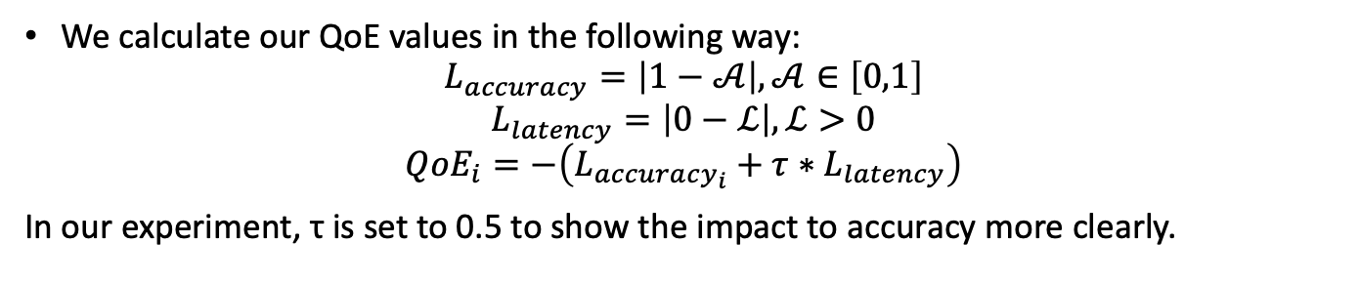
Implementation and Settings
QoE Metrics
We calculate our QoE values in the following way:
$$L_{accuracy}=\left|1−𝒜\right|, 𝒜∈\left[0,1\right]$$
$$L_{latency}=\left|0−ℒ\right|, ℒ>0$$
$${QoE}_{i}=−\left(L_{accuracy_{i}}+τ∗L_{latency}\right)$$
In our experiment, τ is set to 0.5 to show the impact to accuracy more clearly.

Slide 15
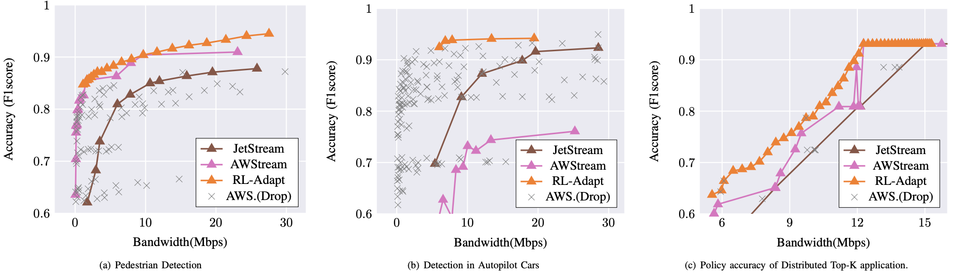
Policy Accuracy Evaluation
Pedestrian Detection: Average Accuracy Improvement 5% - 10%
Detection in Autopilot Cars: Average Accuracy Improvement 20% - 40%
Distributed Top-K: Average Accuracy Improvement 10% - 20%
Notes:
In order to verify the performance of RL-Adapt, we’ve conducted evaluations in three different aspects. First, we con- sider the Policy Accuracy Evaluation, aiming at comparing the accuracy of policies under the same network bandwidth.
As we can see in the Fig. 3, for every bandwidth from 0Mbps to 30Mbps, the accuracy of RL-Adapt’s policy is higher than the accuracy of AWStream’s policy.
On the other hand, the grey scatters are policies that AWStream drops, wasted. Instead of wasting ”unworkable” cases, RL model takes advantage of those cases to guide improved policies. Each time, RL model stores its current policy and tries to find a behavior to maximize its reward as well as to judge whether its current behavior lies in the circle of a good reward.
why awstream drops
We take Detection in Autopilot cars for an example …

Slide 16
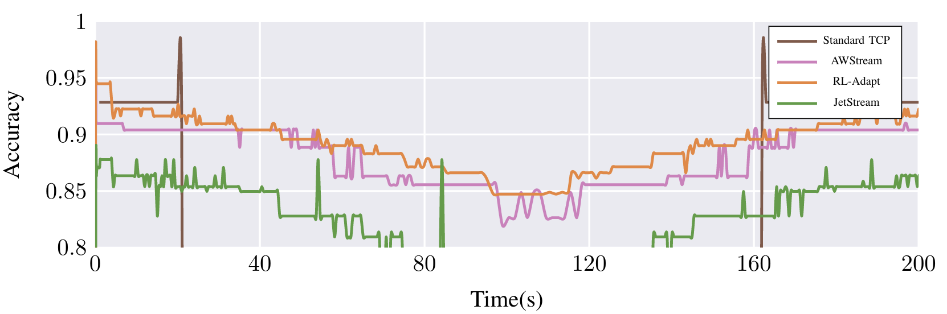
Effectiveness of adaptive streaming
Pedestrian Detection Runtime Accuracy: 10%-20% Improvement Compared to State-of-the-art Method.
Notes:
Among all three systems, JetStream shows the worst adaptability due to a relatively high accuracy drop. For the other two systems, RL-Adapt has better accuracy than AWStream and suffers less latency overhead at the same time point.
Both the policy accuracy and policy granularity determine the performance of runtime system. A high policy accuracy ensures the application achieve little- influenced performance under limited bandwidth. On the other hand, a small-pieced policy granularity grants runtime system more swiftness to switch to a higher-bandwidth policy when there are enough network resources.

Slide 17
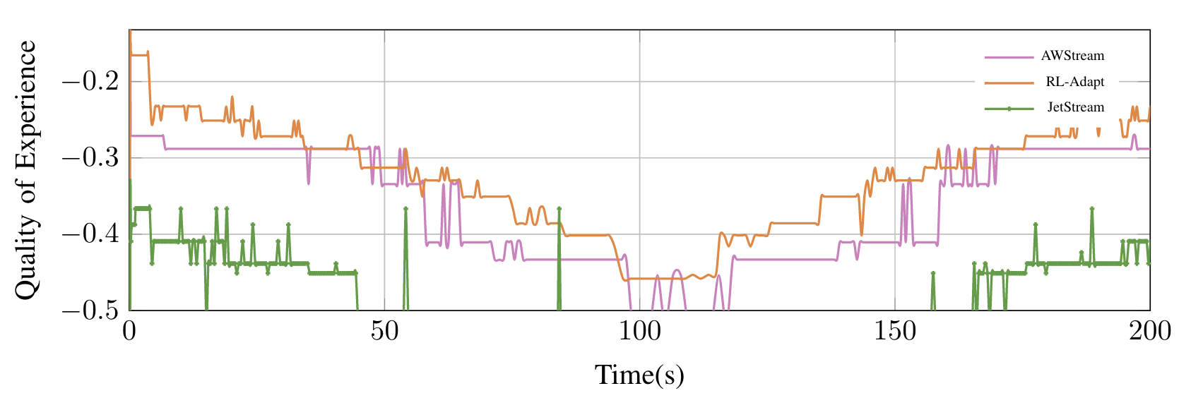
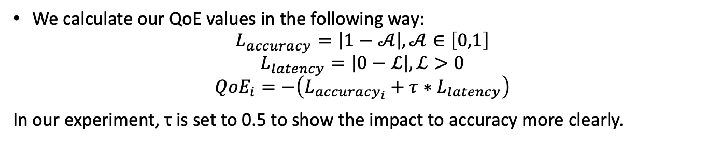
QoE Performance Evaluation
We calculate our QoE values in the following way:
$$L_{accuracy}=\left|1−𝒜\right|, 𝒜∈\left[0,1\right]$$
$$L_{latency}=\left|0−ℒ\right|, ℒ>0$$
$${QoE}_{i}=−\left(L_{accuracy_{i}}+τ∗L_{latency}\right)$$
In our experiment, τ is set to 0.5 to show the impact to accuracy more clearly.
Notes:
Quality of Experience(QoE) is a comprehensive index to indicate the overall performance of a particular task at a certain moment. We calculate our QoE values in the following way:
In our experiment, τ is set to 0.5 to show the impact to accuracy more clearly. Our results show that RL-Adapt out- performs the state-of-the-art scheme, with 20% improvements on average QoE.

Slide 18
QoE Performance Evaluation
Pedestrian Detection QoE: Average 20% Improvement Compared to State-of-the-art Method.

Slide 19
Conclusion
We present RL-Adapt, an adaptive IoT streaming system that generates adaption policies using reinforcement learning (RL) and provides declarative APIs for efficient development.
We implement the prototype of RL-Adapt and evaluate its performance extensively on three representative real-world IoT applications. Our results show that RL-Adapt outperforms the state-of-the-art scheme, with 20% improvements on average QoE.
For more questions:
Contact: Bonan Shen, shenbonan2@gmail.com
Slides: https://github.com/rladapt/rladapt/blob/master/rladapt.pptx
Repository: www.github.com/rladapt
Notes:
We present RL-Adapt, an adaptive IoT streaming system that generates adaption policies using reinforcement learning (RL) and provides declarative APIs for efficient development. Unlike existing adaptive streaming systems that use fixed adaption policies or inaccurate system models, RL-Adapt trains a neural network model that learns optimal policy decision from observations and interactions. At runtime, RL- Adapt decides the optimal policy based on the estimation of current network bandwidth. We implement the prototype of RL-Adapt and evaluate its performance extensively on three representative real-world IoT applications. Our results show that RL-Adapt outperforms the state-of-the-art scheme, with 20% improvements on average QoE.
For more questions Contact Bonan Shen

