Slide 1
GWAS Overview and
Single SNP Tests using R
Adapted from Joanne Cole, PhD – GENC6120 Lecture
R Ladies Aurora
January 14, 2026
Presented by Kristen Sutton, PhD

Slide 2
Learning Objectives
Distinguish rare vs common variants in the genome
Identify the major differences between rare and common disease
Compare and contrast the different approaches to identify regions in the genome involved in disease
Describe how a GWAS is conducted and interpret the results (P-values, Betas/ORs, Manhattan Plots)

Slide 3
Review: Basic Concepts

Slide 4
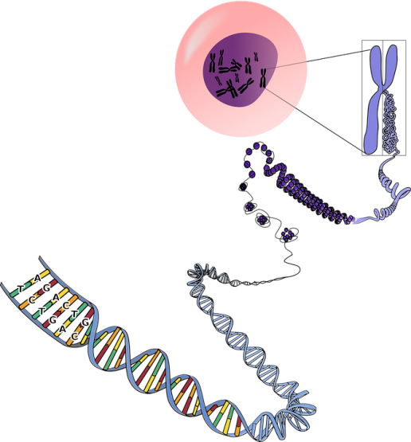
Genome Structure
Humans have 22 pairs of autosomes + 1 pair of sex chromosomes
Together, the chromosomes contain >3 billion base-pairs
A visual representation of a single chromosome, its folded DNA, and the nucleotides that make it up
A single base-pair
Notes:
https://www.differencebetween.com/difference-between-dna-and-vs-chromosome/
https://facts.net/science/biology/15-captivating-facts-about-dna-nucleotides-a-t-c-g/

Slide 5
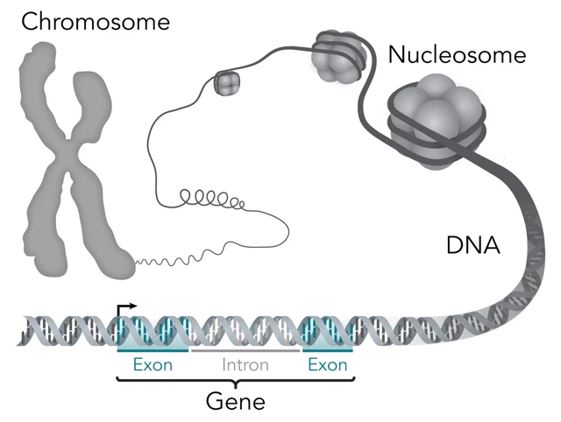

Genome Structure
Genes are segments of DNA that encode proteins
Humans have ~20,000 protein-coding genes
40% of the genome is genic (introns + exons)
1% of the genome is protein-coding (exons)
Inter-genic region
In reality, introns are typically much larger than exons
Notes:
https://storymd.com/journal/jbr3n4d02w-genetics/page/pdoyos2g9zq-how-genes-work
Numbers from Johnathan Pritchard (textbook in preparation)

Slide 6
>99% of the genome is identical between any two people ~1% contributes to human diversity
Mutation – a rare change to the DNA sequence that severely disrupts function and typically leads to disease
  Occurs in <<1% of the population
  Technically mutation just means change to the DNA sequence, but this is more often how we use the word in human genetics
Polymorphism – a common change to the DNA sequence in which there are two or more different alleles
  The minor allele occurs in >1% of the population
  Polymorphisms occur roughly every 300-1000bp (~10-15 million common polymorphisms in the genome)
Genetic variant/marker – a polymorphic DNA segment of known location
Notes:
Allele – one of two or more alternative forms of a DNA sequence

Slide 7
Types of genetic variation and mutations
Single Nucleotide Variant (SNV)
  Variation of a single DNA base pair (bp)
  Single Nucleotide Polymorphism (SNP): an SNV which occurs >1% in the population
Insertion/Deletion (InDel)
  Less frequent than SNVs
  Insertion or deletion of DNA bps (<50 bps)
  Short tandem repeats (STR) are repeats of short sequences of DNA and are a type of InDel
Structural Variation
  Least frequent
  Includes deletions, duplications, insertions, inversions, and translocations
  Copy number variations (CNVs) are a subset of structural variations that lead to a change in copy number (loss or gain) of a DNA fragment >50 bps (typically >1kb)
  Aneuploidies affect entire chromosomes (e.g., Trisomy 21)
SNPs and InDels are the two major types of common genetic polymorphisms
Notes:
Turner S

Slide 8
SNPs
rsID = a unique and stable identifier for every SNP. It links the alleles/genotypes to a chromosomal location (which is updated with each genome build)
Occur every ~100-300 base-pairs
  > 10 million SNPs in the human genome
An example SNP rs56372821
Possible alleles
  G is the major allele
  A is the minor allele
Possible genotypes
  GG (homozygous major allele)
  GA (heterozygous)
  AA (homozygous minor allele)
SNP rs56372821
chr8:27578983 (build GRCh38)
Allele | Allele Frequency*
G | 84%
A | 16%
* Individuals of European ancestry only
Frequencies may vary in other populations

Slide 9
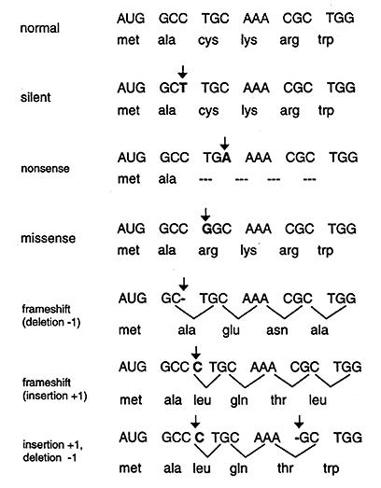
Impact of genetic variation
Variants that affect the coding sequence
Genetic variation can impact a phenotype in many ways
Variants that directly affect the coding sequence of a protein
  Often have the highest impact
  Easiest to predict their impact
Variants outside of the coding region often have a milder impact
  Much more common than changes to the coding sequence
    >80% of the genome is non-coding
    Milder effects are less likely to be severely deleterious
  Can affect the expression, stability, or function of a gene product (typically a protein)
+ splice variants, CNVs, and SV
https://step1.medbullets.com/biochemistry/102010/type-of-dna-mutations

Slide 10
Monogenic disease vs. Common disease

Slide 11
Monogenic disease = Mendelian disease
Definition: A “single gene/genetic variant” causes disease
Reality: Factors outside of the causative gene/genetic variant can contribute to variable disease presentation
  Huntington’s disease: variable disease presentation (e.g., unaffected, mild, severe) based on the number of CAG repeats in the HTT gene
  Duchenne and Becker muscular dystrophies: severity depends on which genetic variant in the dystrophin gene (DMD) you inherit
Notes:
Penetrance: how often the genotype leads to disease (e.g., unaffected vs. affected)
Expressivity: the range of disease presentation (e.g., mild vs. severe)

Slide 12
Common disease and Complex traits
Diseases and traits which are caused by a combination of multiple genetic and environmental factors (and their interactions)
Monogenic Disease
Polygenic Traits
Cystic fibrosis
Breast cancer
Height
Familial hypercholesterolemia
Heart disease
Marfan syndrome
Late onset Alzheimer’s
Type 2 Diabetes
Monogenic diabetes
Eye color
Schizophrenia
Some cancers

Slide 13
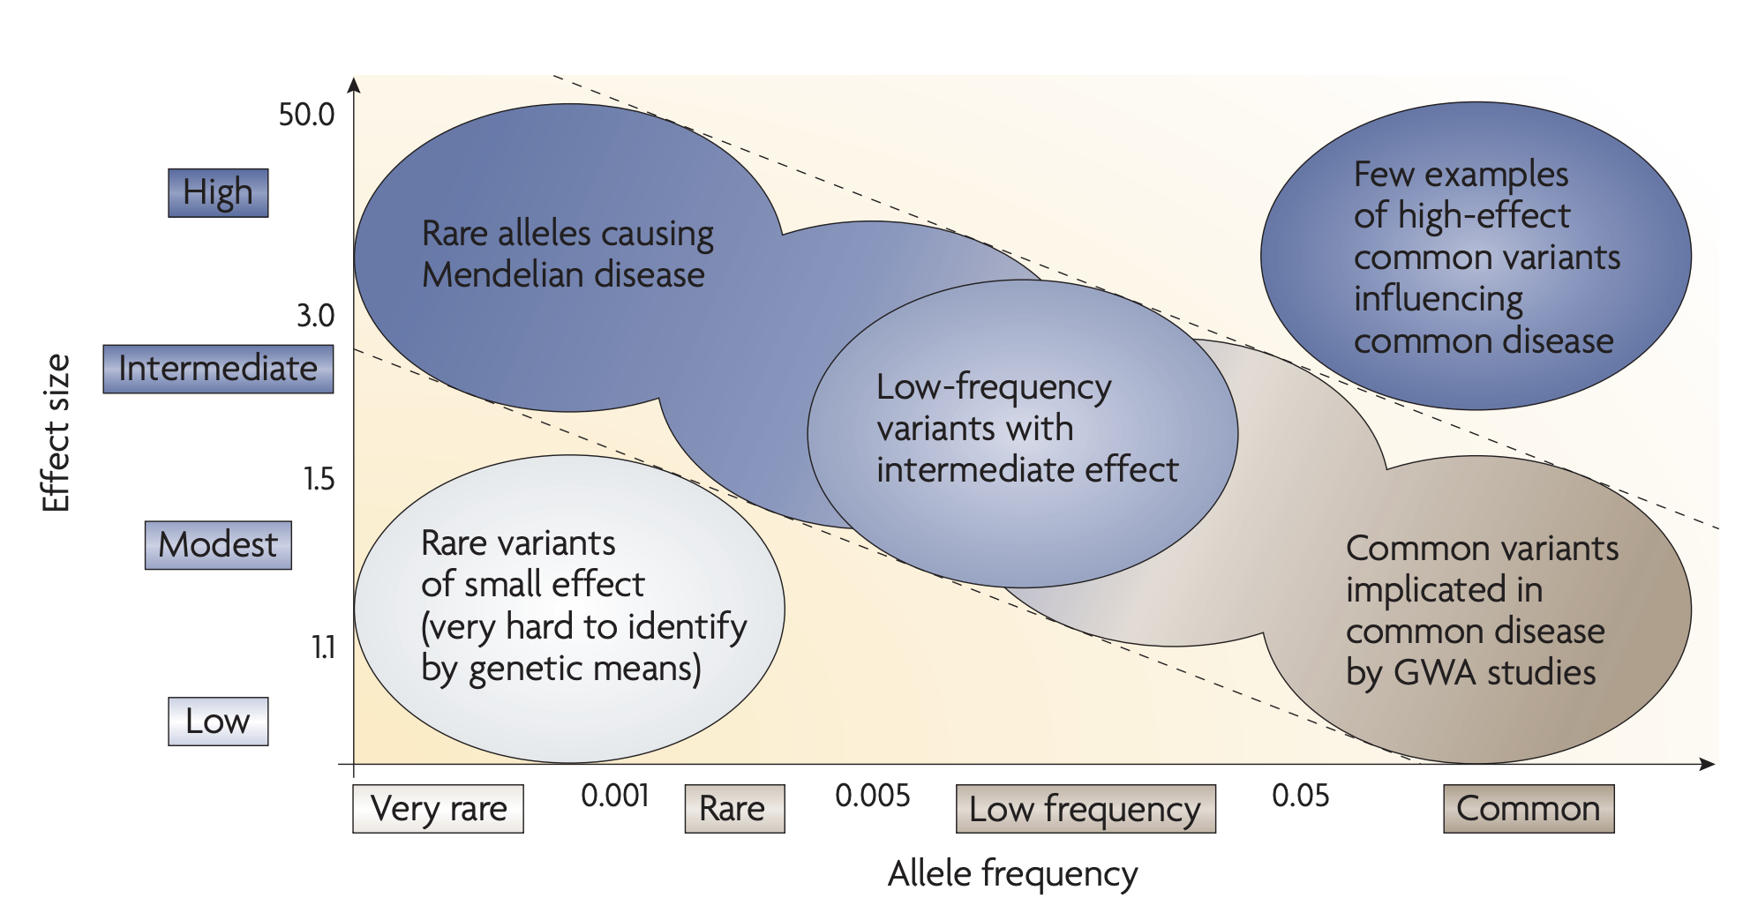
Atonarakis et al., Nature Reviews Genetics 2010

Slide 14
How to identify disease loci?
Locus (plural loci): a physical location in the genome. Typically used to refer to a region of the genome associated with your trait of interest.

Slide 15
Association Studies
Test for the statistical relationship between genotype and phenotype
Candidate gene association studies
Genome-wide association studies (GWAS)
Next generation sequencing association studies

Slide 16
Polygenic traits: Identify the genetic variants
Atonarakis et al., Nature Reviews Genetics 2010

Slide 17
The genetic underpinnings of common complex traits (i.e. polygenic traits)
Multiple variants with small effect sizes
Environment plays a role in etiology
Many adult-onset phenotypes
E.g., diabetes, asthma, height, blood pressure, Crohn’s disease, schizophrenia, age-related macular degeneration, etc.

Slide 18
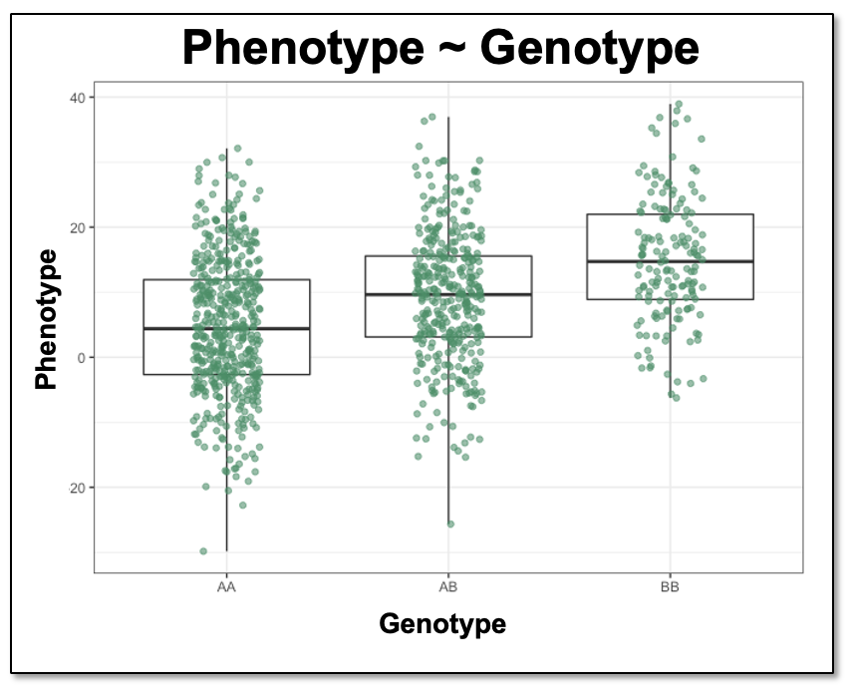
Association studies
Test for the statistical association between genotype and phenotype
Typically, under an additive genetic model, where each additional minor allele changes the phenotype by the same amount (See Plot)
Though less frequently done, you can also test for an association under dominant, recessive, or genotype models
Quantitative outcomes are prettier to plot, but the same general approach (with slightly different statistical regressions) applies for case-control GWAS

Slide 19
Association Studies
Candidate gene studies test a limited number of variants/genes based on a priori information (e.g., biological hypotheses or focus on a linkage peak)
  Very high false positive rate

Slide 20
Association Studies
Genome-wide association studies (GWAS) test millions of common genetic variants across the genome for a statistical relationship with your phenotype of interest
  i.e. Is there a significant difference in genotypes between cases and controls? across quantitative outcomes?

Slide 21
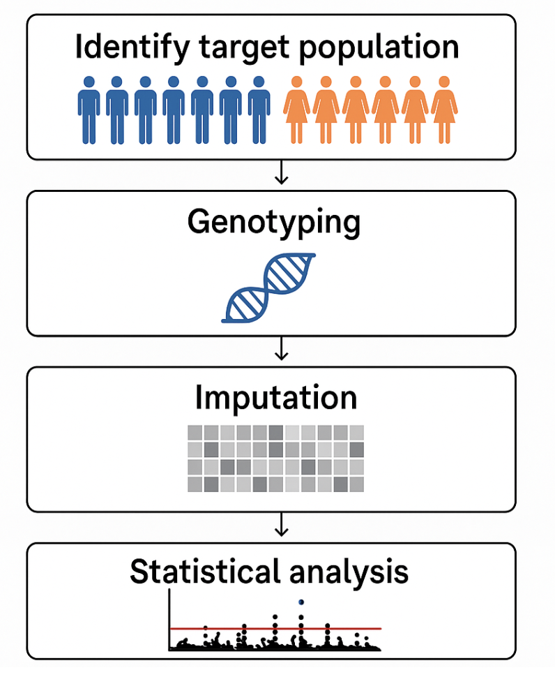
  Consider: homogeneity, trait prevalence, inclusion and equity, genetic ancestry, sample size
  ~1 million variants (e.g., SNPs and indels) are directly measured on a microarray with oligonucleotide probes
  Then millions of additional variants are inferred through imputation using large whole-genome sequencing reference panels
  Test for the statistical association between genotype and phenotype, one by one, at all variants

Slide 22
Target population
Historically, conduct GWAS in a single homogeneous genetic ancestry
  Most GWAS are in individuals of European ancestry
  Avoids “population stratification” – ancestral differences in allele frequencies that lead to spurious associations with the phenotype

Slide 23
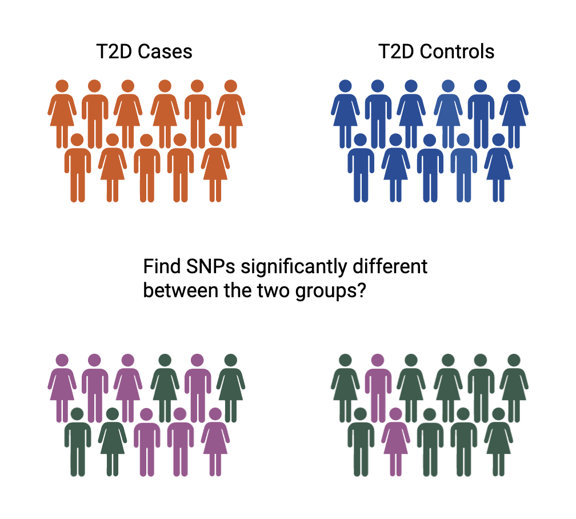
Population Stratification
GWAS: Find SNPs with different allele frequencies between groups

Slide 24
Population Stratification
GWAS: Find SNPs with different allele frequencies between groups
South Asian ancestry
European ancestry
If cases and controls differ by other characteristics, your GWAS will find genetic associations with those other characteristics (false positive associations)
Notes:
The prevalence of the condition does not need to be different between the two ancestries for population stratification to occur, because there will always be a slight difference in ancestral groups between cases and controls -> non-random sampling, subtle biases like regional differences, or differences in correlates with ancestry, etc.

Slide 25
How to address population stratification
Minimize population heterogeneity in your sample
Adjust for genetic ancestry as covariates
Fancier statistical models: mixed models with random effects for genetic ‘relatedness’

Slide 26
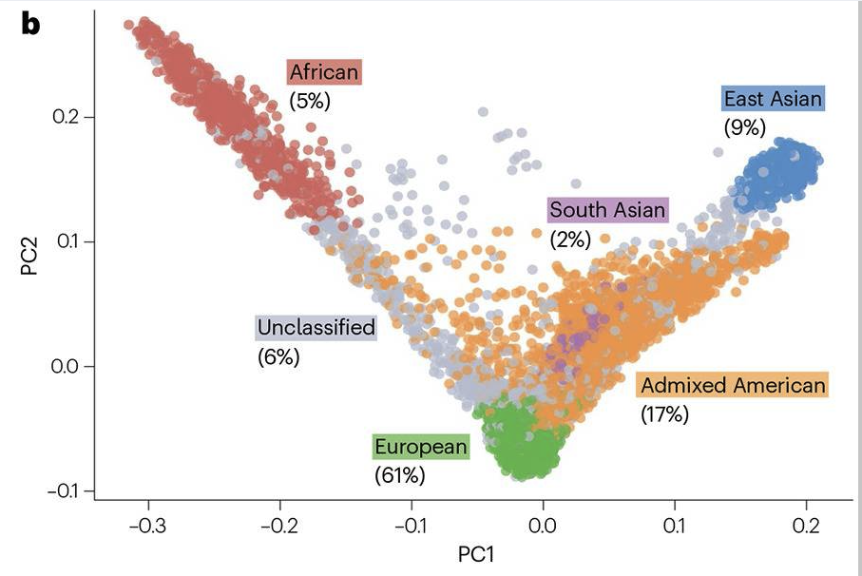
Genetic principal components analysis (PCA)
Common approach to control for population stratification
Genetic PCA identifies the largest axes of genetic variation across individuals
  The biggest difference between all people is genetic ancestry
Kachuri et al 2024

Slide 27
Target population
Historically, conduct GWAS in a single homogeneous genetic ancestry
  Most GWAS are in individuals of European ancestry
  Avoids “population stratification” – ancestral differences in allele frequencies that lead to spurious associations with the phenotype
Now, many studies combine individuals of multiple ancestries
  Use advanced statistical approaches to correct for relatedness and ancestry
  More inclusive, larger sample sizes
  Not always statistically appropriate if the phenotype greatly differs across populations

Slide 28
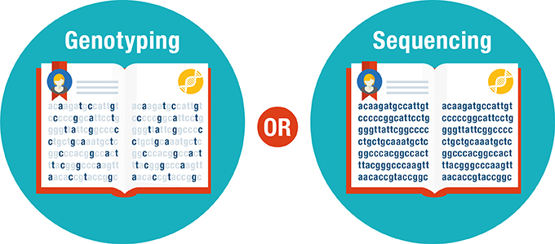
Genotyping arrays vs sequencing technologies
Targets specific variants using pre-designed probes/primers on an array
Cheaper and fairly comprehensive capture of common variants
Misses any alleles or variants not included
Captures every base in a region, exome, or genome-wide using different technology
Includes Sanger, Next Gen, and Third Gen
Higher resolution, higher cost, more data, for better or for worse
Figure: www.aboutgeneticcounselors.com

Slide 29
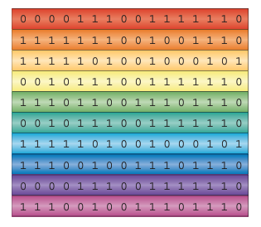
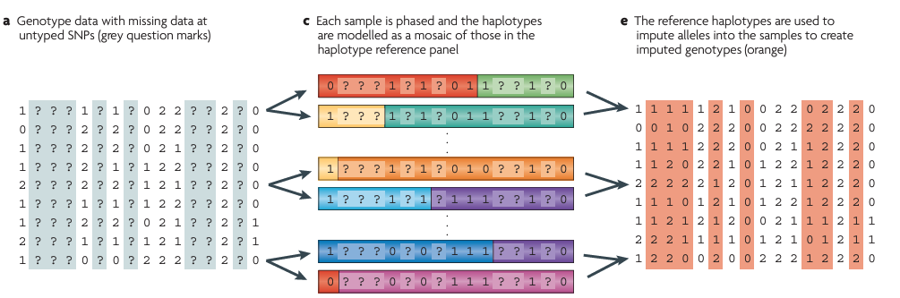
Imputation
Reference set of sequenced haplotypes
1. We have genotyped data with missing information from genetic variants that were not on the genotyping array
2. We match each row to a reference set of sequenced haplotypes to fill in the missing information
Each row is an individual, each number represents the number of alternate alleles present at that genetic marker (0/1/2 for the three possible genotypes)
Marchini and Howie 2010

Slide 30

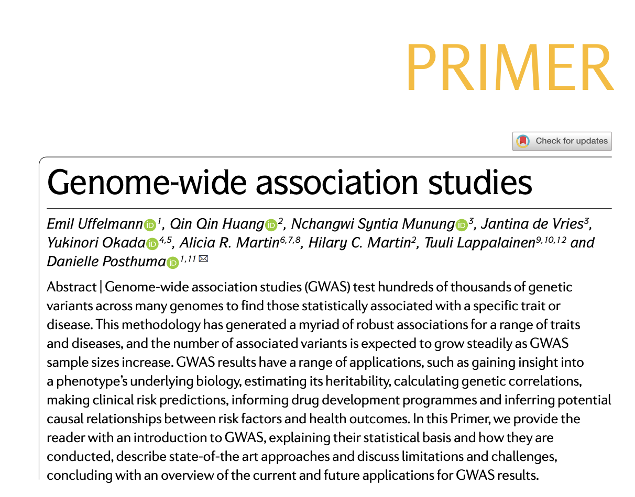
I recommend this paper on GWAS

Slide 31
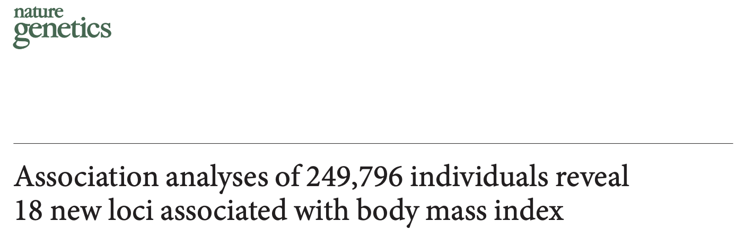
Let’s do a GWAS!
2010
Speliotes et al

Slide 32
GWAS of Body Mass Index (BMI)
Goal: identify genetic loci (regions in the genome) associated with BMI
GWAS cannot identify causal genes
  But it can point to loci that contain causal disease genes or regulatory elements that act on gene expression

Slide 33
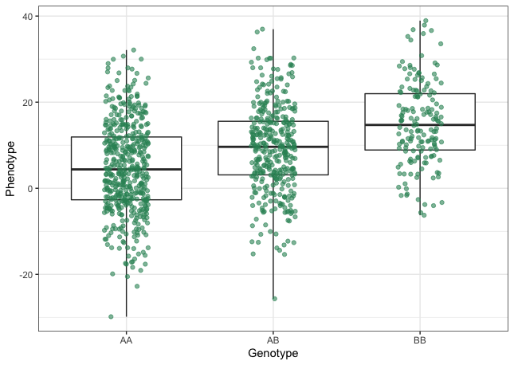
GWAS linear regression model at a single SNP
BMI ~ SNP 1 Genotype
For each individual, plot their:
  Genotype in terms of number of effect alleles (x-axis)
  BMI (y-axis)
BMI
0
1
2
Number of effect alleles at SNP 1

Slide 34
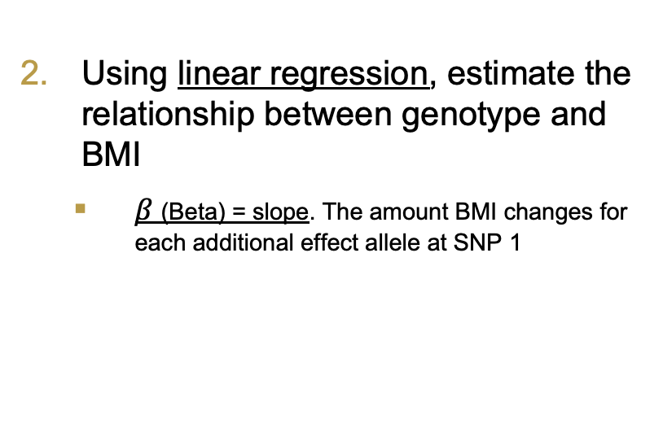
GWAS linear regression model at a single SNP
$$outcome =β∗{SNP}_{1}+intercept+covariates+error$$
BMI ~ SNP 1 Genotype
BMI
Genotype at SNP1 in terms of number of effect alleles
Using linear regression, estimate the relationship between genotype and BMI
  $β$(Beta) = slope. The amount BMI changes for each additional effect allele at SNP 1
BMI
0
1
2
Number of effect alleles at SNP 1
Note: logistic regression is a slightly different model used for binary traits (e.g., case-control status)

Slide 35
GWAS linear regression model at a single SNP
BMI ~ SNP 1 Genotype
Repeat for each SNP in your data, genome-wide
BMI
0
1
2
Number of effect alleles at SNP 1
In reality, computers and specialized statistical genetics software do these calculations for us

Slide 36
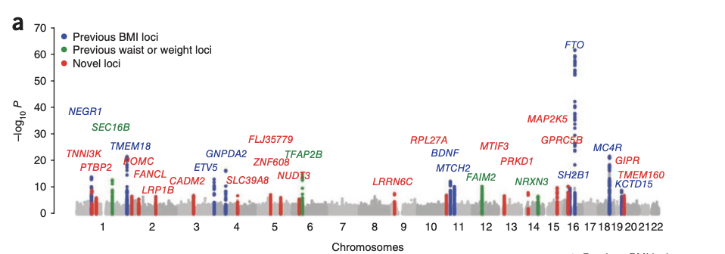
GWAS Manhattan Plot
A tool to visualize our loci significantly associated with BMI
Each point is a SNP which we tested for association with BMI
Y-axis = Statistical strength of the association (transformed P-value)
x-axis = chromosomal location of each tested SNP

Slide 37
GWAS Manhattan Plot
Additional concepts to take-away
Why is the genome-wide significance threshold so stringent (P<5.0 x 10⁻⁸)?
Why do significant SNPs cluster together in peaks of association signal?
P<5x10⁻⁸
P<0.00000005

Slide 38
The P<5.0x10⁻⁸ genome-wide significance threshold
P<0.05 is the most widely used significance threshold for a single statistical test
  The probability of getting your result due to chance alone (and not a real association) is less than 5%
Multiple Testing Problem: What happens when you conduct 100 tests?
  5/100 tests will be false positives
  The more tests we conduct, the more likely any given test will be a false positive
Multiple Testing Correction: Adjust your significance threshold to still reflect the wanted 5% false positive rate
Notes:
- P<0.05 is equivalent to saying “The probability of getting your result due to chance (and not a real association) is less than 5%”. Smaller p-values mean more significant results, because you are more confident your result is not due to chance.
- Multiple Testing problem: When you conduct multiple tests, you are more likely that any given test is a false positive (that the results are due to chance alone). Therefore, we need to adjust our significance threshold. A good video explaining this: https://www.youtube.com/watch?v=HpjlcEH4zuY
- We need to correct the original 0.05 threshold by the number of tests we are performing. Although we are testing 10 million common genetic variants in the genome, they are not all independent. Genetic variants physically close together are correlated due to linkage disequilibrium.
- So we just need to adjust for the approximately 1 million independent common genetic variants in the genome

Slide 39
The P<5.0x10⁻⁸ genome-wide significance threshold
Should we adjust for the ~10 million common variants that we tested for association with BMI?
... Not quite
The genotypes of genetic variants that are physically close together are correlated (they are in LD)
  Linkage disequilibrium (LD) – the correlation between SNPs arising due to their physical proximity and the probability of recombination events
Approximately only ~1 million independent common genetic variants in the genome (in individuals of European ancestry)
P < 0.05/1,000,000 = 0.00000005 = 5.0x10⁻⁸
Notes:
- P<0.05 is equivalent to saying “The probability of getting your result due to chance (and not a real association) is less than 5%”. Smaller p-values mean more significant results, because you are more confident your result is not due to chance.
- Multiple Testing problem: When you conduct multiple tests, you are more likely that any given test is a false positive (that the results are due to chance alone). Therefore, we need to adjust our significance threshold. A good video explaining this: https://www.youtube.com/watch?v=HpjlcEH4zuY
- We need to correct the original 0.05 threshold by the number of tests we are performing. Although we are testing 10 million common genetic variants in the genome, they are not all independent. Genetic variants physically close together are correlated due to linkage disequilibrium.
- So we just need to adjust for the approximately 1 million independent common genetic variants in the genome

Slide 40
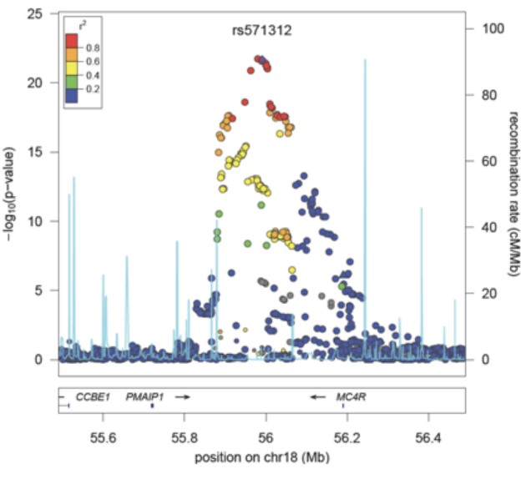
Why do significant SNPs cluster together in peaks of association signal?
Regional Manhattan Plot = Zoomed in Manhattan plot
The genotypes of SNPs close together (in linkage disequilibrium) are correlated → their association with BMI will be correlated too!
Important. GWAS identify clusters of correlated SNPs in loci associated with your trait of interest. These loci may overlap genes, suggesting their importance. However, GWAS do not directly identify the causal genes in the locus.
GWAS tend to name loci by their nearest gene, but this does not mean we are confident it is the causal gene

Slide 41
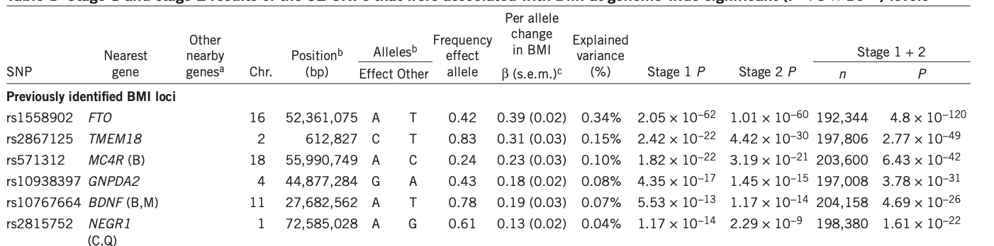
GWAS summary statistics table
Binary traits/case-control outcomes (e.g., Obese vs. non-obese) are fit using a logistic regression and the beta is transformed into an odds ratio (OR)
  Odds ratio (OR): the odds of having obesity for carriers of the effect allele / the odds of having obesity for non-carriers of the effect allele
Lead SNP for naming purposes. The locus makes up many correlated genetic variants in LD.

Slide 42
The utility and limitations of GWAS
GWAS has been used to identify thousands of loci associated with polygenic traits in an unbiased manner
  Works well for common variants and common traits
Small effect sizes can have real impact
  Nominate candidate genes in which bigger perturbations have a larger impact on the phenotype
  Aggregation of many variants with small effect sizes into a polygenic score can together have a moderate effect on the phenotype
Limitations
  Association does not mean causality: GWAS does not identify the causal variant or gene, and getting to this next step is non-trivial
  Requires very large sample sizes (in the thousands, at least)
  Most GWAS have been conducted in people of European genetic ancestry and the GWAS associations and derived polygenic scores may not translate well to other more diverse populations

Slide 43
Sneak Peek at Polygenic Scores
Polygenic risk scores (PRS) = Polygenic Scores (PGS)
PGS is a measure of an individual’s overall genetic risk or propensity for a given disease or trait
  They are calculated as the sum of their genome-wide genetic effects, calculated from genome-wide GWAS data

Slide 44
How to calculate a simple PRS?
The simplest model:
For each individual, and for each SNP, multiply the number of effect alleles (0, 1, or 2) by the effect (beta) on the trait of interest
PRS = Sum of these values (the aggregate risk for each individual)
Example with 3 genome-wide significant loci
Using the lead SNP from each independent locus
Individual | SNP1* (beta = 2.2) | SNP2* (beta = 1.4) | SNP3* (beta = 1.6) | PRS
1 | 0 | 2 | 0 | 2.8
2 | 2 | 1 | 0 | 5.8
3 | 1 | 2 | 0 | 5.0
4 | 0 | 0 | 1 | 1.6
Individual 1 PRS = 0*2.2 + 2*1.4 + 0*1.6 = 2.8
Note: More complex models take into account genome-wide genetic effects and correlation between SNPs

Slide 45
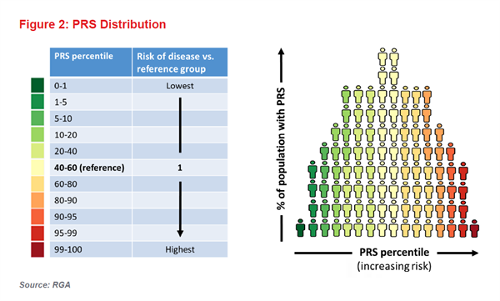
What does a PRS mean?
The higher your PRS the higher your aggregated genetic risk for the disease of interest

Slide 46
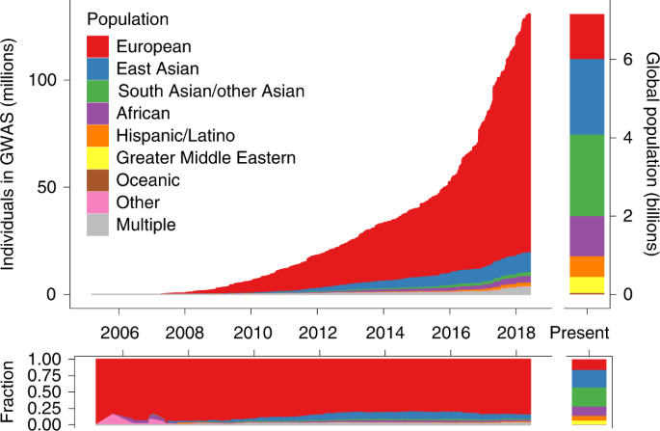
A current important hot topic:
Increasing diversity in genetic studies
Most genetic studies to date have been done in individuals of European ancestry
How well the GWAS signals and PGS translate to non-White populations is a major area of research
Martin et al., Nature Genetics 2019

