Slide 1
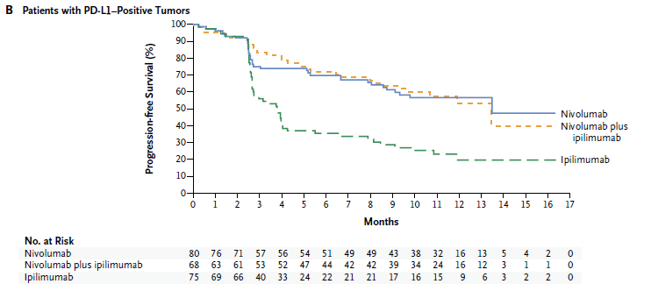
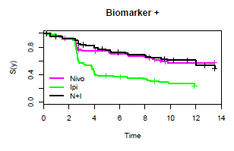
Digital Data Extraction Using R & Other Tools
Jaya M. Satagopan
Attending Biostatistician
Memorial Sloan Kettering Cancer Center
@satagopj satagopj@mskcc.org
Notes:
Thank you, R-Ladies NYC, for organizing this event. I’m very pleased to have the opportunity to present this work.
As a biostatistician at a cancer center, I get to work a lot with survival data as shown in these figures. Patients are followed up from a starting time and we observe how many of them have an event such as disease progression or death. Initially everyone is event-free. As time progresses, patients may die, which is indicated by repeated drop in the curve. Patients may also exit the study i.e., they are censored, as indicated by tick marks on the curve, which is better visible in the right hand side plot. We typically have different patient groups such as patients receiving different treatments, as indicated by different colored lines in these figures.
The left side figure is a published figure based on a phase III clinical trial. Having access to individual patient-level data will be of significant use to pursue ancillary projects, especially to use these data to conduct empirical evaluations of new statistical methods. However, patient-level data from such studies may not be readily available to investigators from outside the study team. My colleague Alexia Iasonos were faced with this issue a couple of years ago.
To address this issue, we pursued a digital data extraction strategy and obtained the curve on the right hand side. I’m going to share this approach with you today.

Slide 2





Combine the strengths of 3 tools and collaboration
+
+
DigitizeIt
Joey Kanik
Alexia Iasonos
Notes:
To get the right hand side figure, Alexia and I combined the strengths of 3 computer tools – Adobe Illustrator, DigitizeIt software and R - and collaborated with our graphics expert, Joey Kanik.

Slide 3
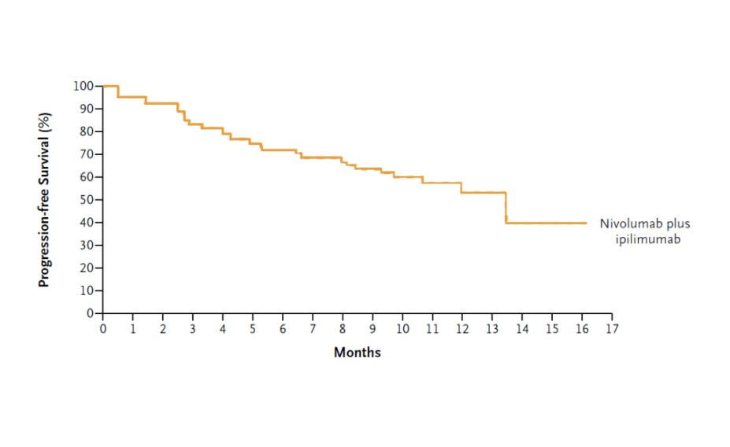
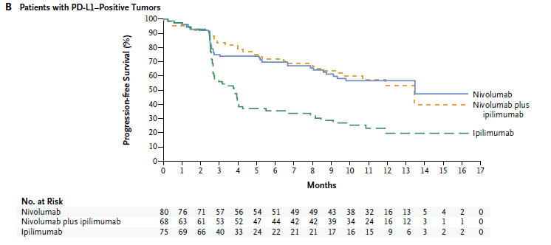
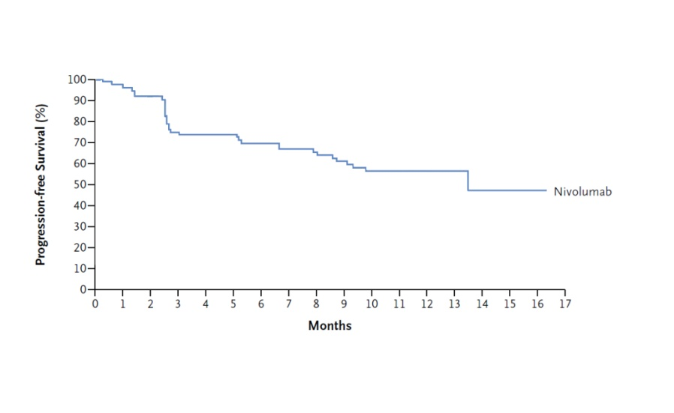
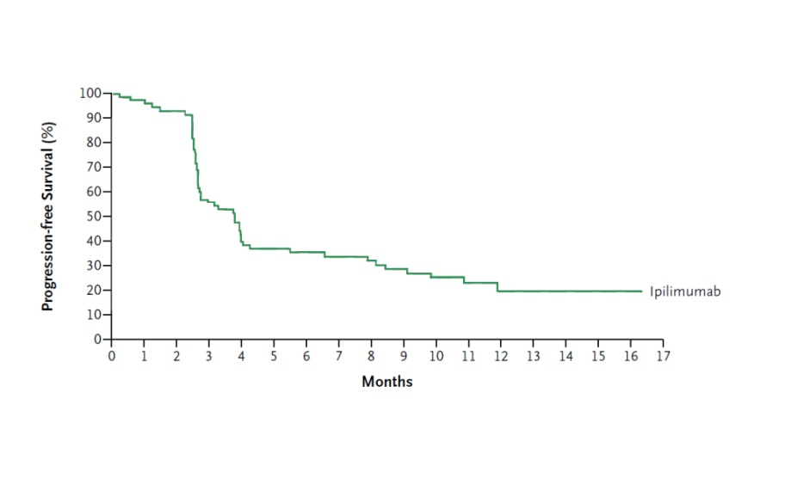
Step 1: Extract individual lines from published figure
https://www.adobe.com/products/illustrator.html
Notes:
The first step is to extract individual lines from the figure we want to digitize. This can be done using Adobe Illustrator. Here I show a figure published by Larkin and colleagues.

Slide 4
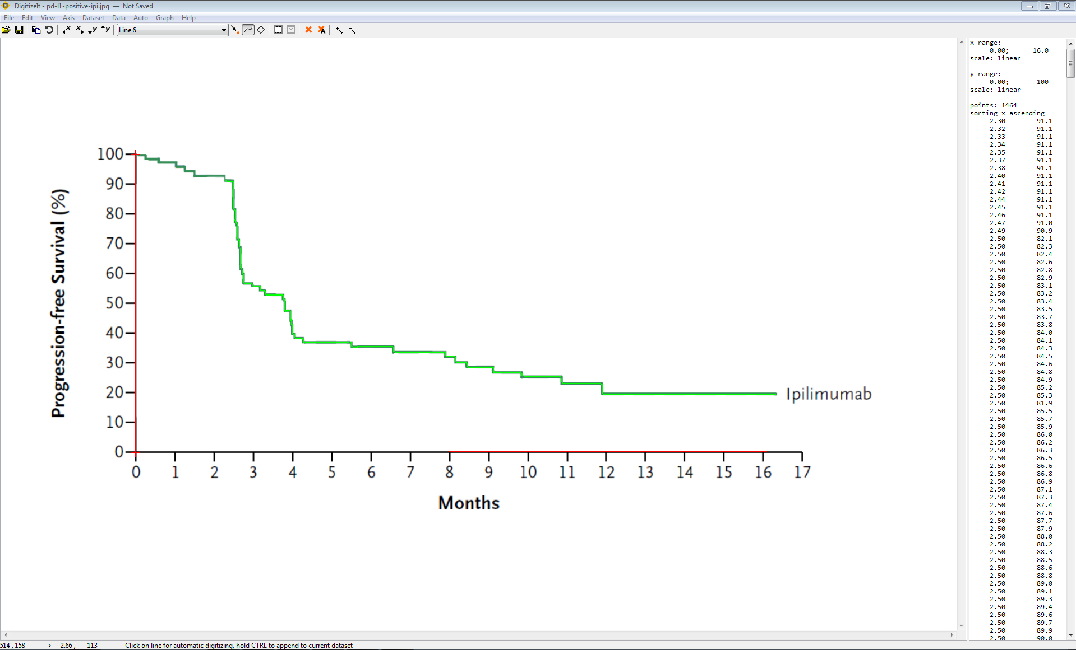
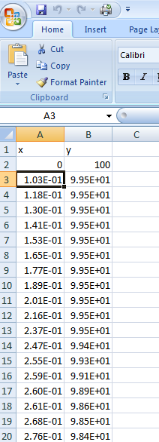
Step 2: Digitally extract (x,y) values
https://www.digitizeit.de/
Notes:
Next, read the individual figures as pdf or jpeg image using a digitization software. Many softwares are available. We used DigitizeIt. Once we open the image and click on the line we want to digitize, this software immediately outputs the (x,y) coordinates. For each month (horizontal axis) on the first column in the oval, we get the corresponding survival probability (vertical axis) on the second column. This can be saved as a text or excel or csv file.

Slide 5
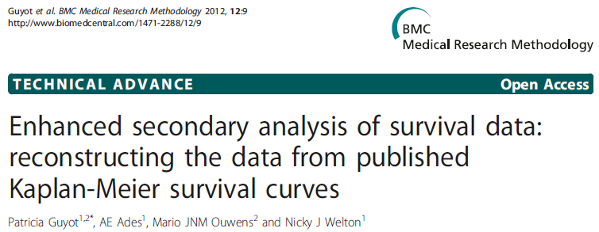
Step 3: Convert (x,y) values to person-level data
Pre-process
Us (pre-processing) +
Guyot et al (data extraction)
Notes:
Finally, we used R to convert these (x,y) coordinates to patient-level data. First, we wrote an R program to pre-process the (x,y) data to clean it up for further use. This is because sometimes, the digitization software repeats certain rows multiple times. We haven’t figured out why this happens, but our R code cleans the data and prepares it for the next stage, which is the individual-level data extraction process.
To do this, we use the work of Guyot et al. These authors have derived linear equations to convert survival probabilities (the y-axis) to survival data, and provide an R program to do this. We converted this to an R function, which is easy to do.
When the published survival curves include the number of individuals at risk in the bottom, we can use this information along with the pre-processed data as inputs to the Guyot et al R function.
An R screen shot of the individual level data is shown here (point to the lower right hand side).

Slide 6
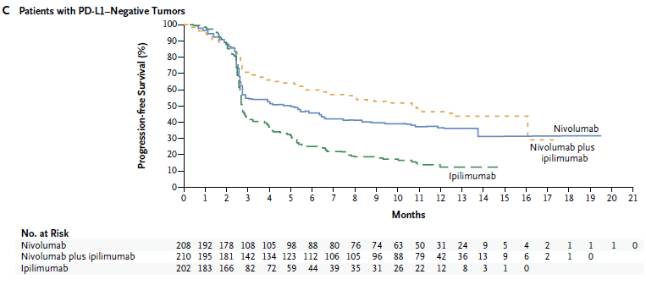
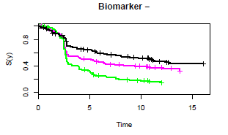
Digital extraction provides a good approximation
Notes:
The top figures are the published graphs of Larkin et al. The bottom graphs are prepared using the the corresponding digitally extracted data. As we can see, the digital data provide a good approximation to the published data.
Other authors shown in the bottom have also used Guyot et al’s equations to extract data, and found that it gives good approximations.
Note from the figures that the published data gives information up to month 17, while we have only up to months 14 or 15. This is because there are only 1 or 2 people at risk at later times, which impacts how well data can be extracted at these time points.
Nonetheless, this is a good approach to obtain approximate data for use in methodological research.

Slide 7
Clinical data sharing is a vast and heavily discussed topic
Our effort: a temporary solution for an immediate need using Adobe I, DigitizeIt & R
Notes:
There is a huge and growing body of research about sharing medical data.
What we have done is to obtain a temporary or short-term solution to address our immediate needs while these discussions are underway.

Slide 8
For R codes and digitized data:
https://www.mskcc.org/departments/epidemiology-biostatistics/biostatistics/data-brief-full-data-set
Notes:
We have published these digital data extraction method.
The code and the extracted data are available from this web page.
Thank you.

