Slide 1


R-Ladies Paris:
Inaugural Meeting
October 5, 2016
Notes:
- thank our two sponsors tonight

Slide 2
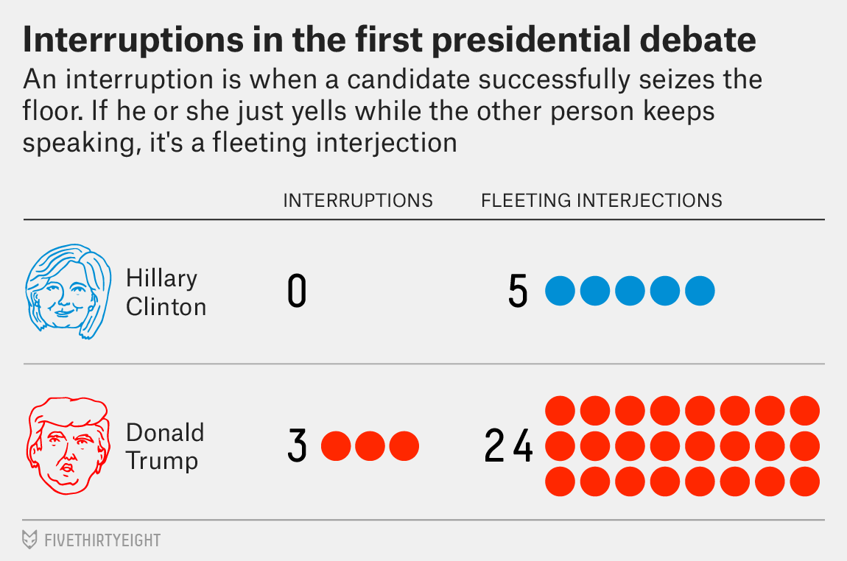
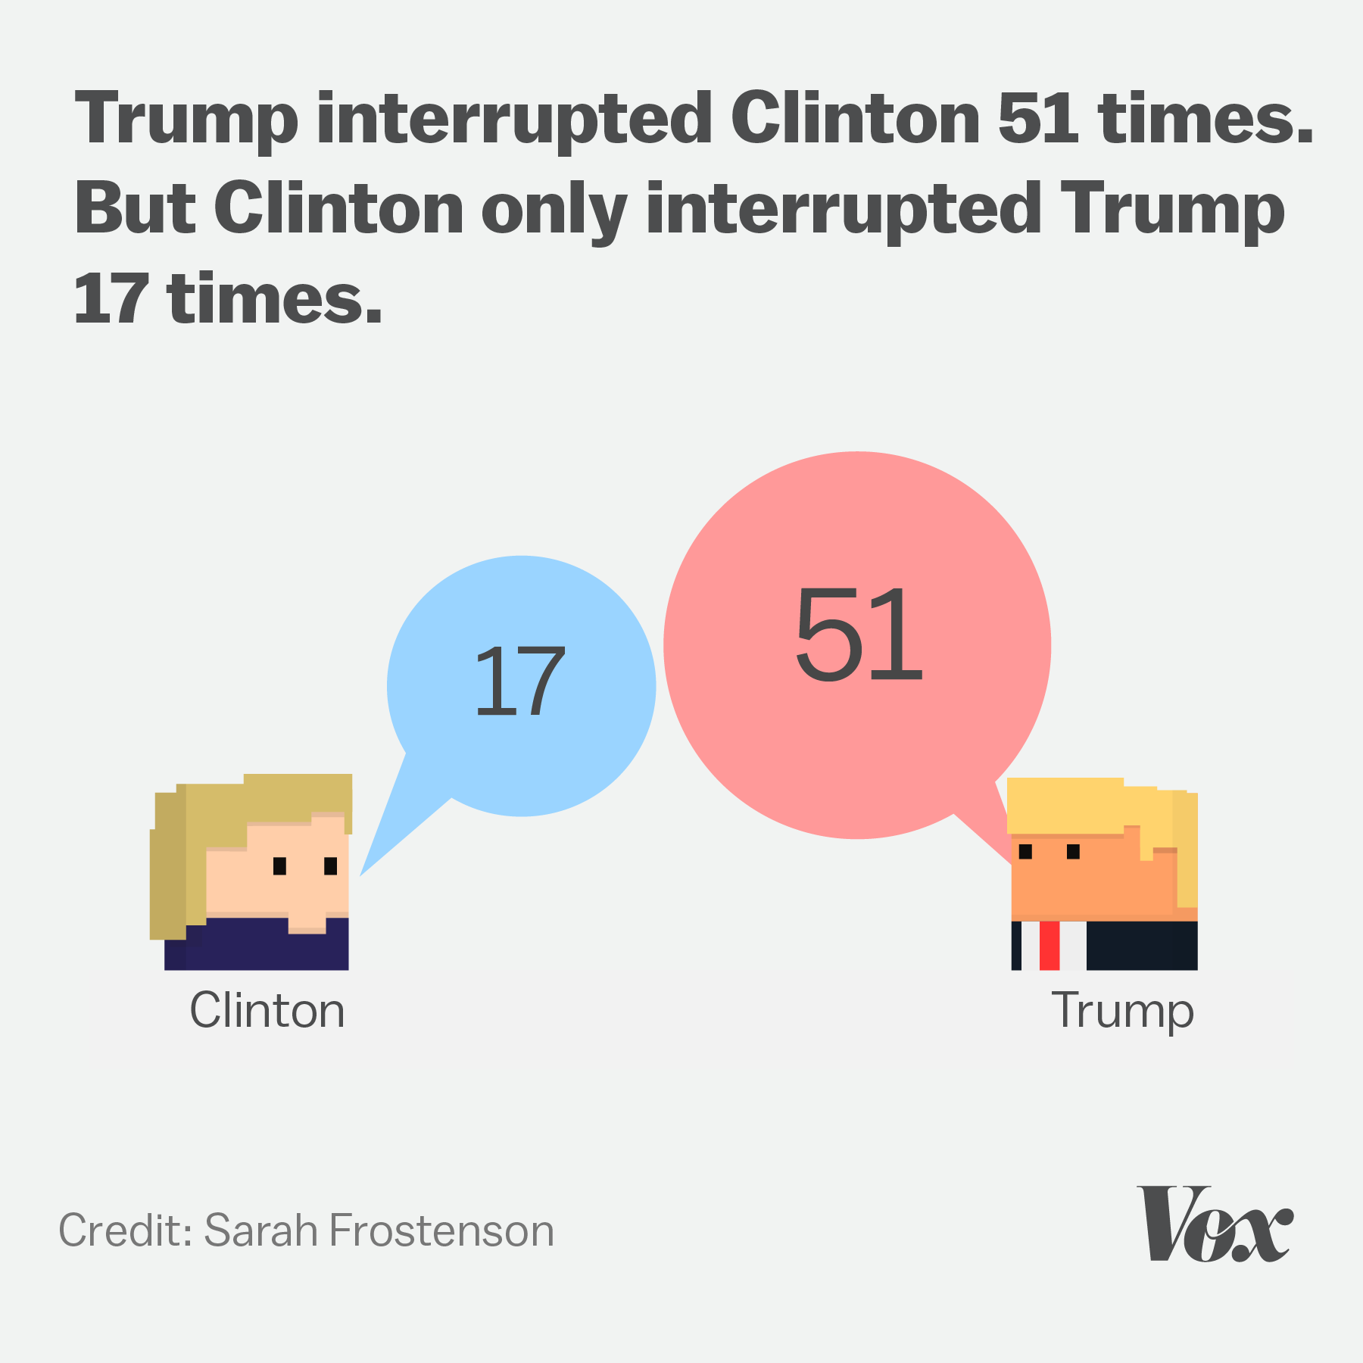
Why is this needed?
Notes:
- not sure where the best place for this slide is

Slide 3
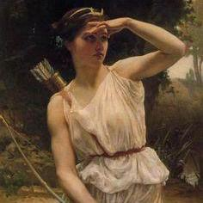
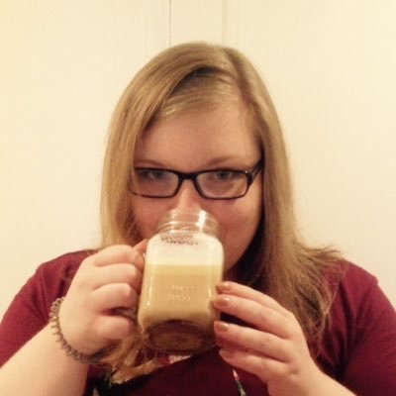
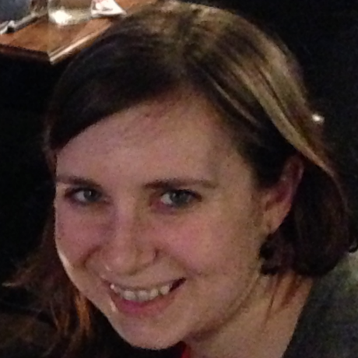
Who are we?
Diane Beldame
Christina Bergmann
Page Piccinini

Slide 4
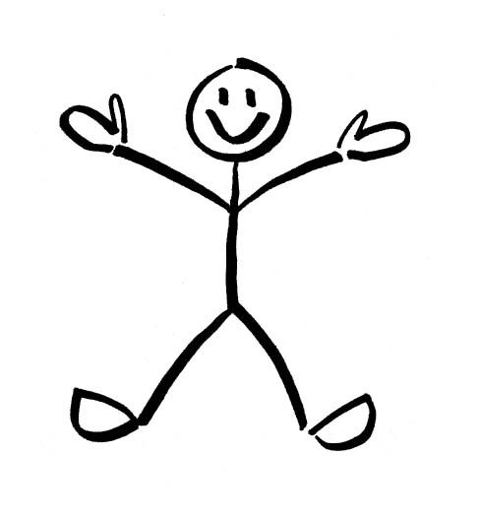
Who are you?
(according to survey results)
advanced
(1)
intermediate
advanced
(4)
27
intermediate
(9)
intermediate
beginner
(4)
beginner
(9)

Slide 5
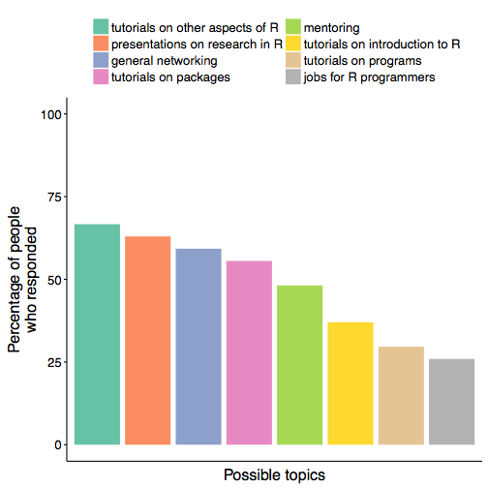
Who are you?
(according to survey results)

Slide 6
Who are you?
(according to survey results)
Notes:
other aspect, e.g. Markdown and Shiny
all over the place though in terms of tutorials in general

Slide 7
Who are you?
(according to survey results)
Notes:
- top three

Slide 8
Who are you?
(according to survey results)
Notes:
- focus on this one b/c I’m not sure if everyone means the same thing

Slide 9
Other questions?
Language? French, English, bilingual?
Meeting times?

