Slide 1




R-Ladies Paris:
Inaugural Meeting
October 5, 2016
Notes:
- thank our two sponsors tonight

Slide 2
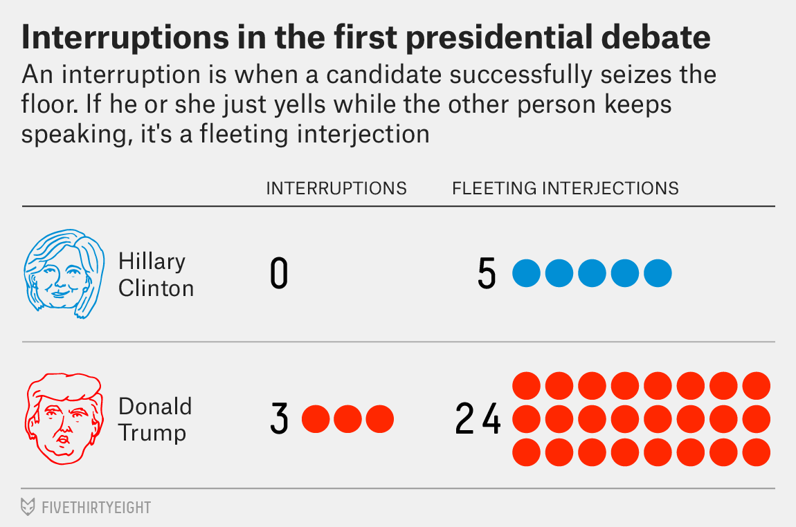
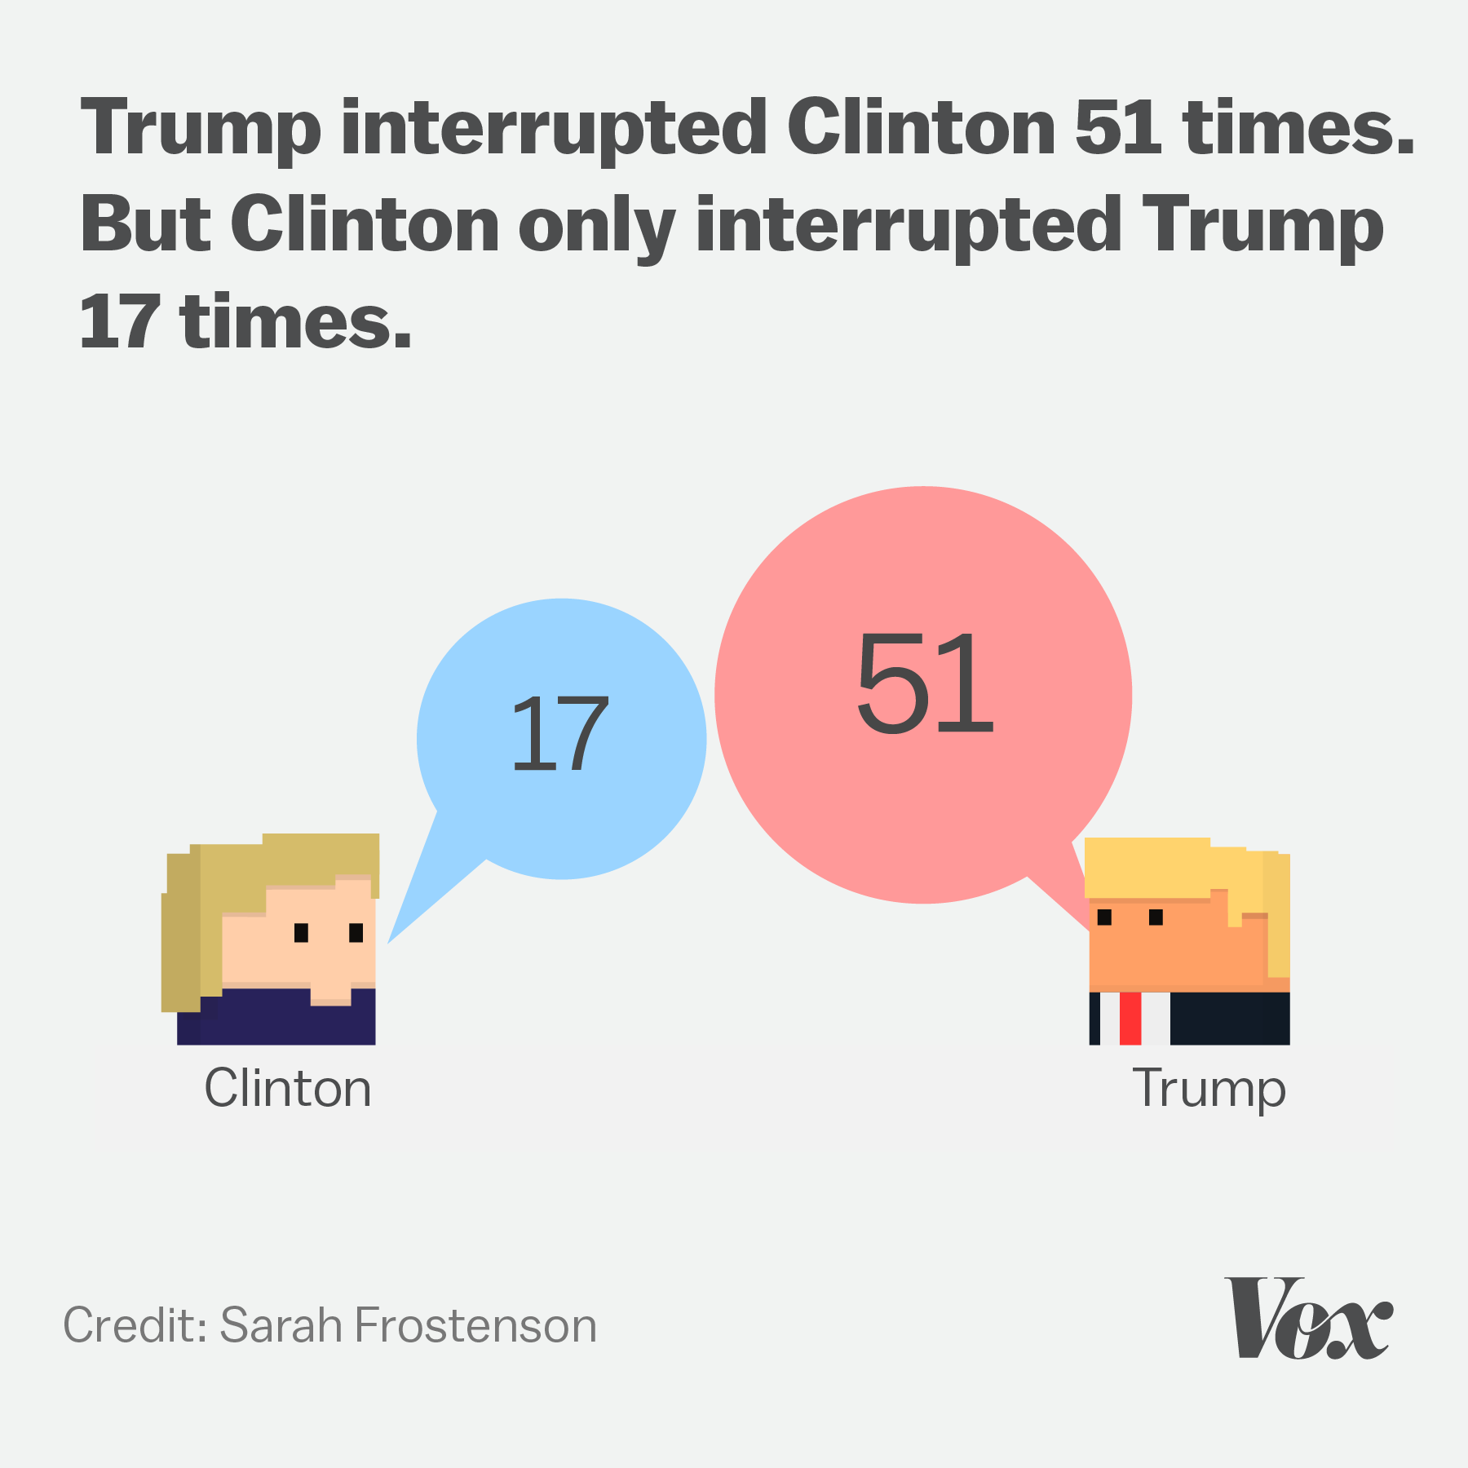
Why is this needed?

Slide 3
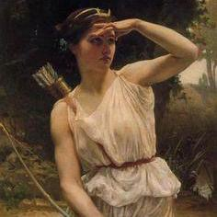
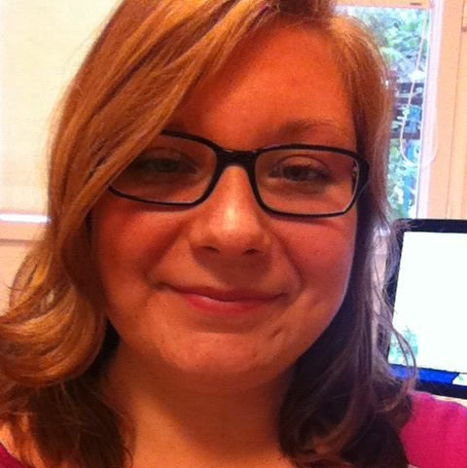
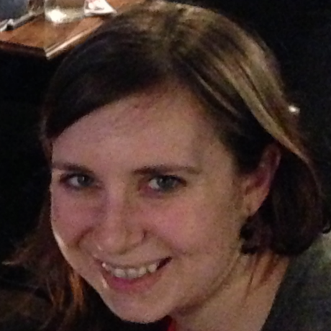
Who are we?
Diane Beldame
Christina Bergmann
Page Piccinini

Slide 4

Who are you?
(according to survey results)
advanced
(3)
intermediate
advanced
(5)
35
intermediate
(9)
intermediate
beginner
(8)
beginner
(10)
Notes:
have a round of who is present before animating survey results
—> name, where work, etc.

Slide 5
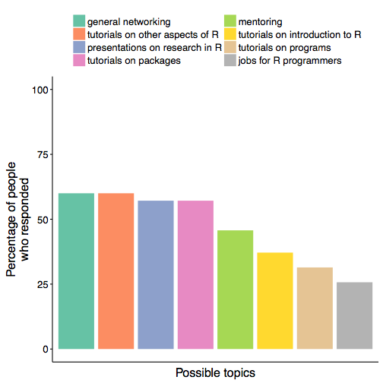
Who are you?
(according to survey results)

Slide 6
Who are you?
(according to survey results)
Notes:
- top three

Slide 7
Who are you?
(according to survey results)
Notes:
other aspect, e.g. Markdown and Shiny
all over the place though in terms of tutorials in general

Slide 8
Who are you?
(according to survey results)
Notes:
- focus on this one b/c I’m not sure if everyone means the same thing

Slide 9
Flash survey qs
Academia / Industry?
What do you use R for?
How long have you used R?
Are you in other R groups?

Slide 10
Future meeting qs
Language? French, English, bilingual?
Meeting frequency / times?
Speakers? (you or suggestions)
Logo?
Notes:
speakers include ppl who want to speak and suggestions for speakers (some ppl said yes in initial survey)
I have done small tutorials on dplyr/tidyr or ggplot2 at INRA that I could recycle depending in the desired level. Otherwise potentially the use of Bioconductor packages.
analyzing eye-tracking data
missing values
- mention posters too

