Slide 1
Maths Power in STEM
Lyndal Henden
15-06-2017

Slide 3
Discipline profile of the mathematical sciences, 2016, AMSI
Notes:
NAPLAN data – national assessment program – literacy and numeracy (years 3,5,7 and 9)

Slide 4
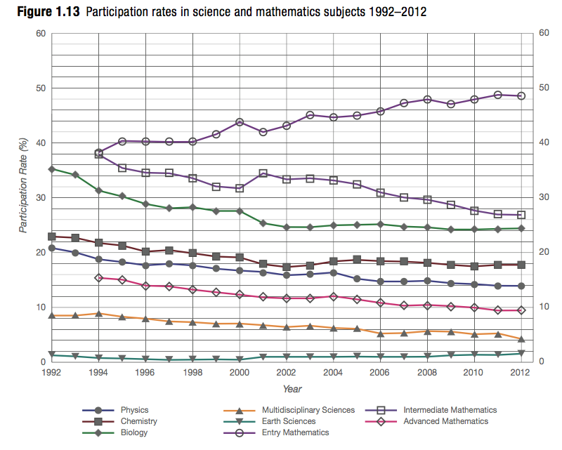

Slide 5
Percentage of Bachelor Degrees with intermed. maths pre req in Australia
Notes:
many universities have dropped intermediate or advanced mathematics as prerequisites for entry into science and engineering degrees

Slide 6

Choose Maths Initiative

Slide 7
NAPLAN yr 9 numeracy results 2015
below
standard
at
standard
above
standard
Notes:
NAPLAN data – national assessment program – literacy and numeracy (years 3,5,7 and 9)

