Slide 1
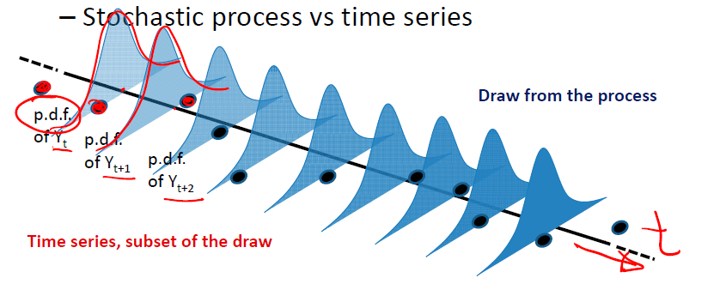
droiT mwkrivi - cvladis dakvirvebaTa Tanmimdevroba, romlebic ganxorcielebulia drois sxvadasxva SualedebSi. dakvirvebaTa Tanamimderoba aris statistikurad damoukidebeli SemTxveviTi sidideebis realizaciaTa Tanamimdevroba

Slide 2
stoqasturi (SemTxveviTi) procesebi
zogadad, droiTi mwkrivebis analizi ganasxvavebs sami tipis
monacemTa warmomqmnel process:
stacionaruls
trend-stacionaruls
integrirebadi (sxvaobiT-stacionaruls)
Tu integrirebadi procesi pirveli rigis sxvaobiT daiyvaneba
stacionarul mwkrivze, vityviT, rom procesi pirveli rigis
integrirebadia I(1), Sesabamisad, “d” rigis integrirebadia, I(d) Tu
“d” rigis sxvaobiT daiyvaneba.

Slide 3
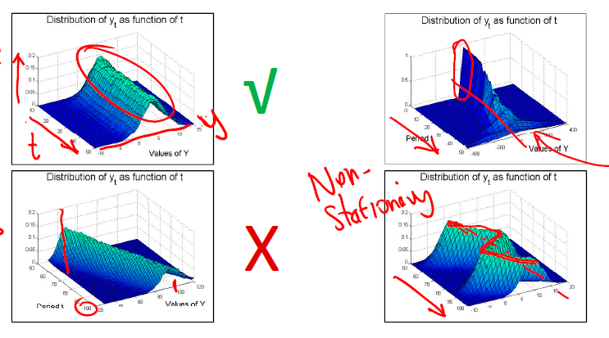
monacemebis warmomqmneli procesebi

Slide 4
martivi stacionaruli procesebi: $AR\left(1\right)$ da $MA\left(1\right)$
pirveli rigis mcuravi saSualos procesi
mcuravi saSualos martivi struq­tura gulisxmobs, rom dakvirvebebi, romlebic erTmaneTisagan dacilebulia ori da meti lagiT, arakorelirebulebi arian.

Slide 5


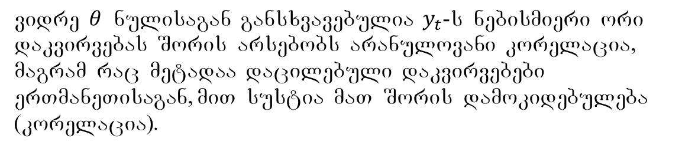
pirveli rigis avtoregresiuli procesi
$$V\left\{y_{t}\right\}=V\left\{θy_{t−1}+ε_{t}\right\}= θ^{2}V\left\{y_{t−1}\right\}+V\left\{ε_{t}\right\}$$
SesaZlebelia pirobis SemoReba
vidre $θ$ nulisagan gansxvavebulia $y_{t}$-s nebismieri ori dakvirvebas Soris arsebobs aranulovani korelacia, magram rac metadaa dacilebuli dakvir­vebebi erTmaneTisagan, miT sustia maT Soris damokidebuleba (korelacia).

Slide 6
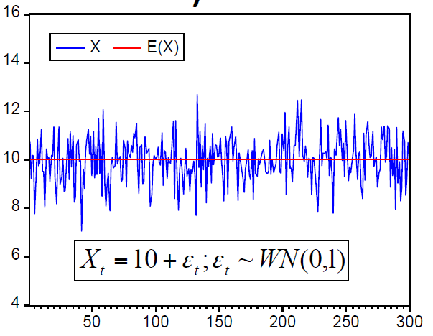
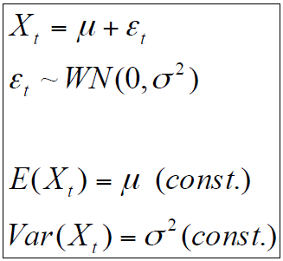
stacionaruloba
kovariacia $X_{t1}$ da $X_{t2}$ Soris mudmivia da damokidebulia $t1−t1$
intervalze da ara TviTon $t1$ da $t2$ mniSvnelobebze
(ix. R-studio)

Slide 7
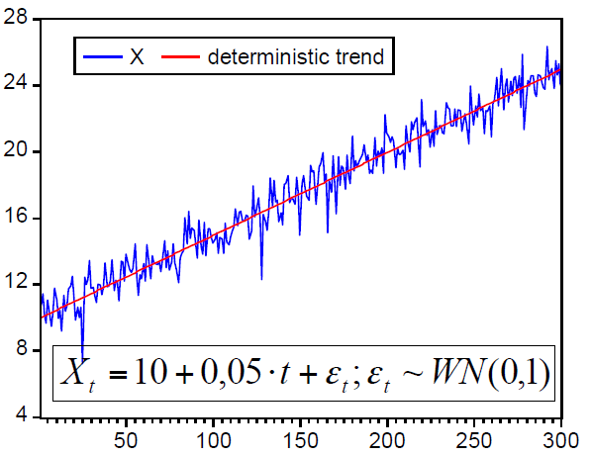
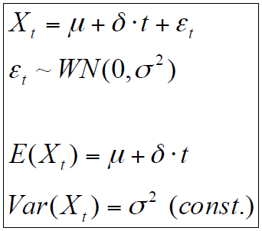
trend-stacionaruloba
$X_{t}$ mwkrivi irxeva mudmivi, gansazRvrulu trendis irgvliv, mwkrivs
ewodeba trendTan dabrunebadi

Slide 8
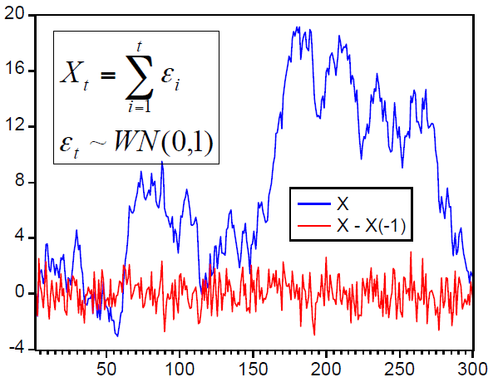
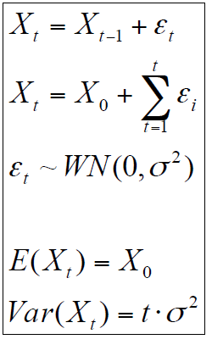

$I\left(1\right)$: შემთხვევითი ხეტიალი
variacia mudmivad izrdeba da mwrkivi saSualo mniSvnelobas
ar ubrundeba.

Slide 9
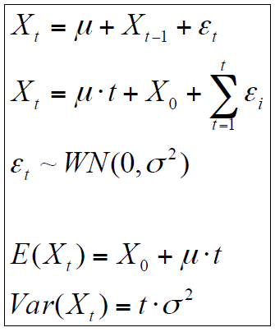
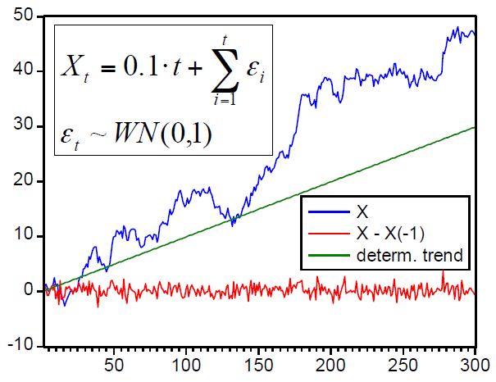

$I\left(1\right)$: SemTxveviTi xetiali driftiT
SevniSnoT, rom SemTxveviT xetialis drifti trendi ar aris,
romlis irgvliv moZraobs mwkrivi da romelsac ubrundeba.
variacia mudmivad mzardia.

Slide 10
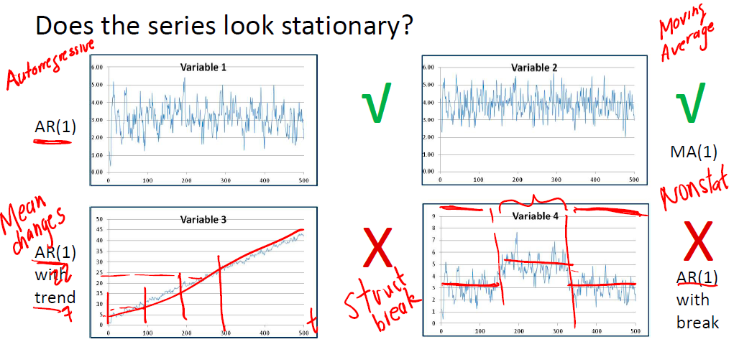
droiTi mwkrivebi

Slide 11
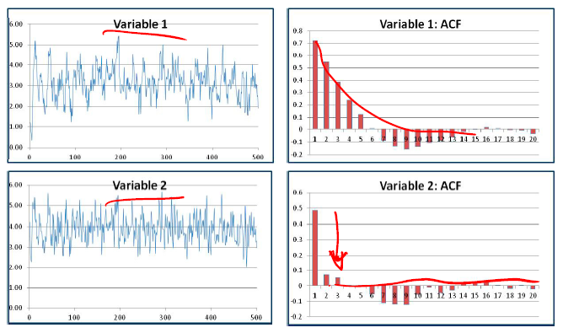


avtokorelaciuri funqciis grafiki
$$AR\left(1\right)$$
$$MA\left(1\right)$$

Slide 12
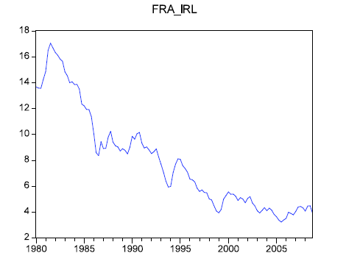
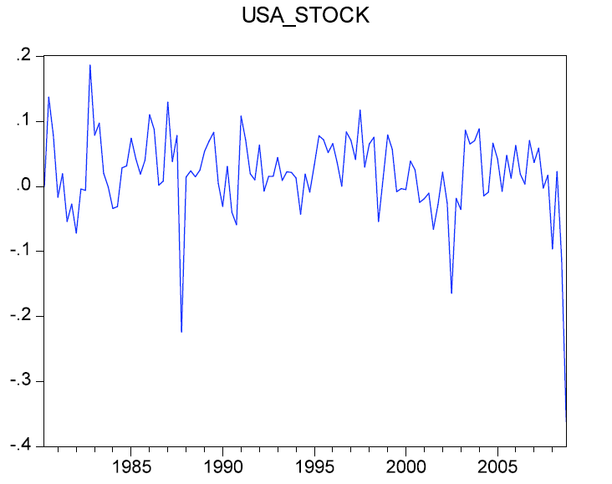
magaliTi
safrangeTis grZelvadiani saprocento ganakveTi 1980-2005 wlebi
aSS-s safondo indeqsi 1980-2005

Slide 13
