Slide 1

R-ladies Tbilisi meet-up
Topic: Machine learning with R
Presenter: Nino MELITAURI
e-mail: tbilisi@rladies.org

Slide 2
Machine learning
is a field of computer science that gives computer systems the ability to "learn“ with data.
The name comes from 1959, by Arthur Samuel.
There are a lot of machine learning algorithms, today we discuss decision tree and random forest

Slide 3
Objectives
What Is a Decision Tree.
How Do Decision Trees Work.
What is the Random Forest algorithm?
How does it work?
What is the difference between Bagging and Random Forest?

Slide 4
Decision Tree
A decision tree partitions the data into subsets.
The goal of a decision tree is to encapsulate the training data in the smallest possible tree.
There are several steps involved in the building of a decision tree: Splitting, Pruning, Tree Selection.
A decision tree is overfitted if it gives highly accurate output on training data, but low accurate output on test data.

Slide 5
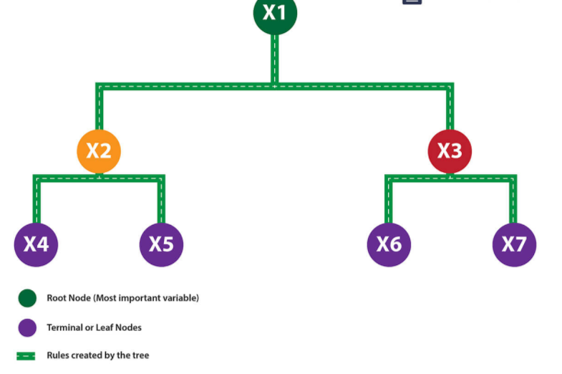
Decision Tree

Slide 6
pruning strategies
Minimum error. The tree is pruned back to the point where the cross-validated error is a minimum. Cross-validation is the process of building a tree with most of the data and then using the remaining part of the data to test the accuracy of the tree.
Smallest tree. The tree is pruned back slightly further than the minimum error. Technically the pruning creates a tree with cross-validation error within 1 standard error of the minimum error. The smaller tree is more intelligible at the cost of a small increase in error.

Slide 7
Decision Tree
Decision trees can be used either for classification, for example, to determine the category for an observation, or for prediction, for example, to estimate the numeric value. Using a decision tree for classification is an alternative methodology to logistic regression. Using a decision tree for prediction is an alternative method to linear regression.

Slide 8
Random forest
Random forest is a tree-based algorithm which involves building several trees (decision trees), then combining their output to improve generalization ability of the model. The method of combining trees is known as an ensemble method. Ensembling is nothing but a combination of weak learners (individual trees) to produce a strong learner.

Slide 9
How does Random forest work?
uses the Bagging (Bootstrap Aggregating) algorithm to create random samples.
About 1/3 of the rows from initial data are left out, known as Out of Bag(OOB) samples.
OOB sample is used to determine unbiased estimate of the error.
Unlike a tree, no pruning takes place in random forest; i.e., each tree is grown fully. In decision trees, pruning is a method to avoid overfitting. Pruning means selecting a subtree that leads to the lowest test error rate.

Slide 10
What is the difference between Bagging and Random Forest?
They create randomized samples of the data set (just like random forest) and grows trees on a different sample of the original data. The remaining 1/3 of the sample is used to estimate unbiased OOB error.
They consider the features at a node (for splitting).
Once the trees are fully grown, they uses averaging or voting to combine the resultant predictions.
In Random Forest, only a subset of features are selected at random at each split in a decision tree. In bagging, all features are used.

Slide 11
Could you answer the following questions please?
What Is a Decision Tree.
How Do Decision Trees Work.
What is the Random Forest algorithm?
How does it work?
What is the difference between Bagging and Random Forest?

