Slide 1
Retrieving Twitter Data with rtweet / Identifying Anti-Vaccination Communities
Alexandra Stephens

Slide 2

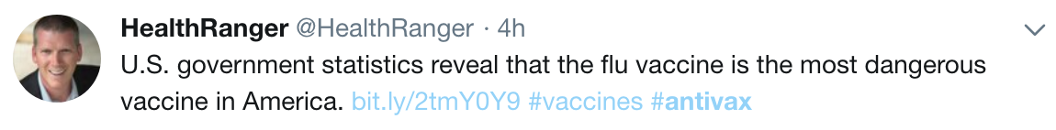
Case Study Goal
Classify tweets as “anti” or “pro” vaccination

Slide 3
Retrieving and Visualizing Data

Slide 4
Set up access
Create a Twitter account
Apply for a Twitter developer account
Create an App

Slide 5
Set up access
Create a Twitter account
Apply for a Twitter developer account
Create an App
install.packages("rtweet") library(rtweet) twitter_token <- create_token( app = "twitter_app_name", consumer_key = "XXXXXXXXXXXXXXX", consumer_secret = "XXXXXXXXXXXXXXXXXXXXX", access_token = "XXXXXXXXXXXXXXXXXXXXXXXXXXX", access_secret = "XXXXXXXXXXXXXXXXX")

Slide 6
Search tweets
Notes:
“create_token() automatically saves your token as an environment variable”
“Every user should have their own Oauth (Twitter API) token. By default token = NULL this function looks for the path to a saved Twitter token via environment variables (which is what create_token() sets up by default during initial token creation). For instruction on how to create a Twitter token see the tokens vignette, i.e., vignettes("auth", "rtweet") or see ?tokens.”

Slide 7
Search tweets
Limit is 18,000 every 15 minutes
Add retryonratelimit = TRUE
When rate limit resets, continues searching
st <- search_tweets('#antivax OR vaccines OR #vaccineswork', n = 18000, type = "recent", include_rts = TRUE, lang = "en")
Notes:
“create_token() automatically saves your token as an environment variable”
“Every user should have their own Oauth (Twitter API) token. By default token = NULL this function looks for the path to a saved Twitter token via environment variables (which is what create_token() sets up by default during initial token creation). For instruction on how to create a Twitter token see the tokens vignette, i.e., vignettes("auth", "rtweet") or see ?tokens.”

Slide 8
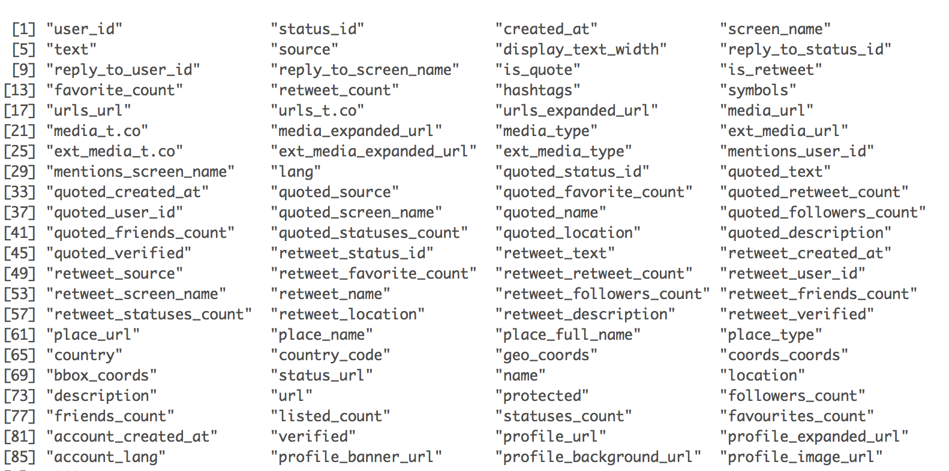

Slide 9

Important Columns
[1] text
[2] created_at
[3] screen_name
[4] user_id
[5] retweet_user_id
[6] location

Slide 10
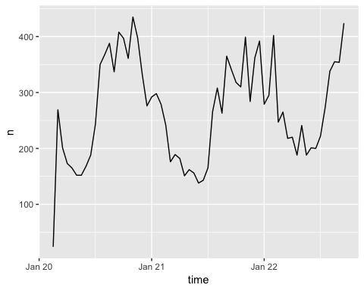
Visualize frequency
ts_plot(st, "hours")

Slide 11
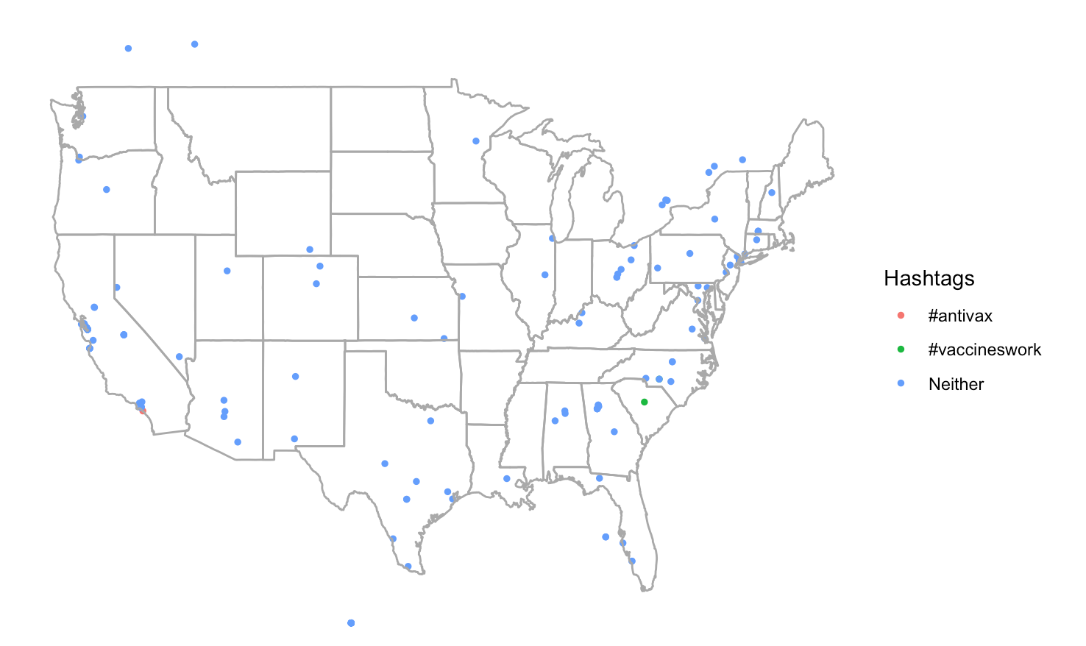
Create map of twitter data

Slide 12
Create map of twitter data
library(ggplot2)
library(ggmap)
rt <- search_tweets('#antivax OR vaccines OR #vaccineswork', geocode = lookup_coords("usa"), n = 8000, lang = "en")
states <- map_data("state")
ggplot(data = states) + geom_point(data = rt, aes(x = lng, y = lat, colour = Hashtags), size = 1) + geom_polygon(aes(x = long, y = lat, group=group), fill = NA,
color = "dark grey") + theme_void()
Need Google API Key

Slide 13
Create map of twitter data
sum(is.na(rt$lat) == FALSE)/
dim(rt)[1]*100
## [1] 1.898177

Slide 14
Friends and Followers
I selected “seed” users that are reliably for or against vaccination
User IDs only are returned
who_flwrs <- get_followers("WHO", n = 50000) hr_flwrs <- get_followers("HealthRanger", n = 50000) who_flwing <- get_friends("WHO") hr_flwing <- get_friends("HealthRanger")
Notes:
The number of friends is limited by twitter to 5000 Followers is unlimited

Slide 15
Extras
Get last 500 tweets World Health Organization has favorited
Returns same columns as search_twitter
Search users who’s bios contain string
who_favs <- get_favorites("WHO", n = 500)
p_users<- search_users("political party", n = 1000)

Slide 16
Cleaning Twitter Text

Slide 17
What does the text look like?
head(st$text,4)
## [1] "Triplets all become autistic within hours of vaccination… https://t.co/uciuQaTJo2 #vaccines #antivax #autism" ## [2] "@JestDempsey @hezzie7 For how much vaccines are pushed (as they should be) you would think healthcare professionals would be encouraged to go above and beyond to ensure babies are vaccinated. My recommendation is to start calling health clinics everywhere because it takes forever to get into RD." ## [3] "Meridian has been nominated to win a 2018/2019 Vaccine Industry Excellence (ViE) Award for Best Clinical Site or Network! Vote now at: https://t.co/r3AM3V6kHN You can learn more about Meridian’s vaccine experience at https://t.co/lcYsNoHCF5 #vaccines #clinicalresearch #wvcusa https://t.co/jJedd0Brki" ## [4] "Hey, @CDCgov , Pharma ... if you want people to accept vaccinations, take responsibility for the injuries and deaths and fix your damned vaccines. Your denialist program is failing. What will you do when Congress is filled with people who have injured loved ones?"

Slide 18
Remove Unwanted Text
library(stringr)
pat <- c("[\r\n]|&amp.|@.*?\\S+|@.*?$|^RT |https?:.\\S+|https?:.*$")
st$text <- st$text %>% str_replace_all(pattern = pat, "") st$retweet_text <- st$retweet_text %>% str_replace_all(pattern = pat, "") head(st$text,4)
Notes:
\S: Most engines "whitespace character": space, tab, newline, carriage return, vertical tab

Slide 19
Remove Unwanted Text
## [1] "Triplets all become autistic within hours of vaccination… #vaccines #antivax #autism”
## [2] " For how much vaccines are pushed (as they should be) you would think healthcare professionals would be encouraged to go above and beyond to ensure babies are vaccinated. My recommendation is to start calling health clinics everywhere because it takes forever to get into RD.”
## [3] "Meridian has been nominated to win a 2018/2019 Vaccine Industry Excellence (ViE) Award for Best Clinical Site or Network! Vote now at: You can learn more about Meridian’s vaccine experience at #vaccines #clinicalresearch #wvcusa ”
## [4] "Hey, , Pharma ... if you want people to accept vaccinations, take responsibility for the injuries and deaths and fix your damned vaccines. Your denialist program is failing. What will you do when Congress is filled with people who have injured loved ones?"

Slide 20
Exploratory Analysis

Slide 21
What can you do with this data?
Natural language processing
Analyze sentiment
Social network analysis
Community detection

Slide 22
The TidyText Format
library(tidytext) library(dplyr) text_df <- st %>% select("text") text_df$int <- c(1:length(text_df$text)) text_df <- text_df %>% unnest_tokens(word, text)
## int word ## 2 2 for ## 2.1 2 how ## 2.2 2 much ## 2.3 2 vaccines ## 2.4 2 are ## 2.5 2 pushed ## 2.6 2 as ## 2.7 2 they ## 2.8 2 should ## 2.9 2 be

Slide 23
Removing Stop Words & Word Stemming
## int word ## 2 2 for ## 2.1 2 how ## 2.2 2 much ## 2.3 2 vaccines ## 2.4 2 are ## 2.5 2 pushed ## 2.6 2 as ## 2.7 2 they ## 2.8 2 should ## 2.9 2 be
## int word ## 8 2 vaccin ## 9 2 push ## 10 2 healthcar ## 11 2 profession ## 12 2 encourag ## 13 2 ensur ## 14 2 babi ## 15 2 vaccin ## 16 2 recommend ## 17 2 start

Slide 24
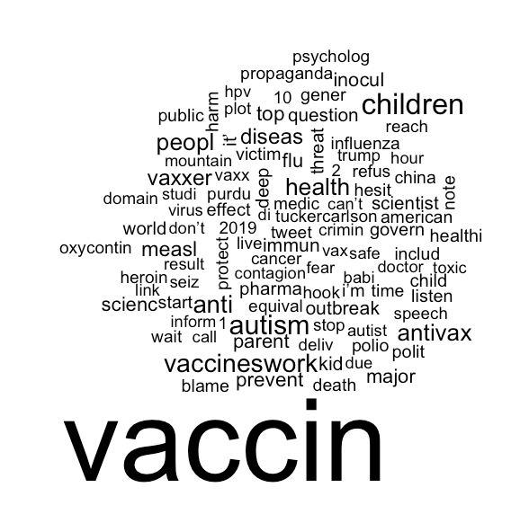
Word Clouds

Slide 25
Word Clouds
library(SnowballC)
library(wordcloud) text_df <- text_df %>% mutate(word = wordStem(word)) data(stop_words) text_df %>% anti_join(stop_words) %>% count(word) %>% with(wordcloud(word, n, max.words = 100))

Slide 26
Sentiment
head(sentiments)
## # A tibble: 6 x 4 ## word sentiment lexicon score ## <chr> <chr> <chr> <int> ## 1 abacus trust nrc NA ## 2 abandon fear nrc NA ## 3 abandon negative nrc NA ## 4 abandon sadness nrc NA ## 5 abandoned anger nrc NA ## 6 abandoned fear nrc NA

Slide 27
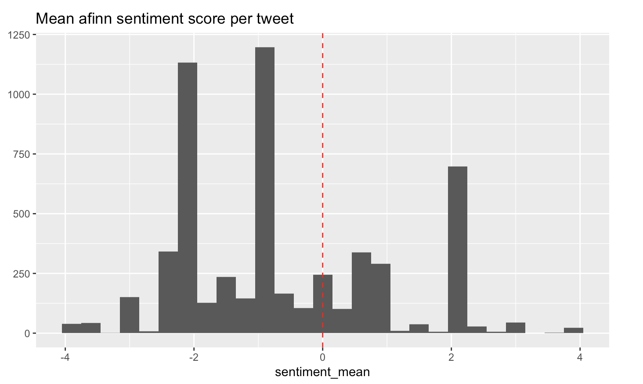
Sentiment

Slide 28
Social Network Community Detection
Nodes: unique users and tweets
Edges:
Between users and tweets they tweeted or retweeted
Between seed users, their friends and followers

Slide 29
Questions?

Slide 30
What would you like to do with Twitter data?

Slide 31
Links
This Study Github
My personal Github
LinkedIn
Contact: Astephens35@gmail.com
Twitter: @AlexStephens35

Slide 32
Citations
D. Kahle and H. Wickham. ggmap: Spatial Visualization with ggplot2. The R Journal, 5(1), 144-161. URL http://journal.r-project.org/archive/2013-1/kahle-wickham.pdf

