Slide 1
Introduction to R Shiny
Lisa Moller
Notes:
Welcome!
My name
Who has had any experience with Shiny/who has made an app?

Slide 2
What Are We Going to Cover?
WHY make a shiny app?
Basics of Shiny through making a simple app with two files
- install.packages(“shiny”)
- install.packages(“shinyWidgets”)
A small bit on reactive programming
And any other questions/ideas you have
Make an app with your data??
Notes:
I would love it if people follow along, stop me if something doesn’t make sense.
If you do want to follow along, make sure “shiny” and “shinyWidgets” are installed

Slide 3
WHY Shiny?
It’s fun!!!
It’s interactive, and powerful tool to convey information
With a little bit of R knowledge, you can get it running pretty quickly.
It’s free*
It’s reproducible
*of course there are always ways to pay
Notes:
I know I don’t really have to sell you all, since you’re here, but it’s something I’ve come across at work.
As companies are becoming more data-focused, it’s a good way to sell your skills.
There are plenty of other ways to show your work – Excel, PowerBI, Tableau, so why Shiny?

Slide 4

Let’s Do This!!
Notes:
We will start with opening a new app and looking at that for structure.

Slide 5
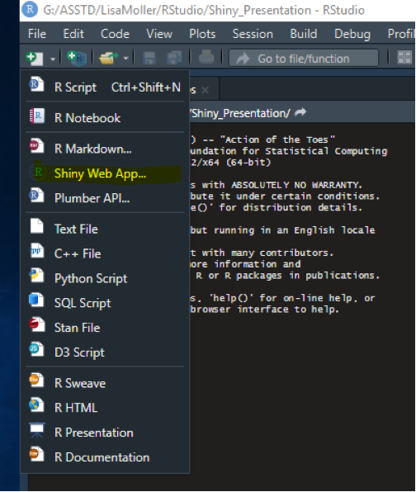
Create a New Shiny Web App
Notes:
In the top left corner under File, select the New button and then Shiny Web App
(I open my own new shiny app)
Name your app
Single or Multiple?
a. We’ll use Multiple
b. Single works if it’s a fairly simple app
3. Decide where you want to save the app
4. Select Create

Slide 6
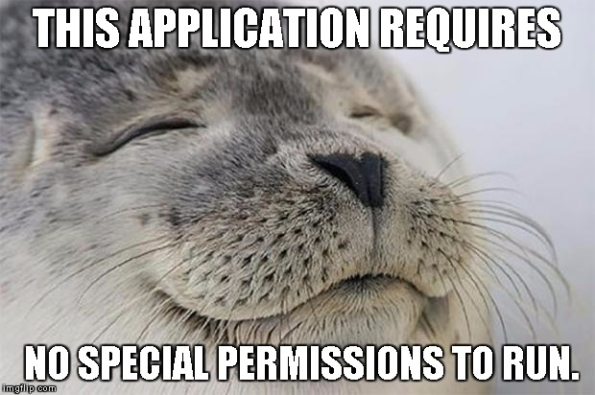
Notes:
Run your new app!
Top right of either the UI or Server file.

Slide 7
So that’s it!
That’s all there is to it!
Just kidding…..

Slide 8
So How Does the App Work?
Reactive Programming
Shiny apps have two parts – the UI and the Server
- UI – controls what the users sees and interacts with
- Server – controls the information presented
Notes:
We split our two parts into two files. If we created our app in one file, the UI and Server would be two parts of the same file.
These two files work together to allow the user to make a change to the app, say slide the slider, and the data output shown in the app changes as well.
Let’s take a closer look at the two files….

Slide 9
UI File
For our layout, we have…
- titlePanel()
- sidebarLayout()
- sidebarPanel()
- mainPanel()
These control the three main parts of our app.
Notes:
As an initial caveat, there are many different ways to structure your app. We’ll use our example app structure so you get a general idea. I have a list of resources at the end to share on where to look for other layouts.
Three parts: title, side, main.

Slide 10
Server File
Contains a function that will hold all the contents of our app
Inside the function, you can see an output statement, output$distPlot
You’ll have an output statement for each plot/table/etc.

Slide 11
But How Does it Really WORK? Step 1 of 4
1. In the UI file, the sliderInput, "bins", changes when the user makes a change.
Notes:
As I said earlier, the files work together. They use "inputs" and "outputs" to communicate.

Slide 12

But How Does it Really WORK? Step 2 of 4
2. The Server files "watches" for any changes in the UI input with input$bins.

Slide 13
But How Does it Really WORK? Step 3 of 4
3. The Server then changes output$distPlot.

Slide 14
But How Does it Really WORK? Step 4 of 4
4. And the updated output shows on the UI with plotOutput("distPlot")

Slide 15
Said in a Different Way…

Slide 16
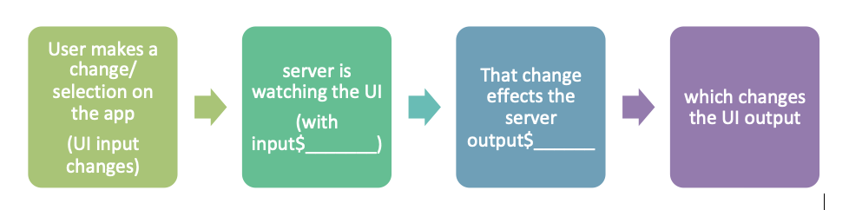
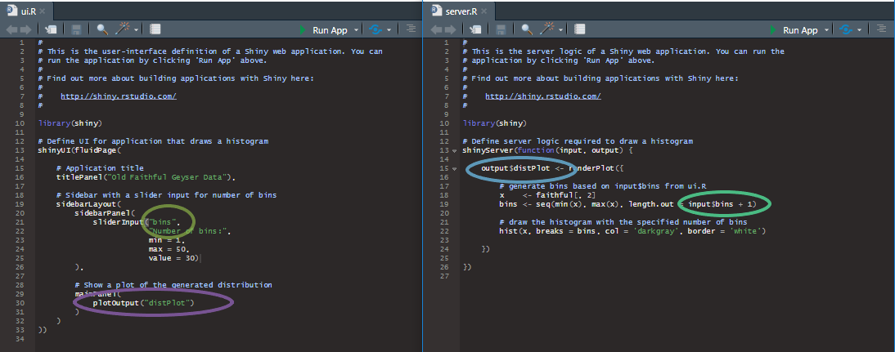

Slide 17
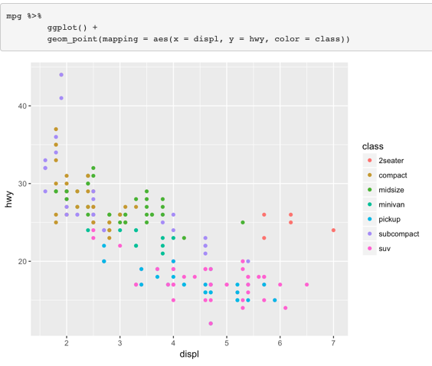
Now to Make Our Own App
Notes:
Say we wanted to make the plot below with the ability to select the class of car? (example from R for Data Science by Garrett Grolemund and Hadley Wickham)
Open github in “no_file” folder.

Slide 18
Updates… (for code, open https://github.com/Lmoller/how_to_make_your_first_shiny_app/blob/master/no_file/ui.R)
UI file
- add library(ggplot2), library(dplyr) and library(shinyWidgets)
- change the title of the app in the titlePanel.
- remove the sliderInput section and replace it with pickerInput
- change the variable in plotOutput to mpgPlot.
2. Server file
- add the reactive expression
- replace code for the plot
- change the name of distPlot to mpgPlot
Notes:
After changes, double check…
UI file, we have the inputId in the pickerInput.
Check the Server file for the input. It's in our reactive expression. That input adjusts the dataset that is used in the plot.
Server: plot output, mpgPlot, adjusts with our changes.
UI: plotOutput.
Let's run the app!

Slide 19
Resources
Mastering Shiny by Hadley Wickham: https://mastering-shiny.org/
RStudio Resources!
- https://shiny.rstudio.com/gallery/
- https://shiny.rstudio.com/articles/app-formats.html
- https://shiny.rstudio.com/articles/basics.html (a great intro to reactive programming)
- https://shiny.rstudio.com/tutorial/
Shiny Dashboard as a Package: https://www.r-bloggers.com/best-practice-development-of-robust-shiny-dashboards-as-r-packages/
Functions Excel Users Love: https://www.r-bloggers.com/forget-about-excel-use-these-r-shiny-packages-instead/
Shiny cheatsheet: https://shiny.rstudio.com/images/shiny-cheatsheet.pdf

