Slide 1


Slide 2


Introduction to Shiny Application Development
Rise & Shiny by R-Ladies DC
October 7, 2017

Slide 3
Things We Need to Get Started
R
RStudio
shiny (package)

Slide 4
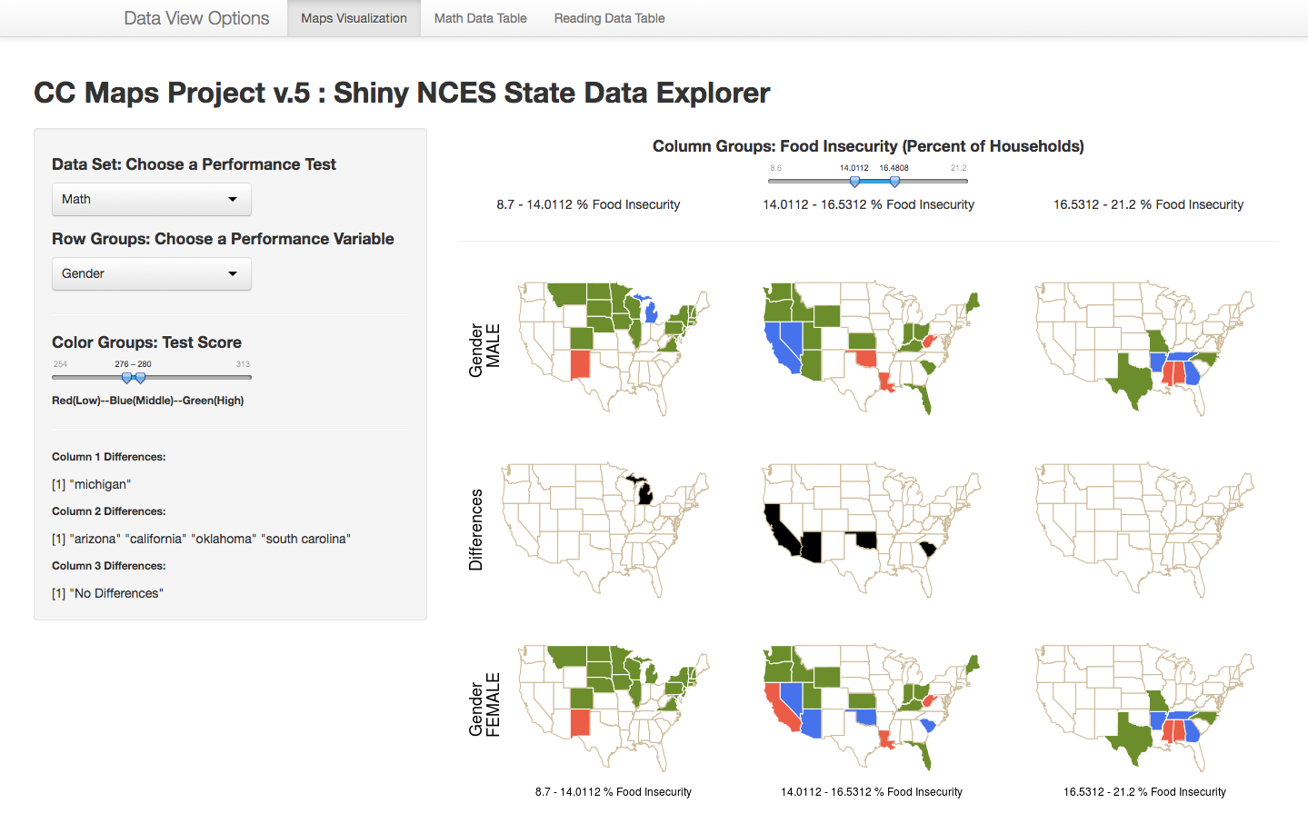

What is a Shiny App?
An Interactive Web Page
Computer or Web Server
Components:
User Interface (html) Web Document
Server Instructions (R Code)

Slide 5
What We’ll Do Today
Talk about App Architecture
Look at some examples of Shiny Apps
Walk through the “How to build a Shiny app” tutorial Article
Cover concepts like reactivity at a high level as we go
Discuss options for deploying Shiny Apps

Slide 6
Shiny App Architecture – “Use the Template”
library(shiny)
ui <- fluidPage()
server <- function(input, output) {}
shinyApp(ui=ui, server=server)
An Interactive Web Page
Components:
User Interface (html)
Server Instructions (R Code)

Slide 7
Learning Recommendation: Go Straight to the Examples!
CAVEAT: IT CAN BE OVERWHELMING
Fancy Stuff: Shiny User Showcase
Better Starting Point: Shiny Gallery

Slide 8
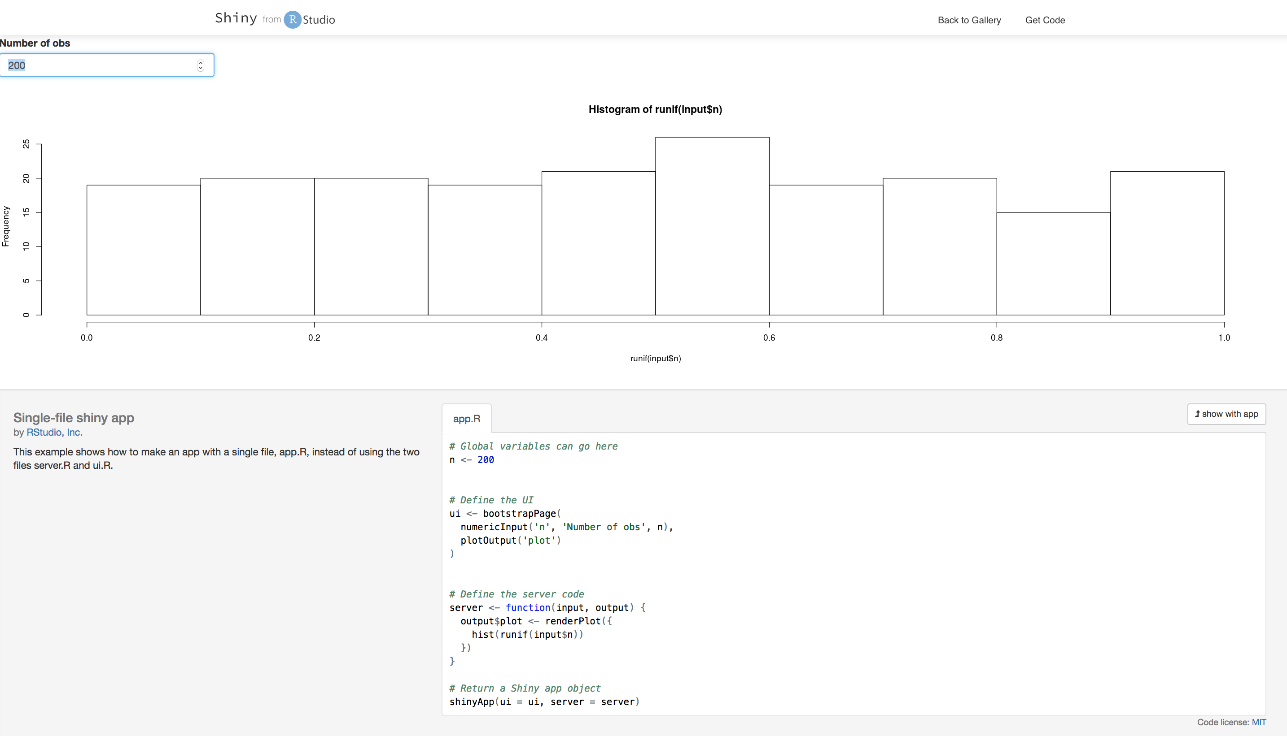
SINGLE-FILE SHINY APP FROM THE GALLERY

Slide 9
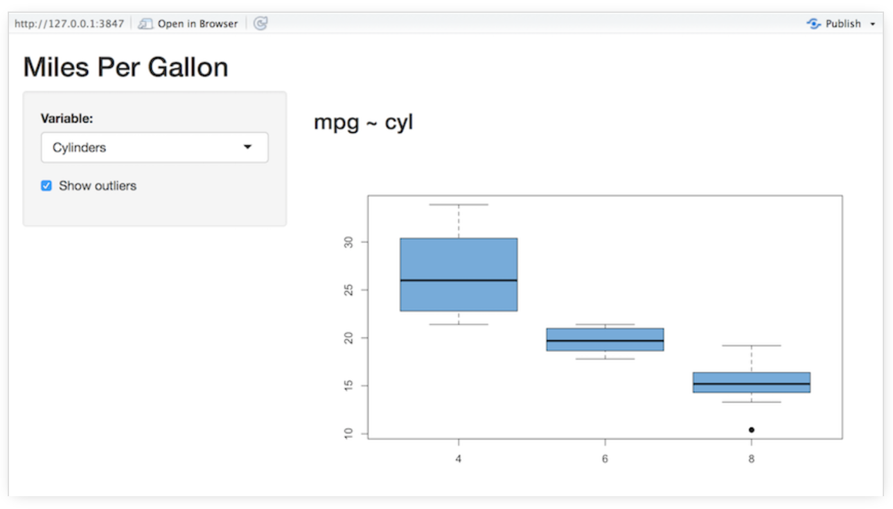
App Tutorial
How to build a Shiny app -- RStudio

Slide 10
How do you deploy Shiny Apps?
Choices!

Slide 11
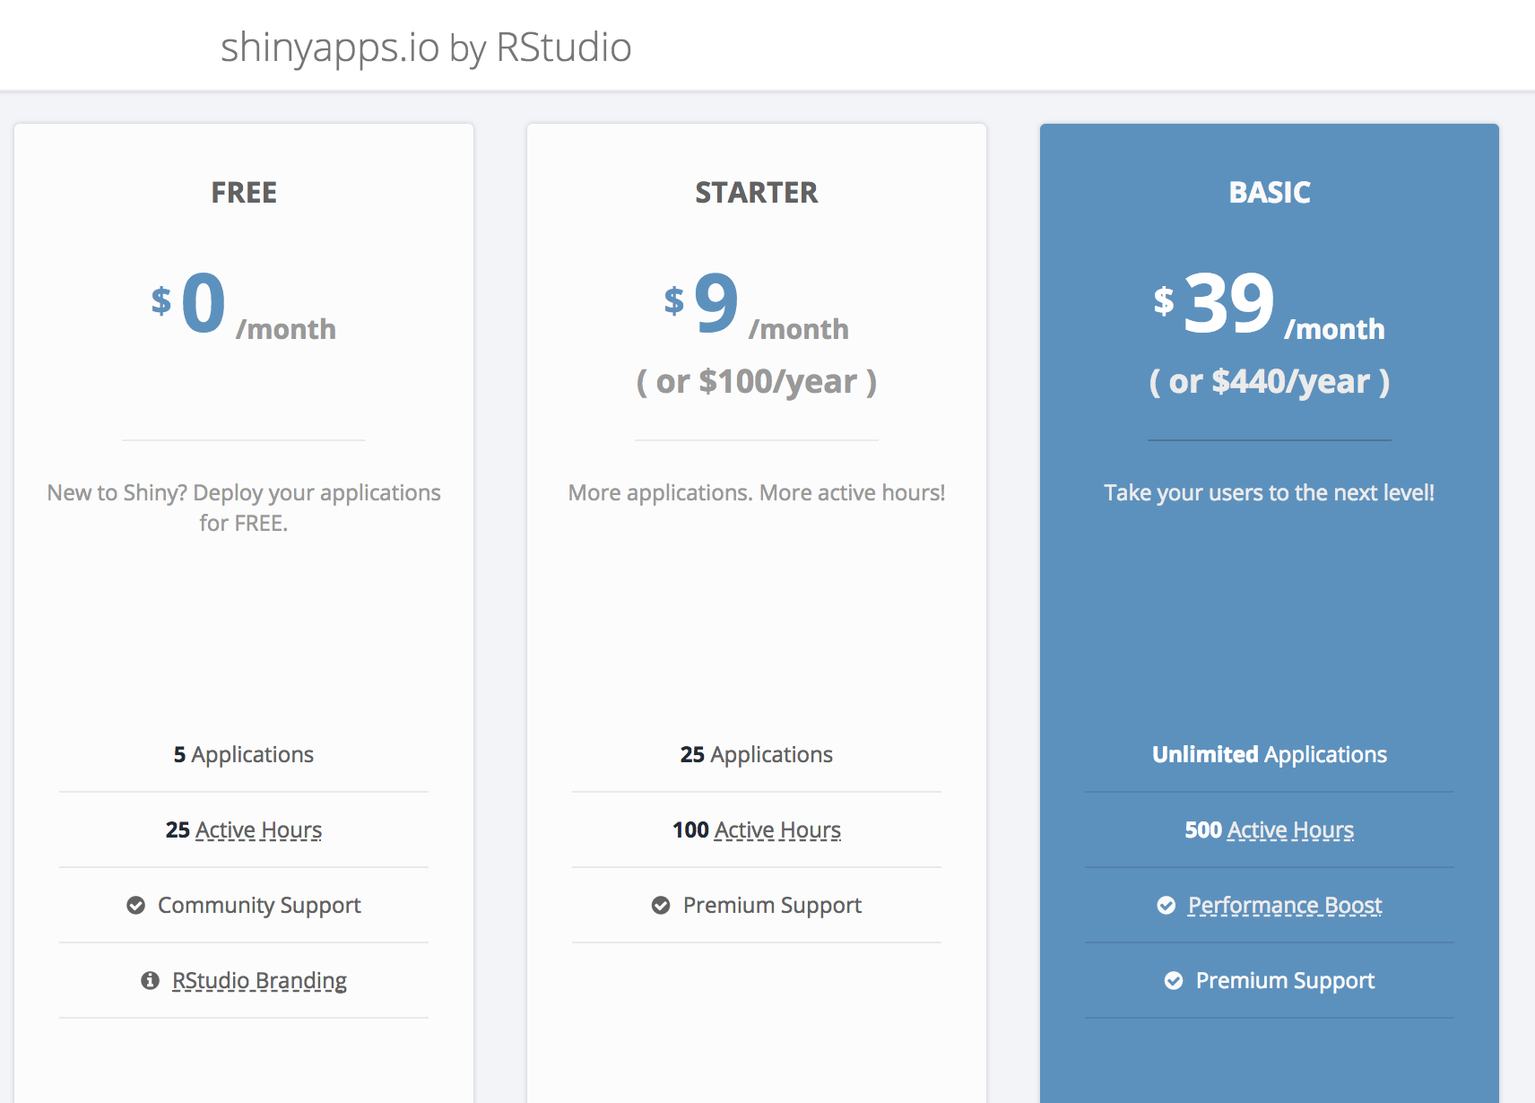
THIS IS AN OPTION…

Slide 13
Learning Recommendation: RStudio Shiny Resources
Three Part Video Tutorial by Garrett Grolemund (used heavily in the construction of this presentation)
RStudio Shiny Articles

Slide 14
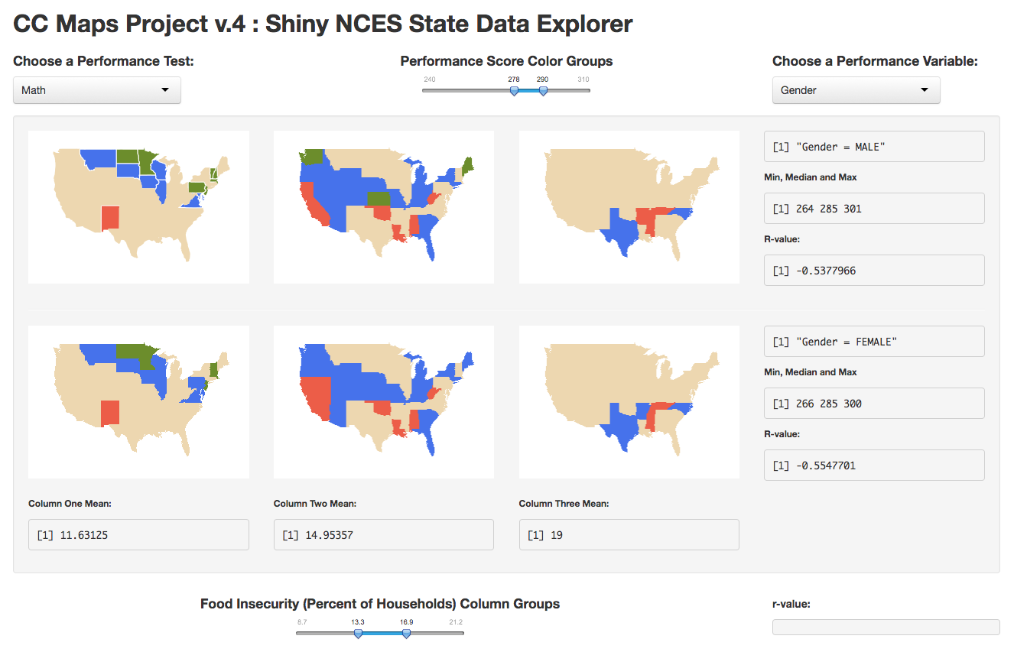
https://kellyo.shinyapps.io/ShinyNCES-food/

Slide 15
https://kellyo.shinyapps.io/facetCC/

Slide 16
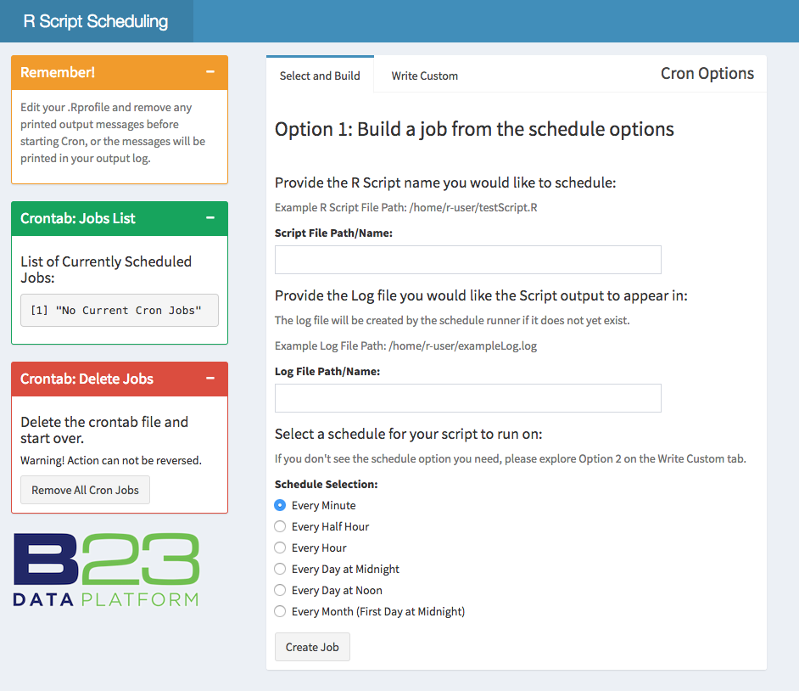
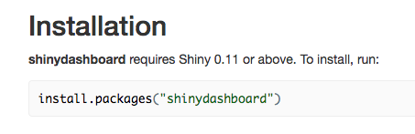
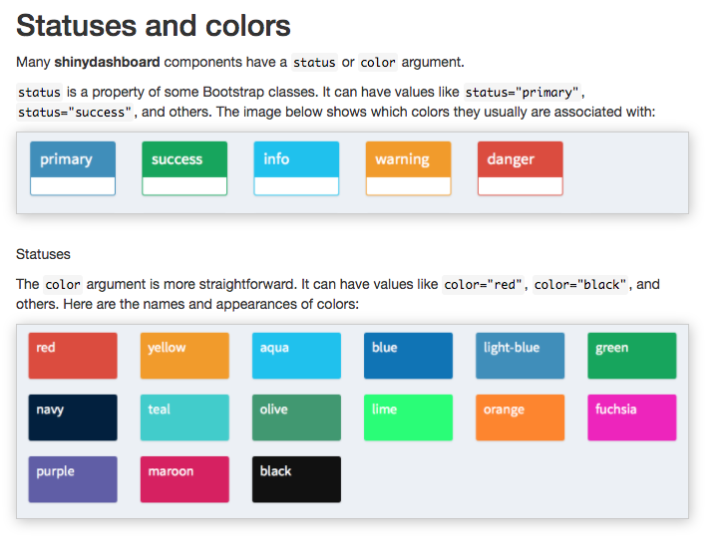
Cheat to Win with Shiny Dashboards!
https://rstudio.github.io/shinydashboard/

