Slide 1
Version Control: Git and GitHub in R
library(dplyr)
rladies_global %>%
filter(city == ‘East Lansing')

Slide 2
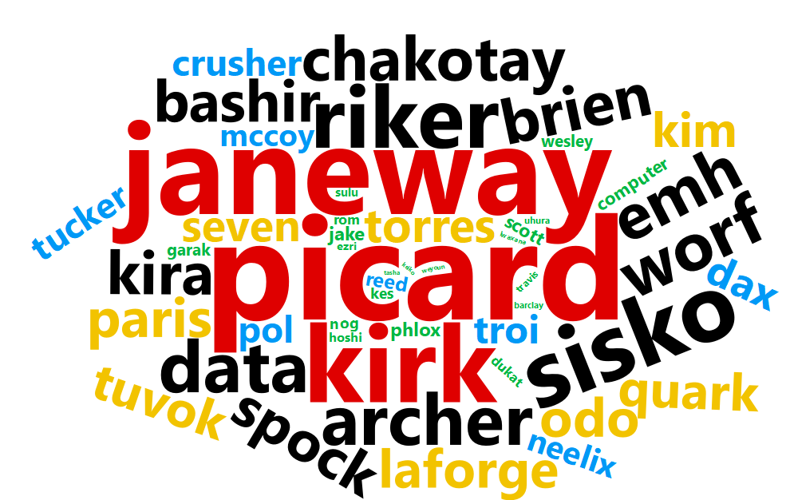

Slide 3
Why Version Control?

Slide 4

1.
Back up and Recovery
The curse of growing code and complexity
https://github.com/logos

Slide 5
2.
Collaboration
Keep everybody on the same page and track who made which changes
https://github.com/logos

Slide 6
3.
Portfolio
Show people (e.g. potential employers) you know your stuff
https://github.com/logos

Slide 7
Local (git) and Global (GitHub) important commands
Commit
Make a checkpoint
Push
Push commits on local machine to GitHub
Pull
Pull code from GitHub to Local machine
https://services.github.com/on-demand/downloads/github-git-cheat-sheet.pdf

Slide 8
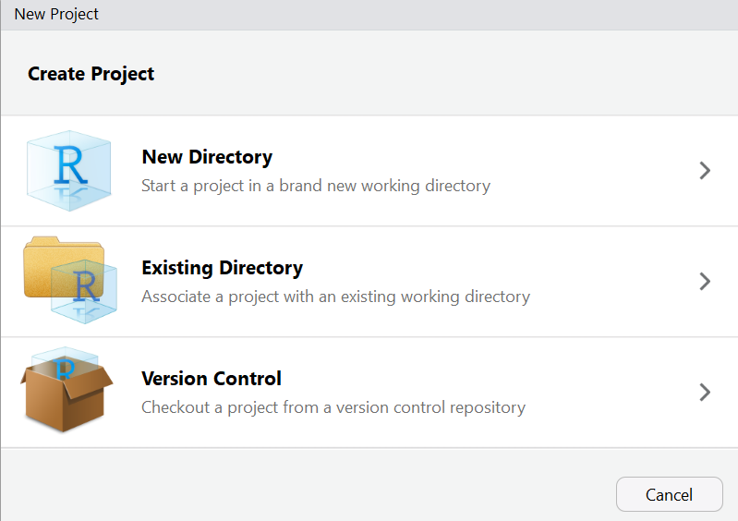
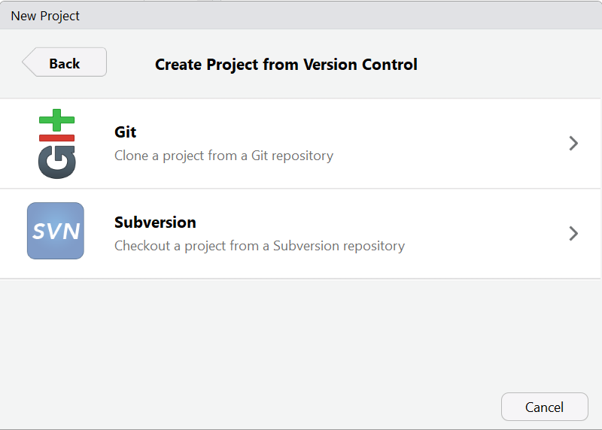
Git in R Studio
COLOR PALETTE
#562457

Slide 9
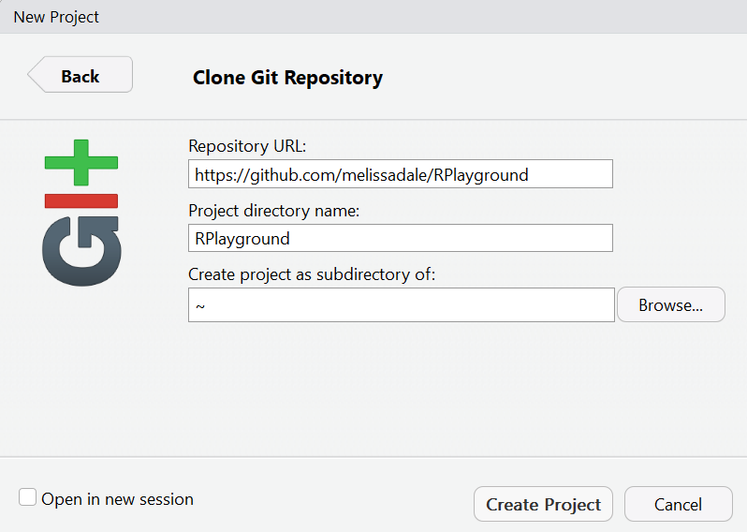
Git in R Studio

Slide 10
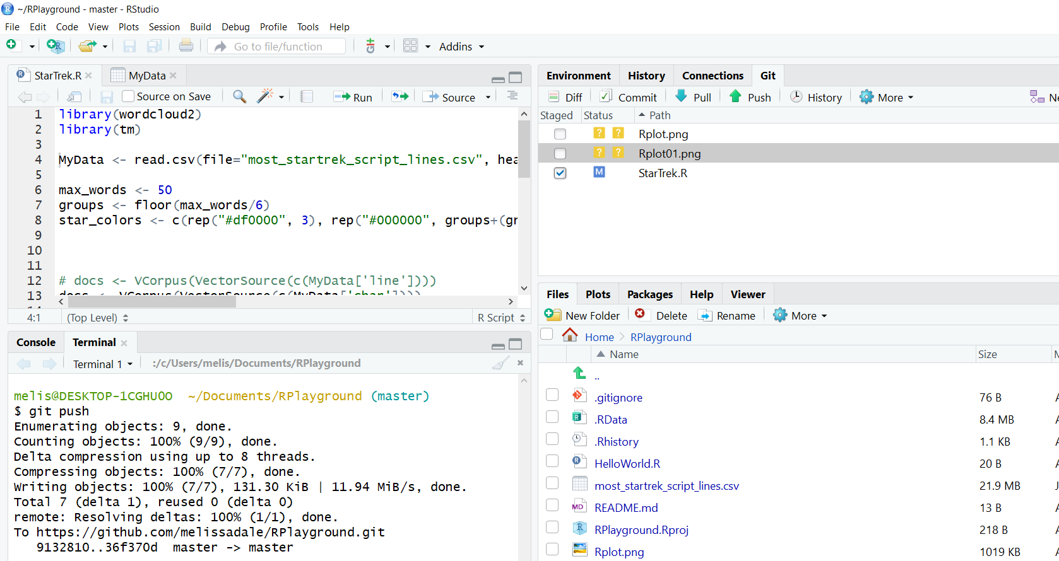
Git in R Studio

Slide 11
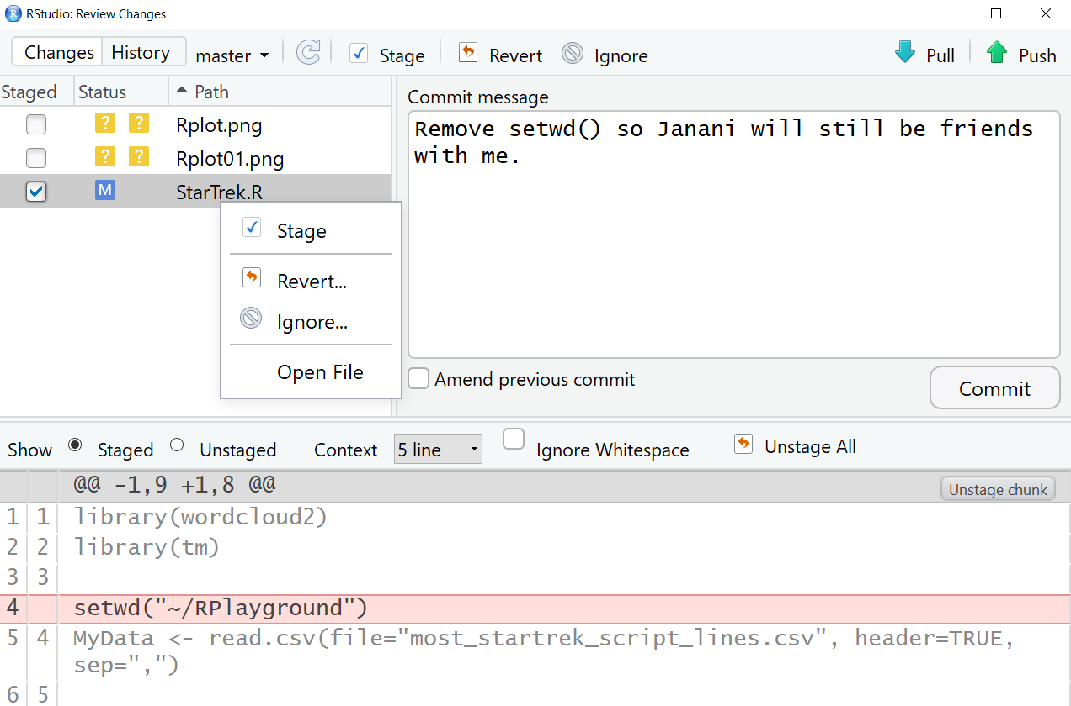
Git in R Studio

Slide 12
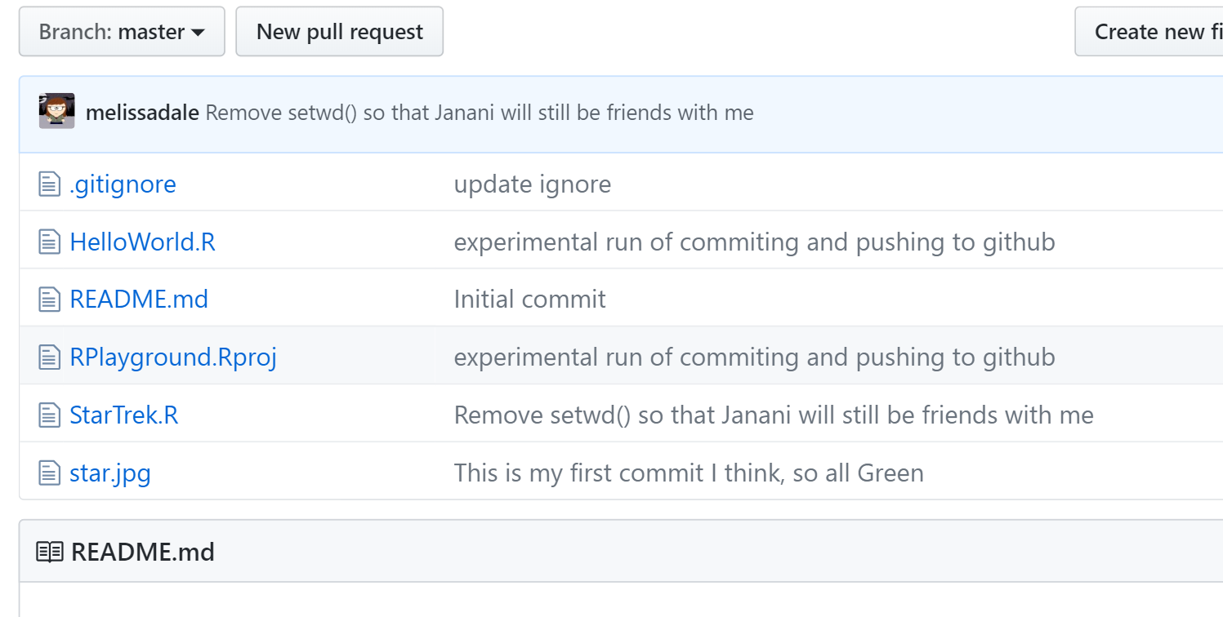
This is now on
GitHub

Slide 13
For everything, there is a first time”
—Spock
Wrath of Khan (1982)
Melissa.r.dale@gmail.com
https://github.com/melissadale/RPlayground
https://github.com/rladies-eastlansing/meetup-presentations-eastlansing.git

