Slide 1
The rocky road to building my first R package
Lucy Morgan

Slide 2
What you need
You need a clear view of what you want your package to do
Is it just for your own use?
How might other people use it?
What inputs will it need?
And so on…
TIP 1
Most people come to write their first package when they have some code they want to share and make available. This can make building your first package stressful… perhaps start with a toy package!

Slide 3
Things you actually need
There are two packages you’ll need to install to create a basic Rpackage
devtools
roxygen2
For installation use
install.packages(“devtools”)
devtools::install_github(“klutometis/roxygen”)
And to load use library(“Package Name”)

Slide 4
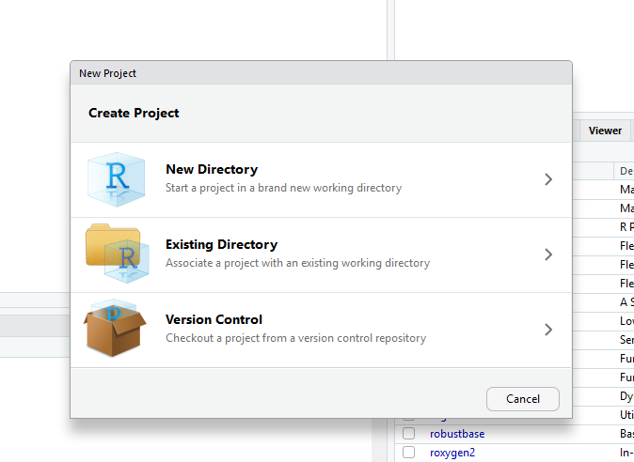
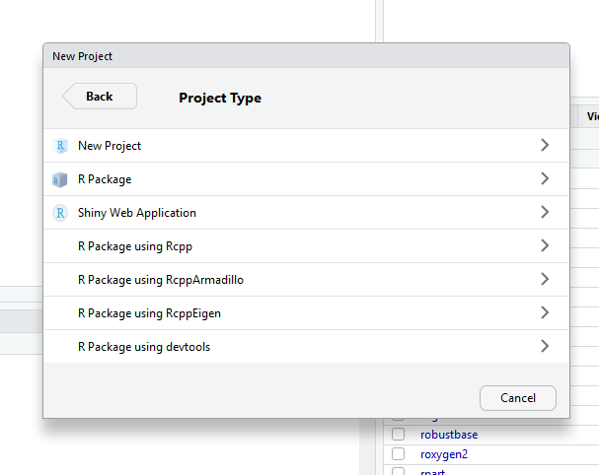
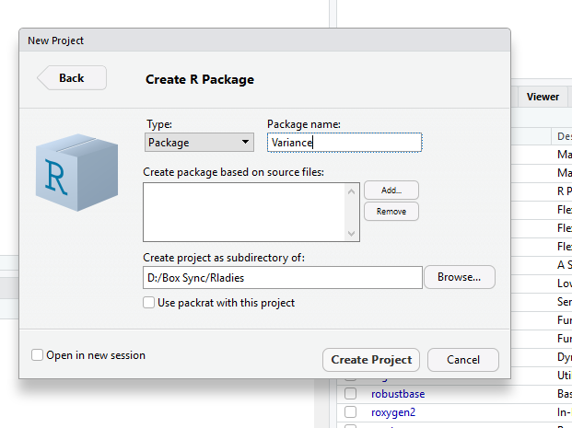
Create the package directory
File > New Project … > New Directory
R Package
Name your package and where you want to put it. The source files are the .R files that contain your code.
OR use package.skeleton(“newpackagename”)

Slide 5
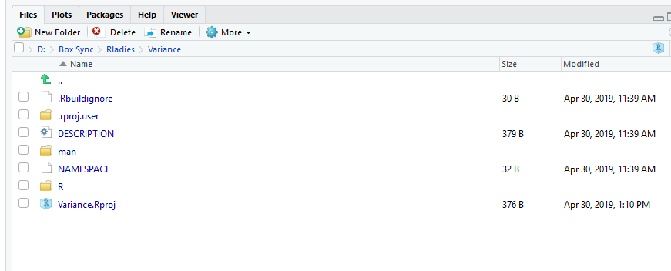
The package directory

Slide 6
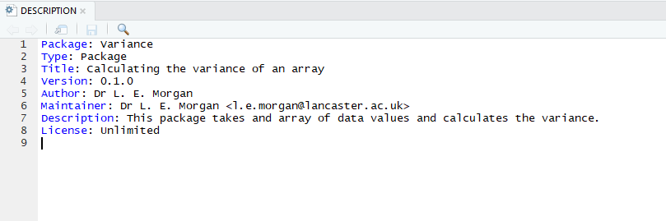
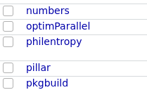
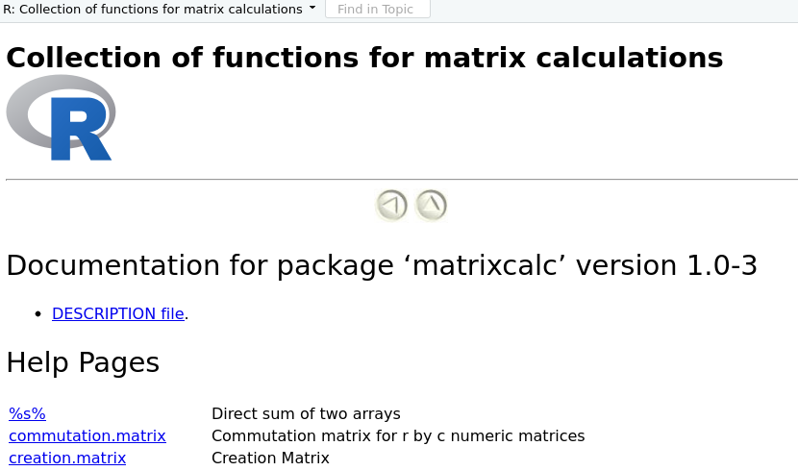
DESCRIPTION
The description file holds important information about the package for example the version, the maintainer and the license.
This DESCRIPTION file can be found by a user by clicking on the package name.
It is displayed on the main package page along with the package manuals, the version and package description.

Slide 7
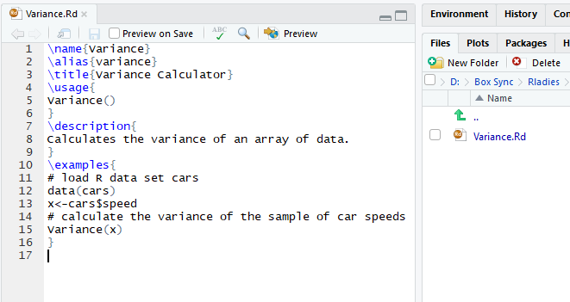
Manual
The manual contains information on the functionality of your package and also allows you to give example
TIP 2
Briefly filling in the package manual file before you start writing your code can help you plan what your code should do, and keep on track.

Slide 8
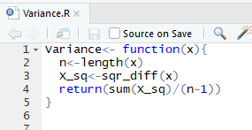
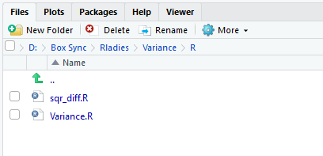
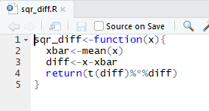
R
The R directory of the package is where all R code should be put.
TIP 3
Although this is a very simple function most functions are not and it helps to modularise your code into testable chunks.

Slide 9
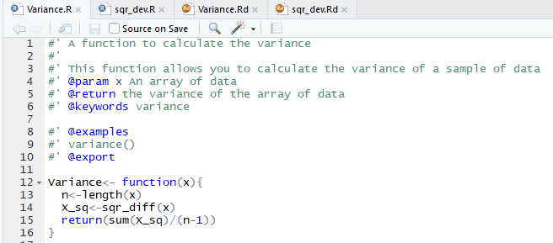
roxygen
https://kbroman.org/pkg_primer/pages/docs.html
Roxyen allows you to speed up your package building.
Speeds up manual building and builds the namespace file.
Using #’ tells R it is an roxygen comment
When you’ve added all your comments use the devtools function document() to build the namespace and manual files.
NOTE! Only use @export in files you want to be accessible to users

Slide 10
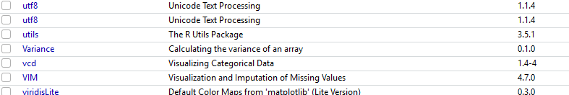
Install your package
Set your working directory to the file which contains your package folder – for me that is the folder that contains the folder “Variance”
Install(“Variance”)
Test your function/s -> Variance(c(1,2,3,4))
Check your manual/s -> ?Variance
For your package to appear in the package list you need to compile it
You can either use the build tool bar or ctrl+shift+b.

Slide 11
Helpful Resources
I am definitely a novice when it comes to building packages but simple packages can save you a lot of time. Here are some sources that helped me put my first package together
https://hilaryparker.com/2014/04/29/writing-an-r-package-from-scratch/ <- a blog post (very simple and straight to the point). Small functions can save you time
http://web.mit.edu/insong/www/pdf/rpackage_instructions.pdf <- detailed instructions
https://support.rstudio.com/hc/en-us/articles/200486488-Developing-Packages-with-RStudio <- R support pages

