Slide 1
Classification
library(caret)
rladies_global %>%
filter(city == ‘Leuven')

Slide 2
Classification
library(caret)
rladies_global %>%
filter(city == ‘Leuven')
R you ready?

Slide 3
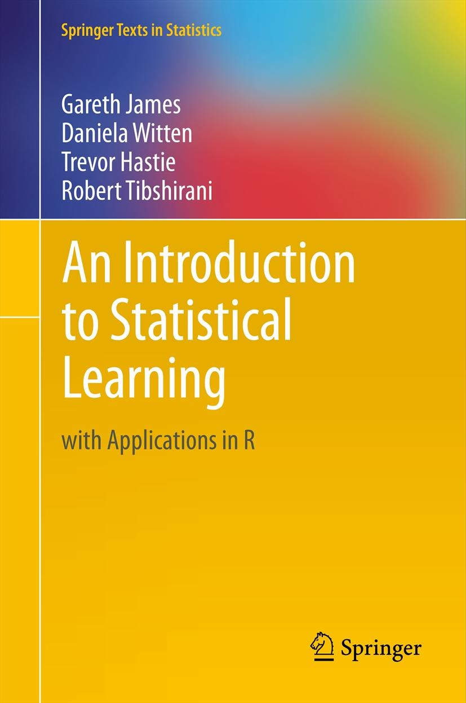
This book
is one of the best machine learning books out there.
It’s also free.
http://www-bcf.usc.edu/~gareth/ISL/ISLR%20First%20Printing.pdf

Slide 4
We have a labelled dataset.
Outcome A
Customer
Disease status
Water condition
Outcome B

Slide 5
We have a labelled dataset.
Outcome A
Customer
Disease status
Water condition
Outcome B
Can we predict whether a new data point is a circle or a triangle?

Slide 6
We have a labelled dataset.
Let’s see how these algorithms work.
Outcome A
Customer
Disease status
Water condition
Outcome B
Can we predict whether a new data point is a circle or a triangle?

Slide 7
K Nearest Neighbours

Slide 8
Labels are assigned to known datapoints.

Slide 9
Labels are assigned to known datapoints.
New point is placed within known space.

Slide 10
Labels are assigned to known datapoints.
New point is placed within known space.
Find K neighbours (here, K = 3).

Slide 11
Labels are assigned to known datapoints.
New point is placed within known space.
Find K neighbours (here, K = 3).
All neighbours are circles -> new point is a circle.

Slide 12
Logistic Regression

Slide 13

The logistic function returns probabilities between 1 and 0.
$$σ(t)=\frac{1}{1+ e^{−t}}$$

Slide 14
The logistic function returns probabilities between 1 and 0.
$$σ(t)=\frac{1}{1+ e^{−t}}$$
Probability that point is a circle
1
0
Combinations of factors

Slide 15
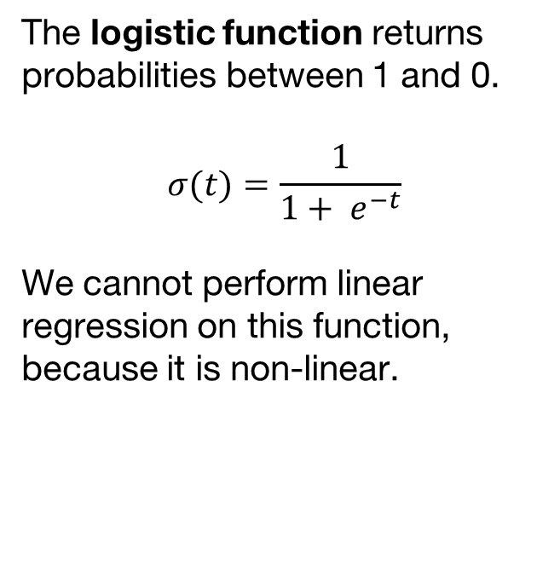
The logistic function returns probabilities between 1 and 0.
$$σ(t)=\frac{1}{1+ e^{−t}}$$
We cannot perform linear regression on this function, because it is non-linear.
Probability that point is a circle
1
0
Combinations of factors

Slide 16
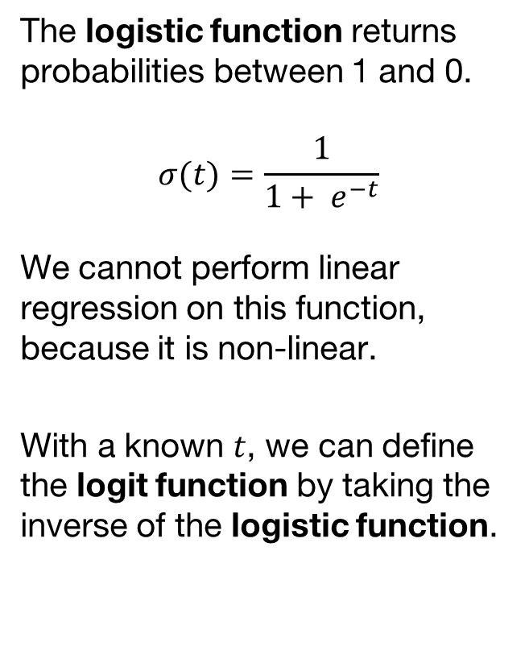
The logistic function returns probabilities between 1 and 0.
$$σ(t)=\frac{1}{1+ e^{−t}}$$
We cannot perform linear regression on this function, because it is non-linear.
With a known $t$, we can define the logit function by taking the inverse of the logistic function.
Probability that point is a circle
1
0
Combinations of factors

Slide 17
The logistic function returns probabilities between 1 and 0.
$$σ(t)=\frac{1}{1+ e^{−t}}$$
We cannot perform linear regression on this function, because it is non-linear.
With a known $t$, we can define the logit function by taking the inverse of the logistic function.
Probability that point is a circle
Log
Odds
Combinations of factors
The logit function is linear. Therefore, we can use linear regression to fit a model.

Slide 18
Random Forest

Slide 19
Random forests are like simple decision trees.
A decision tree finds the best way to split a dataset.

Slide 20
Random forests are like simple decision trees.
A decision tree finds the best way to split a dataset.
It looks through all predictors to find the one that has the smallest prediction error.
C > 5
C ≤ 5

Slide 21
Random forests are like simple decision trees.
A decision tree finds the best way to split a dataset.
It looks through all predictors to find the one that has the smallest prediction error.
Then, a new branch is generated.
C > 5
C ≤ 5
H > 5

Slide 22
Random forests are like simple decision trees.
A decision tree finds the best way to split a dataset.
It looks through all predictors to find the one that has the smallest prediction error.
Then, a new branch is generated.
This results in high sensitivity to noise and to overfitting.
C > 5
C ≤ 5
H > 5

Slide 23
Random forests are like simple decision trees.
A decision tree finds the best way to split a dataset.
It looks through all predictors to find the one that has the smallest prediction error.
Then, a new branch is generated.
This results in high sensitivity to noise and to overfitting.
C > 5
C ≤ 5
H > 5

Slide 24
Why use one tree when you can have a forest?

Slide 25
Random forests are made from multiple decision “stumps”.

Slide 26
Random forests are made from multiple decision “stumps”.
Each stump is given a training set randomly sampled with replacement from the original set.

Slide 27
Random forests are made from multiple decision “stumps”.
Each stump is given a training set randomly sampled with replacement from the original set. They use one predictor.
C > 5
C ≤ 5
F > 5
F ≤ 5
I ≤ 5
I > 5

Slide 28
Random forests are made from multiple decision “stumps”.
Each stump is given a training set randomly sampled with replacement from the original set. They use one predictor.
The random forest averages the predictions (regression) or takes the majority vote (classification).
C > 5
C ≤ 5
F > 5
F ≤ 5
I ≤ 5
I > 5

Slide 29

Classification
with caret
Data preparation
Model training
Model evaluation

Slide 30
Find a dataset
https://archive.ics.uci.edu/ml/datasets/Cervical+cancer+%28Risk+Factors%29
Cervical cancer (Risk Factors) Data Set
Fernandes, K., Cardoso, J. S., & Fernandes, J. (2017, June). Transfer learning with partial observability applied to cervical cancer screening. In Iberian conference on pattern recognition and image analysis (pp. 243-250). Springer, Cham.
library(datasets)
data(iris)

Slide 31
Model training
Replace ? with NA
Split up your data in a training and a test set
Train your model
read.csv
train
createDataPartition

Slide 32
Prevent overfitting!
Test error
Training error

Slide 33
Model testing
Test model
Evaluate predictions
Improve model
predict
kappa
trControl
confusionMatrix
LOOCV
Boot
cv

Slide 34
Unlabeled data Upclass RSSL

