Slide 1
R-Ladies Montréal
Introduction to R and RStudio
R-Ladies MTL February Meet Up
Tuesday, February 27th 2024 @ 18h
Location: Room 189 (floor 1), 550 rue Sherbrooke Ouest, Montreal, QC H3A 1B9
Join us to network and discuss:
How to get started in coding!
Basics of R and RStudio
How to import and manipulate data
Visualize datasets with ggplot2 R package
Room directions: From main floor, take the elevators to floor 1. Walk through the main glass doors and left through the open wood doors. Take the first left to get to room 189.
All levels welcome!
Note this session is geared towards new R users.

Slide 2
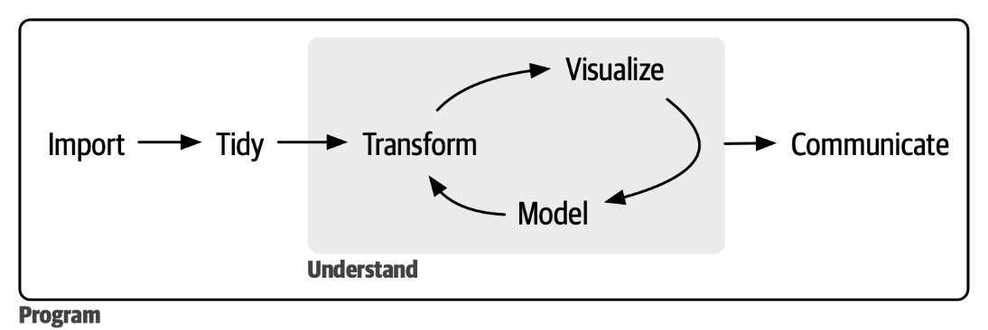
Data science process
Data “wrangling”

Slide 3
What is r?
R is a programming language for statistical computing and data visualization
Ross Ihaka and Robert Gentleman (1993)
GNU project licensed https://www.gnu.org/home.en.html
4 essential freedoms:
Freedom 0: run the program as you wish, for any purpose.
Freedom 1: study/change how the program works (access to the source code).
Freedom 2: redistribute copies to help others.
Freedom 3: distribute copies of your modified versions to benefit the community.

Slide 4
Getting started in rstudio
Comprehensive R Archive Network (CRAN) https://cran.r-project.org/
Network of identical servers with up-to-date R code and documentation
CRAN mirrors – the same but pick one that is closest to you!
Download:
R https://cran.r-project.org/
RStudio IDE by Posit https://posit.co/downloads/
R package repository
https://cran.r-project.org/web/packages/available_packages_by_date.html

Slide 5
Getting started in rstudio
Comprehensive R Archive Network (CRAN) https://cran.r-project.org/
Network of identical servers with up-to-date R code and documentation
CRAN mirrors – the same but pick one that is closest to you!
Download:
R https://cran.r-project.org/
RStudio IDE by Posit https://posit.co/downloads/
R package repository
https://cran.r-project.org/web/packages/available_packages_by_date.html

Slide 6
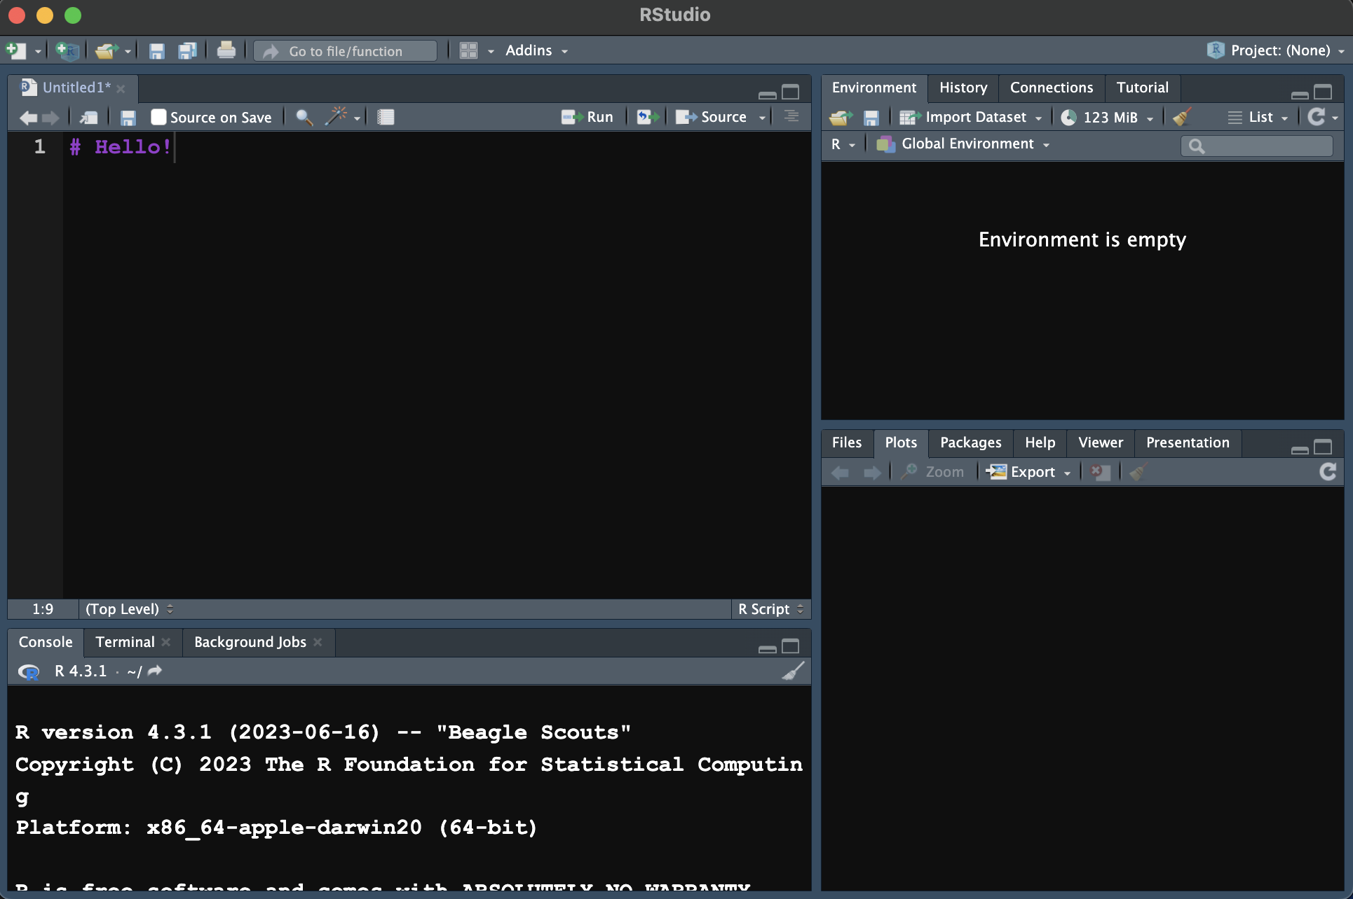
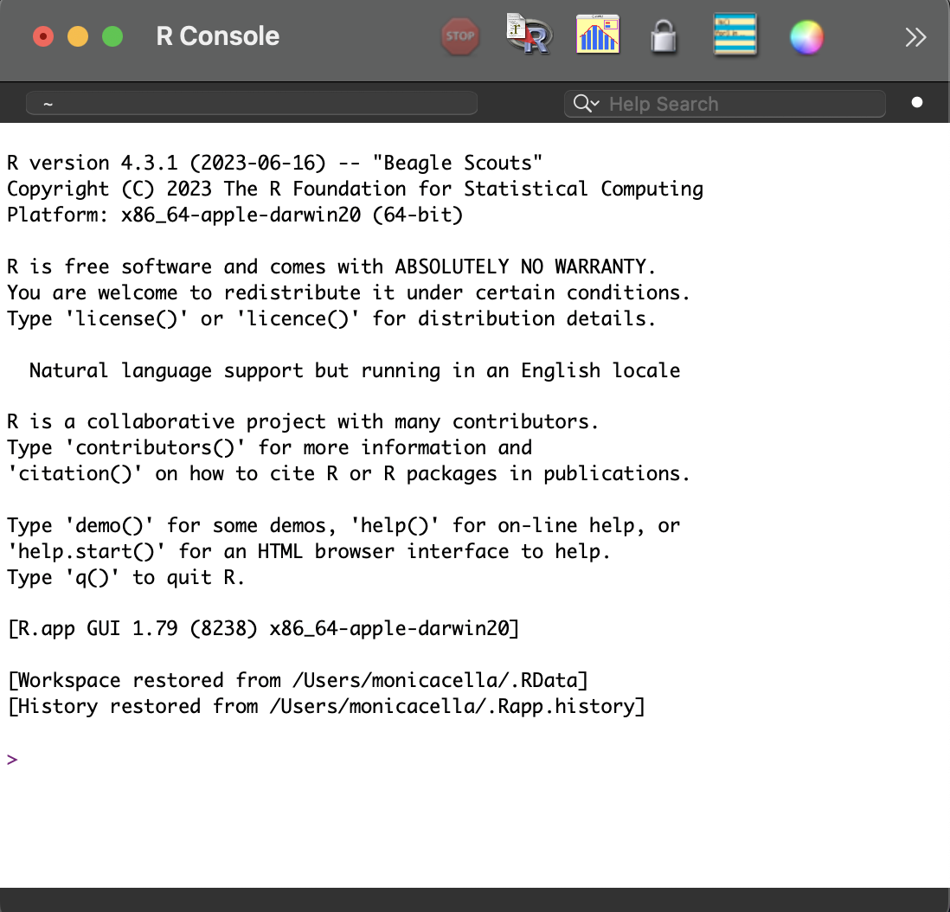
Getting started in rstudio
https://rstudio.github.io/cheatsheets/rstudio-ide.pdf

Slide 7


The very basics
When in doubt: CHECK THE INTERNET!
https://stackoverflow.com/
https://posit.co/resources/cheatsheets/
…and many others!
Built-in help in Rstudio:
?functionname
E.g. ?seq()
Base R: https://iqss.github.io/dss-workshops/R/Rintro/base-r-cheat-sheet.pdf

Slide 8
The very basics: Packages
Packages are the heart of R language.
Anyone can make them, improve them (“free”).
CRAN has ~21,000 packages available to download.
https://cran.r-project.org/
https://cran.r-project.org/web/packages/available_packages_by_name.html
ggplot2 is a very popular package!
https://cran.r-project.org/web/packages/ggplot2/index.html
We download and then install them in our “library” on Rstudio.

Slide 9
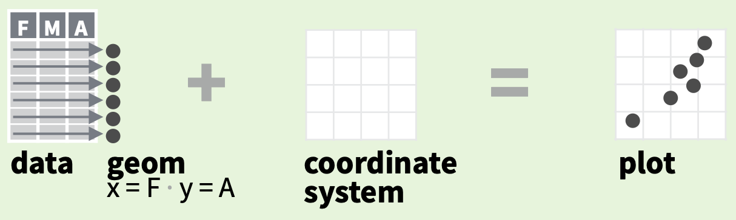
Ggplot2
GGPLOT2: Grammar of Graphics
Only 3 things:
Data set
Geoms (markers to visualize your data!)
Coordinate system

Slide 10
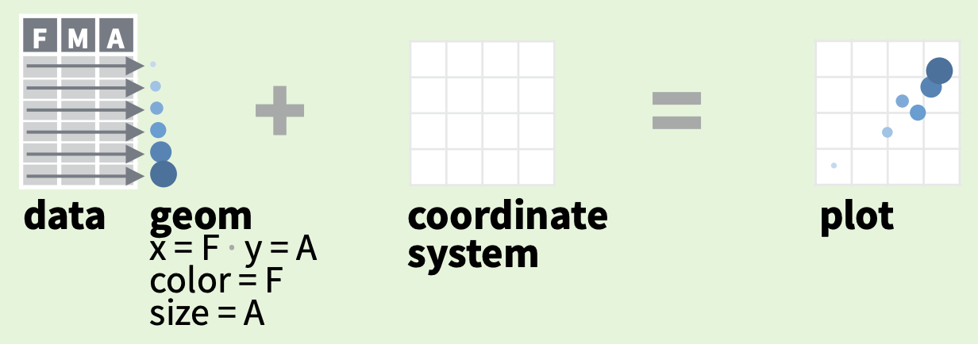
Ggplot2
Use a geom function to represent data points.
Use the geom’s aesthetic properties (“aes”) to represent variables.
Each function returns a layer.
Create more complex graphs by adding more layers.
We build from simple to complex.
Aesthetics!

Slide 11
Ggplot2
GGPLOT2: Grammar of Graphics
Only 3 things:
Data set
Geoms (markers to visualize your data!)
Coordinate system

Slide 12
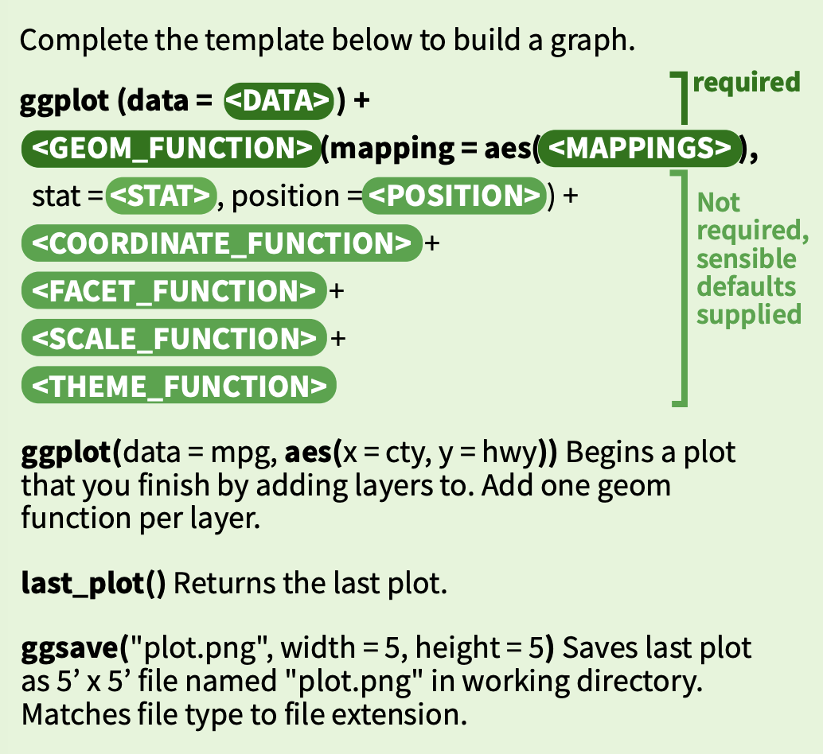

Slide 13
Now let’s move on to the fun part… working with data!

Slide 14
Trying out ggplot2:
Download ggplot2 package from CRAN:
install.packages(“ggplot2”)
Load into System Library (do each time):
library(“ggplot2”)

Slide 15
Trying out ggplot2:
Let’s use example data for now: “diamonds” dataset
R packages often come with example datasets.
To list what datasets are available in each package in your library:
data(package = .packages(all.available = TRUE))
data(package = "ggplot2")

Slide 16
Reading in our own data:
We can easily “read in” or import our own data sets:
For Excel files, let’s use Hadley Wickham’s easy-to-use package:
install.packages("readxl")
library("readxl")
For csv files, we can use already available functions in R:
read.table("Example_data.csv", header = TRUE, sep = ",")
Try it with Example_data.csv and Example_data.xlsx before trying your own data set first

Slide 17
Excellent resources:
Free books!
https://r4ds.hadley.nz/
https://ggplot2-book.org/
Our github resources:
https://github.com/rladies/meetup-presentations_montreal/tree/master/20240227_intro_night
Thank you for attending!!!

