Slide 1

Reshaping data
Intro at R-Ladies Philly
August 2018
Source: https://www.datacamp.com/community/tutorials/long-wide-data-R

Slide 2
Why convert wide <-> long?
lme4::lmer() for mixed linear modeling, ggplot2::ggplot() for visualization are designed for long-form
But there are other functions designed for wide-form such as mosaicplot()
That means that you need to convert the form to do analysis or visualization unless the data is already processed and in the right form

Slide 3
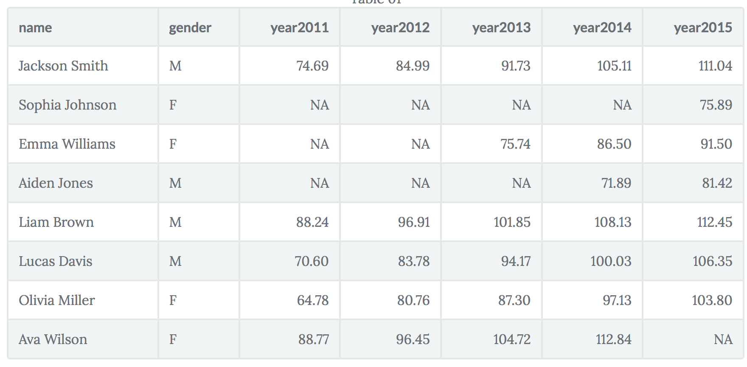
Example – wide or long?

Slide 4
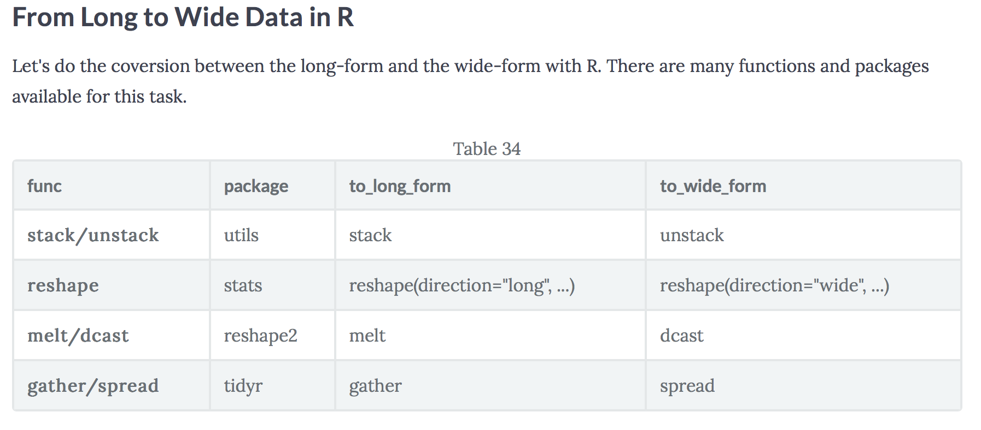

Slide 5
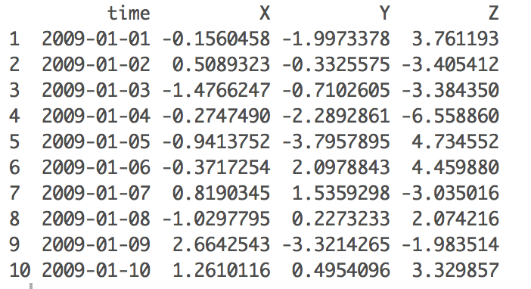
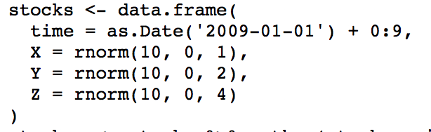
Example in R

Slide 6
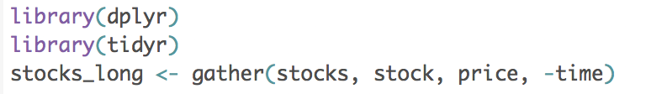
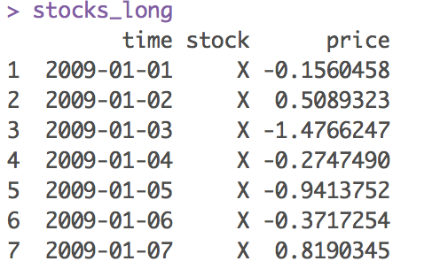
Make it long!

Slide 7
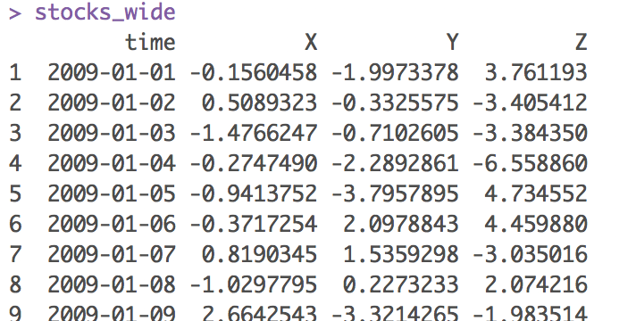
Make it wide again!

