Slide 1

Data Wars: Python vs. R
Seda Japp

Slide 2
History
R was created by Ross Ihaka and Robert Gentleman as an open source language in 1995. Both are statisticians. The purpose was to deliver a better and more user-friendly way to do data analysis, statistics and graphical models.

Slide 3
History
R was created by Ross Ihaka and Robert Gentleman as an open source language in 1995. Both are statisticians. The purpose was to deliver a better and more user-friendly way to do data analysis, statistics and graphical models.
Python was created by Guido Van Rossem in 1991 and focused more on code readability and ease.

Slide 4
History
R was created by Ross Ihaka and Robert Gentleman as an open source language in 1995. Both are statisticians. The purpose was to deliver a better and more user-friendly way to do data analysis, statistics and graphical models.
Python was created by Guido Van Rossem in 1991 and focused more on code readability and ease.
R Statistics & Data Visualization
Python Data Manipulation & Automation

Slide 5
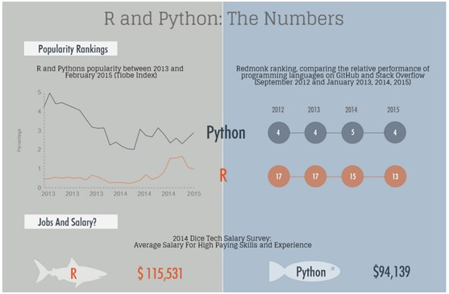
Fun Facts (or Speculations?)
Source: https://www.datacamp.com/community/tutorials/r-or-python-for-data-analysis

Slide 6
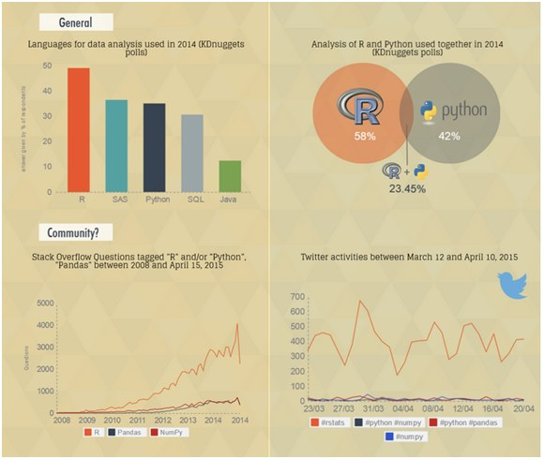
Fun Facts
Source: https://www.kdnuggets.com/2015/05/r-vs-python-data-science.html

Slide 7
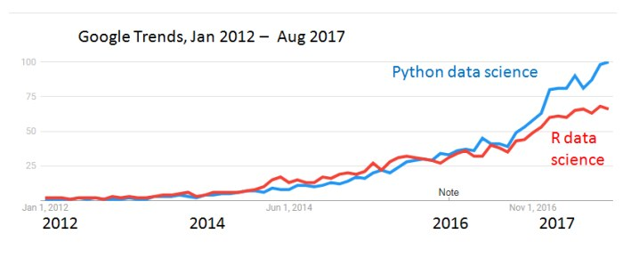
Fun Facts

Slide 8
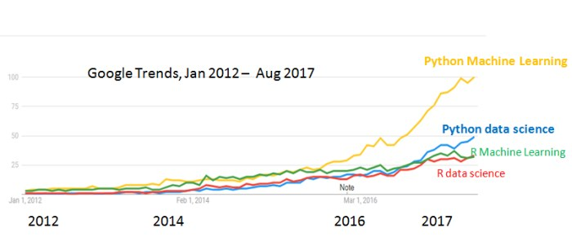
Fun Facts

Slide 9
Pros and Cons
 | R | Python
Ease of learning | 0 | 1
Visualization capabilities | 1 | 0
Community Support | 1 | 1
Deep learning libraries | 0 | 1
Data Wrangling | 0 | 1
Speed | 0 | 1
Ad-hoc Statistics | 1 | 0

Slide 10
Hands-on Examples
Visualization with heat map
Linear Regression
KNN classification
Timing

Slide 11
Hands-on Examples
Visualization with heat map
Linear Regression
KNN classification
Timing
You can find the examples in my github repo:
https://github.com/sedacavdaroglu/RLadieshttps://github.com/sedacavdaroglu/RLadies

Slide 12
My Experience
Python’s syntax is more intuitive
R is easier and has more functionalities for data visualization, simple regression and marketing analytics (e.g., conjoint analysis)
Python sometimes has nerve breaking bugs mostly related to compatibility issues – rrrr
I haven’t experienced that yet with R – but again I haven’t used R as much.

Slide 13
Conclusion
Use R if you are mainly trying to understand your data, the data is relatively clean and visualization is the most important thing – you don’t want to do fancy machine learning.
Use Python if you would like to eventually interface your code with a web-based system.
If you need a lot of data wrangling after which you want to visualize the data, you can first use Python and then R.
If your data is really small, you can as well use excel sometimes ☺

Slide 14
Resources
https://qz.com/1063071/the-great-r-versus-python-for-data-science-debate/
https://www.kdnuggets.com/2015/05/r-vs-python-data-science.html
https://www.datacamp.com/community/tutorials/r-or-python-for-data-analysis
https://www.infoworld.com/article/3187550/data-science/python-vs-r-the-battle-for-data-scientist-mind-share.html

