Slide 1
TF-IDF
By Darina Chudnovskaya
4/19/2018

Slide 2
Preprocessing
Tokenization
breaking down stream of text into tokens, a meaningful unit
single words or phrases (n-grams)
Stemming
Transform words into its stem
Running -> Run, Ladies -> Lady
Stop words
The, Of, Be, Are

Slide 3
Raw Document Term Matrix
 |  | (Var 1) | (Var 2) | (Var 3) | (Var 4) | … | (Var 999) | (Var 1000)
 |  | apple | cat (stemmed) | dog(stemmed) | farm | … | White House | Senate
(Obs 1) | Doc 1 | 1 | 3 | 2 | 1 | … | 0 | 0
(Obs 2) | Doc 2 | 0 | 1 | 2 | 0 | … | 3 | 2
(Obs 3) | Doc 3 | 0 | 1 | 1 | 0 | … | 4 | 4
(Obs …) | … | … | … | … | … | … | … | …
(Obs N) | Doc N | 2 | 4 | 3 | 1 | … | 0 | 0
 |  | Reduced Document by Term Matrix after Stemming, Filtering, Synonyms, and so on

Slide 4
TF-IDF
TF- Term Frequency
IDF- Inverse Document Frequency
Tf*IDF
Notes:
Weighting words
Tf-idf- accentuates terms that are frequent in the document, but not frequent in general
Its a compliment to semantic analysis - tfid gives meaning/message in text and semantic analysis (ch2) conveys feelings/thoughts so you get different types of classification

Slide 5
Term Frequency
A term is more important if it occurs more frequency in a document
c(t,d) where c=count, t=term, d=document
Frequency count (c) of term (t) in document (d)
Raw term frequency
TF of a term (t) in document (d) = number of times t occurs in d
Not a great measure because relevance does not increase proportionally with term frequency
Document length
Documents can be verbose or have more content
Need to penalize long documents-but not over penalize
Notes:
A document with 10 occurrences of the term is more relevant than a document with 1 occurrence of the term. But not 10 times more relevant.

Slide 6
Standardized Term Frequency
TF(t) = (Number of times term t appears in a document) / (Total number of terms in the document)
Supercalifragilisticexpialidocious occurs 3 times in a document of 1000 words
TF= 3/1000= 0.003
Norm. TF
Raw TF
Notes:
Logarithmic function/ relationship between raw and standardized tf

Slide 7
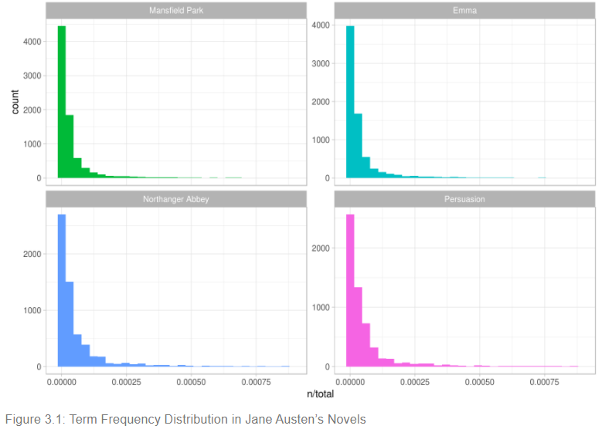
Standardized Term Frequency
Notes:
In Figure 3.1 let’s look at the distribution of n/total for each novel, the number of times a word appears in a novel divided by the total number of terms (words) in that novel. This is exactly what term frequency is.
Tail-common words

Slide 8
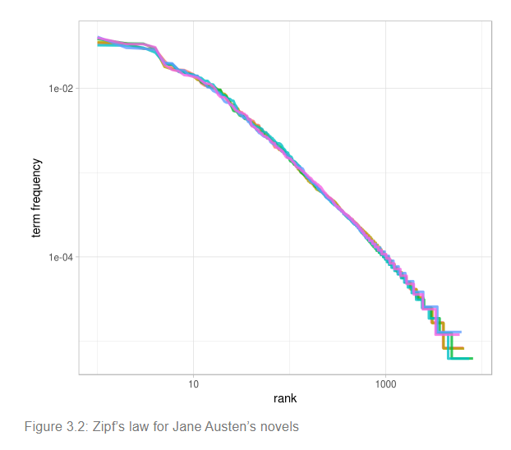
Zipf’s Law
The frequency that a word appears is inversely proportional to its rank

Slide 9
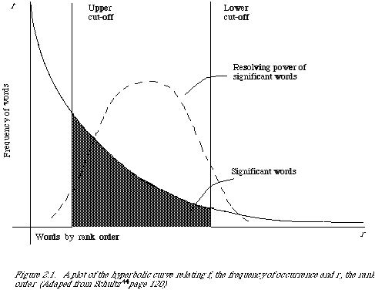
Document Frequency
Rare terms are more informative than frequent terms
Notes:
IE stop words- frequent and not informative
Words occurring too many or too few not informative-want middle

Slide 10
Inverse Document Frequency
df_{i} = number of documents containing term i
idf_{i} = log₂ (N/df_{i}) where N is the total number of documents in a corpus
Indication of term’s discrimination power
Assign higher weights to the rare terms
Notes:
Corpus specific property
which decreases the weight for commonly used words and increases the weight for words that are not used very much in a collection of documents

Slide 11
TF*IDF Weighting
A term occurring frequently in the document but rarely in the rest of the corpus is given higher weight
tf_{t} x idf_{t}
Increases with:
The number of occurrences within a document
The rarity of the term in the corpus
Does not appear in many documents

Slide 12
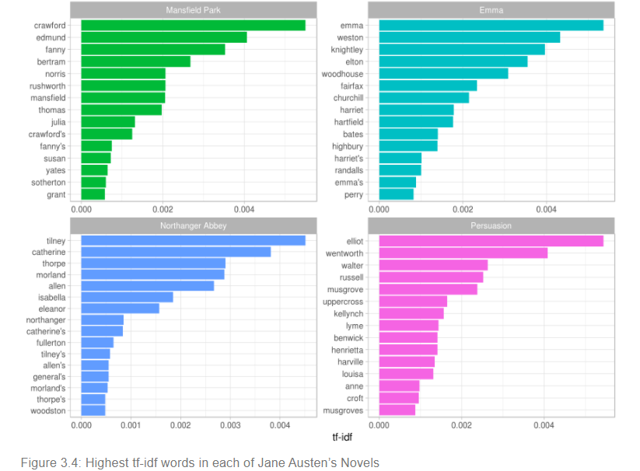

Slide 13
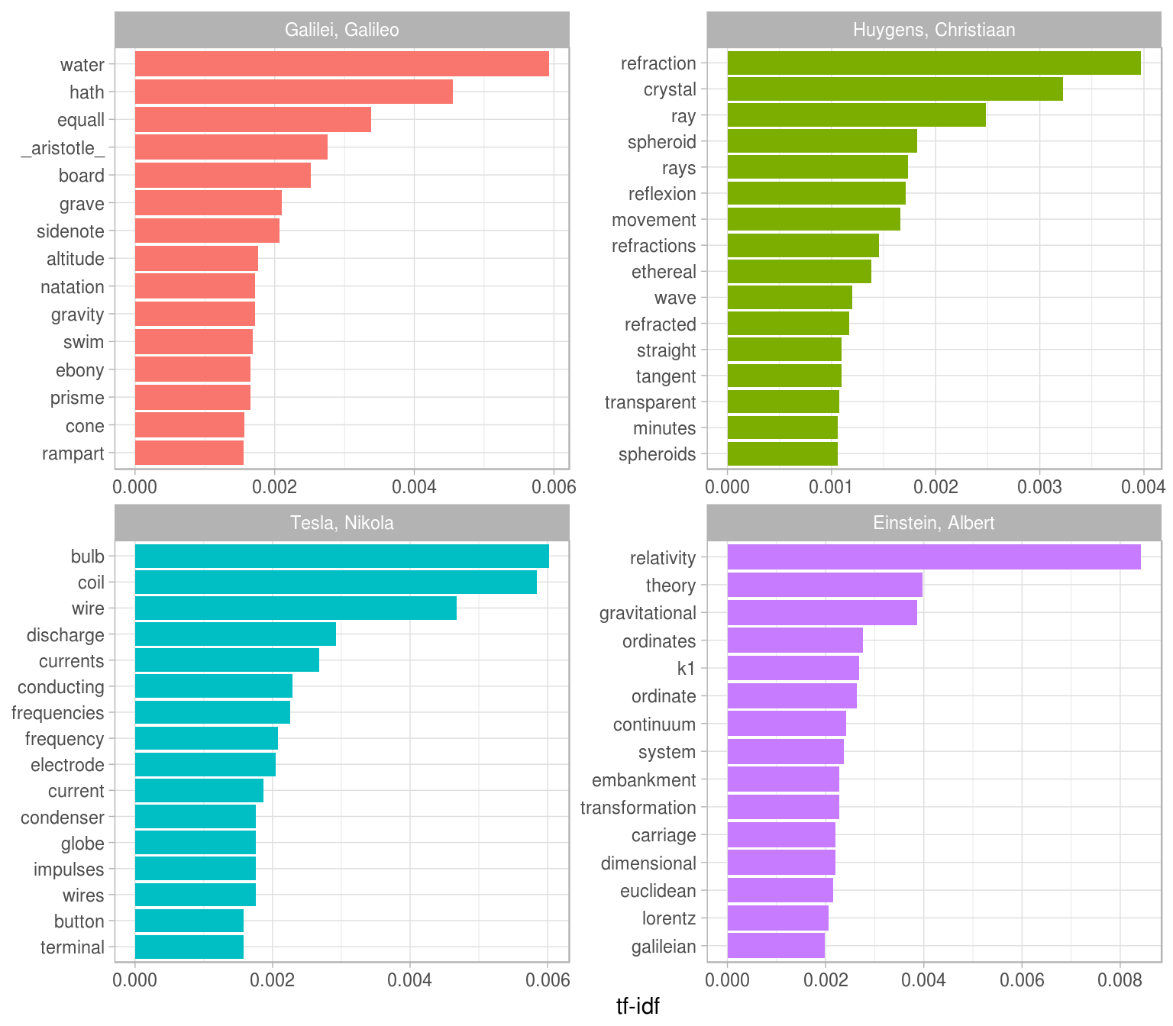

Slide 14
In Conclusion
TF-IDF is a way to determine important words/meaning
Summarization of documents, books, and the corpus
Classification/categorization
Search engines
Notes:
can be used when have many docs, need to classify them into categories/topics; filtering stop words ie the ex with physics text using "eq.")
summarization about docs, books, texts
search engines (use rank to find relevant web pages for a query)

Slide 15
References
Silge J and Robinson D. “Text Mining with R. A Tidy Approach.” 2018
Armour F. “Text Analytics and Vector Space Models, part 1 and 2”. [Lecture]. Washington, DC.

