Slide 1
Cleaning up Messy Genetics Data
Irem Celen
6/21/2018
R-Ladies Philadelphia

Slide 2


How do tidy data look like?
Each variable is a column
Each observation is a row
Each type of observational unit is a table
It is almost NEVER the case with genetics data

Slide 3
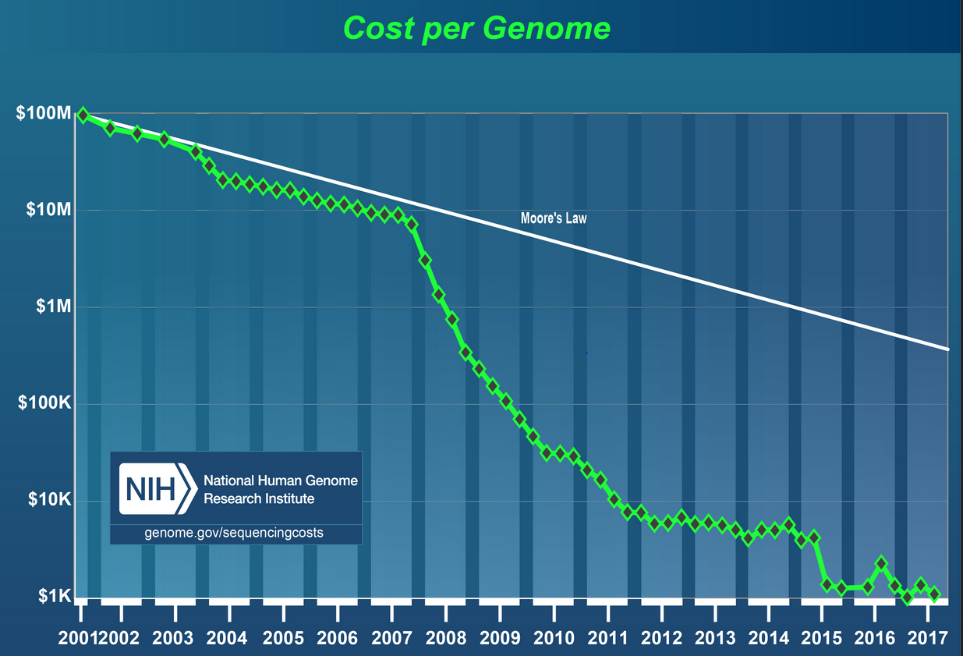
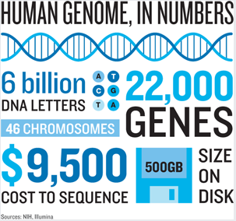
Genetics data…
can help:
identify mechanisms causing disease
develop drugs
improve agricultural sustainability
and many more…
Messy genetics data can have serious consequences

Slide 4
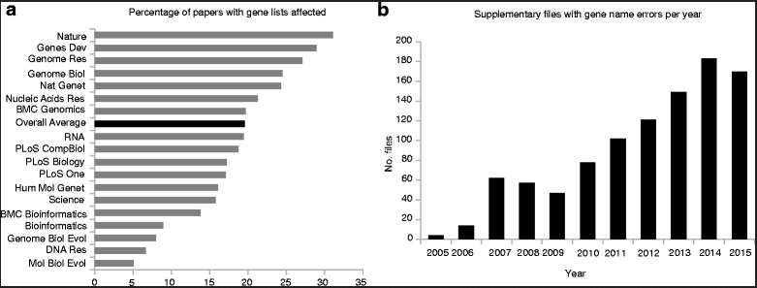
~20% of genetics papers with supplementary xlsx files have gene name errors¹
Common issues in genetic datasets
1. Gene name errors
Ziemann et al., 2016 (Genome Research)
1. Ziemann M, Eren Y, El-Osta A. Gene name errors are widespread in the scientific literature. Genome Biol. 2016

Slide 5
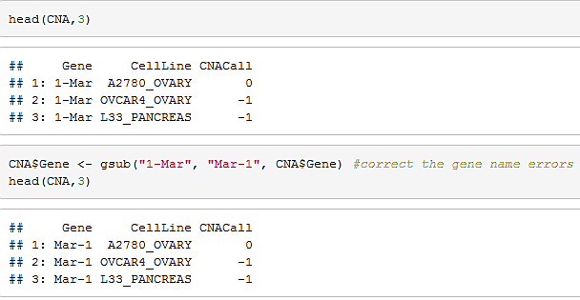
Common issues in genetic datasets
1. Gene name errors (Cont’d)
Main reason: opening a file in Excel
How to correct it with R?
oct-1 1-oct
mar-1 1-mar
2310009E13 2.31E+13
SEPT2 2006/09/02
...
Notes:
Convert gene names to dates and floating point numbers

Slide 6


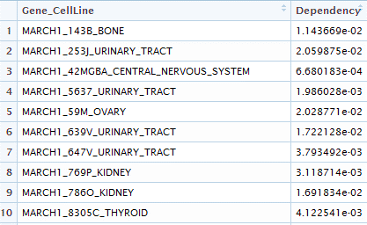
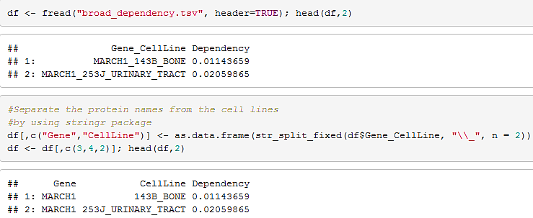
Common issues in genetic datasets
2. Multiple variables in one column
How to correct it with R?
Notes:
Convert gene names to dates and floating point numbers

Slide 7

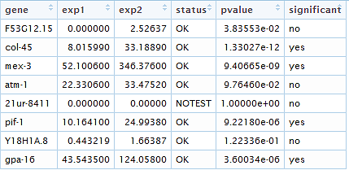
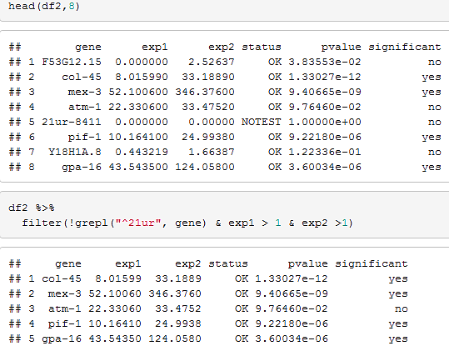
Common issues in genetic datasets
3. “Noise” in the data
How to correct it with R?

Slide 8
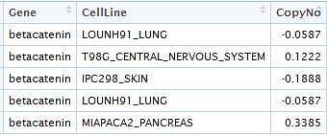
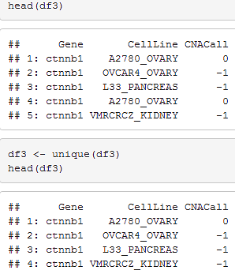
Common issues in genetic datasets
4. Duplicate data
How to correct it with R?

Slide 9
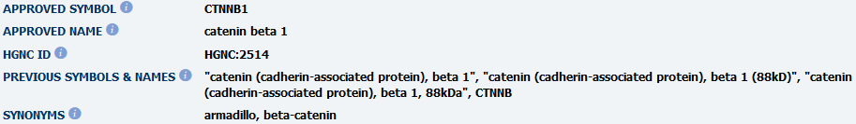


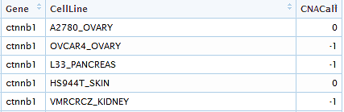
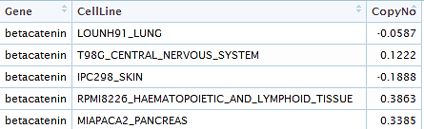
Common issues in genetic datasets
5. Usage of different gene IDs/names in different databases
How to correct it with R?
File 1
File 2
Notes:
Convert gene names to dates and floating point numbers

Slide 10
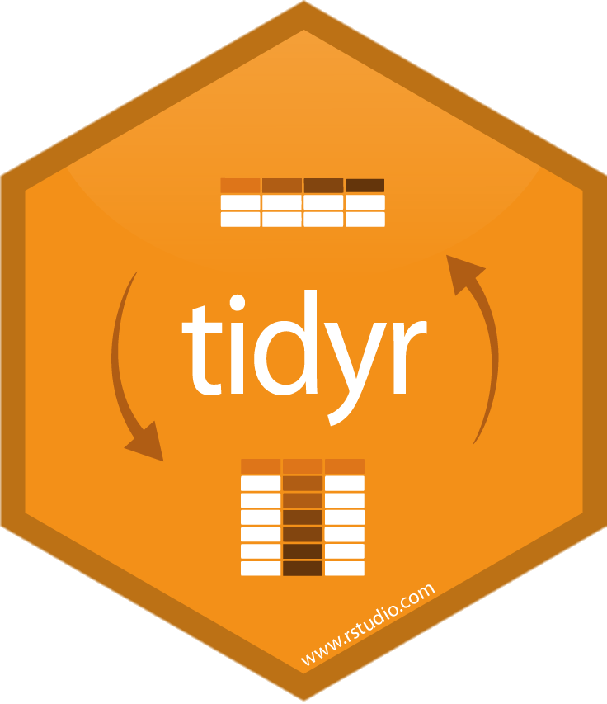


Lifesaver R libraries for data cleaning

Slide 11
Concluding thoughts…
It is important to inspect data before analysis
head(), tail()
str(), dim(), class()
colnames(), rownames()
summary()
…

Slide 12
Thanks!

