Slide 1
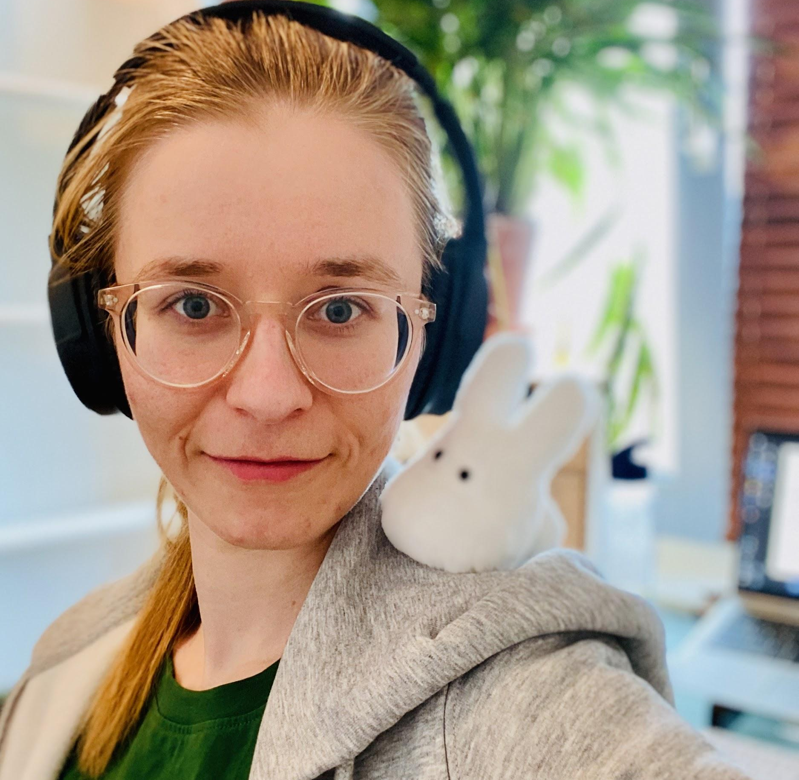


[ONLINE] - R-Ladies NL book club:
Advanced R Chapter 10 (Function factories)
By Sarah Stolle
Tuesday, 4th August
18:00- 19:30
Amsterdam

