Slide 1
Where Can I Get More Help?
Resources for R

Slide 2

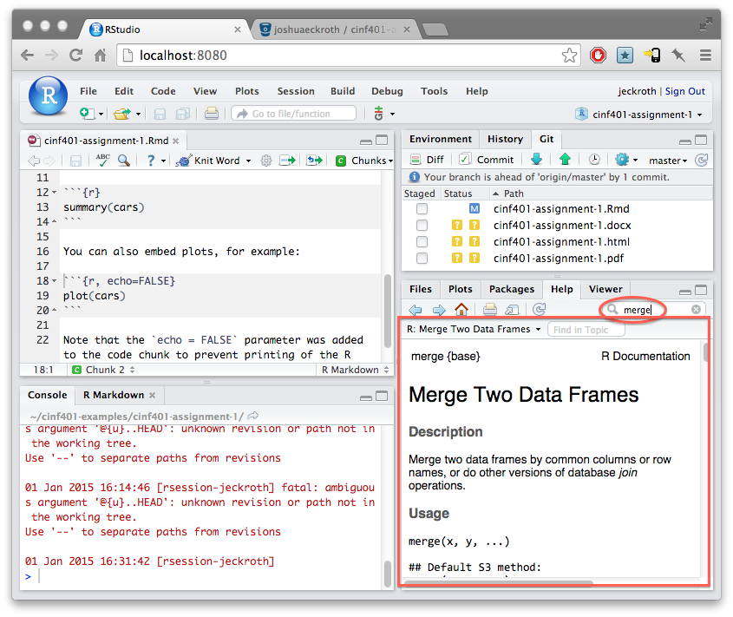
THE R-Studio Help Tab

Slide 3
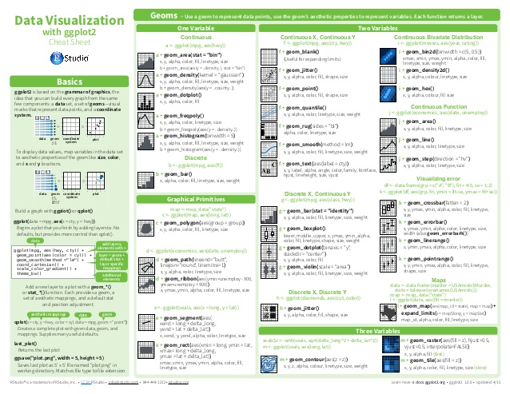
R “Cheat-Sheets” https://www.datacamp.com/community/data-science-cheatsheets

Slide 4

Blogs
R-Bloggers
https://www.r-bloggers.com
DataCamp Blog
https://www.datacamp.com/community/blog
R Statistics Blog
https://www.r-statistics.com
R-Studio Blog
https://blog.rstudio.com

Slide 5

Online Books
P. Kuhnert & B. Venables, An Introduction to R: Software for Statistical Modeling & Computing
J.H. Maindonald, Using R for Data Analysis and Graphics
B. Muenchen, R for SAS and SPSS Users
W.J. Owen, The R Guide
D. Rossiter, Introduction to the R Project for Statistical Computing for Use at the ITC
W.N. Venebles & D. M. Smith, An Introduction to R

Slide 6


