Slide 1

hit the mole league
B877007 김은직
B877032 장진혁

Slide 2
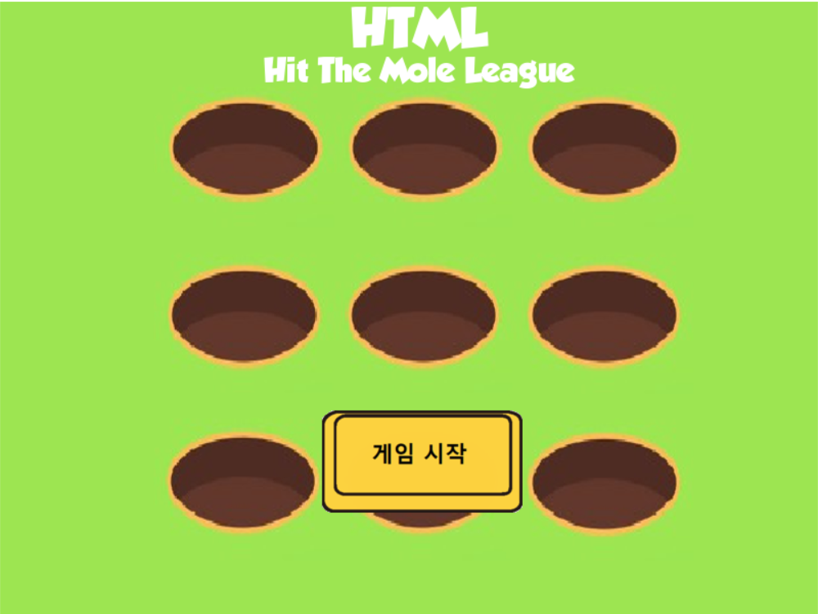
Game explain
Main menu

Slide 3
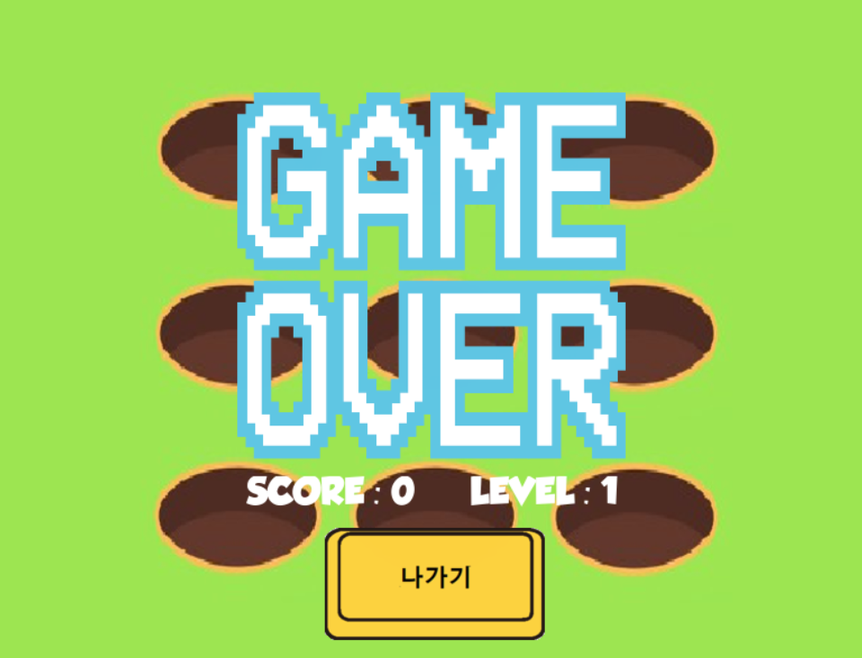
Game explain
End menu

Slide 4
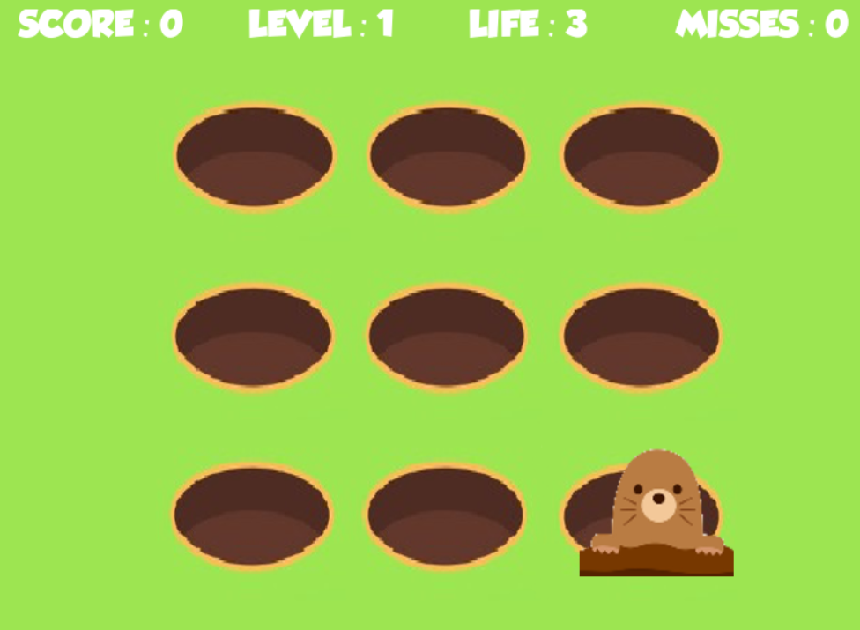
Game explain
Game Interface
Score
Level
Life
Misses

Slide 5




Game RULE
PLUS 10 SCORE!!

Slide 6
Game play
Let’s play NOW!!

