Slide 1
Project Presentation
Hyunjae Kim

Slide 2
Overview
Topic From Shesha’s Lecture
Slurm
Containers
Troubles I’ve had and Lessons learned

Slide 3
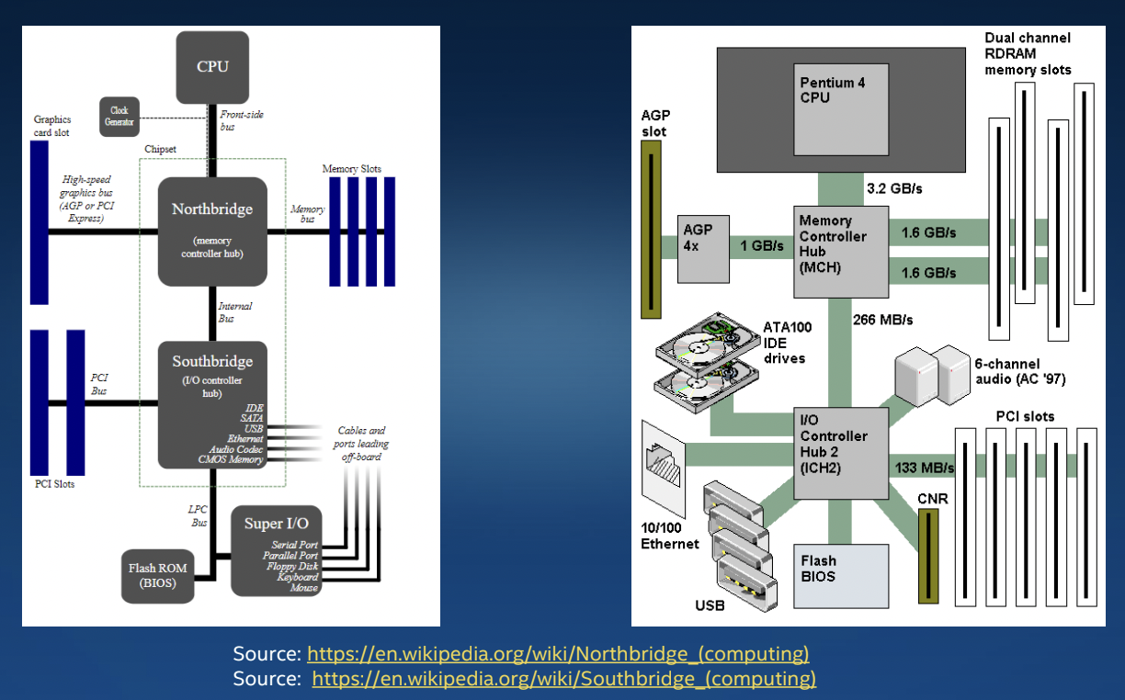
Computer Architecture

Slide 4
Latency vs band width

Slide 5
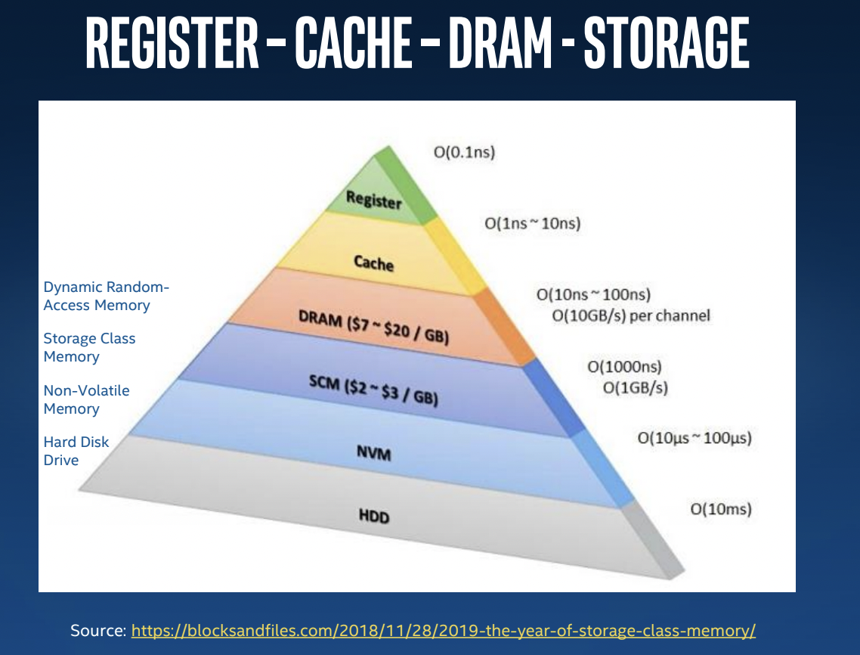
Memory Hierarchy

Slide 6
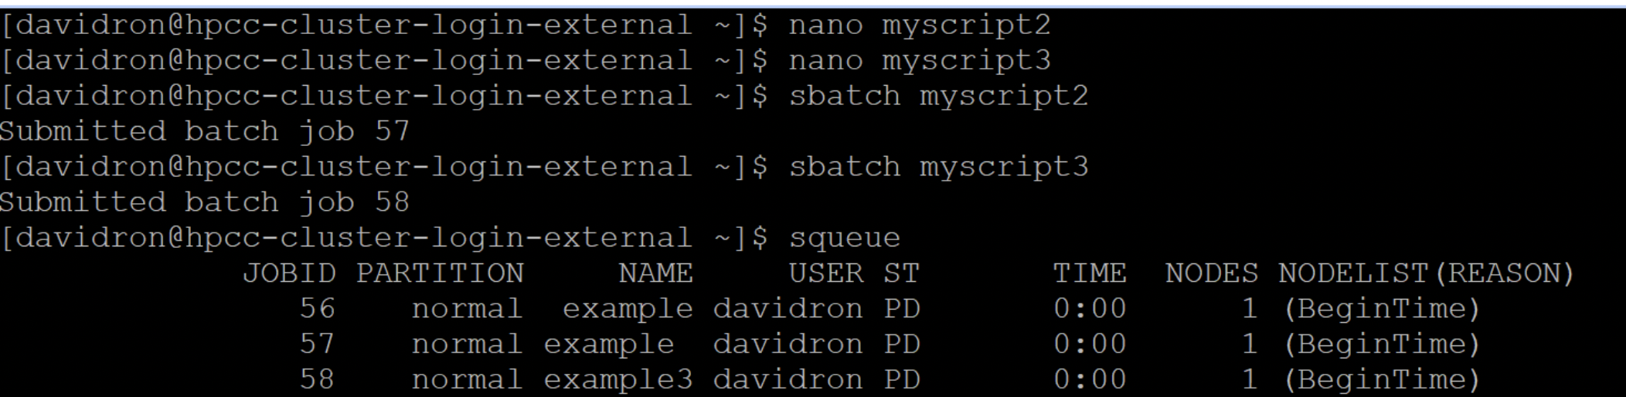
slurm
Open source cluster management system
Job scheduling system
For linux cluster
Functions:
Allocates resources
Provide framework for job submitted to clusters
Manage queue pending jobs

Slide 7
Advantage
Automates the management of jobs submitted to a cluster.
Modular and has plugins for accounting, resource optimization, time management, power consumption
Allows administrator to ..
provide more resources for certain jobs or users
prioritize certain users or jobs

Slide 8
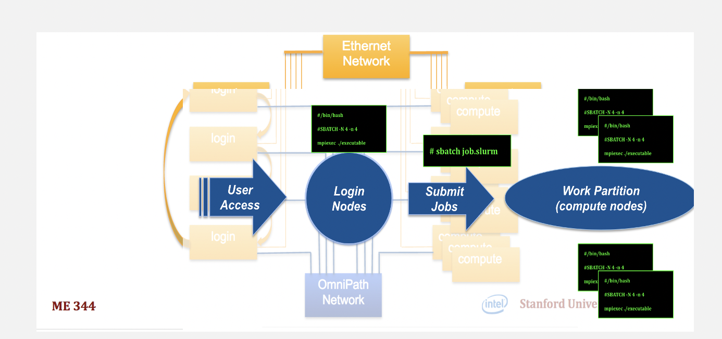
Slurm workflow

Slide 9
container?
Executable units of software where application code is packaged, along with its libraries and dependencies
it can be run anywhere, whether it be a desktop, laptop, HPC system, or the cloud

Slide 10
Advantage of container
No need to install the whole program for each machine
Form of Operating System virtualization for OS which features are leveraged to both isolate processes and control the amount of CPU, memory, and disk those processes have access to

Slide 11
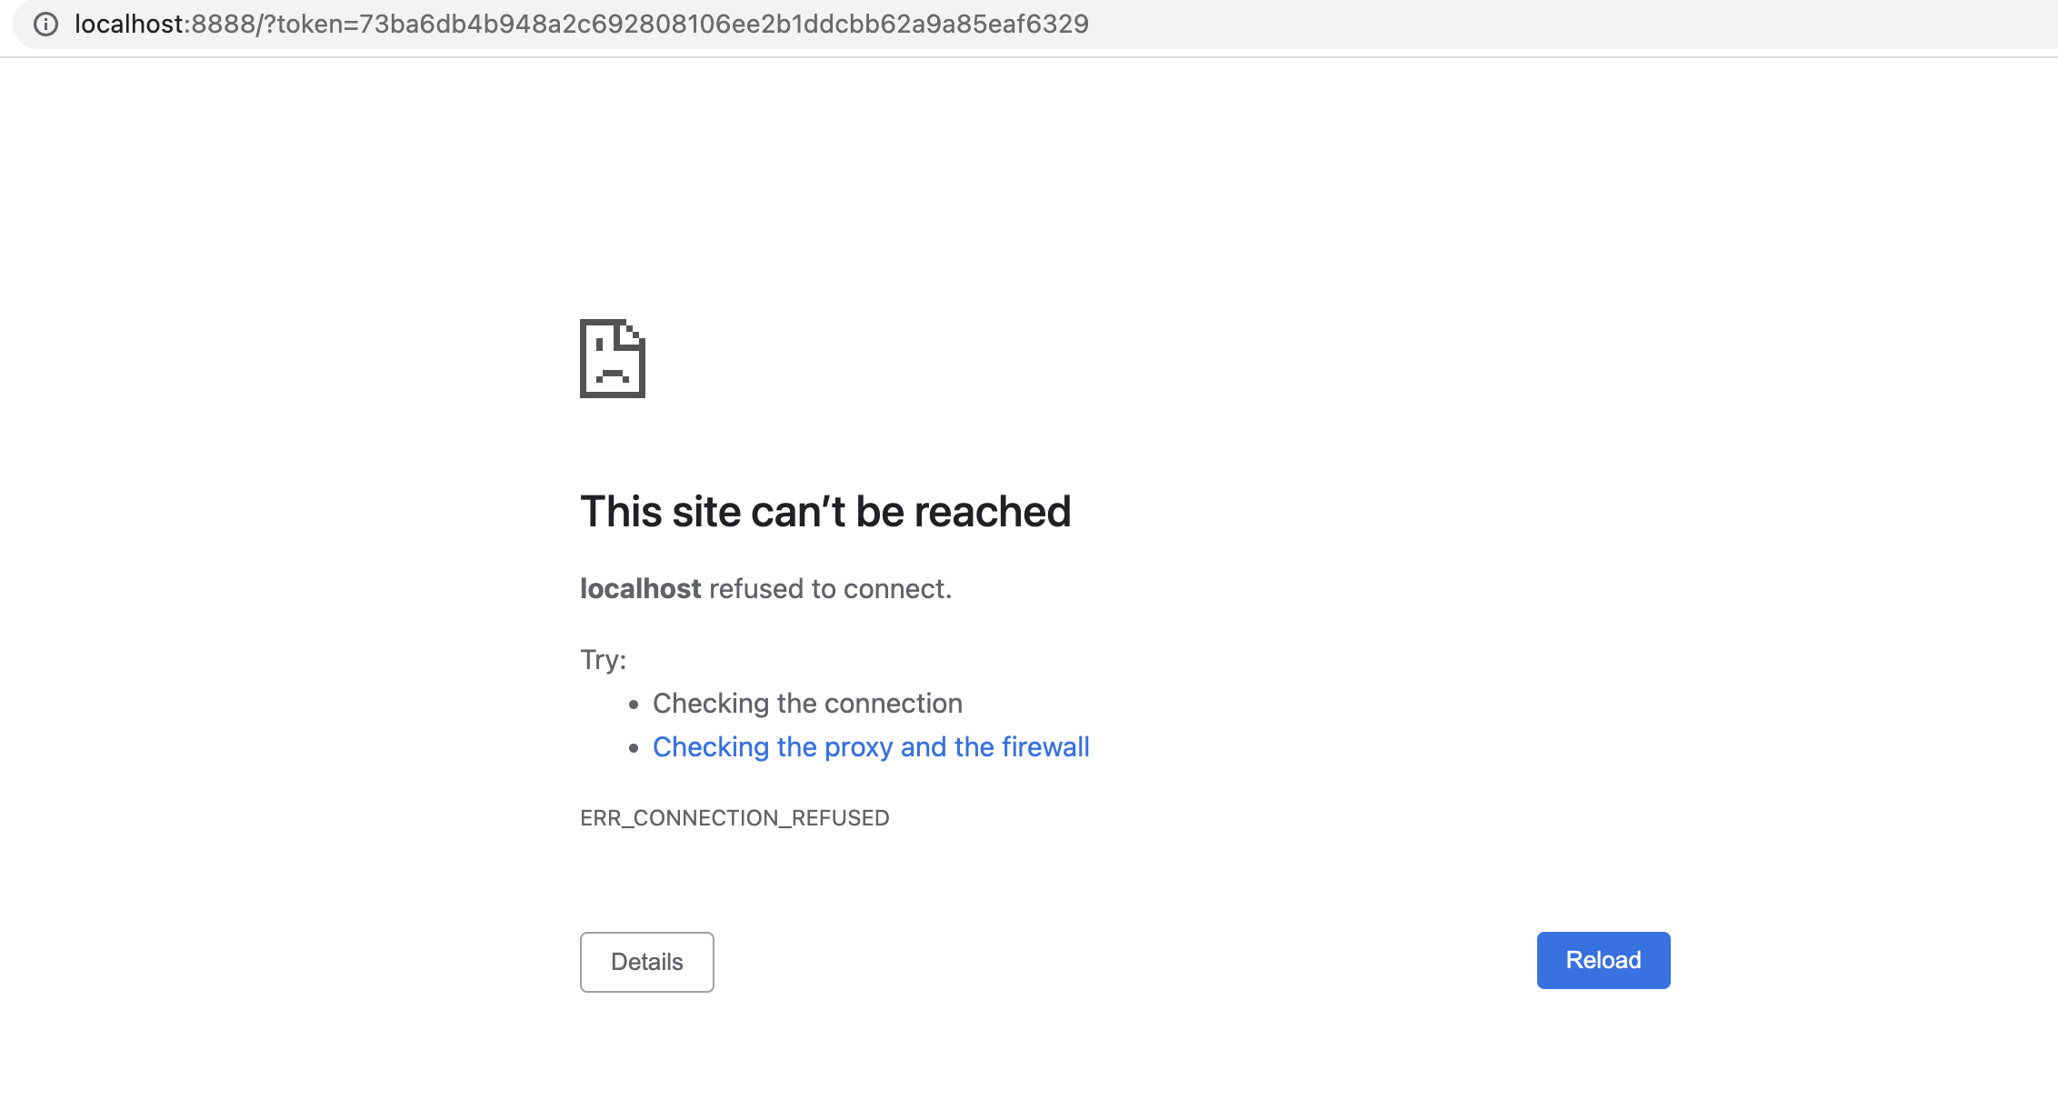
Troubles in project 1
Logging in to user account fail ← not adding user account
“mdirun_mpi” did not work ← miss the step of installation
Localhost not working

Slide 12
Lessons from troubles
Read the instruction thoroughly, .
Always look close to each step.
Always consider which account logged in to cluster.
Check the command is connecting to the same domain/area where I logged in ex)CHROOT
Check the typo before running the script
Previous commands affects the current state

