Slide 1
로봇제어실험 Task Space Control
2013046422
김효정

Slide 2
Indirect vs Direct
 | x_error | y_error
Indirect regulation <two_link> | 8.92E-05 | 2.64E-03
Indirect regulation <two_link_df> | 4.70E-04 | 2.98E-03
difference | -3.81E-04 | -3.38E-04
Indirect CLIK & Pinv <two_link> | 6.74E-05 | 1.27E-04
Indirect CLIK & Pinv <two_link_df> | 6.04E-05 | 1.28E-04
difference | 7.02E-06 | -1.40E-06
Indirect RAC <two_link> | 2.35E-04 | 1.55E-04
Indirect RAC <two_link_df> | 2.48E-04 | 1.64E-04
difference | -1.27E-05 | -8.50E-06
 | x_error | y_error
Direct regulation <two_link> | 6.78E-05 | 9.05E-05
Direct regulation <two_link_df> | 1.08E-02 | 1.65E-03
difference | -1.08E-02 | -1.56E-03
Direct Task Space IDC <two_link> | 4.90E-04 | 3.39E-04
Direct Task Space <two_link_df> | 2.35E-02 | 4.00E-03
difference | -2.30E-02 | -3.67E-03
Direct Task Space LBC <two_link> | 8.54E-04 | 8.02E-04
Direct Task Space LBC <two_link_df> | 1.52E-02 | 7.31E-03
difference | -1.44E-02 | -6.51E-03

Slide 3
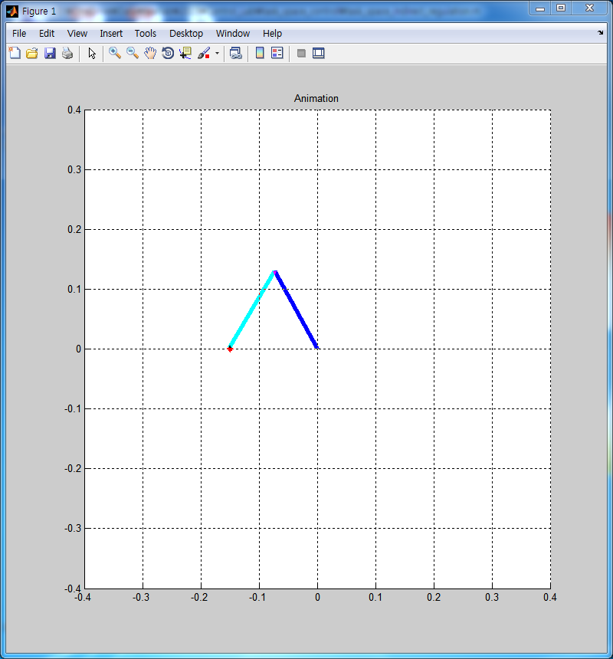
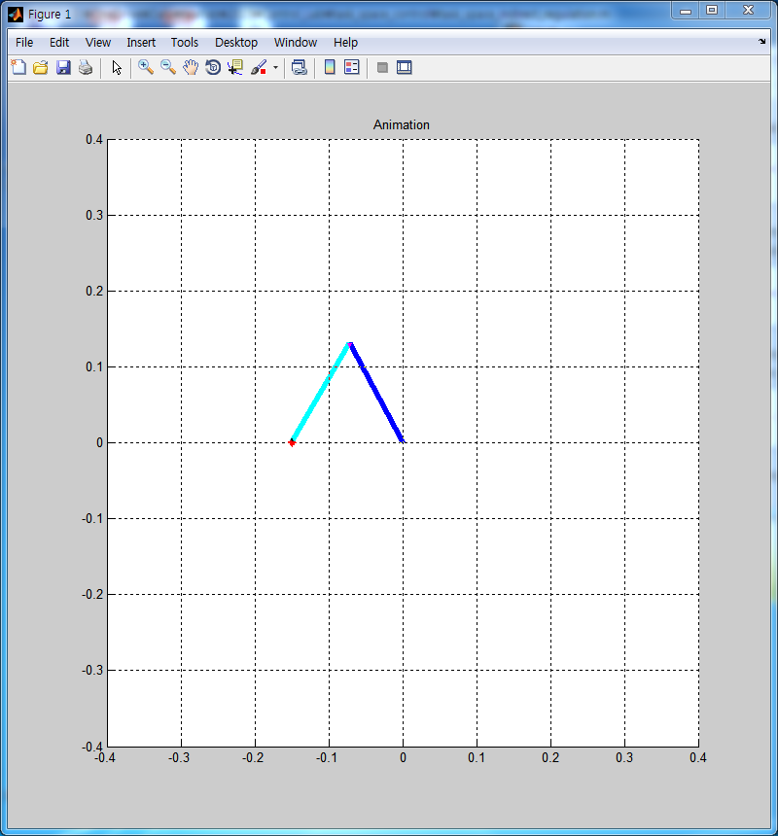
Indirect Regulation

Slide 4

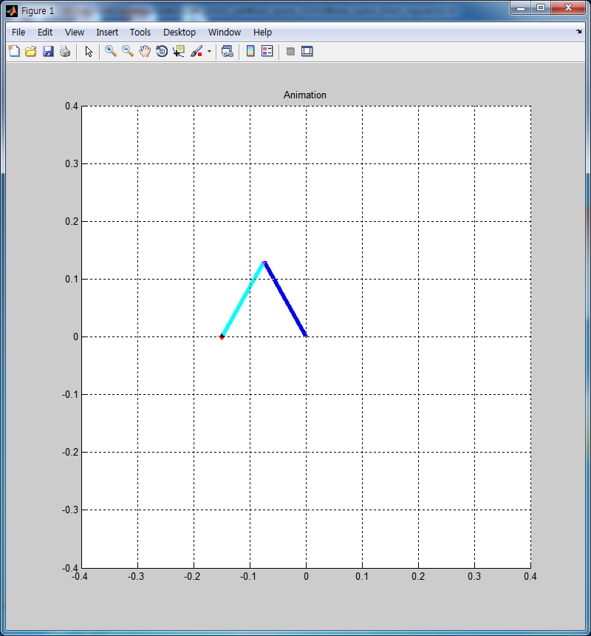
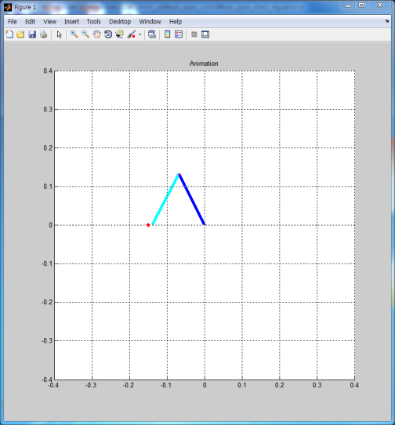
Direct Regulation

Slide 5

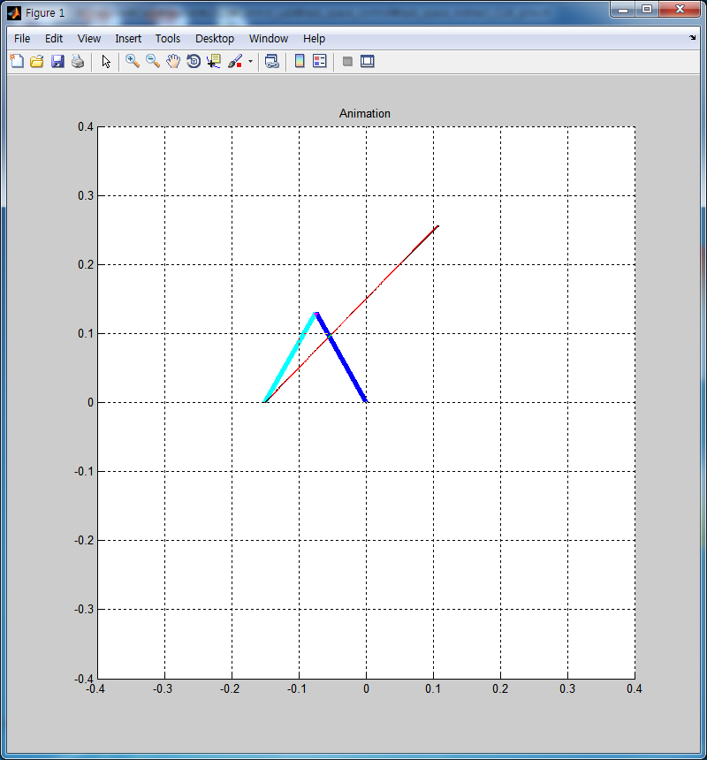

Indirect Task Space Control using CLIK and Jacobian Pseudoinverse

Slide 6

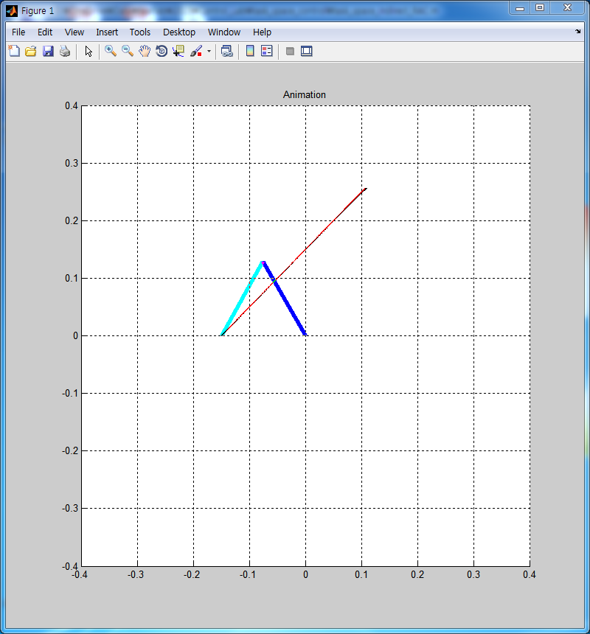
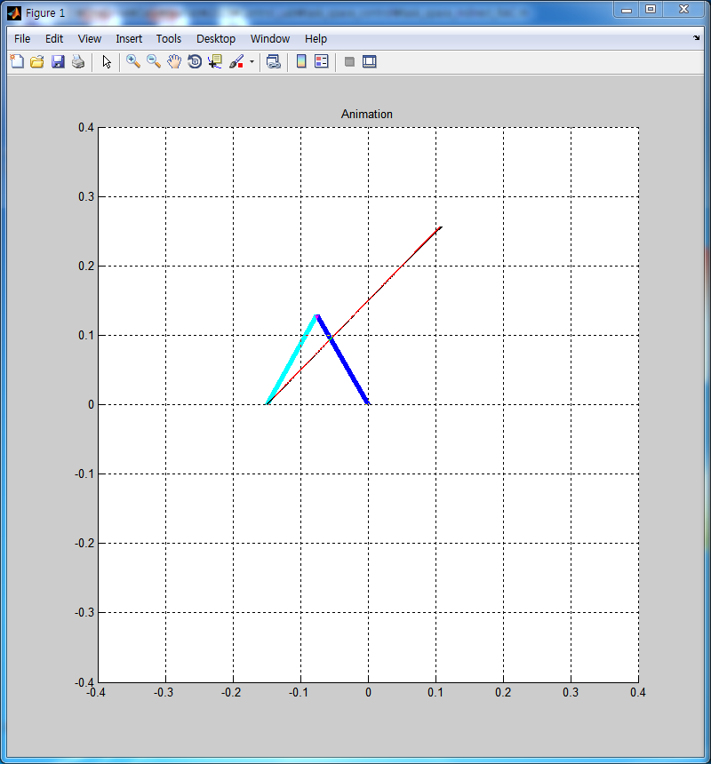
Indirect Task Space RAC scheme using joint-space IDC scheme

Slide 7

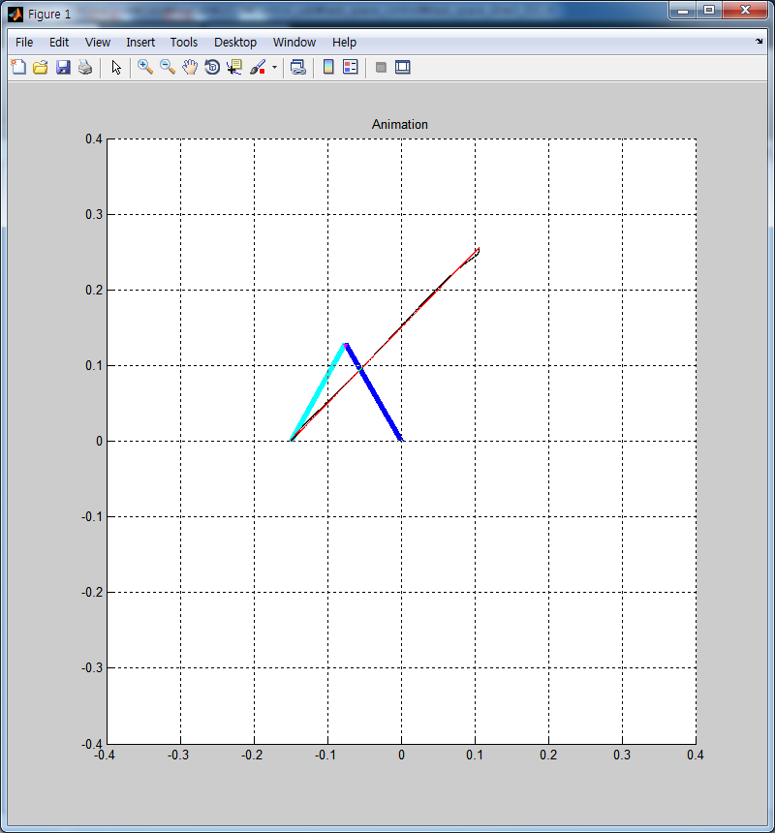
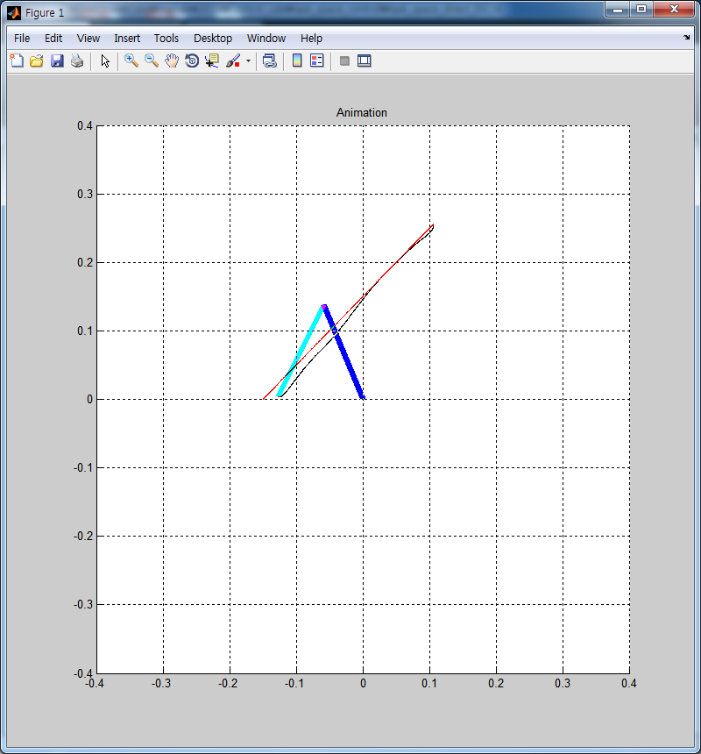
Direct Task Space IDC

Slide 8

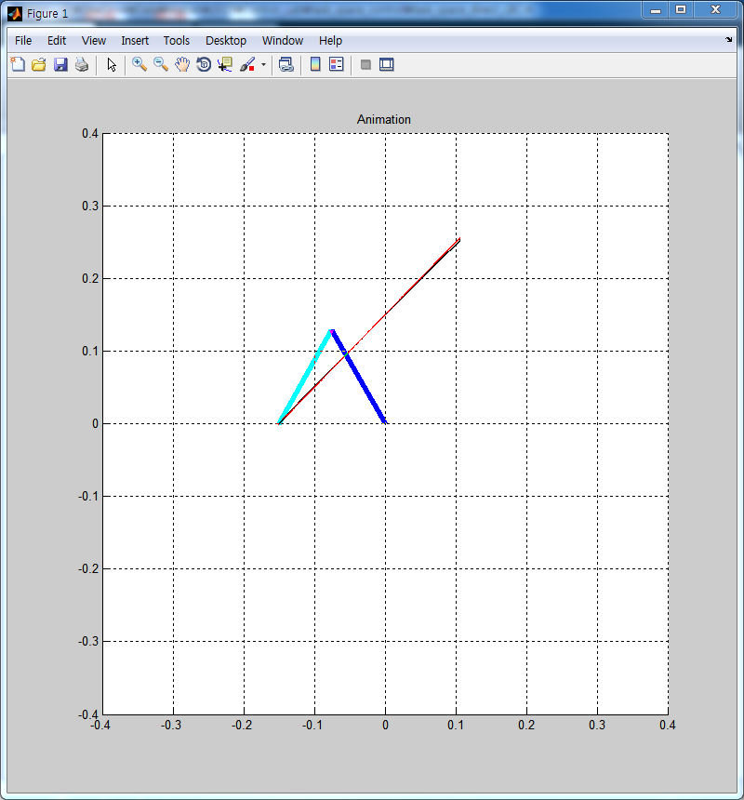
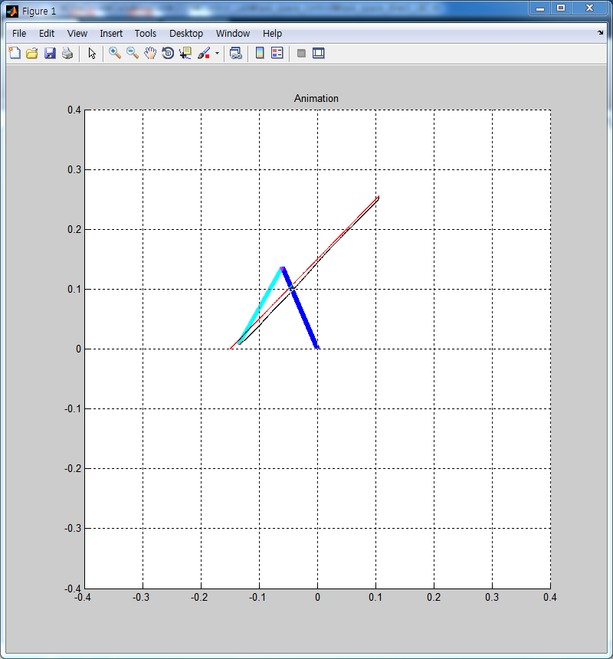
Direct Task Space LBC

Slide 9
Best Controller
Direct보다 Indirect가 disturbance나 friction에 영향을 덜 받는 것으로 보아 Indirect가 더 좋은 제어기라고 가정
Task space tracking controllers(Indirect) : Indirect CLIK&Pseudoinv vs Indirect RAC
제어기의 성능을 gain값의 변화에 영향을 덜 받는 것을 좋은 제어기 라고 가정
하나의 gain만 변화시키면서 기준(진폭의 크기가 0.02이하인 제어기)을 통해 gain의 max와 min 값을 결정

Slide 10

Indirect CLIK&Pseudoinv
$K_{p}=\left[\begin{matrix}0.5 & 0 \\ 0 & 0.5\end{matrix}\right], K_{d}=\left[\begin{matrix}1 & 0 \\ 0 & 1\end{matrix}\right], K=\left[\begin{matrix}50 & 0 \\ 0 & 50\end{matrix}\right]$
결과 : Kp, Kd에 민감하게 반응
 | min | max
kp | - | 3
kd | 0.2 | 1.5
k | 5 | 400

Slide 11
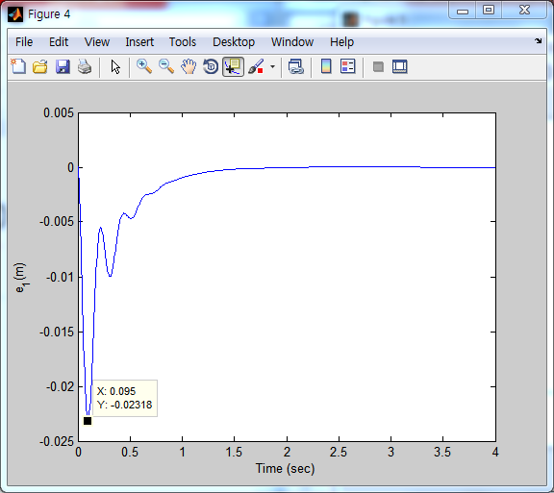
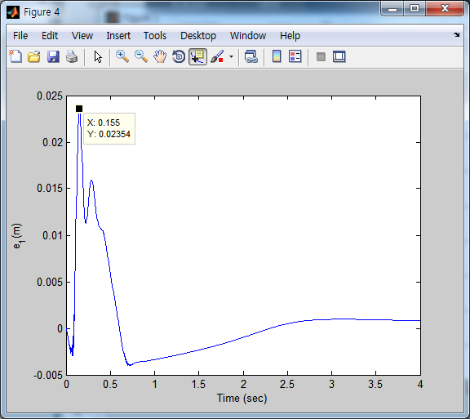
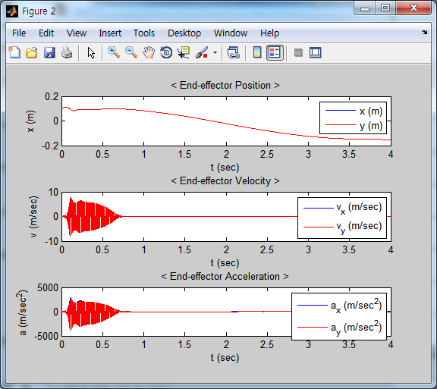
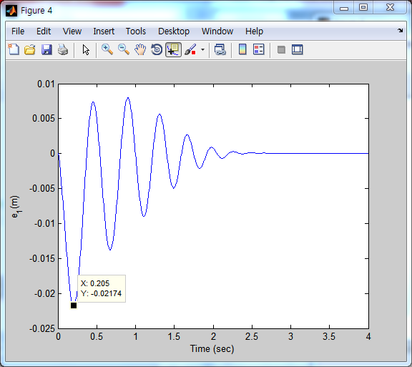
Indirect CLIK & Pseudoinv
kd = 1.5
kp = 3
kd = 0.2

Slide 12

Indirect RAC
$K_{p}=\left[\begin{matrix}17 & 0 \\ 0 & 17\end{matrix}\right], K_{d}=\left[\begin{matrix}50 & 0 \\ 0 & 50\end{matrix}\right]$
결과 : CLIK보다 kp,kp의 범위가 넓다
 | min | max
kp |  | 400
kd | 10 | (150)

Slide 13
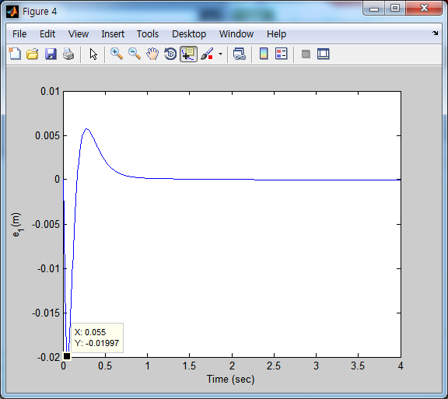
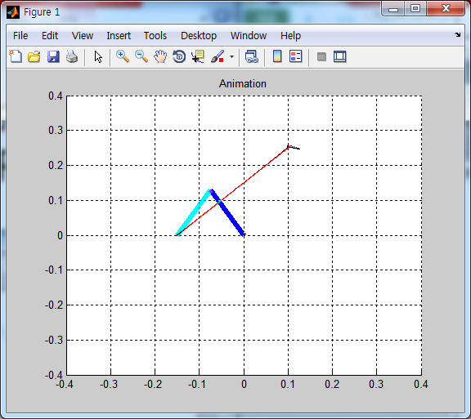
Indirect RAC
kp=400

Slide 14
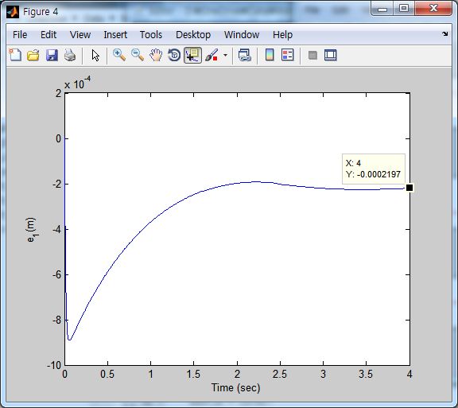
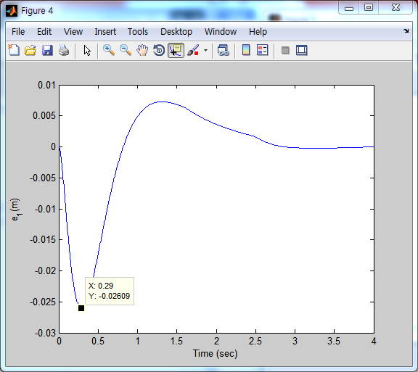
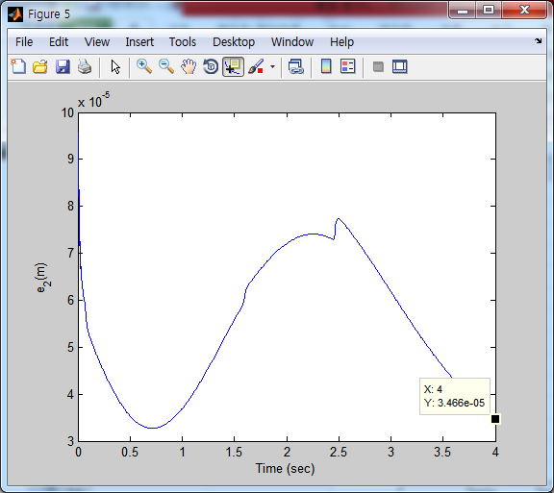
Indirect RAC
kd=150
kd=10
Kd = 50
0.0002.48, 1.64e-04

Slide 19
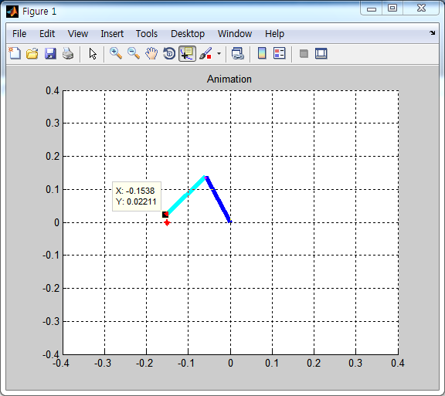
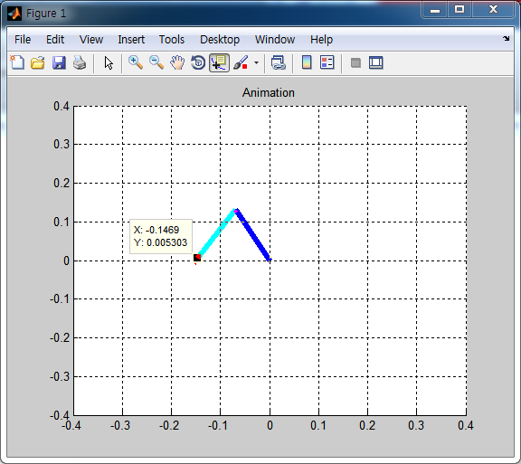
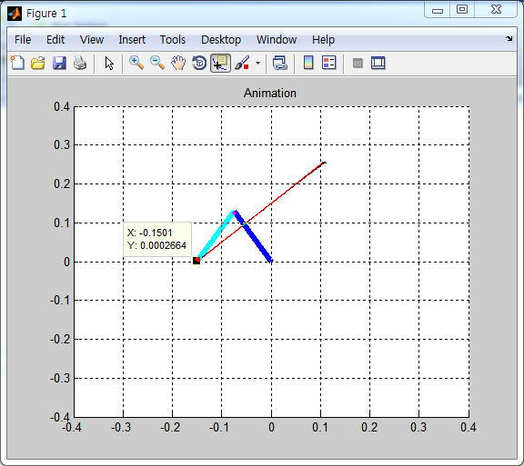

Slide 20
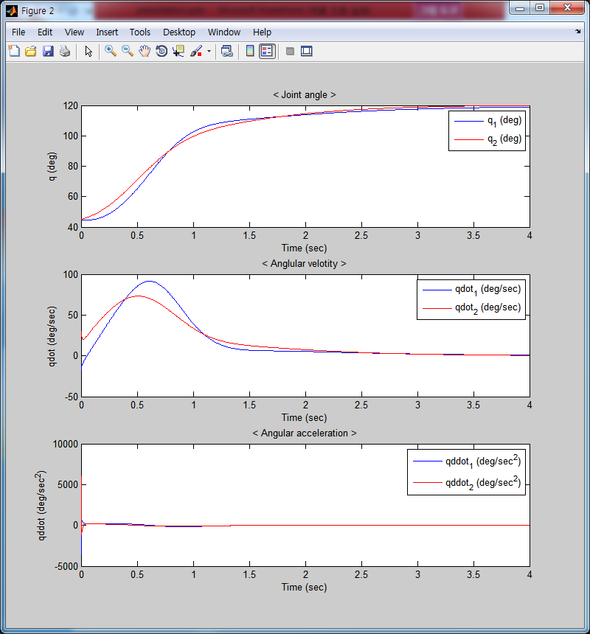
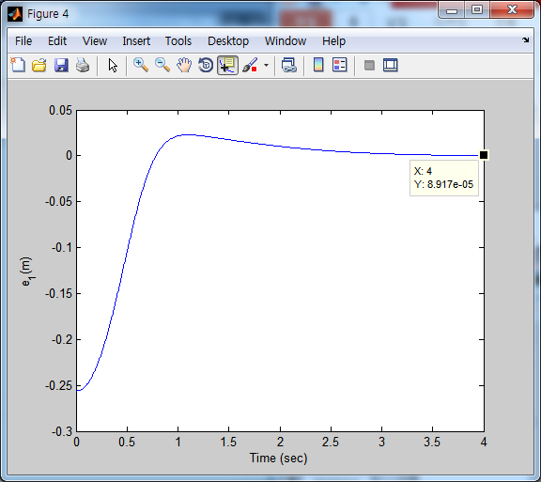
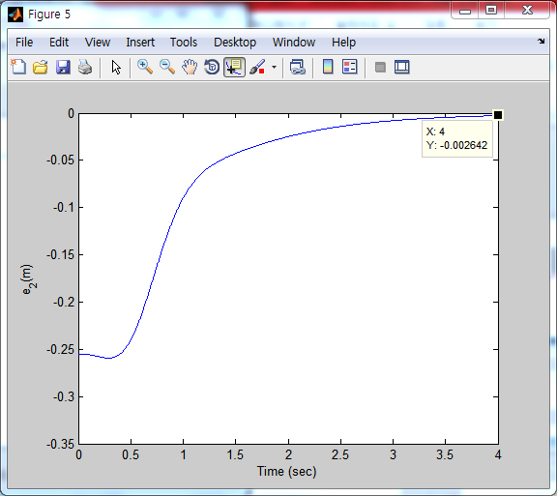
Indirect_Regulation(two_link)

Slide 21
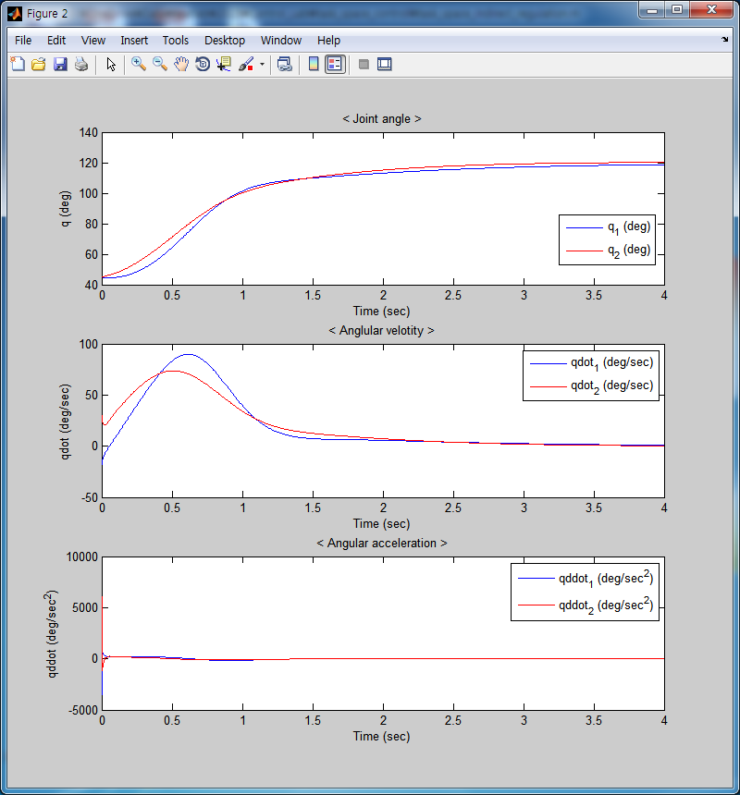
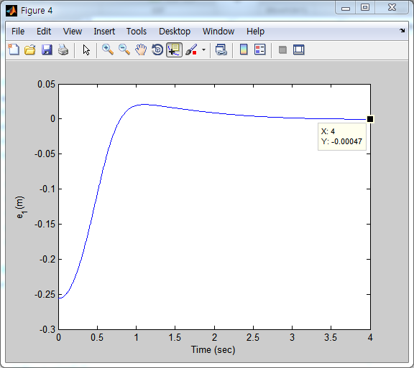
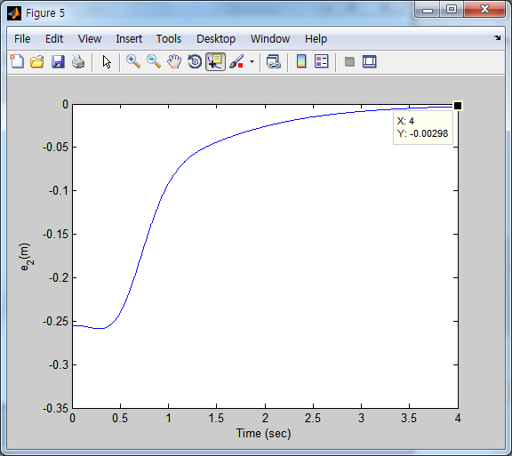
Indirect_Regulation(two_link_df)

Slide 22
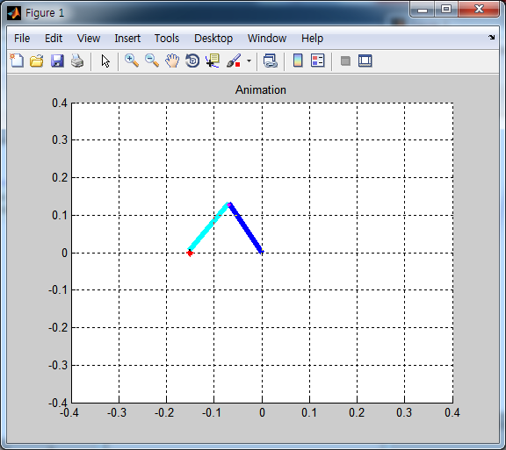
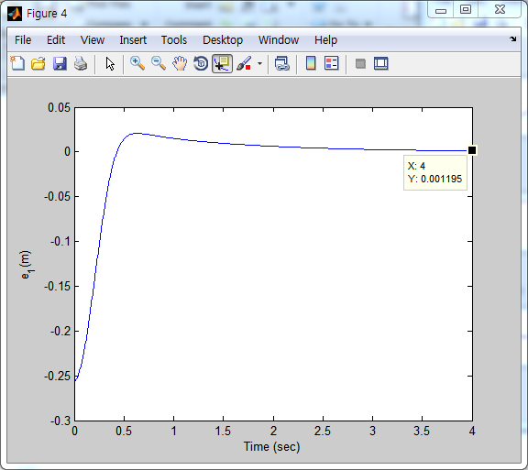
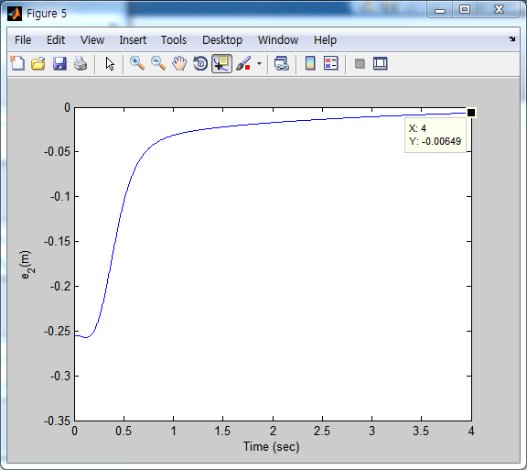
kp = kp*0.5; kd = 0.3*1.5; k = 50*1.5;

Slide 23
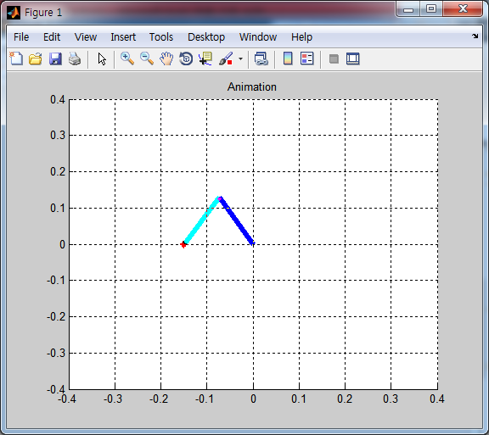
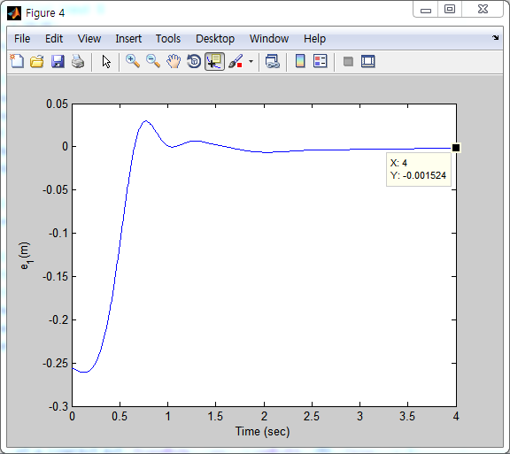
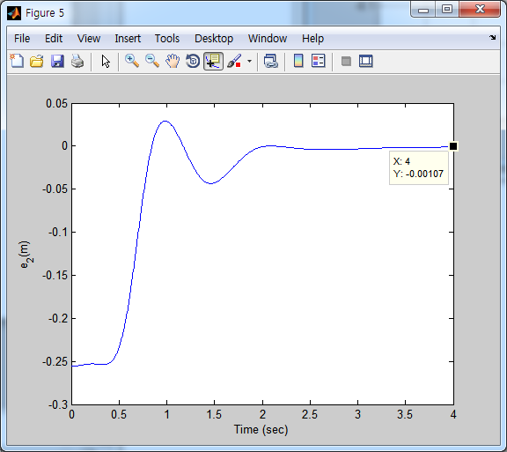
kp = kp*1.5; kd = 0.3*0.5; k = 50*1.5;

Slide 24
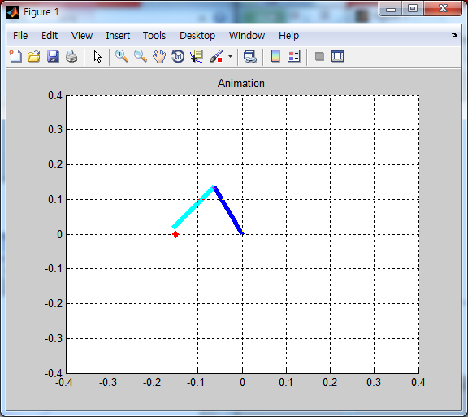
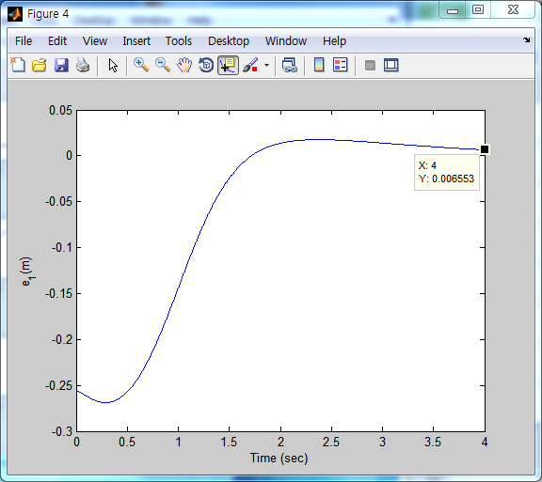
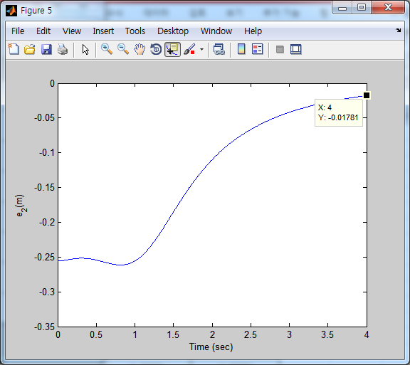
kp = kp*1.5; kd = 0.3*1.5; k = 50*0.5;

Slide 25
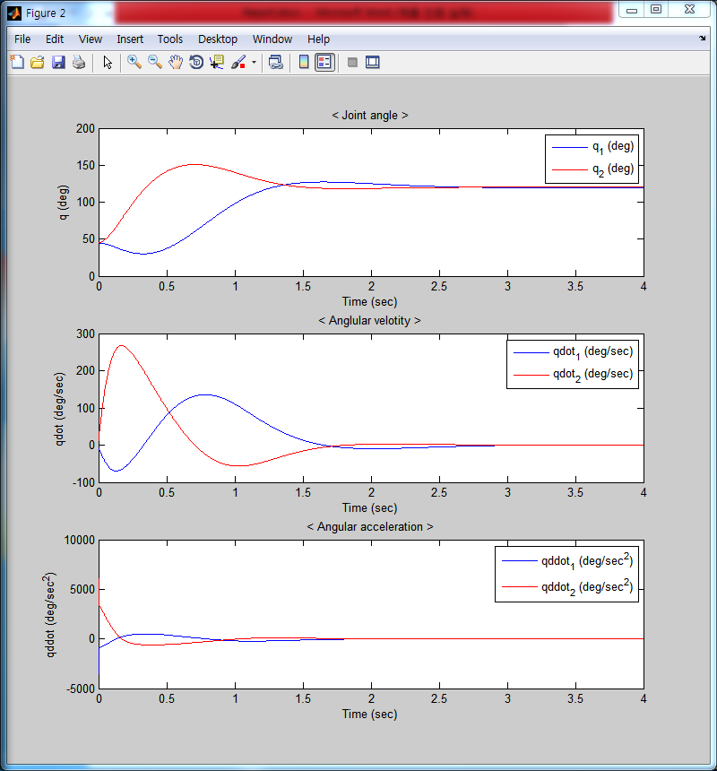
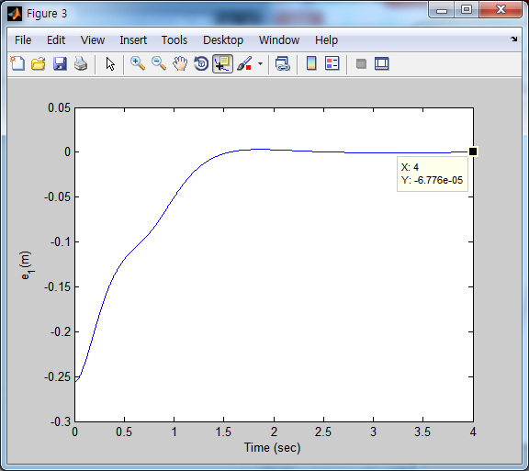
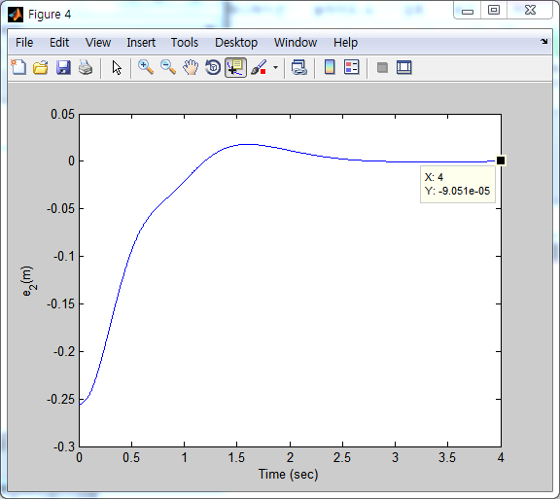
Direct_Regulation(two_link)

Slide 26

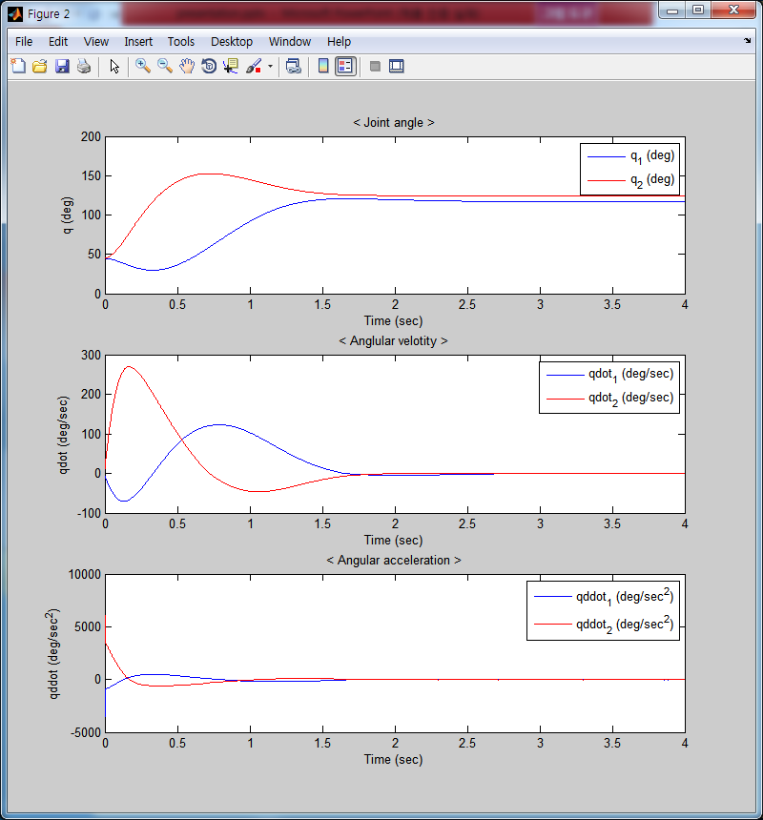
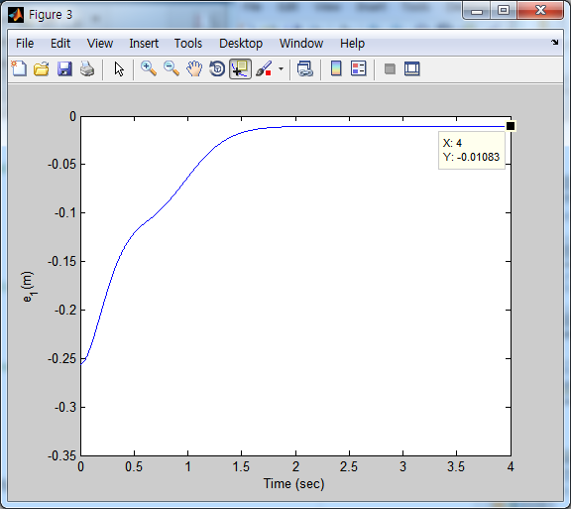
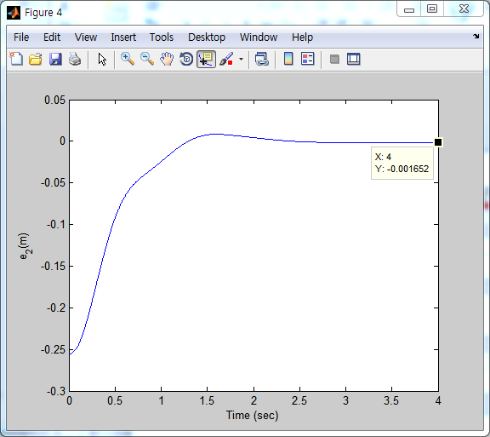
Direct_Regulation((two_link_df)

Slide 27
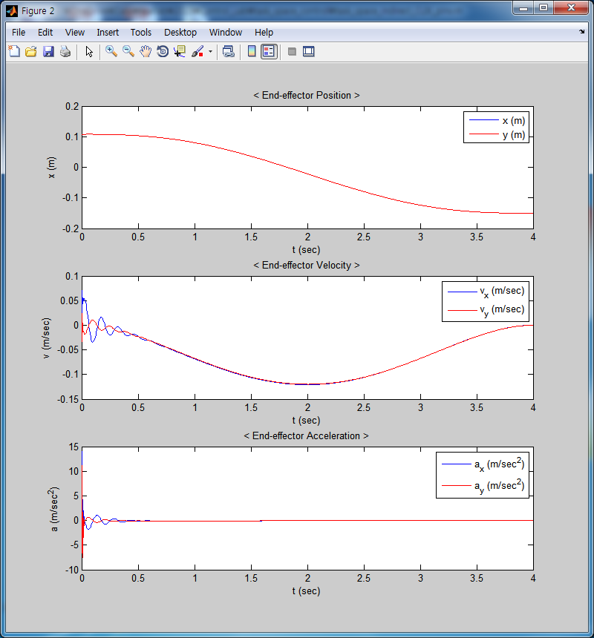
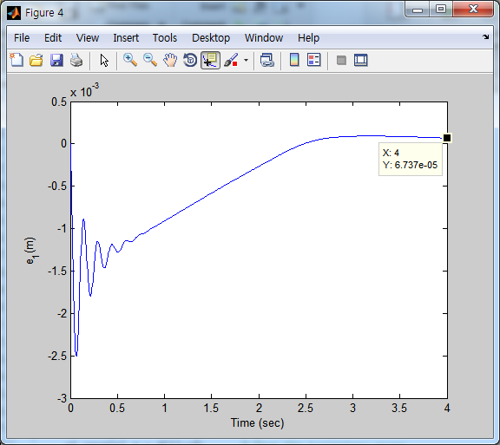
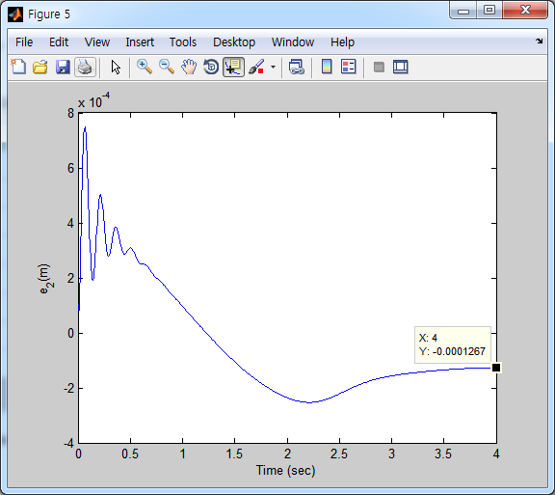
Indirect_CLIK_Pinv(two_link)

Slide 28
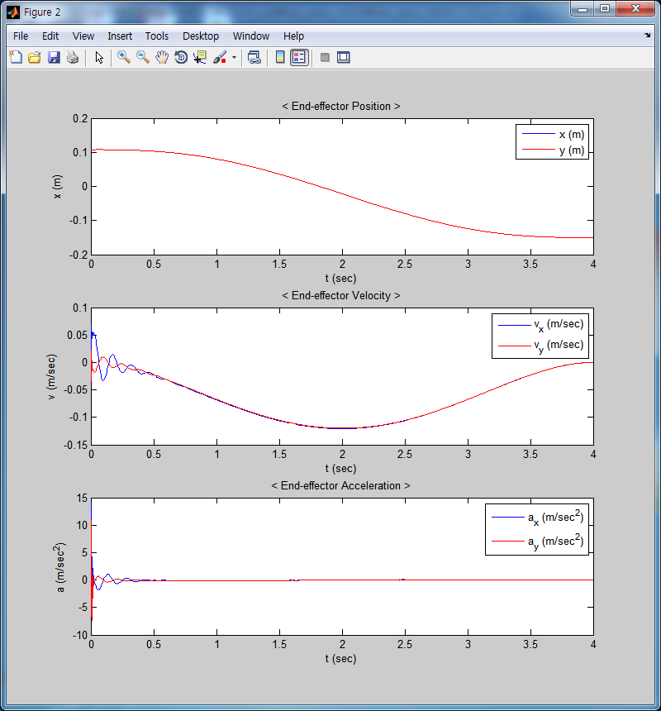


Indirect_CLIK_Pinv(two_link_df)

Slide 29



Indirect_RAC(two_link)

Slide 30



Indirect_RAC(two_link_df)

Slide 31



direct_IDC(two_link)

Slide 32



direct_IDC(two_link_df)

Slide 33



direct_LBC(two_link)

Slide 34



direct_LBC(two_link_df)

Slide 36
제어기의 성능을 gain값의 변화에 영향을 덜 받는 것을 좋은 제어기 라고 가정
모든 제어기가 gain값이 증가했을 때 보다 감소 했을 때 영향을 더 많이 받음(0.5배 vs 1.5배)
Indirect보다 direct가 전반적으로 robust함을 알 수 있음(error값의 차이)
Indirect_regulation vs Indirect_CLIK&pinv vs indirect RAC

Slide 41


