Slide 1
Classification of Thyroid Cancer Recurrence
Using Least Squares vs Linear SVM
- Rahul Lakhera

Slide 2
Motivation & Objective
Cancer recurrence remains a major challenge, with several cancers such as ovarian, glioblastoma, pancreatic, and lung showing relapse rates of 50–90%.
Even Differentiated Thyroid Cancer (DTC), though highly curable, recurs in 15–30% of patients, often years after remission, demanding lifelong follow-up.
This study leverages Machine Learning — specifically Least Squares Regression and Linear SVM — to predict recurrence risk, enabling personalized patient monitoring and timely medical intervention.
Objective: Compare two linear models – Least Squares Regression and Linear SVM – for recurrence prediction.
This study contributes to precision oncology and enhances follow-up planning for thyroid cancer patients.

Slide 3
Background & Literature Review
The dataset originates from the UCI ML Repository's Differentiated Thyroid Cancer Recurrence study.
Prior research applied Logistic Regression, Decision Trees, and SVM models achieving accuracies around 0.90–0.94.
This work extends that benchmark using rigorous inner–outer 5-fold cross-validation to ensure reproducibility.
Results show performance consistent or slightly superior to published metrics.
Dataset Reference:
UCI ML Repository – Differentiated Thyroid Cancer Recurrence Dataset

Slide 4
Data Exploration & Preprocessing
Dataset contained 383 samples with clinical and pathological features.
No missing or null values detected during exploration.
Categorical variables (Gender, Tumor Stage, etc.) encoded via One-Hot Encoding to avoid ordinal bias.
StandardScaler applied to numeric feature (Age) ensuring mean=0, variance=1.
These steps prevented dominance of high-scale features and stabilized SVM optimization.

Slide 5
Model 1: Least Squares Regression
Least Squares Regression minimizes squared error; outputs thresholded at 0.5 for binary classification.
Performance:
- Accuracy: 0.960
- Balanced Accuracy: 0.932
- Precision (No / Yes): 0.95 / 1.00
- Recall (No / Yes): 1.00 / 0.86
- F1-Score (No / Yes): 0.97 / 0.93
Interpretation: Performs well on majority class (non-recurrence) but misclassifies some recurrence cases.
Indicates mild bias toward dominant class and lack of decision-margin robustness.

Slide 6
Model 2: Linear SVM
Linear SVM seeks optimal hyperplane maximizing margin between classes.
GridSearchCV tuned C ∈ {0.01, 0.1, 1, 10, 100}; best parameter = 0.1.
Performance:
- Accuracy: 0.974
- Balanced Accuracy: 0.955
- Precision (No / Yes): 0.96 / 1.00
- Recall (No / Yes): 1.00 / 0.91
- F1-Score (No / Yes): 0.98 / 0.95
Inference: Superior recall for recurrence class, fewer false negatives, stronger boundary discrimination.

Slide 7
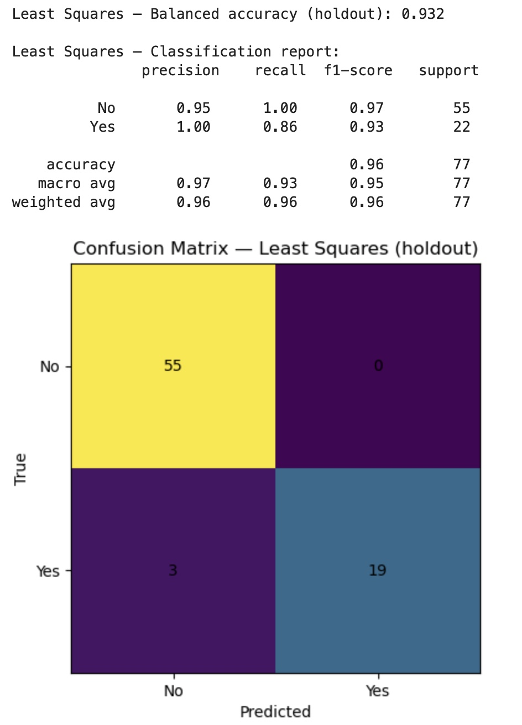
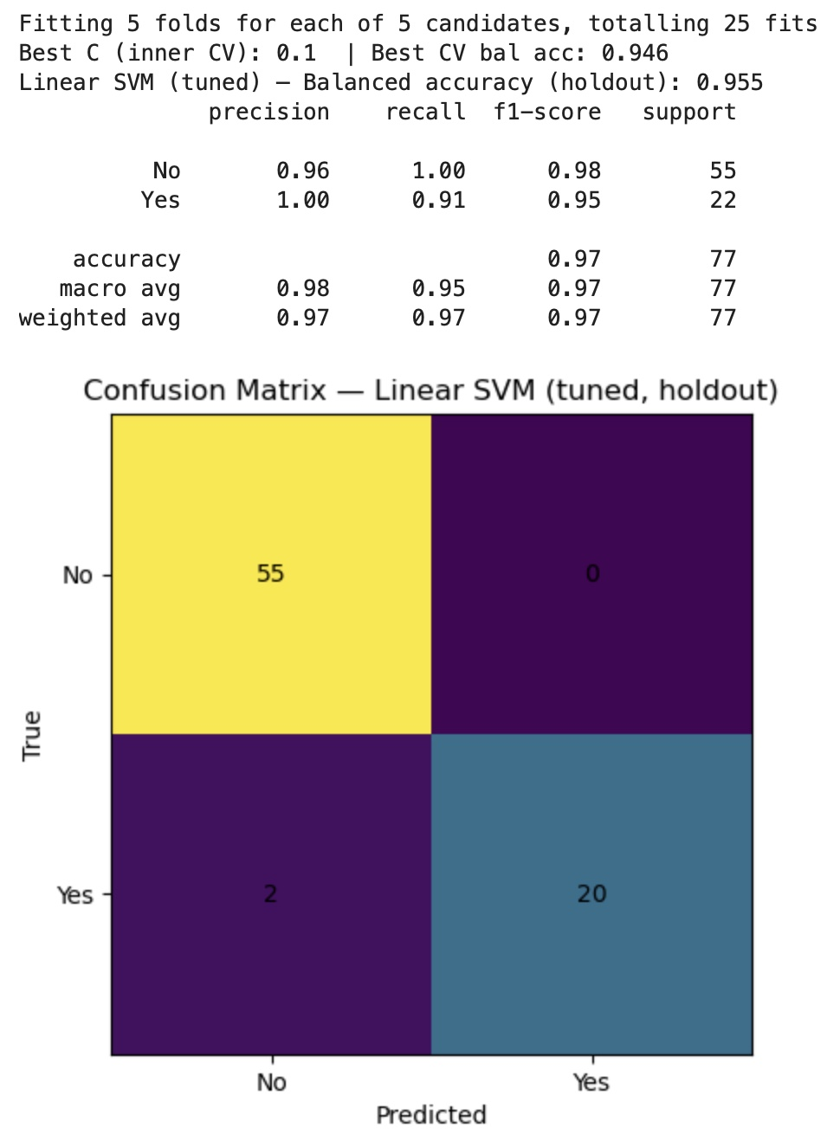
Confusion Matrix Comparison
SVM shows clearer class separation and fewer false negatives than Least Squares Regression.

Slide 8
Discussion & Insights
Preprocessing (One-Hot Encoding & Scaling) greatly improved model stability and fairness.
SVM handled mild non-linearity and class imbalance better due to margin optimization.
Least Squares was interpretable but less effective in separating binary classes.
SVM’s higher recall reduced false negatives — critical for early recurrence detection.
Overall, SVM outperformed by balancing accuracy, generalization, and clinical reliability.

Slide 9
Conclusion & Future Work
The Linear SVM model achieved a higher balanced accuracy (0.955) compared to Least Squares Regression (0.932), demonstrating superior classification performance.
The SVM generalized better across folds, effectively handling the slight class imbalance and non-linear feature relationships present in the dataset.
Least Squares Regression, while interpretable and computationally simple, showed limitations in modeling binary class boundaries, resulting in misclassification of a few recurrence cases.
The study highlights the importance of proper data preprocessing, One-Hot Encoding and Standard Scaling significantly improved model stability and performance.
These results emphasize how machine learning can complement clinical expertise, supporting early detection of recurrence and enabling more personalized patient follow-up strategies.

