Slide 1
LiteX: Python-Powered SoC Design for FPGAs
From Button-to-LED to RISC-V SoC in Five Examples
BsC Electronics & Computer Science
Target: Olimex GateMate A1 EVB | Toolchain: Yosys + p_r + openFPGALoader

Slide 2
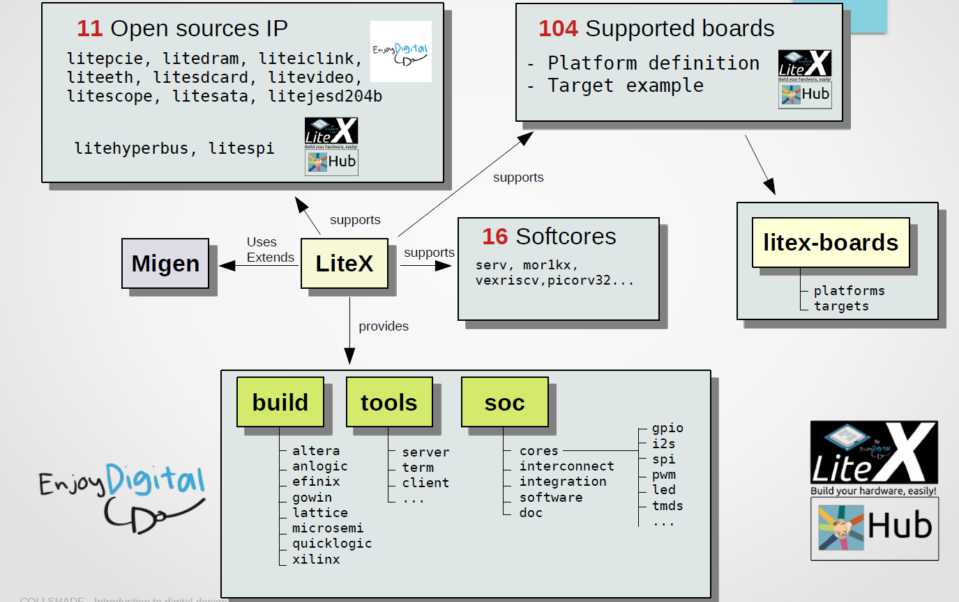
LiteX

Slide 3
LiteX overview

Slide 4
LiteX overview

Slide 5
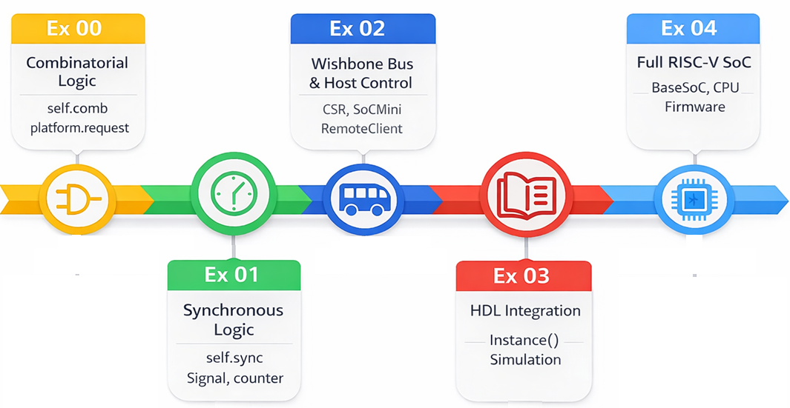
What would be covered in this presentations

Slide 6
What is LiteX?
Python-based SoC (System-on-Chip) builder framework
Uses Migen as its HDL: describe hardware in Python, generate Verilog
Complete integration: bus interconnects, peripherals, CPUs
Open source: github.com/enjoy-digital/litex
Supports 20+ FPGA families and 10+ soft CPUs
Active community with extensive board support
Key Insight
Write Python classes instead of VHDL/Verilog. LiteX generates all the glue logic, address decoding, and bus wiring automatically.

Slide 7
What is Migen?
The HDL inside LiteX
Module: base class for all hardware blocks
self.comb += : combinatorial (wire) assignments
self.sync += : synchronous (clocked/registered) assignments
Signal(width): declares hardware wires/registers
Python operators: +, ==, If(), Cat() map to hardware
# Migen (Python)
counter = Signal(26)
self.sync += counter.eq(counter + 1)
self.comb += led.eq(counter[23])
// Verilog equivalent
reg [25:0] counter;
always @(posedge clk)
counter <= counter + 1;
assign led = counter[23];

Slide 8
Why LiteX for Students?
Rapid prototyping: full SoC in ~60 lines of Python
No vendor lock-in: GateMate, Lattice, Xilinx, Intel, Gowin...
One language: hardware, simulation, and host control all in Python
Reusable IP: peripherals are Python classes you can import
Open-source toolchain: Yosys + nextpnr/p_r (no licenses needed)
Auto-generated: bus wiring, address maps, CSR registers, memory layout
Built-in simulation: test before synthesis with run_simulation()
Host communication: control FPGA from PC via UART bridge

Slide 9
Traditional FPGA Flow vs LiteX Flow
Traditional Flow
LiteX Flow
Write VHDL/Verilog by hand
Manual bus wiring and address maps
Vendor-specific tools (Vivado, Quartus)
Separate testbench language (SystemVerilog)
Manual host communication setup
Difficult to reuse across projects
Write Python Module classes
AutoCSR auto-generates bus + addresses
Open-source: Yosys + p_r/nextpnr
Python simulation with run_simulation()
Built-in UART bridge + RemoteClient
pip install and import peripherals

Slide 10
The GateMate A1 Platform
Board: Olimex GateMateA1-EVB
FPGA: Cologne Chip CCGM1A1 (20,480 CPEs)
Clock: 10 MHz on-board oscillator
User I/O: 1 LED (IO_SB_B6), 1 Button (IO_SB_B7)
Serial: UART via DirtyJTAG/RP2040
Programmer: openFPGALoader with DirtyJTAG cable
Memory: 32x BRAM20K + 64x BRAM40K blocks
Toolchain
Yosys -- synthesis (Verilog/VHDL to netlist)
p_r -- place & route (GateMate-specific)
openFPGALoader -- bitstream programming
GHDL plugin -- VHDL support in Yosys

Slide 11
Example 00: Combinatorial Logic
Button to LED -- no clock needed
Goal: press the button, LED lights up instantly
Pure combinatorial logic -- no flip-flops, no clock
Introduces: Module, self.comb, platform.request(), platform.build()
Entire design: 78 lines including comments
+----------------------------------+
| Btn2Led (combinational) |
| |
| Button (IO_SB_B7) |
| | |
| +---> LED (IO_SB_B6) |
| |
| self.comb += led.eq(btn) |
+----------------------------------+
Active-low: button pressed = 0, LED driven low = ON
No clock domain: signal propagates combinationally

Slide 12
Example 00: The Code
btn2Led.py
class Btn2Led(Module):
"""Combinational button-to-LED module. Drives LED directly from button signal."""
def __init__(self, led, btn):
# Both signals are active-low: pass btn straight through to led
self.comb += led.eq(btn)
def main():
import os, subprocess
# Initialize the platform with pin/IO definitions
platform = Platform()
# Request named signals from the platform configuration
led = platform.request("user_led_n", 0)
btn = platform.request("user_btn_n", 0)
# Instantiate the top-level module
module = Btn2Led(led, btn)
# Synthesize and place-and-route via the Cologne Chip toolchain
build_dir = os.getcwd() + "/build"
platform.build(module, build_dir, run=True)
# Program the bitstream onto the FPGA
subprocess.run(["openFPGALoader", "--cable", "dirtyJtag", "build/top_00.cfg"], check=True)
_io = [
("clk0", 0, Pins("IO_SB_A8")),
("user_led_n", 0, Pins("IO_SB_B6")),
("user_btn_n", 0, Pins("IO_SB_B7")),
]
class Platform(CologneChipPlatform):
default_clk_name = "clk0"
default_clk_period = 1e9 / 10e6 # 10 MHz
def __init__(self):
CologneChipPlatform.__init__(self, "CCGM1A1", _io, toolchain="colognechip")
The entire hardware logic is just one line: self.comb += led.eq(btn)

Slide 13
Example 01: Synchronous Logic
LED blink with a free-running counter
Goal: LED blinks at a visible rate (~1 Hz)
26-bit counter increments every clock cycle (10 MHz)
Bit 23 drives the LED: toggles every 2^23 cycles = ~0.84 seconds
Introduces: self.sync, Signal(width), clock domains
Uses upstream platform from litex_boards (no inline _io)
+-------------------------------+
| Blink (Module) |
| |
| counter[25:0] |
| | self.sync: +1 each |
| | clock cycle |
| v |
| counter[23] --> LED |
| (self.comb) |
+-------------------------------+

Slide 14
Example 01: The Code
blinkLed.py
class Blink(Module):
"""LED blink module. Bit 23 of a free-running counter drives the LED."""
def __init__(self, led):
counter = Signal(26)
# Combinatorial assignment: wire counter bit 23 directly to the LED pin
self.comb += led.eq(counter[23])
# Synchronous assignment: increment counter every clock cycle
self.sync += counter.eq(counter + 1)
def main():
import os
# Initialize the platform with pin/IO definitions
platform = olimex_gatemate_a1_evb.Platform()
# Get LED signal from platform
led = platform.request("user_led_n", 0)
# Instantiate top-level module
module = Blink(led)
# get the build directory
build_dir = os.getcwd() + "/build"
# Synthesize and place-and-route via the Cologne Chip toolchain
platform.build(module, build_dir)
# program the chip
platform.create_programmer().load_bitstream(build_dir + "/top_00.cfg")
self.comb += led.eq(counter[23]) -- wire (combinatorial)
self.sync += counter.eq(counter + 1) -- register (clocked)
New: uses litex_boards.platforms instead of inline _io definition

Slide 15
Example 02: Wishbone Bus
Host-controlled LED via UART bridge
Host PC (Python) FPGA
+----------------+ +----------------------------+
| RemoteClient | | UARTWishboneBridge |
| wb.write() |<--->| (Wishbone bus master) |
| wb.read() | UART| | |
+----------------+ | | Wishbone bus |
| v |
litex_server | LED Peripheral |
--uart | (Wishbone slave) |
| @ 0x40000400 |
+----------------------------+
Wishbone bus: standard FPGA interconnect (CYC, STB, ACK, WE, ADR, DAT)
UARTWishboneBridge: host PC becomes bus master over serial port
Two approaches: manual address decode vs. CSR framework
litex_server bridges UART to TCP for RemoteClient access

Slide 16
Example 02: Direct Wishbone Slave
Manual address decoding
class WishboneLed(Module):
def __init__(self, led):
self.bus = wishbone.Interface(data_width=32, adr_width=30)
led_reg = Signal()
addr_match = Signal()
LED_WORD_ADDR = 0x10000100 # 0x40000400 >> 2
self.comb += addr_match.eq(self.bus.adr == LED_WORD_ADDR)
self.sync += [
self.bus.ack.eq(0),
If(self.bus.cyc & self.bus.stb & ~self.bus.ack,
self.bus.ack.eq(1),
If(self.bus.we & addr_match,
led_reg.eq(self.bus.dat_w[0]),
),
),
]
self.comb += [
If(addr_match, self.bus.dat_r.eq(led_reg)),
led.eq(~led_reg),
]
Manual Wishbone slave interface
Word addressing: 0x40000400 >> 2
Always ACK to prevent bus hangs
CYC & STB = valid transaction
WE = write enable
~50 lines of bus logic

Slide 17
Example 02: The CSR Approach
Same result, much less code
class LedPeripheral(Module, AutoCSR):
def __init__(self, led):
self.control = CSRStorage(1, name="control")
self.comb += led.eq(~self.control.storage)
4 lines vs 50!
AutoCSR handles all bus wiring, address decoding, and ACK logic automatically.
class Top(SoCMini):
mem_map = {**SoCMini.mem_map, "csr": 0x40000000}
csr_map = {"ctrl": 0, "led": 1} # led @ 0x40000400
def __init__(self, platform):
SoCMini.__init__(self, platform, clk_freq=CLK_FREQ,
uart_name="crossover", csr_paging=0x400)
from litex.soc.cores.uart import UARTWishboneBridge
serial = platform.request("serial")
self.submodules.bridge = UARTWishboneBridge(
pads=serial, clk_freq=CLK_FREQ, baudrate=BAUDRATE)
self.bus.add_master(name="bridge", master=self.bridge.wishbone)
led_pin = platform.request("user_led_n", 0)
self.submodules.led = LedPeripheral(led_pin)

Slide 18
Example 02: Host-Side Control
Python controls FPGA hardware
from litex import RemoteClient
wb = RemoteClient()
wb.open()
# Turn LED on
wb.write(0x40000400, 0x1)
# Read back register
value = wb.read(0x40000400)
print(f"LED = {'ON' if value & 1 else 'OFF'}")
# Turn LED off
wb.write(0x40000400, 0x0)
wb.close()
Step 1: Build & program bitstream
Step 2: litex_server --uart --uart-port=/dev/ttyACM0
Step 3: Run Python script with RemoteClient
Same Python language for:
- Hardware description (Migen)
- Build script (LiteX)
- Host control (RemoteClient)
- Simulation (run_simulation)

Slide 19
Example 03: HDL Integration
Wrapping Verilog/VHDL as a black-box
Goal: use existing Verilog/VHDL modules inside a LiteX design
Use case: CRC32 hardware accelerator from generated HDL
Migen Instance() wraps any HDL module as a black-box
platform.add_source() includes the HDL file in synthesis
Two CSR registers: data (write byte / read checksum) + reset control
Host PC FPGA
+------------------------------+
wb.write(byte) | CSR decoder |
-----UART------->| | |
| v |
wb.read(crc) | CRC32Peripheral |
<--UART----------| data @ 0x40000800 |
| reset_ctrl @ 0x40000804 |
| | |
| v |
| Instance("crc", ...) |
| Verilog/VHDL black-box |
+------------------------------+

Slide 20
Example 03: The Instance() Pattern
Connecting Migen to external HDL
# Add HDL source file to the build
platform.add_source("hdl/crc.v")
# Instantiate the Verilog module as a black-box
self.specials += Instance("crc",
i_crcIn = crc_in, # 32-bit accumulated state
i_data = self.data.r[0:8], # 8-bit input byte from CSR write
o_crcOut = crc_out, # 32-bit next CRC state
)
# Accumulator: feed output back as next input
self.sync += [
If(self.reset_ctrl.re, # Reset strobe
crc_in.eq(0xFFFFFFFF),
).Elif(self.data.re, # Data write strobe
crc_in.eq(crc_out), # Accumulate
)
]
# Read path: invert for CRC32 final XOR
self.comb += self.data.w.eq(~out_buf)
// hdl/crc.v (generated, combinatorial)
module crc (
input [31:0] crcIn,
input [7:0] data,
output [31:0] crcOut
);
// CRC-32/ISO-HDLC polynomial
// 32 XOR equations...
assign crcOut[0] = crcIn[2]
^ crcIn[8]
^ data[2];
// ...
endmodule
Instance("module_name", i_port=signal, o_port=signal)
CSR.re = write strobe, CSR.r = write data, CSR.w = read data

Slide 21
Example 03: Simulation & Testing
Test before synthesis
Problem: Verilog Instance() cannot be simulated by Migen's simulator
Solution: create a pure-Migen mirror (MigenCRC32Step) for simulation
TestBench wires: Wishbone master -> Wishbone2CSR -> CSRBank -> DUT
Validate against Python reference: binascii.crc32()
run_simulation() generates VCD waveforms for inspection
# Testbench: write bytes, then read CRC
def test_process():
# Write "123456789" one byte at a time
for byte in b"123456789":
yield from wb_write(0x0, byte)
# Read back CRC32 checksum
crc = yield from wb_read(0x0)
assert crc == 0xCBF43926, f"CRC mismatch: {crc:#x}"
run_simulation(tb, test_process(), vcd_name="crc32.vcd")

Slide 22
Example 04: Full RISC-V SoC
A complete computer on FPGA
+-----------------------------------------------+
| MySoC (extends BaseSoC) |
| |
| +----------+ +-------+ +--------+ |
| | VexRiscV | | BRAM | | UART | |
| | CPU |->| ROM | | Console| |
| | (minimal)| | + RAM | | 115200 | |
| +----+-----+ +-------+ +--------+ |
| | |
| | Wishbone bus |
| v |
| +----+-----+ +-----------+ |
| | CSR | | CSR | |
| | LED | | CRC32 | |
| | Periph. | | Periph. | |
| +----------+ +-----------+ |
+-----------------------------------------------+
BaseSoC provides CPU, ROM, RAM, UART
Just add your custom peripherals
VexRiscV minimal: 3368 CPEs (16.4%)
BIOS boots automatically
Firmware runs on the CPU
CSR addresses auto-generated
compile_software=True builds BIOS
PicoRV32 variant also available

Slide 23
Example 04: The Code
~20 lines for a complete SoC
class LedPeripheral(Module, AutoCSR):
def __init__(self, led):
self.control = CSRStorage(1, name="control", description="LED control (bit 0: 1=on, 0=off)")
self.comb += led.eq(~self.control.storage)
# -------------------------------------------------
# Custom SoC
# -------------------------------------------------
class MySoC(BaseSoC):
def __init__(self, **kwargs):
kwargs.setdefault("cpu_type", "vexriscv")
kwargs.setdefault("cpu_variant", "minimal")
kwargs.setdefault("uart_baudrate", 115200)
BaseSoC.__init__(self,
with_led_chaser=False, # Disable chaser so we can claim user_led_n ourselves
**kwargs
)
platform = self.platform
# Request physical LED from platform (active-low: _n suffix)
led = platform.request("user_led_n", 0)
# Instantiate peripheral
self.submodules.led_peripheral = LedPeripheral(led)
# Register as CSR
self.add_csr("led_peripheral")
Reuses LedPeripheral from Example 02
BaseSoC handles all CPU plumbing
with_led_chaser=False: claim LED
self.add_csr() registers peripheral
Reusable library pattern:
from mycsrlib import CRC32Peripheral
Build resources (VexRiscV):
CPE: 3368 / 20480 (16.4%)
BRAM 40K: 9 / 32 (28.1%)
Fmax: 27.98 MHz (target: 24)

Slide 24
The LiteX Ecosystem
Supported CPUs
Built-in Peripherals
VexRiscV -- configurable, efficient
PicoRV32 -- compact, simple
Minerva -- formally verified
SERV -- world's smallest RISC-V
OpenRISC, LM32, and more...
UART, SPI, I2C, GPIO
Timer, PWM, Watchdog
Ethernet (LiteEth)
DRAM controller (LiteDRAM)
PCIe, SATA, USB (advanced)
FPGA support: Cologne Chip GateMate, Lattice ECP5/iCE40, Xilinx 7-series/UltraScale, Intel Cyclone/MAX10, Gowin
80+ board definitions in litex-boards | Active GitHub community + Discord

Slide 25
Questions?
LiteX: github.com/enjoy-digital/litex
Migen: m-labs.hk/migen
GateMate: colognechip.com
Board: github.com/OLIMEX/GateMateA1-EVB

