Slide 1
Uncharted
Raissa Largman (presenter), Kate Wendell, Moustafa Asfour, Matt Taylor

Slide 2
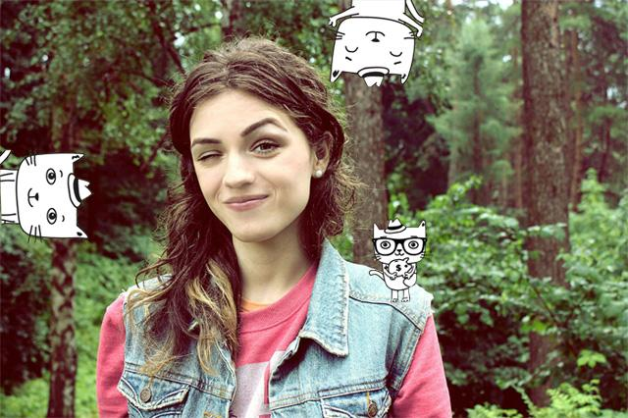
Peggy
Notes:
It’s all about Peggy!

Slide 3
Overview
Tasks
Revised UI
Scenarios
Tools

Slide 4
Tasks

Slide 5
1. Browsing
Notes:
Changes: Trip details page (confined to mobile screen, so what most important -- narrowed, pictures bigger, less text, budget different from cost of hostel)

Slide 6
2. Favorites
Notes:
Changes: Mostly the same functionality, added favorites to details page per request

Slide 7
3. Filtering
Notes:
Changes: Simplified by far (only geofilter since many were confused about the difference between the other types (setting/activity) or why they were relevent, also implementation time, delete from another screen

Slide 8
Revised UI

Slide 9
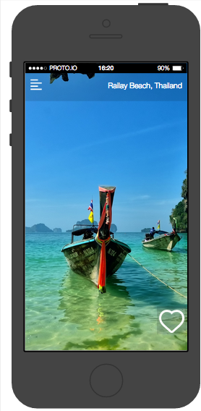
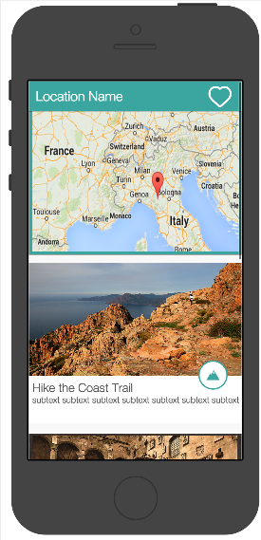
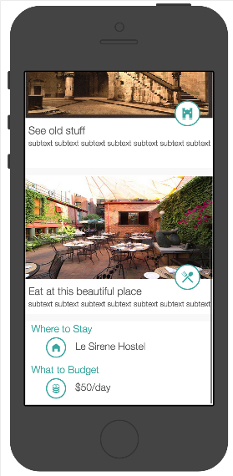
1. Browsing
Destination Screen
Trip Details (top)
Trip Details (bottom)
Notes:
Changes: pictures bigger, less text, budget label to say it is different from cost of hostel, icon to say what type, scrollable map for more context

Slide 10
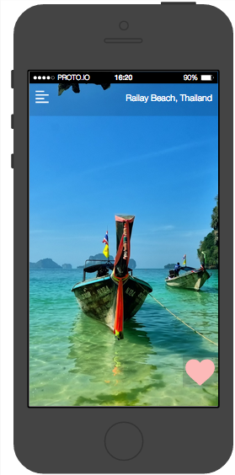
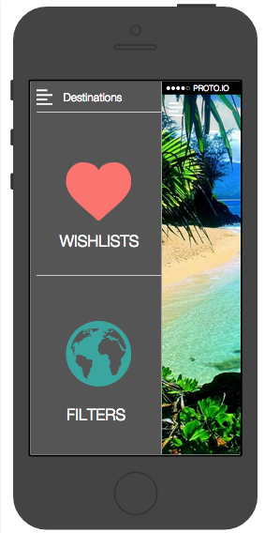
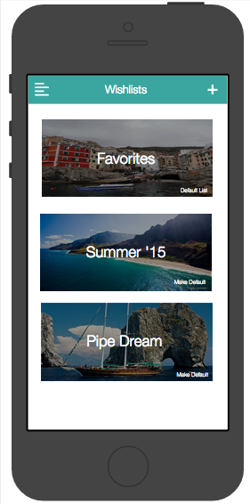
2. Wishlists
Liking a destination
Go to Wishlists
Wishlists Page
Notes:
Changes: pictures are the background to know what type was favorited, but changed the least

Slide 11
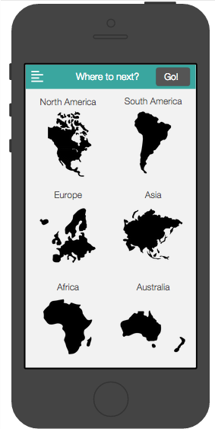
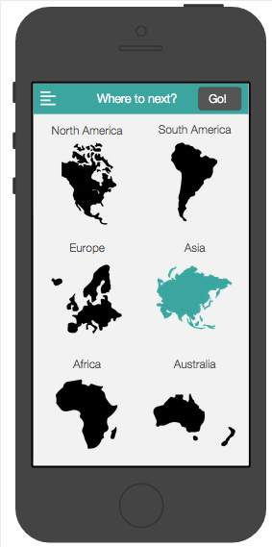
3. Filtering
Go to Filters
Filters Page
Selecting a Filter
Notes:
Changes: Made continent buttons instead of map since it was unclear what would be selected on a map or how to select, removed other pages/tabs since that was very confusing, go button at the top

Slide 12
Scenarios

Slide 13
Demo Time!
Notes:
That’s right, it’s show time!
Load screen → Straight to destination → Click to see trip details → click back → like it → continue to filter → click on Asia → go! → click on details → long tap to like → next → long tap to like → go to wishlists → look at list → go back to island → swipe some more → on Hawaii add list

Slide 14
Tools

Slide 15

Notes:
Drawbacks: no collaboration (log in one at a time, or all around a computer), learning curve (discovered variables too late), changing dimensions??!!!. Good things: once learned, pretty fast, duplication good, did have a lot of functionality, slide in menu already set up

Slide 16
WoZ Techniques / Don’t Work
Filtering = LIES!
Adding wishlists
Favoriting
Notes:
Filters don’t actually do anything, Adding wishlist (fake), Favoriting doesn’t add them to lists right now

Slide 17
Summary
Notes:
simplified filters, more pictures, clearer details | proto.io is mostly good but should have collaboration | some things (especially filtering and linking aren’t working yet)

Slide 18


