Slide 1


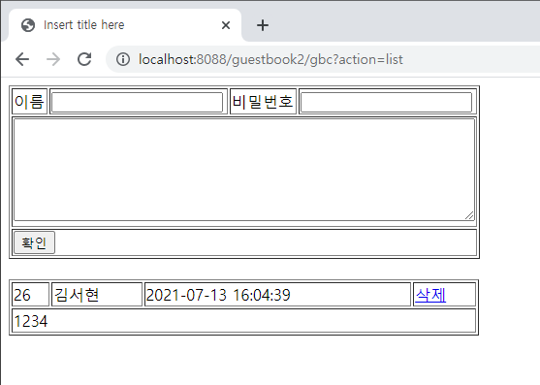
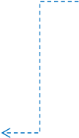
리스트
Rqeust(요청)
Request header
파라미터: action=list
Request body
http://localhost:8088/phonebook2/pbc?action=list
Tomcat
guestbook2
contoller(servlet)객체
rquest
list일때
Response(응답)
response
*포워드
addListjsp
객체
Response header
Response body
(html)

Slide 2
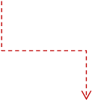

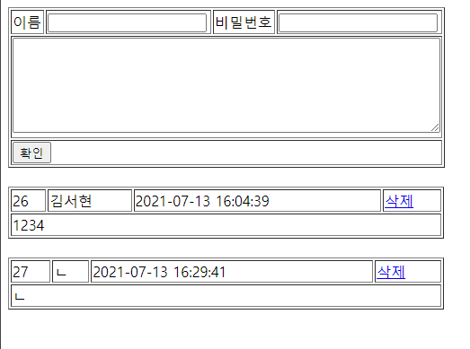
Rqeust(요청)
추가
Request header
파라미터: action=add&name=?&password=?&content=?
Request body
http://localhost:8088/phonebook2/pbc?action=add&name=?&password=?&content=?
Tomcat
guestbook2
contoller(servlet)객체
phoneDao 객체
rquest
add일때
guestbookInsert()
Response(응답)
response
Response header
Response body
(html)
DB

Slide 3

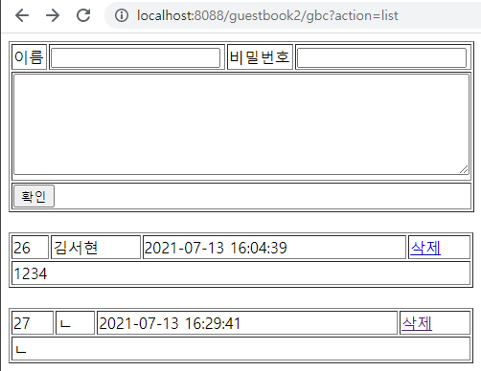
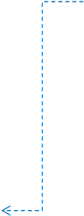

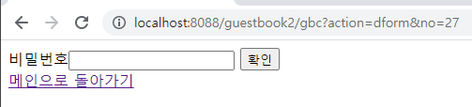
삭제폼
Rqeust(요청)
Request header
파라미터: action=dform&no=?
Request body
http://localhost:8088/phonebook2/pbc?action=dform&no=?
Tomcat
guestbook2
contoller(servlet)객체
rquest
dform일때
Response(응답)
response
*포워드
deleteorm.jsp
객체
Response header
Response body
(html)

Slide 4



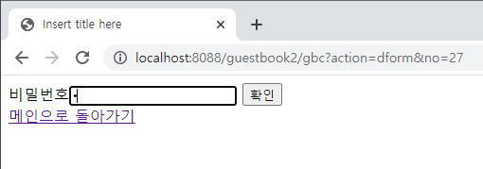
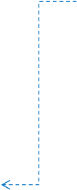
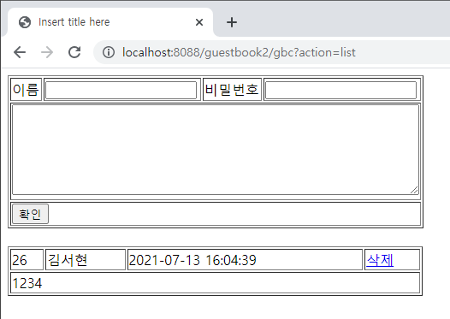

삭제
Rqeust(요청)
Request header
파라미터: action=delete&id=?&password=?
Request body
http://localhost:8088/phonebook2/pbc?action=delete&id=?&password=?
Tomcat
guestbook2
contoller(servlet)객체
phoneDao 객체
rquest
delete일때
guestbookDelete()
Response(응답)
response
DB
Response header
Response body
(html)

