Slide 1

CS4920 Lab 3 – Autonomous System (AS) Classification
LCDR Brett rajchel
LT Rouben Azad

Slide 2
Lab Domain And tasks
Our method consists of using labeled AS classification data to train a machine-learning classifier to classify ASes according to their types.
We first use a ground-truth dataset from PeeringDB (described next), and split it into two parts to create a labeled training and validation set. We then train a machine-learning classifier using a number of features for each AS (described next) to train a decision-tree machine-learning classifier.
Tasks:
Walk through the data with some simple questions (plots, unique counts)
Take in all the features or some, of the AS’s in the database, evaluate them through various machine learning tools to classify AS’s

Slide 3
AS classification Applicability to networking
Helpful for intra-AS and inter-AS router-level topology modeling
E.g. small company AS versus university AS
Documenting and understanding growth of the internet
Different AS types grow with different patterns (E.g. ASes associated with a university typically aren’t expected to grow)
Mapping IP addresses to different types of users
E.g. Can expect student-like activity from traffic originating from university AS
Ref: “Revealing the Autonomous System Taxonomy: The Machine Learning Approach”, Dimitropoulos et al.
Ref: “Inferring AS-level Internet Topology from Router-level Path Traces”, Chang et al.

Slide 4
Learning Objectives
Learn more about ASes and practicality of AS classification
Understand how networking problems are cast as machine learning tasks
Learn more about feature selection
Understand the data types that can be used by machine learning algorithms
Learn how to engineer features from raw data
Pair machine learning algorithms to specific problems and associated data
Given a dataset, understand why some machine learning algorithms perform better than others

Slide 5
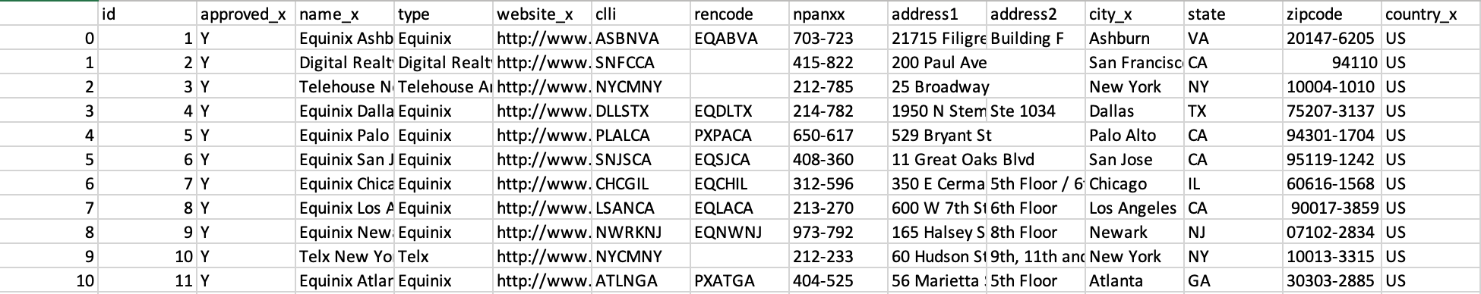
Dataset
From PeeringDB.com
For each AS, the dataset provides 58 features
Labels are the different AS types (network service provider, content, non-profit)
Other features include:
Location
Traffic rate
IP prefixes
Policy

Slide 6
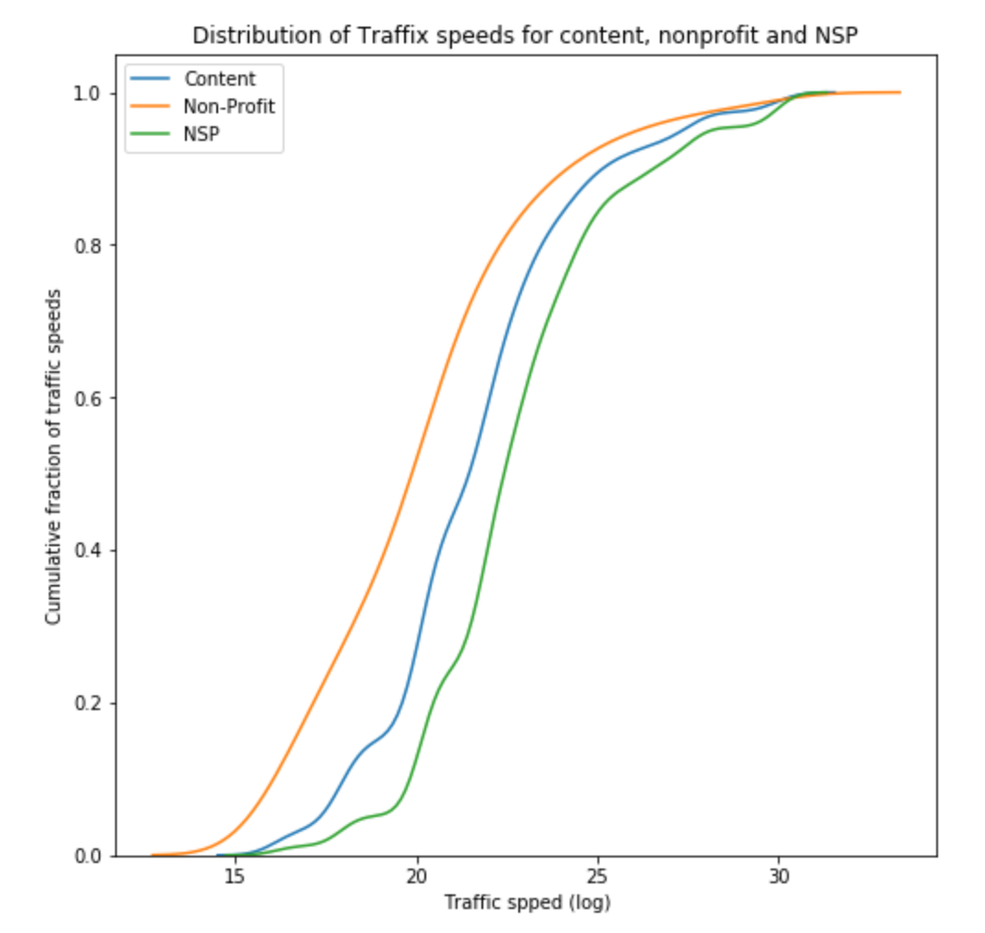
Expected solutions/approach
Students will have to use knowledge of ASes to determine useful features amongst those available
Many unnecessary dataset features will be discarded
Because many AS features are not standardized, data manipulation and encoding will be necessary
Our approach would be to use jupyter notebook to portray plots, CDF that describes the dataset as shown here. (CDF of traffic speed for labels)
Expected to use 3 machine learning algorithms and evaluate the results. Check for Precision accuracy, change configurations within the algorithms to run better or worse, drop or add columns for experimentations.

Slide 7
Pros/cons
Pros
Cons
Small database, fast computation
Large number of features
Labels are available
Expose students to the breadth of machine learning applicability (an uncommon problem solved via machine learning)
Exposure to practical problem
Small database, might hold some bias
3 years old (most recent snapshot from 2016)
Database is in SQL/sqllite (not in proper format)
Data manipulation
Features were often not standardized amongst ASes
Missing fields
Feature meanings were not always intuitive
Excessive data wrangling will be required from students

