Slide 1
Introduction to Computer Science
Presented by DR. Clay Carper
Developed using various sources

Slide 2
What is Computer Science?
A brief description from a few perspectives:
From a CS Doctorate
From a CS Undergraduate
From a non-CS Undergraduate

Slide 3
What is Computer Science? – Doctorate Description
Rigorous study of computational systems
Encompasses theoretical and practical aspects
Encompasses theoretical and practical aspects
Involves original research and peer-reviewed publications
Develops innovative solutions to complex problems

Slide 4
What is Computer Science? – CS Undergrad Description
Covers basics of programming and data structures
Explores complex topics: AI, cybersecurity
Teaches writing efficient code and understanding computer operations
Offers exposure to various computing applications in industries
Provides numerous career opportunities

Slide 5
What is Computer Science? – non-CS Undergrad Description
Focuses on creating and improving software and technology
Essential for developing everyday apps and programs
Involves problem-solving, coding, and enhancing tech efficiency and security
Computer Science majors work on impactful projects
Influences many aspects of life: entertainment, communication, healthcare

Slide 6
What is Computer Science? – Focal point: Problem Solving
Central focus: Using computers and programming to address and solve complex problems
Leverage computers and programming as a tool
Development of domain-agnostic algorithms/software
Evaluate and improve efficiency of solutions
Automation of tasks
Drive technological advancement and innovation

Slide 7
So, what is programming?
Def: Programming is the process of designing and writing instructions that a computer can follow to complete specific tasks
Instructions are commonly referred to as code
Code is an element of a programming language;
A programming language consists of:
syntax
semantic
data types
variables
control structures
functions/procedures
libraries/frameworks

Slide 8
Elements of a programming Language -- Syntax
Determine the structure and format,
Think “structure”
Examples:
The Grammar,
Punctuation
Format, affecting:
What constitutes a valid statement/expression
Reserved keywords, such as:
if
for
while
int

Slide 9
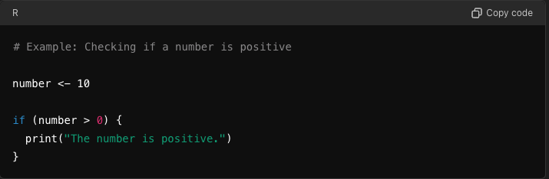
Elements of a programming Language -- Semantics
The meaning behind syntax
Ex: The semantics of the `if` statement:
Evaluates a condition
Executes a block of code based on “truthiness” of the statement

Slide 10
Elements of a programming Language – Data Types
Kinds of values that can be stored and manipulated
Think “different kinds of values”
Common examples:
Integers (…, -2, -1, 0, 1, 2, …)
Floats (decimal-valued numbers*)
Characters (typically a single letter/symbol)
Strings (multiple characters or words)
Booleans (true/false, True/False, TRUE/FALSE, 0/1; the representation varies based on language syntax)
* Float-based values are not equivalent to the Real numbers!

Slide 11
Elements of a programming Language – Variables
Named storage “locations” that hold values
Can change value during execution
Typically have some naming restrictions
Think “what we manipulate or work with”
In R:
Valid characters are letters, numbers, dot (.), and underscore (_)
Cannot start with a number or underscore `name` is valid; `_name`, `0name` are not)
Can start with a dot; cannot be followed by a number (`.name` is valid, `.0name` is not

Slide 12
Elements of a programming Language – Control Structures
Determine the flow of a program
Highly dependent on the language syntax/semantics
Think “order of operations”
Common examples:
If/else
Loops (for, while)

Slide 13
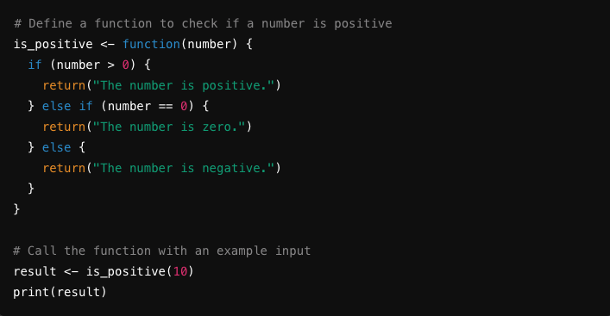
Elements of a programming Language – Functions and procedures
Reusable blocks of code
Perform a specific process/task
Can take input, execute code, and return output(s)/results
Think “reducing repeated code”

Slide 14
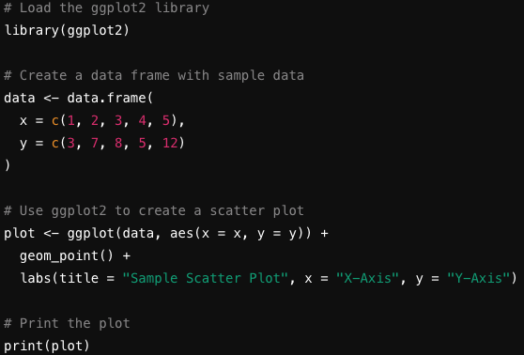
Elements of a programming Language – Libraries and Frameworks
Collections of pre-written code
Often contain functions/procedures
Reduces the need to “reinvent the wheel”
Think “tools to solve problems”

Slide 15
Types of Languages: Compiled vs Interpreted
“How a language is implemented”
Two typical classifications:
Compiled
Interpreted
Usage varies based on the user’s goals/needs

Slide 16
Types of Languages: Compiled
Compiled in a nutshell:
Human-written code is translated into machine-code
Typically run faster
Have low-level interaction with hardware
Example languages:
C/C++
Go
Rust
Swift
Haskell

Slide 17
Types of Languages: Interpreted
Compiled
Code is ran line-by-line with an interpreter at runtime
Gives more flexibility and more simplistic debugging
Run slower; typically lack hardware-focused interaction
Example languages
R*
Python
Ruby
PHP
Perl
* R can have aspects of compiled languages under specific circumstances

Slide 18
Why focus on R?
Rich Ecosystem of packages
Wealth of statistical analysis tools/capabilities
Highly configurable data visualization
Focus on reproducibility and documentation
Integration with other common tools
Open Source

Slide 19
CODE AND YOUR RESEARCH
Make your life easier and better!
REPRODUCIBILITY
If you make a mistake, you can fix it and re-run your code
You can give your code to someone else and they can verify it
You can deploy your old code to a new but similar problem
Gain credibility by essentially “showing your work”
If it is well documented, it’s like a note to your future self on how you did something

Slide 20
CODE AND YOUR RESEARCH
Make your life easier and better!
TRANSPARENCY
Other people can see how you did your work
Other people can verify your work and approve it (your PI: for submission; journal reviewers: for publication)
Other people in your field can evaluate your work more easily for themselves

Slide 21
CODE AND YOUR RESEARCH
Make your life easier and better!
SHARING AND COLLABORATION
Much easier to get help from others in your research group
Much easier to share with people outside your group
New ideas & perspectives, new directions and discoveries

Slide 22
CODE AND YOUR RESEARCH
Make your life easier and better!
PUBLISHING
Sharing your data and code is now required for publication in many journals!
Even if it’s not required…. Expect reviewers to request to see it
Be prepared for this: start early, document well, etc

Slide 23
CODE AND YOUR RESEARCH
Make your life easier and better!
FUNDING
Most funding agencies now require data management plans (which can include code, software, scripts, etc)
Most funding agencies require that you make your data, code, and software public

Slide 24
CODE AND YOUR RESEARCH
But coding doesn’t feel like it’s making my work easier (or more fun)
Start small - every step in the right direction is a good step
Have realistic expectations: you won’t be an expert overnight.
Be willing to be vulnerable: sharing your work can be scary!
Understand that we are all learning and improving - as individuals and as communities

Slide 25
Expectations for this course
Hands on coding experience and exposure!
Just exposure is OK!
Meet you where you are - if in class time isn’t cutting it, we are happy to help out of class
We really only have time to graze the surface of several topics. There’s plenty more to learn out here
Like most things . . . you probably won’t REALLY feel like you’ve learned any of this unless you use it in your own work. That’s where the real learning happens

