Slide 1
Intro to Statistics in R
(AGAIN, BUT DIFFERENT)
Presented by Dr. Rob Baker and Dr. Clay Carper

Slide 2
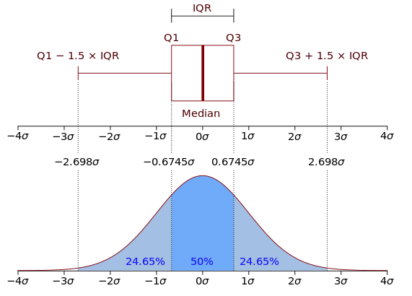
Statistical analysis: outliers
Interpreting box plots:
Compared to the normal distribution
~95% of the data should be within the whiskers
Anything outside the whiskers is likely an outlier.

Slide 3
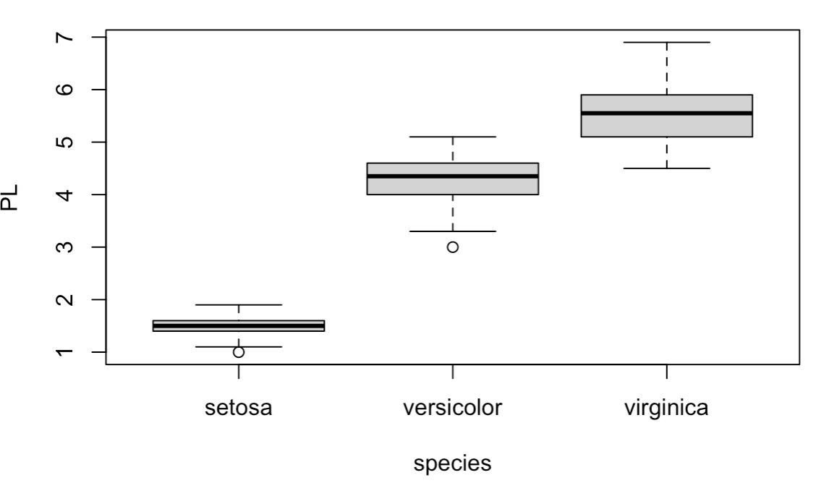
Statistical Analysis: T-Test
Are two groups different?
Get Data:
>PL <- iris$Petal.Length
>species <- iris$Species
Plot the data:
>boxplot(PL ~ species)

Slide 4
Statistical Analysis: T-Test
Are the petal lengths of versicolor and virginica different?
Null Hypothesis (Ho): No, they are not, they are the same.
Get the PW data for the two species:
>PL1 <- PL[50:100] # versicolor
>PL2 <- PL[101-150] # veronica

Slide 5
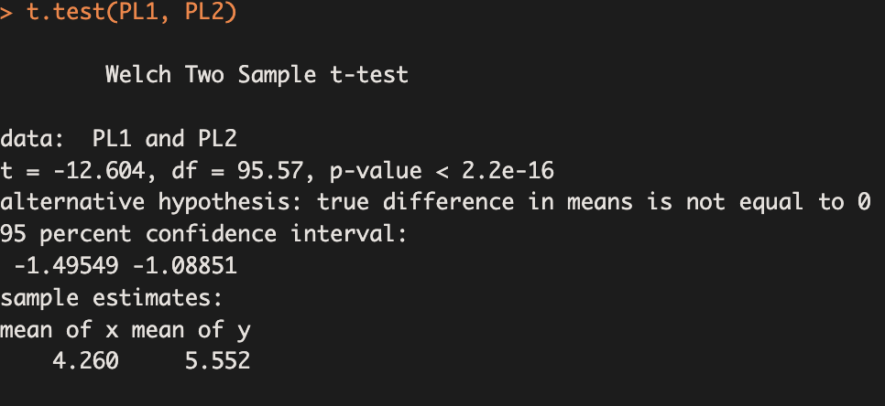
Statistical Analysis: T-Test
>t.test(PL1, PL2) # 2 sampled t-test

Slide 6
Statistical Analysis: T-Test
>PL1 <- PL[50:100] # versicolor
>PL2 <- PL[101-150] # veronica
>t.test(PL1, PL2) # 2 sampled t-test
P-value < 0.05: reject the null hypothesis;
conclude that these groups are significantly different.
T-value is the test statistic
df is the degrees of freedom (estimates sample size)

Slide 7
Statistical Analysis: T-Test
Reporting on the test:
“Petal lengths for Iris virginica were significantly greater than petal lengths of Iris versicolor (t(95.6)=-12.6, p<0.001)”

Slide 8
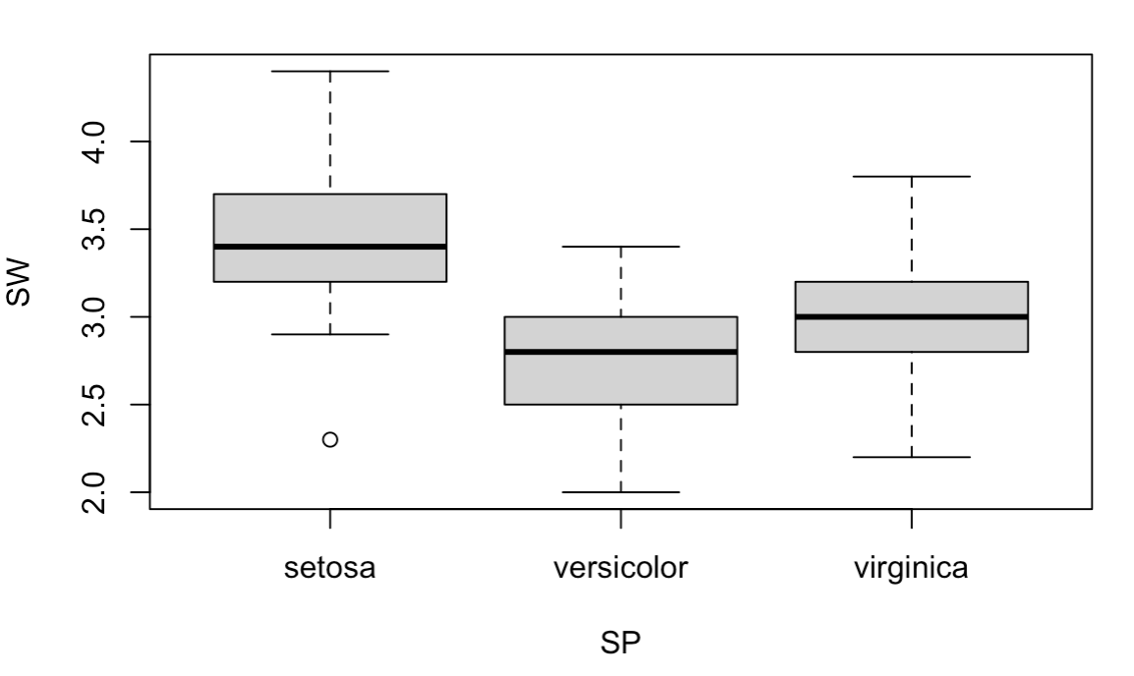
Statistical analysis: ANOVA
ANOVA (Analysis of Variance) allows for testing differences across multiple groups
>SW <- iris$Sepal.Width
>boxplot(SW ~ SP)

Slide 9
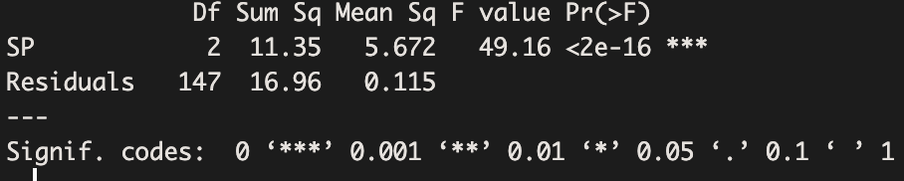
Statistical analysis: ANOVA
ANOVA (Analysis of Variance) allows for testing differences across multiple groups
>summary(aov(SW ~ SP))

Slide 10
Statistical analysis: ANOVA
Pr(>F) is essentially your p-value: <2e-16
The stars (***) indicate that the test p-value is significant at p<0.001
You can conclude that not all the species have the same sepal widths
Reporting “Sepal widths differed among the three species (F(2, 147) = 49.16, p<0.001).”

Slide 11
Statistical Analysis: post-Hoc tests
But which species differ? Are any the same?
Requires post-hoc testing.
Tukey’s HSD

Slide 12
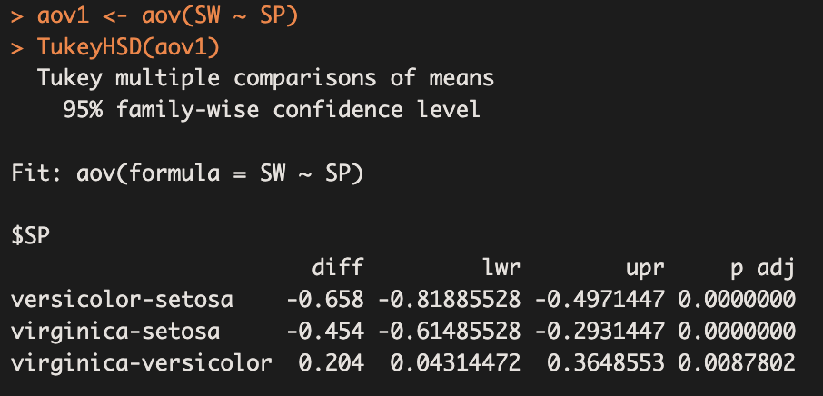
Statistical Analysis: post-Hoc tests
Capture the anova output and analyze that:
>aov1 <- aov(SW ~ SP)
>TukeyHSD(aov1)

Slide 13
Statistical Analysis: post-Hoc tests
“p-adj” is the adjusted p-value for each comparison
Each “p adj” is <0.05 so we can reject the null hypothesis (that there are no differences) and conclude that each group is significantly different from the others

Slide 14
Statistical Analysis: post-Hoc tests
Reporting: only report the results if the main effects of the model (the ANOVA) were significant!
“A post-hoc Tukey test showed that Iris setosa had significantly wider petals than Iris versicolor or Iris virginica (p<0.05) and Iris virginica had significantly wider petals than Iris versicolor (p<0.05).

Slide 15
Statistical Analysis: Contingency Tests
Two categorical variables
Chi-squared test
Example: small and big sepals
df <- iris
df$size <- ifelse(df$Sepal.Length < median(df$Sepal.Length), “small”, “big”)

Slide 16
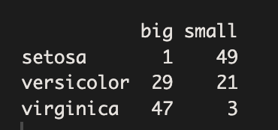
Statistical Analysis: Contingency Tests
>table(df$Species, df$size)
Question: is there a relationship between species and size?
Null Hypothesis (Ho) is that there is NO relationship
> test <- chisq.test(table(df$Species, df$size))

Slide 17
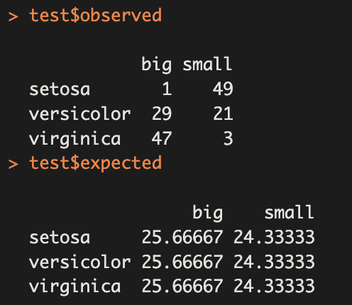
Statistical Analysis: Contingency Tests
>test$oberved
>test$expected
Is there a difference between the observed values and the expected values?

Slide 18
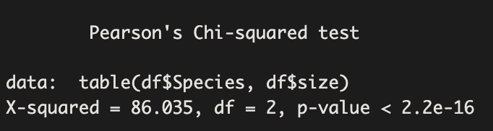
Statistical Analysis: Contingency Tests
>test
p<0.05 so we can reject Ho
We can conclude that there is a relationship between species and size.
“There is a significant relationship between species petal lengths (X²(2) = 86.0, p <0.001)

Slide 19
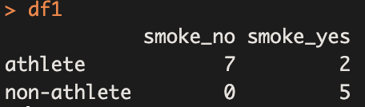
Statistical Analysis: Contingency Tests
Fisher’s exact test: Great for small sample sizes!
>df1 <- data.frame(“smoke_no” = c(7,0),
(“smoke_yes” = c(2,5),
row.names = “athlete”, “non-athlete”),
stringsAsFactors = FALSE)
>colnames(df1) <- “non_smoker”, “smoker”
>df1

Slide 20
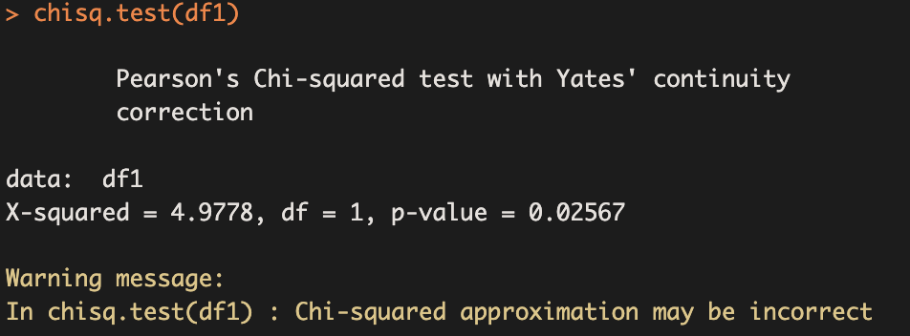
Statistical Analysis: Contingency Tests
Chi-square test fails!
>chisq.test(df1)
Why? The sample
Size was too small!

Slide 21
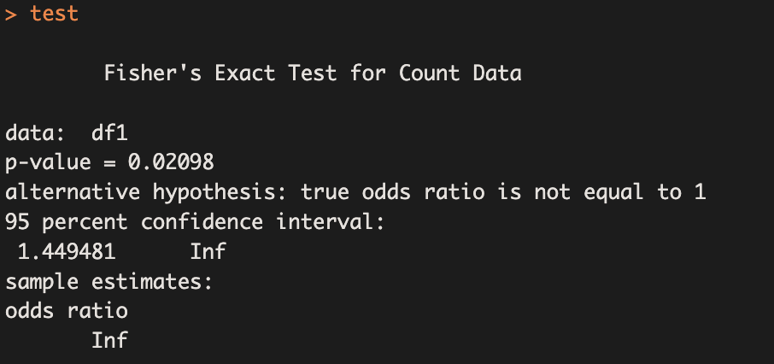
Statistical Analysis: Contingency Tests
Use Fisher’s Exact Test
>test <- fisher.test(df1)
>test
Reject Ho (no association between being an athlete and smoking) and conclude that:
“There is a statistical association between being an athlete and whether or not you smoke (Fisher’s Exact Test, p<0.03)”

