Slide 1
Intro to Statistics in R
(AGAIN, BUT DIFFERENT)
Presented by Dr. Rob Baker and Dr. Clay Carper

Slide 2
Preliminary Content: Probability
Probability overview:
A measure of likelihood that a specific event will occur
Likelihood range from 0 to 1
0 is an event that cannot occur
1 is an event that will certainly occur

Slide 3
Preliminary Content: Probability cont.
Probability formalities:
All values must add to 1
Think: ”Accounting for all possible outcomes”
Compound events must be considered carefully
Often, over counting becomes an issue
Should probabilistic analysis be required, random variables should be studied
Often, this is overkill when discussing non-Bayesian statistics

Slide 4
Preliminary Content: Probability cont.
Brief R-example:
Let’s look at the possible outcomes when rolling two six-sided dice and summing the result

Slide 5
Preliminary Content: p-values
What is a p-value?
A measure of significance relating to the observed results
Critical component of hypothesis testing
Probability of obtaining a test statistic at least as extreme as the observed outcome

Slide 6
Preliminary Content: p-values cont.
Null hypothesis is assumed true
Think: “statement of no effect, no difference”
Typically, two probabilistic outcomes:
Small p-value (usually <= 0.05)
Suggests there is strong evidence against the null hypothesis (reject the null hypothesis)
Large p-value (usually > 0.05)
Weak evidence against the null hypothesis (fail to reject the null hypothesis)

Slide 7
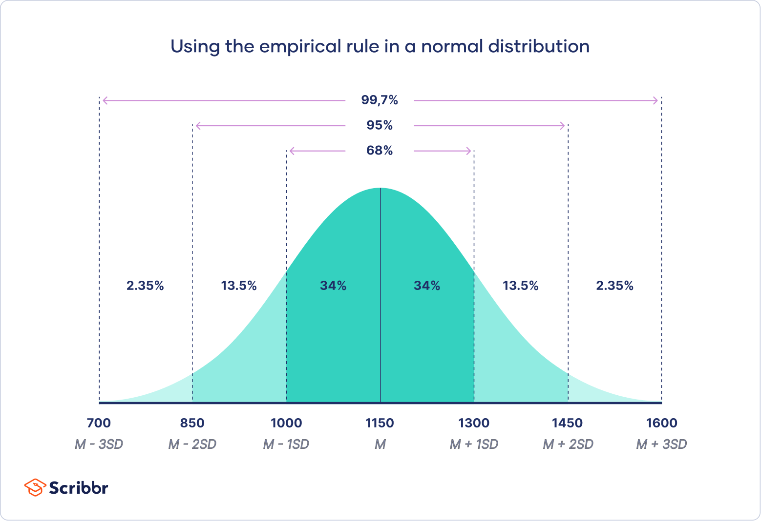
Normal Distribution Primer
The classic “bell curve” data distribution
Think ”majority of the data is near the mean”
Captures many natural phenomena
Ex: Heights and wights of people
Desirable mathematical properties
Symmetry
Defined based on mean and standard deviation
Common assumption in statistical testing

Slide 8
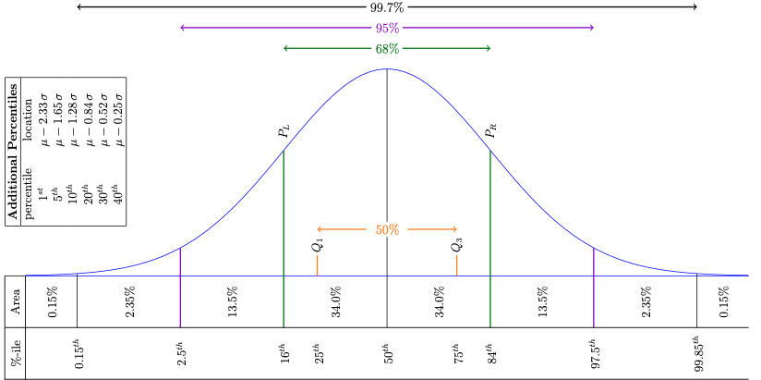
Normal Distribution Primer cont.

Slide 9
Normal Distribution Primer cont.
Brief R-example:
Let’s look at what we can learn about human heights using a normal distribution

