Slide 1
Intro to Statistics in R
(AGAIN, BUT DIFFERENT)
Presented by Dr. Rob Baker and Dr. Clay Carper

Slide 2
Statistical Testing: normality
Most statistical tests assume the data are normally distributed
Most data aren’t perfectly normally distributed
If data aren’t normally distributed, you can transform them to make them more closely approximate the normal distribution

Slide 3
Statistical Testing: Normality
Pros:
Don’t violate the model assumptions (as much)
More confidence in the results
Cons:
Results can be harder to interpret/non-intuitive

Slide 4
Statistical Testing: Normality
When should data be transformed?
Qualitative assessments
Compare to the normal distribution
Use a QQplot

Slide 5
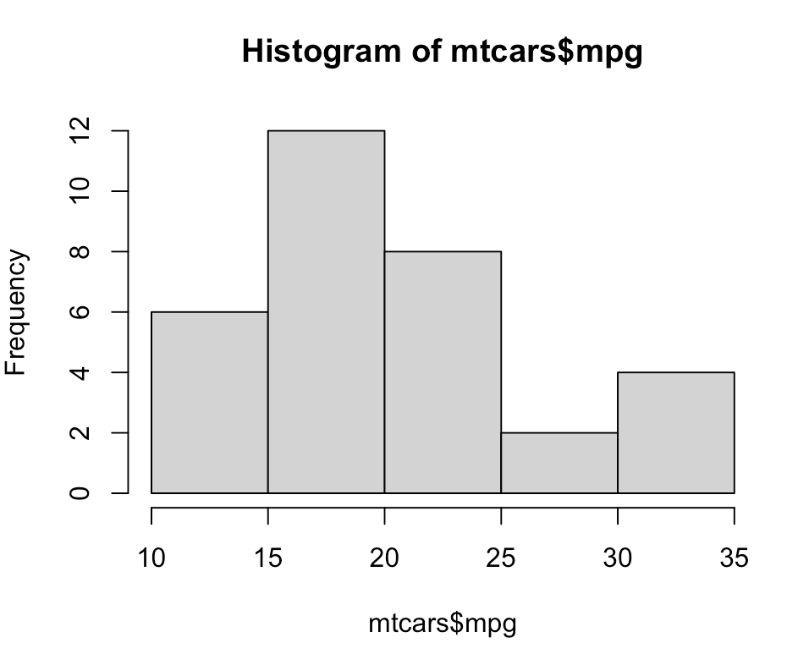
Statistical analysis: Normality
Comparing to the normal distribution:
Generating a histogram is pretty
trivial in R:
>hist(mtcars$mgp)

Slide 6
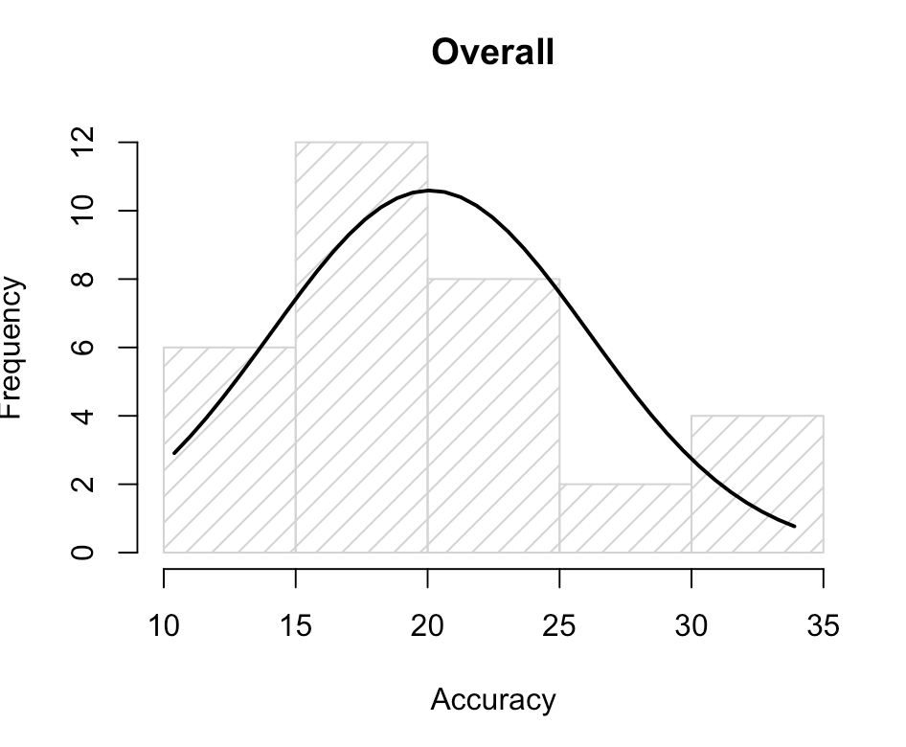
Statistical analysis : Normality
Overlaying a normal distribution for your data is non-trivial:
>g = mtcars$mpg
>h <- hist(g, breaks = 5, density = 10,
col = "lightgray", xlab = “Accuracy”,
main = "Overall")
>xfit <- seq(min(g), max(g), length = 40)
>yfit <- dnorm(xfit, mean = mean(g), sd = sd(g))
>yfit <- yfit * diff(h$mids[1:2]) * length(g)
lines(xfit, yfit, col = "black", lwd = 2)

Slide 7
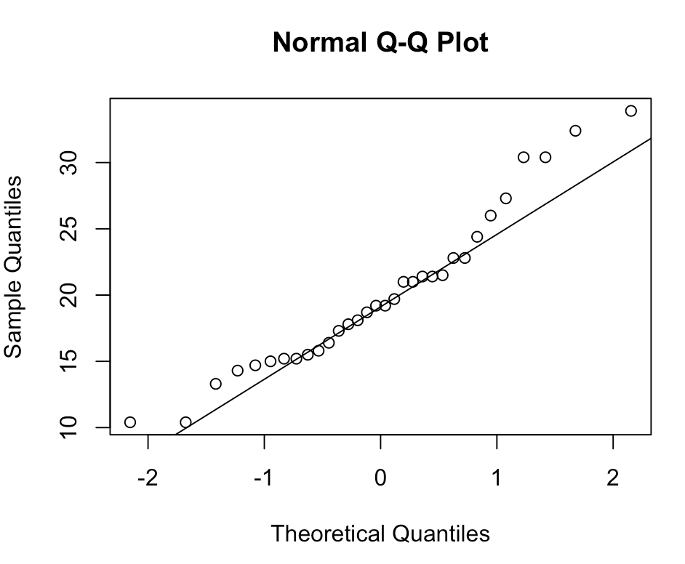
Statistical Analysis: Normality
qq plots provide a better (easier!) way of assessing normality
A qq plot is a quantile-quantile plot; a graphical way of comparing two distributions by plotting their quantiles against one another.
>qqnorm(mtcars$mpg)
>qqline(mtcars$mpg)
The dots represent your data points and the straight line is the normal distribution.

Slide 8
Statistical Analysis: Normality
Does this data sufficiently deviate from normal to warrant a transformation?
Does the transformation substantially improve the fit of the data to the normal distribution?

Slide 9
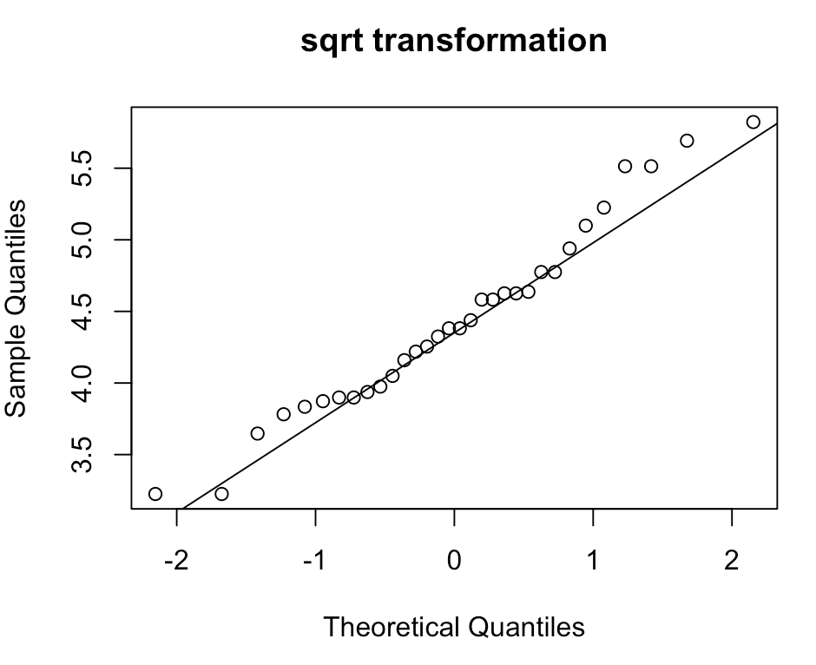
Statistical Analysis: Normality
>qqnorm(sqrt(mtcars$mpg), main = “sqrt transformation”)
>qqline(sqrt(mtcars$mpg))
>qqnorm(mtcars$mpg)
>qqline(mtcars$mpg)

Slide 10
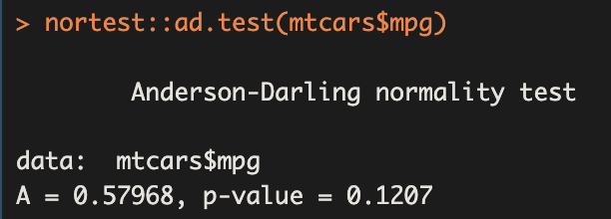
Statistical Analysis: Normality
Formal Normality Tests
Anderson-Darling Test
>install.packages(“nortest”)
>library(nortest)
>nortest::ad.test(mtcars$mpg)

Slide 11
Statistical Analysis: Normality
Formal Normality Tests
Anderson-Darling Test
>install.packages(“nortest”)
>library(nortest)
>nortest::ad.test(mtcars$mpg)
Null hypothesis: there is no difference between our distribution and the normal distribution
p > 0.05
Fail to reject the null hypothesis
No evidence that the distribution is not normal.

Slide 12
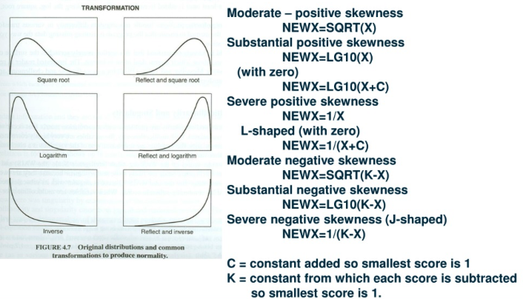
StAtistical Analysis: Normality

Slide 13
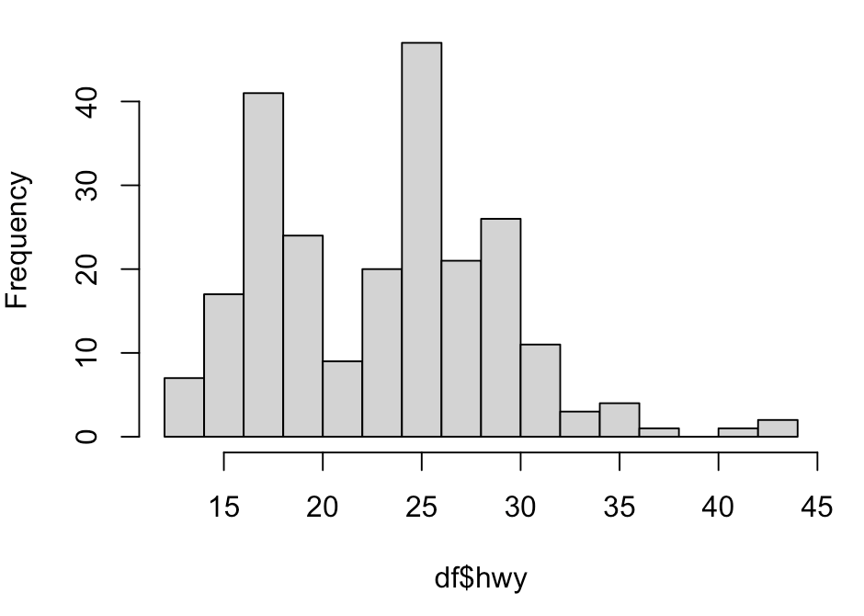
Statistical Analysis: outliers
>install.packges(“ggplot2”)
> df <- ggplot2::mpg
>hist(df$hwy, breaks = sqrt(nrow(df)))

Slide 14
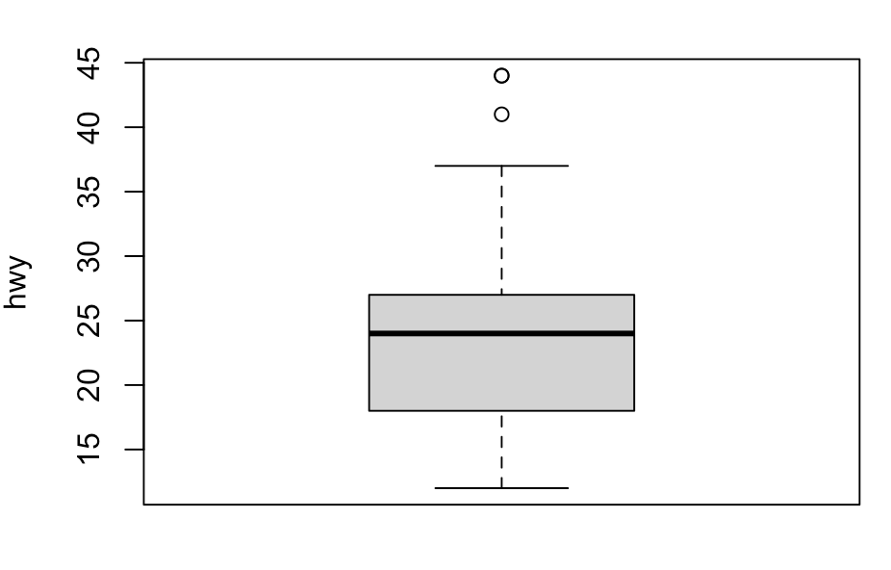
Statistical analysis: outliers
Boxplots:
boxplot(df$hwy, ylab = hwy)

Slide 15
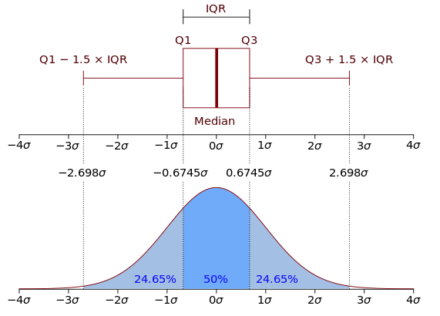
Statistical analysis: outliers
Interpreting box plots:
Compared to the normal distribution
~95% of the data should be within the whiskers
Anything outside the whiskers is likely an outlier.

Slide 16
Statistical Analysis: outliers
Hampel Filter:
Filter anything +/- 3 standard deviations from the median:
#calculate lower bound:
>lb <- median(df$hwy) -3 * mad(df$hwy, constant = 1)
#calculate lower bound:
>ub <- median(df$hwy) +3 * mad(df$hwy, constant = 1)
#detect outliers:
>which(df$hwy < lb | df$hwy > ub)

Slide 17
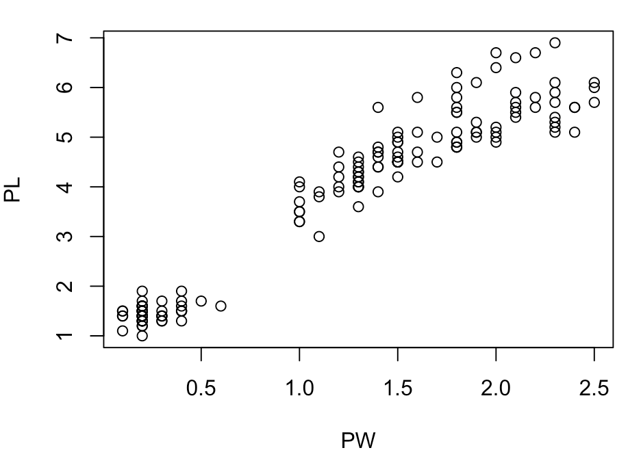
Statistical Analysis: Correlation
Relationships between two groups:
>PL <- iris$Petal.Length
>PW <- iris$Petal.Width
>plot(PW, PL)

Slide 18
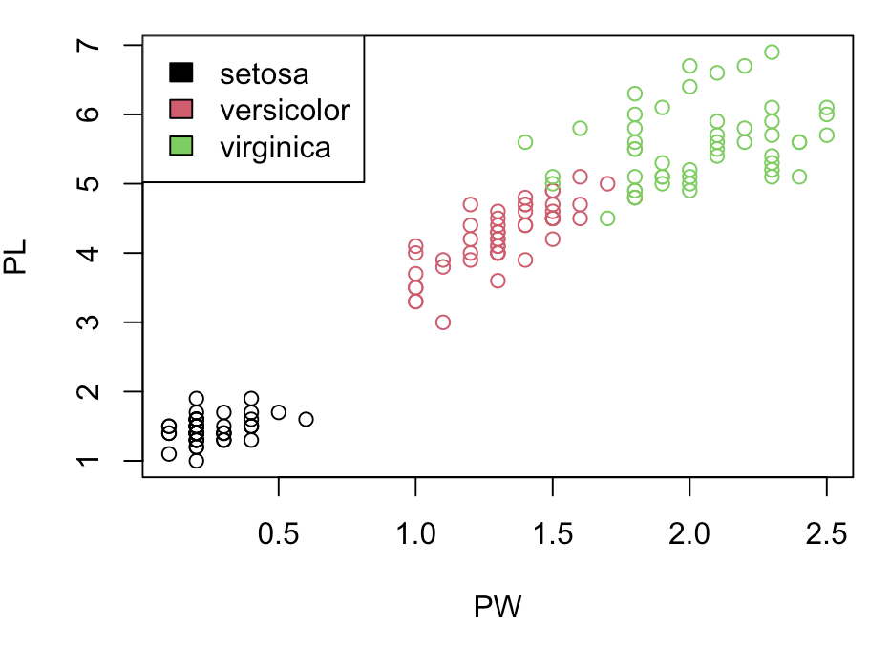
Statistical Analysis: Correlation
Relationships between two groups:
>SP <- as.factor(iris$Species)
>plot(PW, PL, col = SP)
>legend(“topleft”, levels(SP), fill = 1:3)

Slide 19
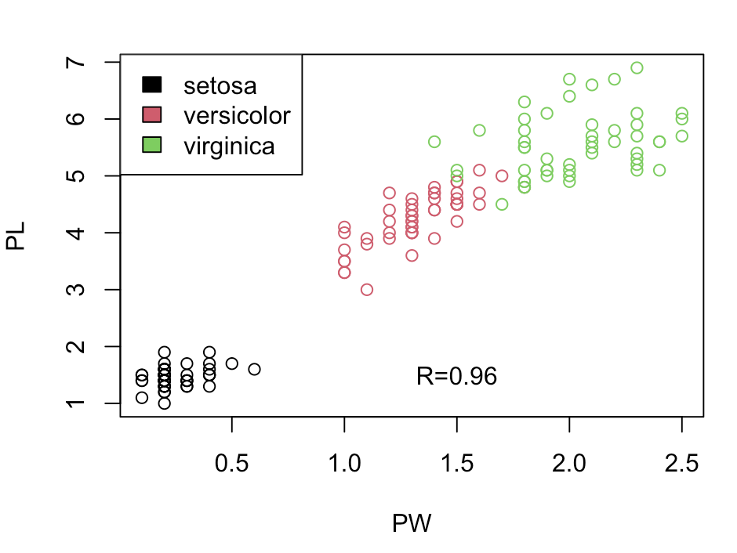
Statistical Analysis: correlations
Calculate the correlation (R):
>cor(PW, PL)
# [1] 0.9628654
Petal width and petal length are positively correlated - the correlation (R) is value is 0.96
Add this to the plot:
>text( 1.5, 1.5, paste(“R=0.96”))

Slide 20
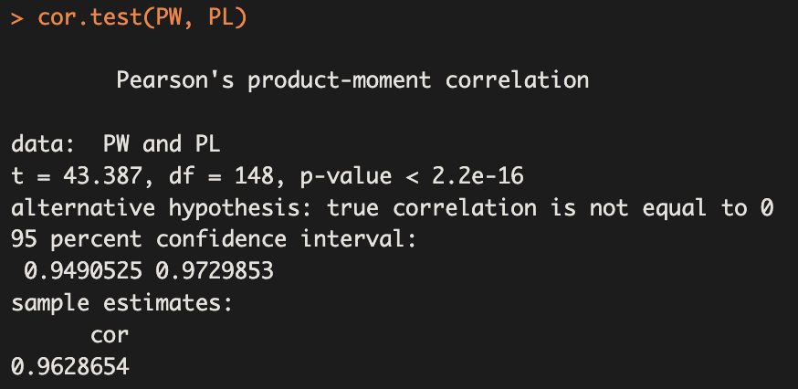
Statistical Analysis: correlations

Slide 21
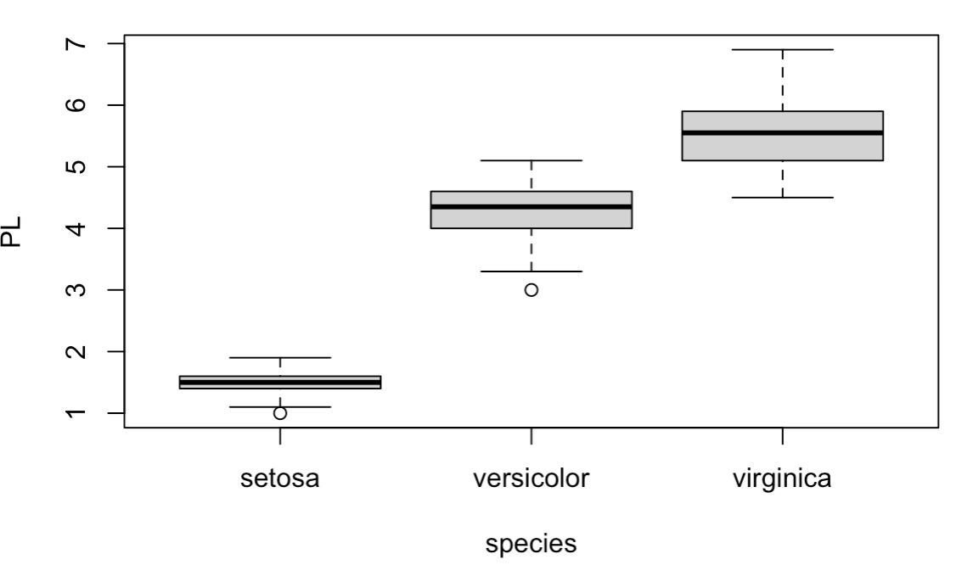
Statistical Analysis: T-Test
Are two groups different?
>boxplot(PL ~ species)

Slide 22
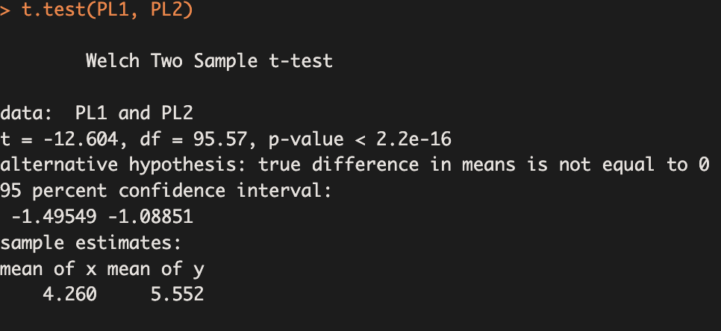
Statistical Analysis: T-Test
>PL1 <- PL[50:100] # versicolor
>PL2 <- PL[101-150] # veronica
>t.test(PL1, PL2) # 2 sampled t-test
P-value < 0.05: reject the null hypothesis; conclude that these groups are significantly different.
T-value is the test statistic
df is the degrees of freedom (estimates sample size)

Slide 23
Statistical Analysis: T-Test
Reporting on the test:
“Petal lengths for Iris virginica were significantly greater than petal lengths of Iris versicolor (t=-12.6, df=95.6, p<0.001)”

Slide 24
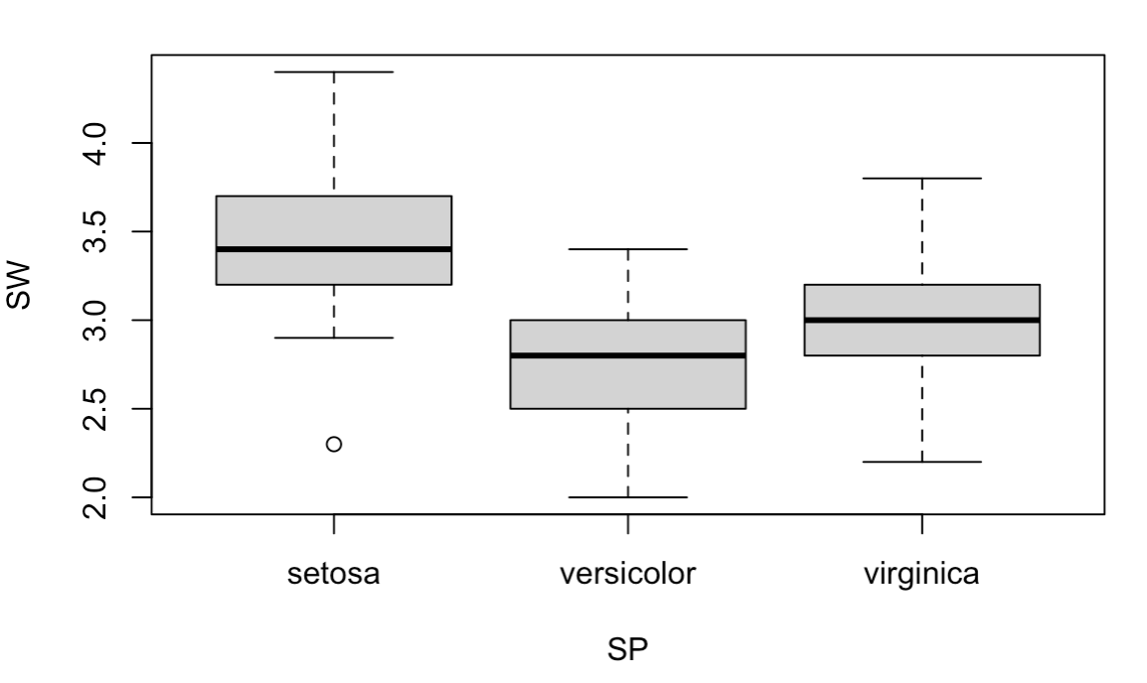
Statistical analysis: ANOVA
ANOVA (Analysis of Variance) allows for testing differences across multiple groups
>SW <- iris$Sepal.Width
>boxplot(SW ~ SP)

Slide 25
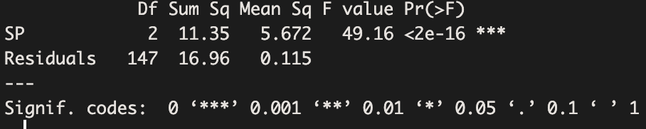
Statistical analysis: ANOVA
ANOVA (Analysis of Variance) allows for testing differences across multiple groups
>summary(aov(SW ~ SP))

Slide 26
Statistical analysis: ANOVA
Pr(>F) is essentially your p-value: <2e-16
The stars (***) indicate that the test p-value is significant at p<0.001
You can conclude that not all the species have the same sepal widths
Reporting “Sepal widths differed among the three species (F(2, 147) = 49.16, p<0.001).”

Slide 27
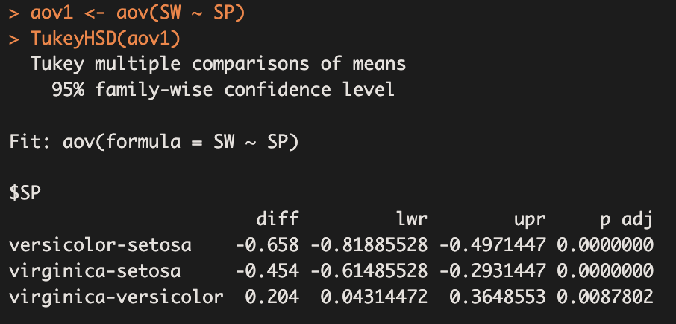
Statistical Analysis: post-Hoc tests
But which species differ? Are any the same?
Requires post-hoc testing.
Tukey’s HSD:
Capture the anova output and analyze that:
>aov1 <- aov(SW ~ SP)
>TukeyHSD(aov1)

Slide 28
Statistical Analysis: post-Hoc tests
“p-adj” is the adjusted p-value for each comparison
Each “p adj” is <0.05 so we can reject the null hypothesis (that there are no differences) and conclude that each group is significantly different from the others

Slide 29
Statistical Analysis: post-Hoc tests
Reporting: only report the results if the main effects of the model (the ANOVA) were significant!
“A post-hoc Tukey test showed that Iris setosa had significantly wider petals than Iris versicolor or Iris virginica (p<0.05) and Iris virginica had significantly wider petals than Iris versicolor (p<0.05).

