Slide 1
R short Course Day 02
McNair Scholars Summer 2025

Slide 2
When to use R?
1. Anytime you need to do anything with data (beyond entering it)
2. Anytime you need to do statistics, R is your friend
3. Anytime you want to make a graph, chart, plot, etc to show your results
4. Anytime you have something you are planning on doing more than once: Is this something I can automate?

Slide 3
What is the difference between R and Rstudio?
R is the programming language. You can write R code in any text file. You can run R without Rstudio. R itself is open source and free.
2. RStudio is a program used to help you organize your files, write and test code, and produce graphics.
IDE: “Integrated Development Environment”
Rstudio is helpful at any level of R coding, but the more you use R and the more complicated your code gets the more you will lean on an IDE like Rstudio.

Slide 4
Brief Tour of Rstudio: live Demo
Some customizations you might want to do:
Tools > Global Options > Appearance - pick a theme
Global environment > Appearance - pane layout
Code > soft wrap long lines
Code > Rainbow parentheses

Slide 5
Rstudio: a brief tour
Console: this is where R code actually runs and where output from that R code will show up.
You can type code directly into the R console, but it isn’t saved so for longer projects or you probably want to store that in an R script
Tips and tricks: tab autocomplete; up-arrow to re-run most recent code, ? to access the help for a given function
Working file: Typically an R script that ends in *.R
This is where you will put code you are working on
You can send code from your R script directly to the console by highlighting it and hitting control-enter
You can save your R script and come back to it later, send it to a friend, etc.

Slide 6
Rstudio: a brief tour
“Files” pane:
Shows all your files
Is where plots will show up when we start making them
Is where function documentation and help will show up if you invoke it
Can show you all your packages that you have access to

Slide 7
Rstudio: a brief tour
“Environment” pane
1. Environment: shows all the variables you have created
2. History: will show the most recent lines of code you have run. You can re-run them by double-clicking them to send them to the console
3. R comes with a built-in tutorial! It’s actually not bad if you want to walk through it on your own.

Slide 8
Base R operators
R has some built in base operators
Assignments: <- (and sometimes = )
Math: +, -, *, /, ^, %, etc
Special characters: $, ( ), { }, [ ], etc
Comparisons: ==, !=

Slide 9
BaseR vs. packages
R comes with a lot of functions pre-loaded. This is called BaseR. They are often (but not always) related to statistics:
Examples:
summary: >summary()
Absolute values: >abs()
What am I looking at? >is.number()
>is.character()
>is.null()

Slide 10
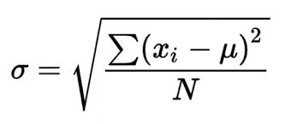
R: packages
You could probably use baseR (and some people already have) to write fairly complicated functions.
Standard deviation:
>sd <- function(x, na.rm = FALSE)
sqrt(var(if(is.vector(x) || is.factor(x)) x else as.double(x), na.rm = na.rm))
But the people who did that are proud of it and want to share with you - so let them!

Slide 11
R packages
Extend baseR by adding additional functions.
Need to be installed (downloaded from a repository - usually CRAN (Comprehensive R Archive Netowork) or sometimes github) - typically once
Need to be loaded into R every time you open a new sessions/restart R
# comment out lines of code by starting them with # # tidyverse is actually several packages and may take tick to download # notice the quotes for install.packages but not for the library function!
>install.packages(“tidyverse”) >library(tidyverse)

Slide 12
R packages
Once you have installed a package and loaded it using the library() function, you have access to all the functions, datasets, and other goodies in the package. You can also access help about a specific function from the console using:
>?read_csv

Slide 13
More on Variables
We can store lots of different types of information in variables!
Single values:
Numbers
+, -, *, /, ^, sqrt(), etc
Text (often referred to as a string or a character string)
paste(), cat(), grep(), strsplit(), stringr package
Logical (TRUE or FALSE)
&&, ||, !

Slide 14
More on Variables
Multiple values:
Vectors
Data frames
Lists
Matrices

Slide 15
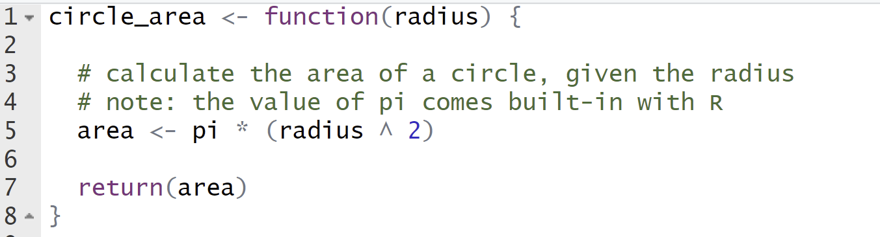
Function Anatomy: Creating a Function
name(s) of input(s) - actual values assigned when function is used
name of the function
output value
function body - the code that does the thing!

Slide 16
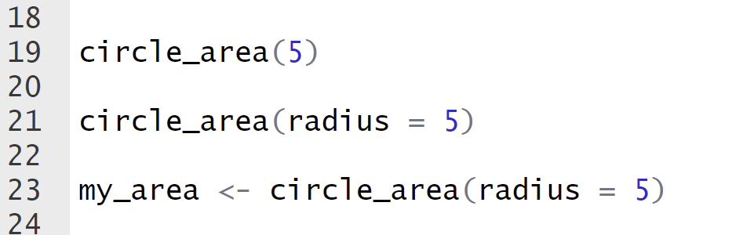
Function Anatomy: Using a Function
name of the function
input value
for clarity, we can also specify the name of the argument
output prints to console
output value assigned to variable

Slide 17
Write your own function!
Decide what you want it to do
E.g. add two numbers together, create a customized sentence based on user input…get creative!
Give it a name that makes sense
It should take at least one argument (input)
Assign a value to a variable in the body of the function
Return a value

Slide 18
Break: ~10 min

Slide 19
R: reading data
One of the fundamental things you will want to do is access data in R.
Typically you will store data in a file (more on data storage tomorrow).
One of the most common types of files is a .csv file
This is essentially a text file where commas separate the values.

Slide 20
Why .csv (why not .xlsx)
.xlsx can have multiple sheets, which one do you want to use?
.xlsx can have funky formatting that is hard for R to interpret:
Text with different colors
Text with different weights (bold, italics, etc)
Rows that are highlighted
Dynamic equations
.xlsx files are actually not a single file, but a zipped set of files written in an .xml language that need to be interpreted.

Slide 21
.CSV
Simple
Text only
Non-proprietary
Has a specific schema that is backed by a standards organization
Very stable over time

Slide 22
Data import
You want to save your data file in the same directory as your .RProject file
# df: short for data frame. Common convention for naming your data. You can call # it whatever you want but it’s a good idea to avoid things that already have # meaning within R. So calling your data “data” is not a good idea >df <- read_csv(“data_file.csv”)

Slide 23
Get data and load it into R!
https://advstats.psychstat.org/
Go to “example datasets”
Download the file “active.csv”
Move the file to your .Rproj folder
Load the file into R: >df <- read.csv(“active.csv”)

Slide 24
Challenge:
1. Go to:
https://vincentarelbundock.github.io/Rdatasets/articles/data.html
2. Choose a dataset
3. Download the dataset (as a CSV!)
4. Load the data into R

Slide 25
Tomorrow…
Tomorrow we will go over how to view your data, navigate your data, how to make changes to your data, etc.

