Slide 1
CN 101.3 – Fundamentals of Data Communications and Security
Lecture 2 – DNS and Email Service
Chamara Disanayake
Senior Lecturer
Department of Network and Security

Slide 2
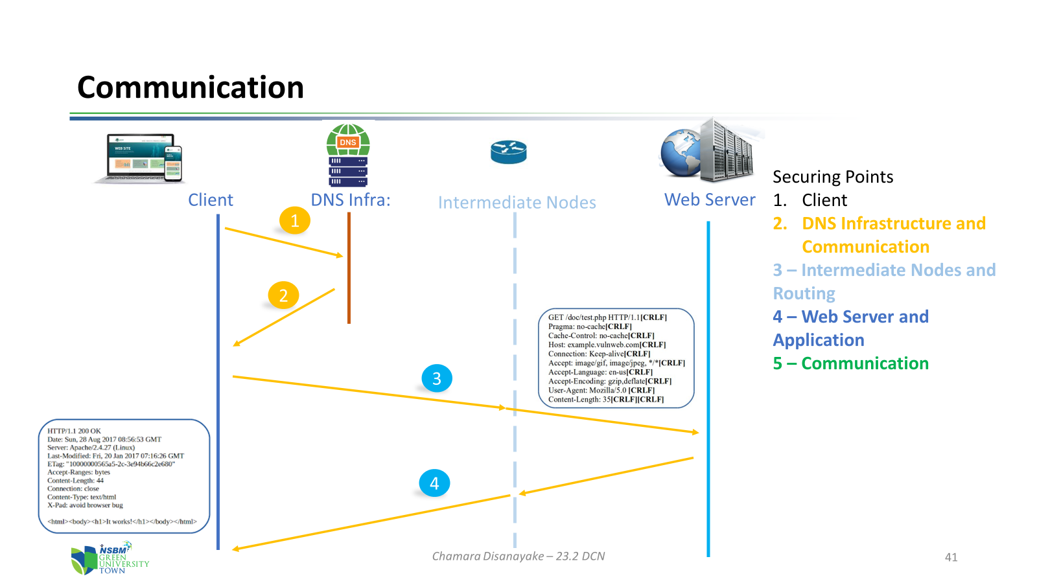
Flash Back
What we discussed?
  How Networking has improved the lifestyle of Human beings
  Network Services
  WWW
  Web Communication

Slide 3
Suggested Plan for the Batch Website
Identify the Objectives/Requirements
  Who are the users, what needs to be shared, who has the authority
Design the website
  Technology / Contents / Color and Theme
Register the domain and URL
  The domain should denote the owner and also obey the DNS rules
    26-1.foc.nsbm.ac.lk
Hosting service
  Supportability, technology, cost, security

Slide 4
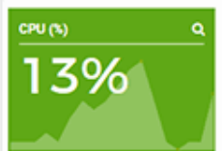
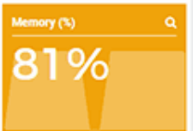
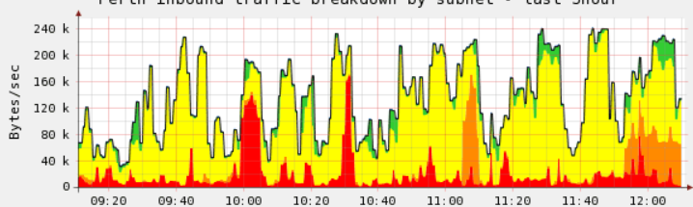
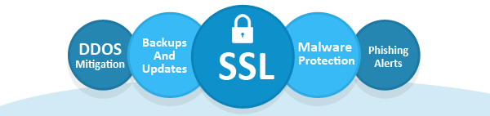
Operational Requirements for Web Application
Performance
  Need to have enough resources to cater the customer base
  Need more processing power, memory and storage in the hosting server
  Need required network capacity to handle communication between the web clients and the server
Security
  Security protocols and measures should be implemented
    HTTPS, Encryption, Session Keys
  Backup procedures should be decided

Slide 5


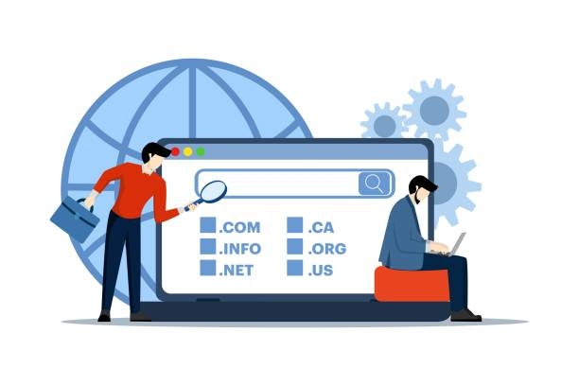
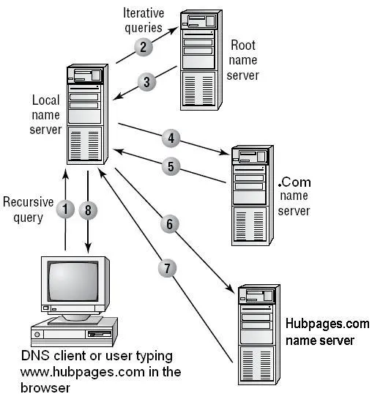
How We Get Domain Name?
What is the Domain Name Registration process?
  Why it is required by all network Services
  Who is managing DNS infrastructure?
  What is the procedure?
  What is the cost and requirements?
How a DNS server resolve URLs?
  Technical Explanation

Slide 6
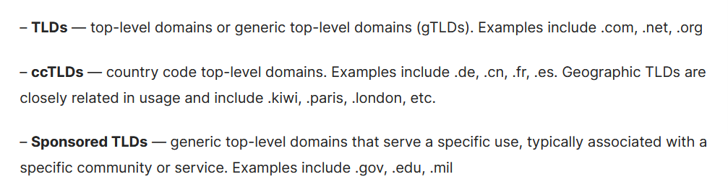

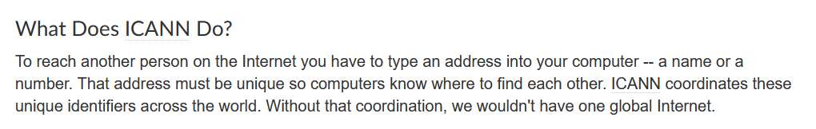
Domain Names and DNS
Domain Name System solves the issue of remembering the IP addresses of the Network Services.
  There are different types of top-level domains available according to the requirement.
For Sri Lanka,
.lk is the ccTLD

Slide 7
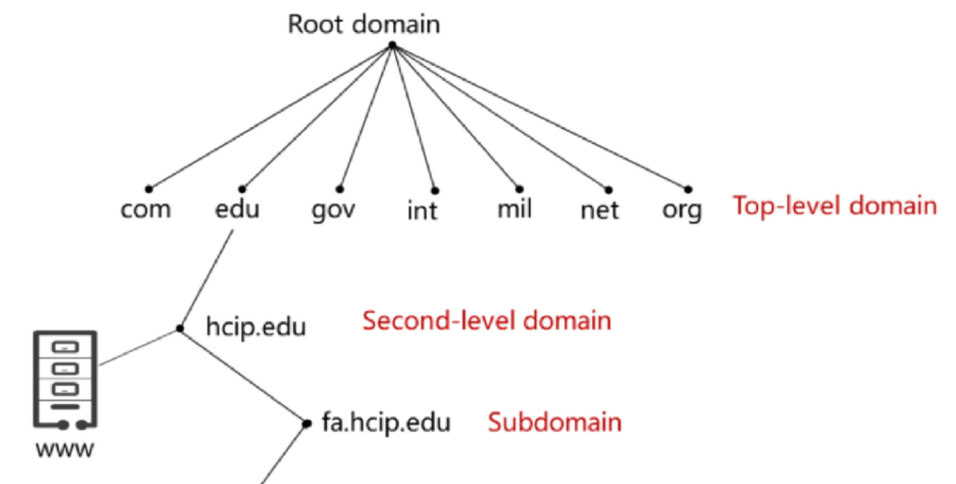
Domain Name Space and Levels
Domain names are hierarchical, and its order is ‘← Right to Left ←
  Sub Domain ← Second level ← Top level ← root Domain ‘.’
    www.nsbm.ac.lk.
Root Domain is Denoted by ‘.’
Different Top-level domain Types
  Generic Top-level domains (gTLD)
      .com, .net, .edu, .music, .io
  County code Top-level domains (ccTLD)
      .lk, .in, .ru, .my, .th, .au
  Sponsored Top-level domains (sTLD)
      .gov, .mil
  Brand Top-level domains
      .google, .apple

Slide 8
How DNS Works
The ‘zones’ are delegated by its top-level zone to sub domains
  Consider the domain nsbm.ac.lk.
  ‘.lk ‘is a sub domain of ‘.’ and ‘ac.lk’ is a sub of ‘.lk’
  . →.lk → .ac.lk → nsbm.ac.lk
Each level is responsible for its all delegations
Each zone has its own DNS server(s) called ‘Authoritative DNS server’.
  Details of the zones are known and confirmed by the ‘Authoritative DNS servers’ referring the ‘name database’
  The IP address of the Authoritative server of each zone is known and available with the ‘DNS server’ of the parent zone.
Recursive DNS servers (Caching DNS) are supporting the clients to resolve the DNS queries referring the authoritative DNS Servers

Slide 9
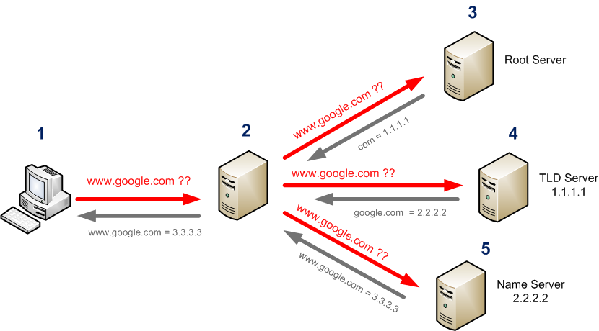
How DNS Works
Clients refer ‘Caching DNS’ (Resolver/Recursive name server) and it refer the DNS hierarchy to resolve the query of the client
  If client want to resolve ‘www.google.com’ what are the steps
Caching DNS

Slide 10
Restrictions in DNS
Permitted letters/symbols
  Letters, numbers are allowed, as well as the dash symbol (“-”). No other punctuation is permitted, including the underscore (“_”).
    0..9, a..z, hyphen (-) and dot (.)
    Each element of a domain name separated by [.] is called a “label.”
    A label should not be empty
    Domain name must not commence or end with a hyphen.
  Domain Names are Case-insensitive
    NSBM.ac.LK ≡ nsbm.ac.lk ≡ nSbM.aC.lK
  The maximum length of each label is 63 characters, and a full domain name can have a maximum of 253 characters.
    Simple short Domain names are preferred

Slide 11
Select Valid Domain Names
www.my_company.lk
www.My-COMPany.lk
ww.my.company.lk
w.w.w.lk
-mycompany.lk
My-company.lk
saman@mycompany.lk
my..company.lk

Slide 12


Select Valid Domain Names
Domain Name should
Follow domain name rules
Short as possible
Meaningful
Depicts origine
www.my_company.lk
www.My-COMPany.lk
ww.my.company.lk
w.w.w.lk
-mycompany.lk
My-company.lk
saman@mycompany.lk
my..company.lk
Explain how it is possible to have හරිතසරසවිය.ලංකා as a valid domain name???
හරිතසරසවිය.ලංකා is converted into Punycode domain name
xn--n0c0abbzqbd1kf.xn--fzc2c9e2c
https://dnschecker.org/idn-punycode-converter.php

Slide 13




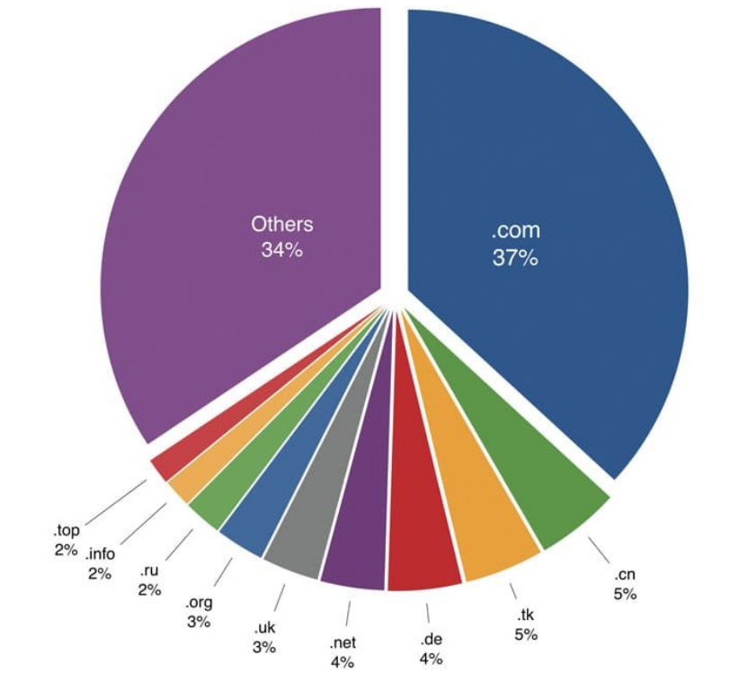
How You Get a Domain Name
Domain names are reserved for the registrants on ‘first come first serve’ basis
  If the user want to request a domain, he/she need to request it from its parent domain.
Need to get domain names from the Domain Registry
  Sri Lanka – LK Domain Registry www.domains.lk

Slide 14
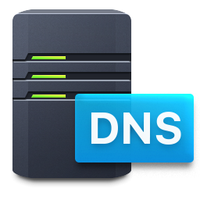
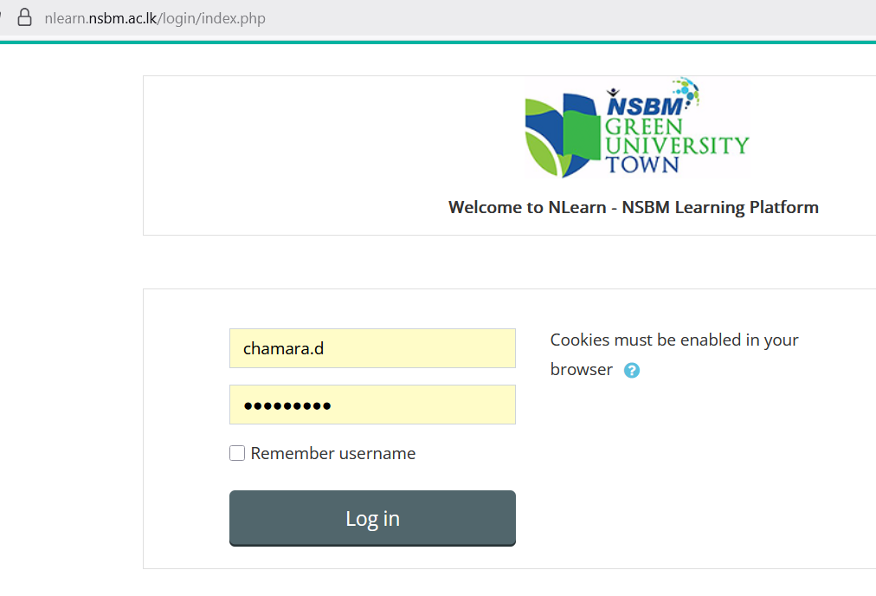
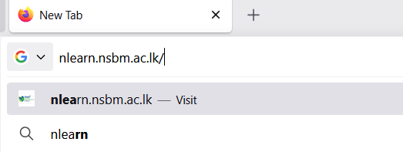
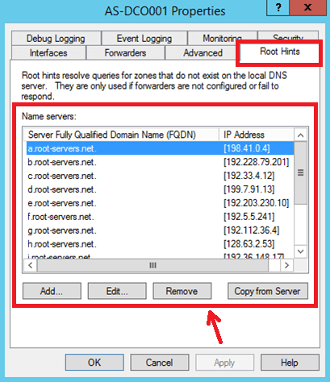
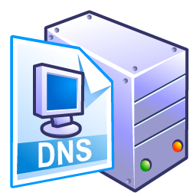

How DNS Resolve
Root DNS
Assume user type nlearn.nsbm.ac.lk, how it will be resolved?
IP of nlearn.nsbm.ac.lk
Try .lk DNS
.lk DNS
IP of
nlearn.nsbm.ac.lk
IP of nlearn.nsbm.ac.lk
IP of nlearn.nsbm.ac.lk
Try .ac.lk DNS
IP of nlearn.nsbm.ac.lk
ac.lk DNS
DNS Cache
IP is 220.247.221.153
IP of nlearn.nsbm.ac.lk
Try .nsbm.ac.lk DNS
DNS Cache
IP is 220.247.221.153
nsbm.ac.lk DNS

Slide 15
Try to Identify Following Parameters
Caching DNS Server/Resolver of your computer
  ipconfig /all
Resolve DNS of following URLs with nslookup command
  www.nsbm.ac.lk
  www.facebook.com
  www.faceboook.com
  www.gogle.com
Find more details of the IP address with https://iplocation.io/ip/

Slide 16
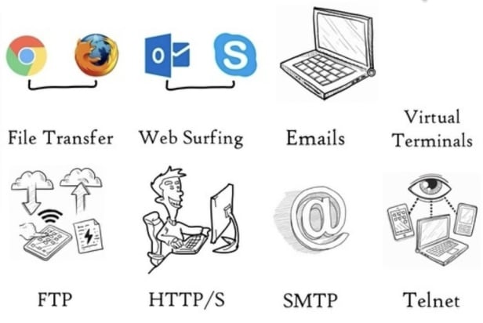
What are the other Services ( Applications)
E-mail service
Messaging services
  Text, Voice, Video
Video Conferencing
Virtual terminals
Contents sharing infrastructure sharing services
  File sharing, Video sharing
  Space sharing, processing power sharing

Slide 17
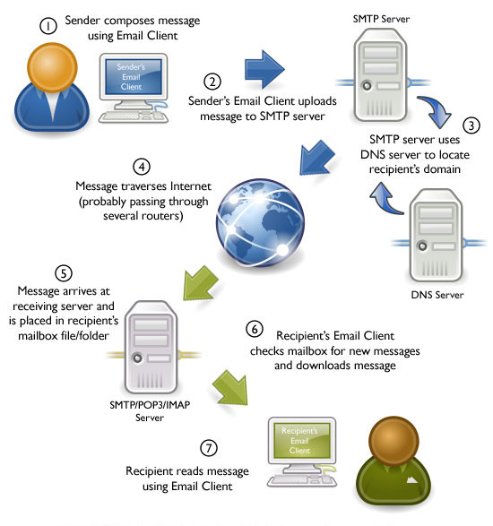

Post Office Service
Mail Sender, Mail Collecting, Mail Sorting, Mail transferring, Mail Delivering, Mail Receiver

Slide 18

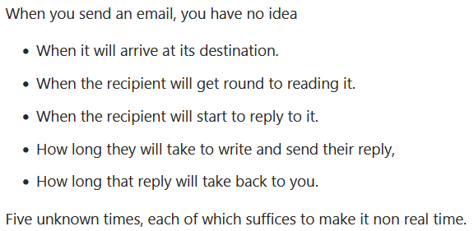
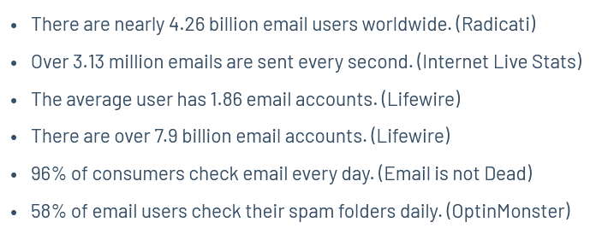
E-Mail Service
E-Mail – The oldest but still used network application which supports the users to access their mails from anywhere.
  E-mail/Webmail services
It is not a ‘Real Time Application’ But, it is very reliable Application

Slide 19

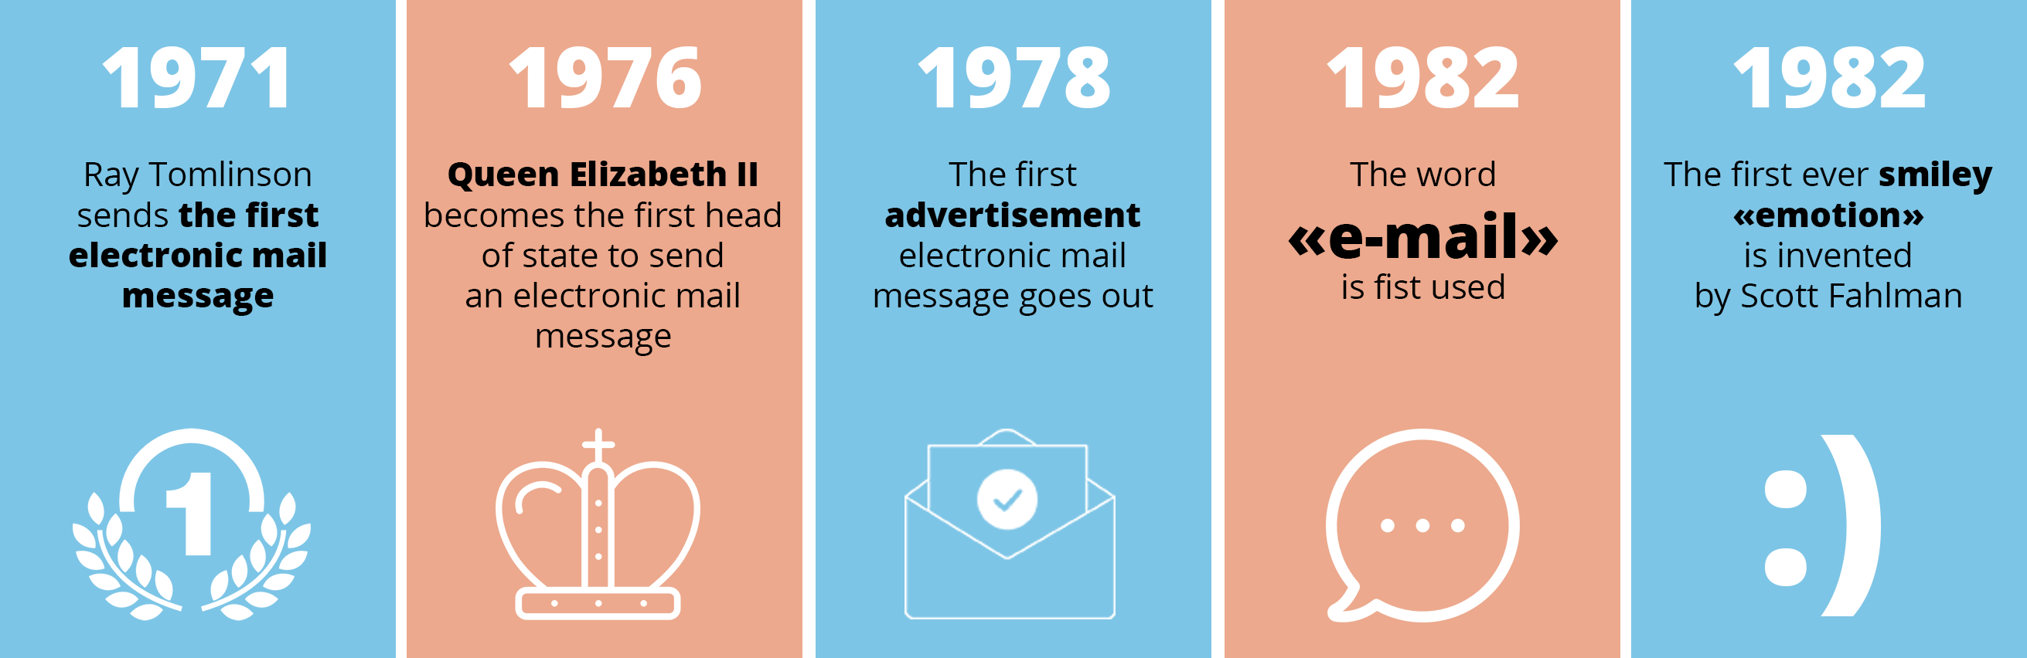
History of E-Mail
The first email was sent by Ray Tomlinson to himself in 1971.
  Famous ‘@’ sign
During the 1980s and 1990s, use of email became common in business, government, universities, and defense/military industries.

Slide 20






What are the Mail Components in E-mail system
Mail Accounts (sender and recipient) and Mail Client applications (User Agent)
  E-mail addresses: mailperson@maildomain
  UA – Outlook Express
Mail servers ( Which provides the service to the users) as front-end servers and back-end servers - MTA
  Incoming server (MDA)/outgoing server (MSA) / Mail DIR servers/ Webmail servers/ Spam-filters & Virus guards
Mail exchange protocols (SMTP/POP/IMAP)

Slide 21





Component Architecture
Incoming E-mail Server of Recipient with Mail Transfer App {MTA) + Mail DIR server
Outgoing E-mail Server of Sender with Mail Transfer App
{MTA)
Outgoing
Incoming
Mail Transfer Rules
Mail Transfer Rules
Mail Transfer Rules
Connected Client Device with
Mail Client App (User Agent)
Connected Client Device with
Mail Client App (User Agent)
Sender with E-mail Address
Recepient with
E-mail Address

Slide 22
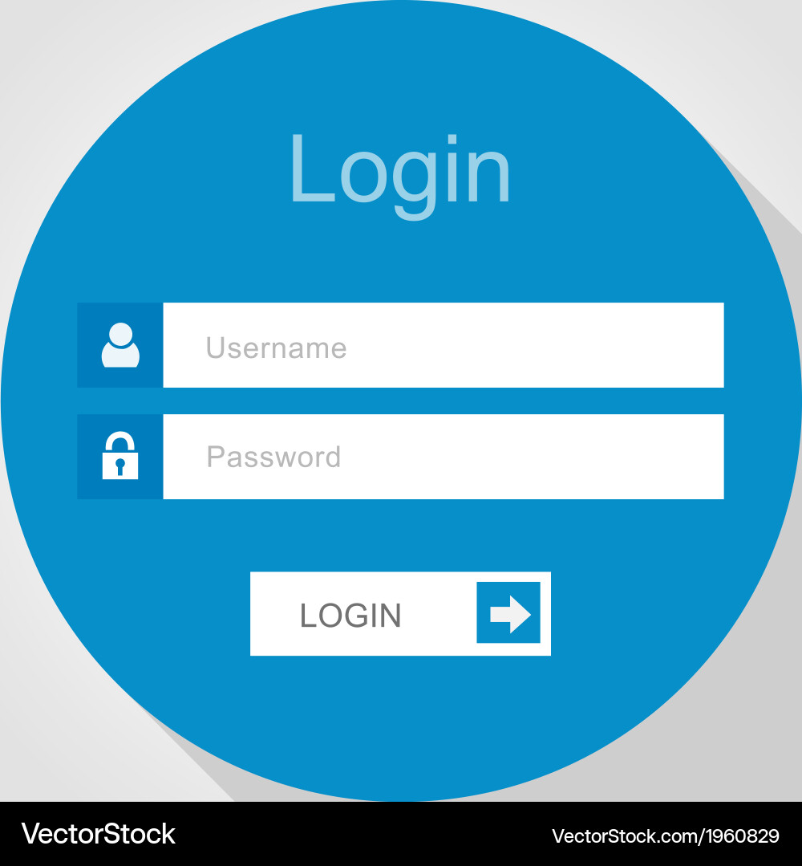


How it Works
Outgoing Process
User Identification by the Mail Service Provider (User Authentication)
2. Local Mail Delivery
Sender to Mail Server
1
Mail Transfer Rule - SMTP
3. Mail Processing
Mail Server process E-mail Details
Mail server checks the Recipient E-mail address
If recipient email has the same domain as the sender, it will be delivered to Recipient’s Mailbox
If recipient email is different from the sender, it has to find the correct server to deliver the E-mail

Slide 23
How it Works
Mail server checks the Recipient E-mail address and if the recipient email domain is different from the sender, it has to find the correct server to deliver the E-mail
Mail Delivery Process
Mail Transfer Rules - SMTP
What is the mail server handles
<recipient email domain>
IP Address of Recipient Mail Server
Up on the main acceptance, the recipient mail server will check,
If it has a registered E-Mail Client
If the E-mail client has the privilege to accept emails
If the E-mail has communication error
What if the E-mail is a SPAM or VIRUS???

Slide 24

How It Works
Recipient’s E-mail Server has the E-mail
Recipient can use local Spam filters/Virus scanners to scan the incoming mail
Mail Transfer Rules
[POP]
A copy of the new mail can be kept in the mail server if required, else it will be downloaded to the client device
Protocol is IMAP
1

Slide 25

Component Architecture
Incoming E-mail Server of Recipient with Mail Transfer App {MTA) + Mail DIR server
Outgoing E-mail Server of Sender with Mail Transfer App
{MTA)
Outgoing
Incoming
SMTP
SMTP
POP/IMAP
Connected Client Device with
Mail Client App (User Agent)
Connected Client Device with
Mail Client App (User Agent)
Sender with E-mail Address
Recepient with
E-mail Address

Slide 26
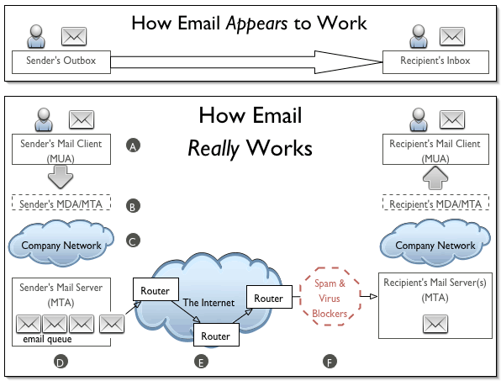
How it Works
How E-mail works

Slide 27
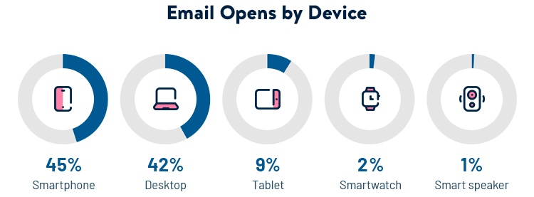
E-mail Addresses
There are nearly 4.26 billion email users worldwide and over 7.9 billion email accounts.
The email address is the unique identifier of the mailbox
Format of the email address: <local_part>@<domain_part>
  Example: chamara.d@ndbm.ac.lk
Local Part Domain Part

Slide 28
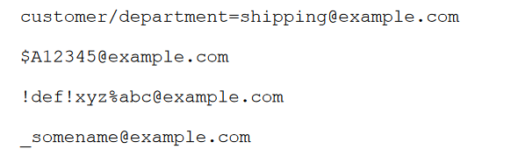
Valid E-mail Address
SAMAN@gmail.com
saman@gamil.com
The local-part of the email address may contain
  A-Z, a-z ASCII
  0-9 digits
  ! # $ % & ’ * + - / = ? ^ _ ‘ . { | } ̃
  “.” period
    may not be used to start or end the local part, nor may two or more consecutive periods appear
චාමර.දිසානායක@හරිතසරසවිය.ලංකා

Slide 29
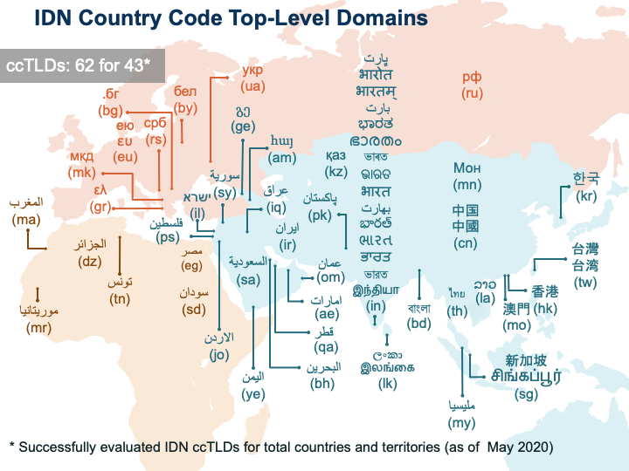
E-mail address – Domain Part
<someone>@<mydomain.lk>
  Allowed characters:
    Case insensitive: a-z, 0-9 and hyphen (-) and dot (.) to separate the domain labels
    Other characters are not allowed in domain names
  Question:
    How the IDN domain names are working in DNS infrastructure?
Domain Part: Example: gmail.com, nsbm.ac.lk, ieee.com,

Slide 30
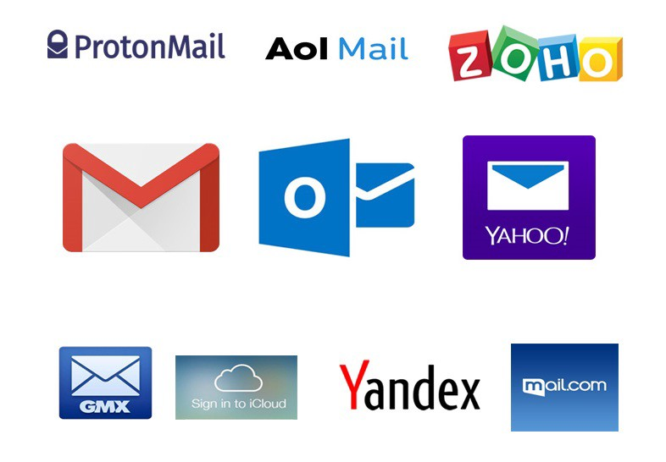
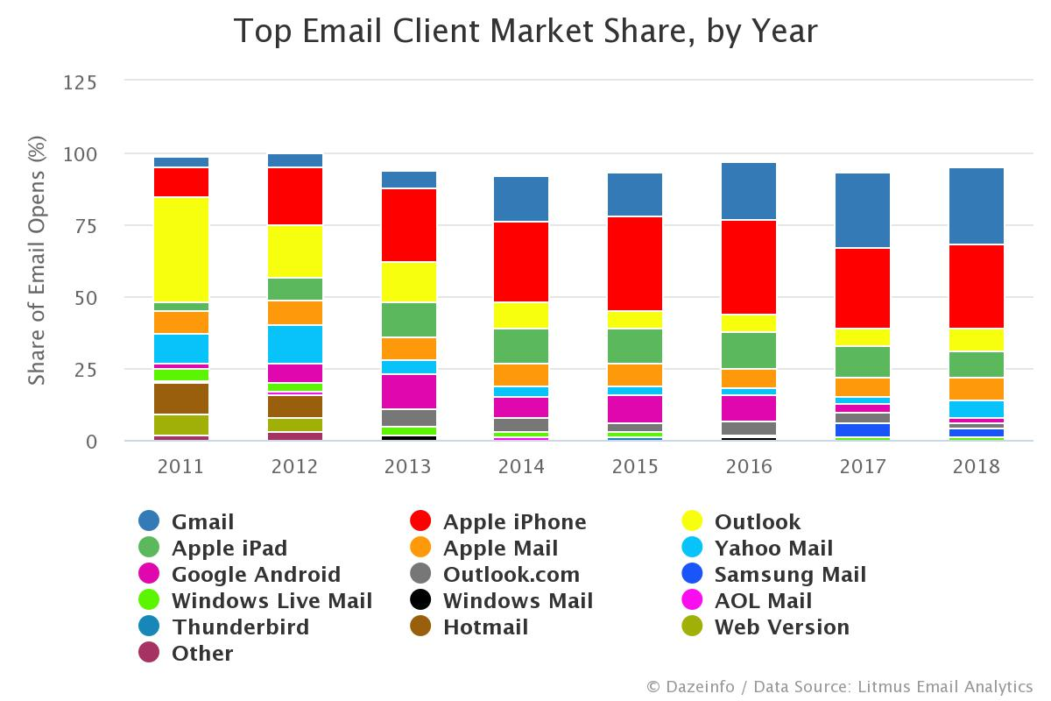
How to Subscribe to E-mail Service
E-mail service providers
  Official e-mail services
  Commercial e-mail services
  Free e-mail services

Slide 31
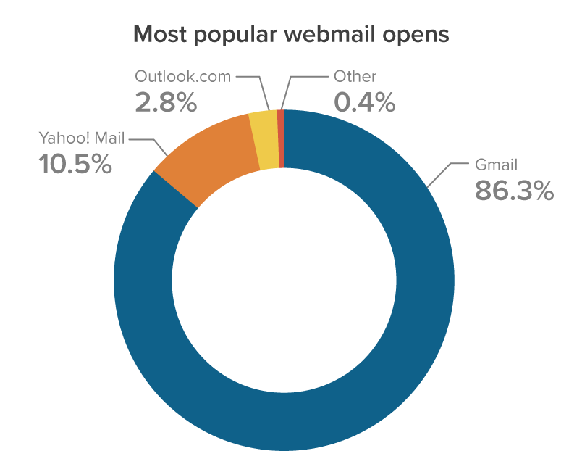

Webmail Service
Webmail is a web-based email service that can be accessed using a web browser.
  No need to install client application into user device
Webmail accounts are usually free, and they are an alternative to email services that require a particular workstation to function.
All emails, calendar services, and contacts are hosted on the email service provider's online servers.

Slide 32

Webmail Server
Incoming E-mail Server of Recipient with Mail Transfer App {MTA) + Mail DIR server
Outgoing E-mail Server of Sender with Mail Transfer App
{MTA)
Outgoing
Incoming
Mail Transfer Rules
Mail Transfer Rules
Mail Transfer Rules
Sender with E-mail Address
Recepient with
E-mail Address
Chamara Disanayake – 25.1 DCN
32

Slide 33
Webmail Service - Functions
Webmail server is a web interface to mail
Webmail server allows the user to authenticate via web interface
It check the user status from the mail server authentication process
If successful, user mailbox details will be displayed
User can read, compose e-mails

Slide 34
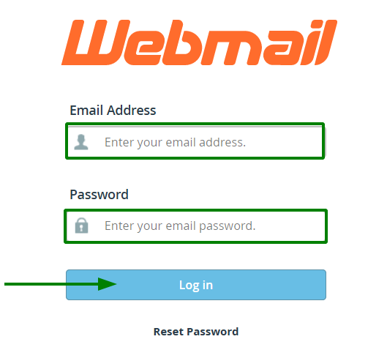
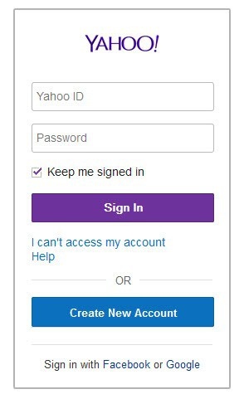
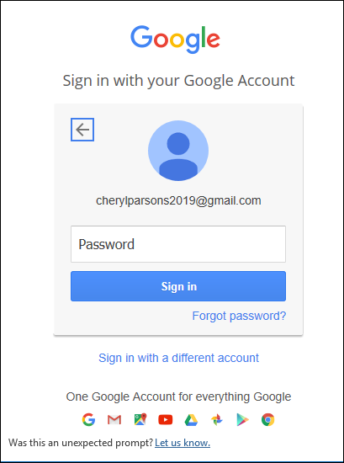
Access Mails through WebMail
Authentication of Email user

Slide 35
Exercise
E-mail is very effective communication medium, but it needs to be secured by utilizing several security measures.
Identify the risks involved with E-mail services.
Discuss security measures can be applied to enhance the security of ‘E-mail systems’
  You need to integrate the solution to the discussed E-mail service architecture discussed earlier.

Slide 36
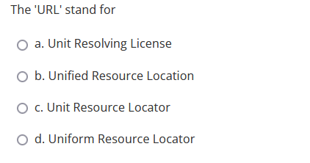
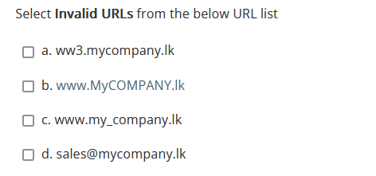
MCQs

Slide 37
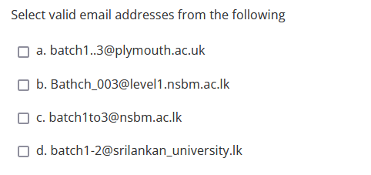
MCQ

Slide 38
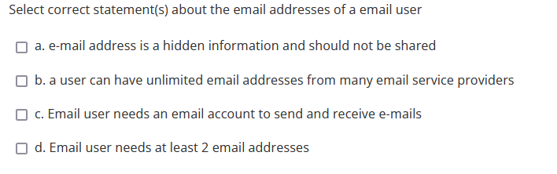
MCQ

Slide 39
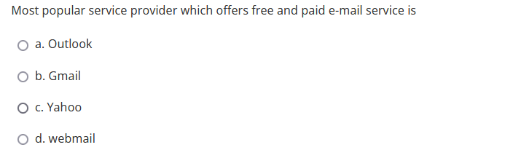
MCQ

