Slide 1

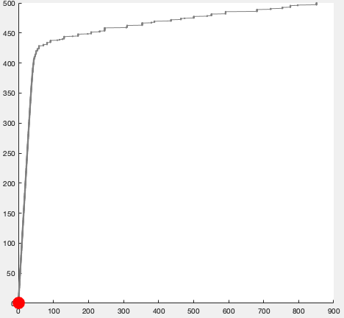


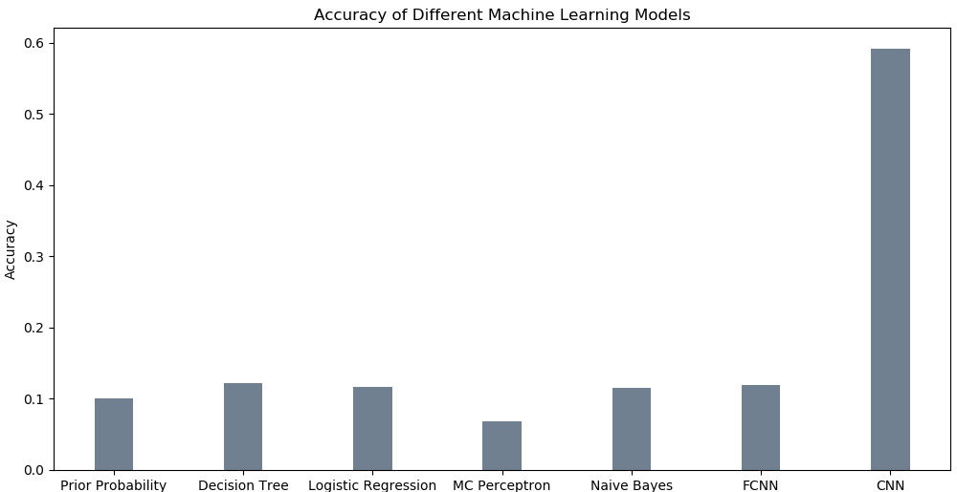
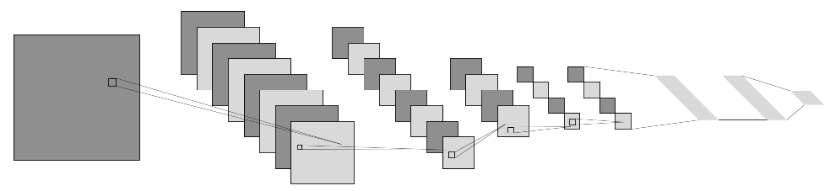
Feature and Pattern Recognition in Disordered Material Architectures
Motivation:
Objectives:
Generate a model using simulated data that can learn the characteristic patterns and responsive features of a simulated medium at different levels of applied stress.
The dynamics of stress transmission in disordered materials are incompletely characterized. A thorough model of long and short range interactions in these material architectures will afford a better understanding of the effects of stress fatigue and work-hardening in a breadth of material systems.
Stress
Technical Approach:
Strain
Results:
Simulate the continuous stress applied to the medium 30 times
For each of the 30 simulations, bin the strain fields according to stress, and assign the bin as a label
Apply general machine learning workflow, testing a number of different models
Use model to characterize consistent patterns in the strain field at given stress levels
Further statistical results
Over here if I have them ☺
(This wont be on final if I don’t have them of course
0-50 mPa (bin 0)
51-100 mPa (bin 1)
101-150 mPa (bin 2)
151-200 mPa (bin 3)
…
451-500 mPa (bin 9)
“1”
24 sets
Training data
Train the model
30 simulations
6 sets
Testing data
Test the model
Contact: Ryder Easterlin, rydereasterlin2020@u.northwestern.edu
Notes:
Work-hardening in crystalline materials-–readup
Cyclic fatigue in crystalline materials- readup

