Slide 1
Data Analytics Lifecycle
CSC 410 Data Engineering
Spring 2020
Instructor: Dr. Md L Ali E-mail: mdali@rider.edu
Copyright © 2015 by John Wiley & Sons, Inc., Indianapolis, Indiana

Slide 2
Contents
Data Analytics Lifecycle Overview
Discovery
Data Preparation
Model planning
Model Building
Communicate results
Model Operationalize
Case Study

Slide 3
Data Analytics Lifecycle
Data science projects differ from BI projects
More exploratory in nature
Critical to have a project process
Participants should be thorough and rigorous
Break large projects into smaller pieces
Spend time to plan and scope the work
Documenting adds rigor and credibility

Slide 4
Data Analytics Lifecycle
Data Analytics Lifecycle Overview
Phase 1: Discovery
Phase 2: Data Preparation
Phase 3: Model Planning
Phase 4: Model Building
Phase 5: Communicate Results
Phase 6: Operationalize
Case Study: GINA

Slide 5
2.1 Data Analytics Lifecycle Overview
The data analytic lifecycle is designed for Big Data problems and data science projects
With six phases the project work can occur in several phases simultaneously
The cycle is iterative to portray a real project
Work can return to earlier phases as new information is uncovered

Slide 6
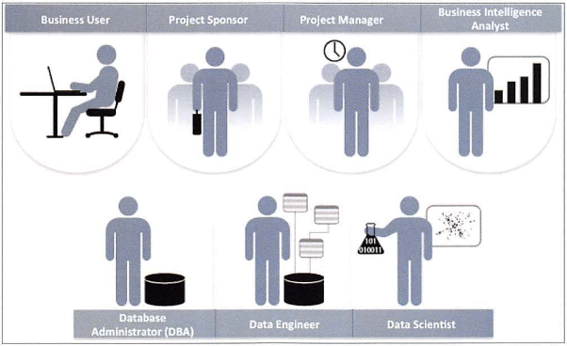
2.1.1 Key Roles for a Successful Analytics Project

Slide 7
Key Roles for a Successful Analytics Project
Business User – understands the domain area
Project Sponsor – provides requirements
Project Manager – ensures meeting objectives
Business Intelligence Analyst – provides business domain expertise based on deep understanding of the data
Database Administrator (DBA) – creates DB environment
Data Engineer – provides technical skills, assists data management and extraction, supports analytic sandbox
Data Scientist – provides analytic techniques and modeling

Slide 8
2.1.2 Background and Overview of Data Analytics Lifecycle
Data Analytics Lifecycle defines the analytics process and best practices from discovery to project completion
The Lifecycle employs aspects of
Scientific method
Cross Industry Standard Process for Data Mining (CRISP-DM)
Process model for data mining
Davenport’s DELTA framework
Hubbard’s Applied Information Economics (AIE) approach
MAD Skills: New Analysis Practices for Big Data by Cohen et al.

Slide 9
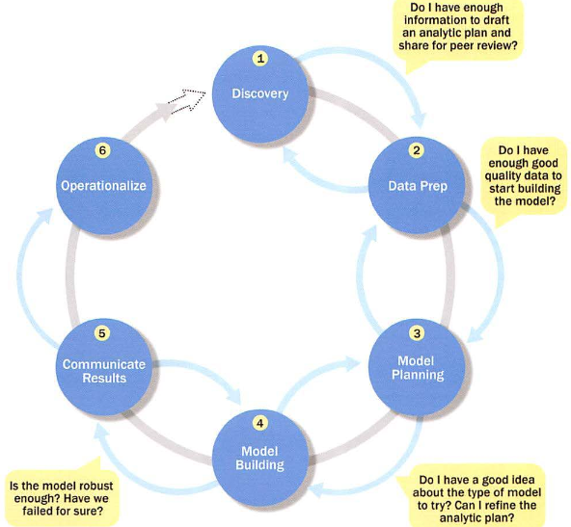
Overview of Data Analytics Lifecycle

Slide 10
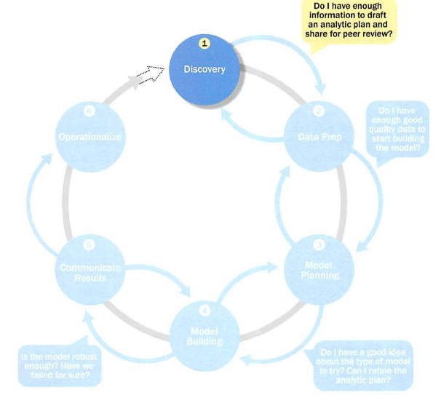
2.2 Phase 1: Discovery

Slide 11
2.2 Phase 1: Discovery
Learning the Business Domain
Resources
Framing the Problem
Identifying Key Stakeholders
Interviewing the Analytics Sponsor
Developing Initial Hypotheses
Identifying Potential Data Sources

Slide 12
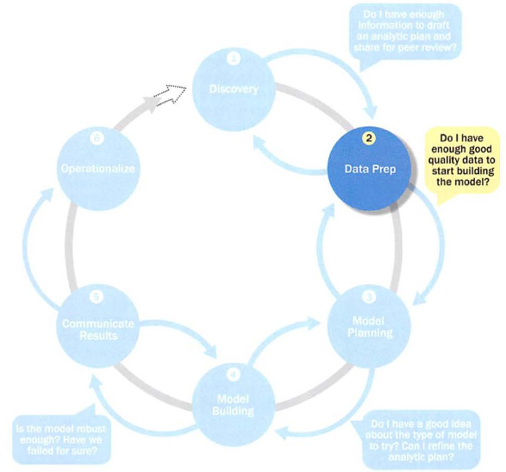
2.3 Phase 2: Data Preparation

Slide 13
2.3 Phase 2: Data Preparation
Includes steps to explore, preprocess, and condition data
Create robust environment – analytics sandbox
Data preparation tends to be the most labor-intensive step in the analytics lifecycle
Often at least 50% of the data science project’s time
The data preparation phase is generally the most iterative and the one that teams tend to underestimate most often

Slide 14
2.3.1 Preparing the Analytic Sandbox
Create the analytic sandbox (also called workspace)
Allows team to explore data without interfering with live production data
Sandbox collects all kinds of data (expansive approach)
The sandbox allows organizations to undertake ambitious projects beyond traditional data analysis and BI to perform advanced predictive analytics
Although the concept of an analytics sandbox is relatively new, this concept has become acceptable to data science teams and IT groups

Slide 15
2.3.2 Performing ETLT (Extract, Transform, Load, Transform)
In ETL users perform extract, transform, load
In the sandbox the process is often ELT – early load preserves the raw data which can be useful to examine
Example – in credit card fraud detection, outliers can represent high-risk transactions that might be inadvertently filtered out or transformed before being loaded into the database
Hadoop (Chapter 10) is often used here

Slide 16
2.3.3 Learning about the Data
Becoming familiar with the data is critical
This activity accomplishes several goals:
Determines the data available to the team early in the project
Highlights gaps – identifies data not currently available
Identifies data outside the organization that might be useful

Slide 17
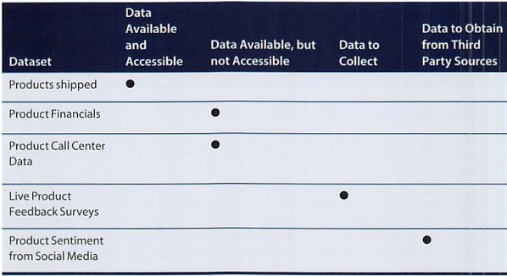
2.3.3 Learning about the Data Sample Dataset Inventory

Slide 18
2.3.4 Data Conditioning
Data conditioning includes cleaning data, normalizing datasets, and performing transformations
Often viewed as a preprocessing step prior to data analysis, it might be performed by data owner, IT department, DBA, etc.
Best to have data scientists involved
Data science teams prefer more data than too little

Slide 19
2.3.4 Data Conditioning
Additional questions and considerations
What are the data sources? Target fields?
How clean is the data?
How consistent are the contents and files? Missing or inconsistent values?
Assess the consistence of the data types – numeric, alphanumeric?
Review the contents to ensure the data makes sense
Look for evidence of systematic error

Slide 20
2.3.5 Survey and Visualize
Leverage data visualization tools to gain an overview of the data
Shneiderman’s mantra:
“Overview first, zoom and filter, then details-on-demand”
This enables the user to find areas of interest, zoom and filter to find more detailed information about a particular area, then find the detailed data in that area

Slide 21
2.3.5 Survey and Visualize Guidelines and Considerations
Review data to ensure calculations are consistent
Does the data distribution stay consistent?
Assess the granularity of the data, the range of values, and the level of aggregation of the data
Does the data represent the population of interest?
Check time-related variables – daily, weekly, monthly? Is this good enough?
Is the data standardized/normalized? Scales consistent?
For geospatial datasets, are state/country abbreviations consistent

Slide 22
2.3.6 Common Tools for Data Preparation
Hadoop can perform parallel ingest and analysis
Alpine Miner provides a graphical user interface for creating analytic workflows
OpenRefine (formerly Google Refine) is a free, open source tool for working with messy data
Similar to OpenRefine,
Data Wrangler is an interactive tool for data cleansing an transformation

Slide 23
Read More
Data Preparation Process, Preprocessing and Data Wrangling
Python Data Transformation Tools for ETL

Slide 24
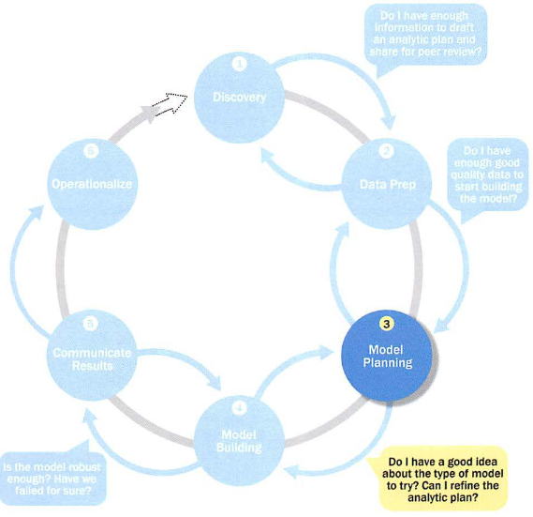
2.4 Phase 3: Model Planning

Slide 25
2.4 Phase 3: Model Planning
Activities to consider
Assess the structure of the data – this dictates the tools and analytic techniques for the next phase
Ensure the analytic techniques enable the team to meet the business objectives and accept or reject the working hypotheses
Determine if the situation warrants a single model or a series of techniques as part of a larger analytic workflow
Research and understand how other analysts have approached this kind or similar kind of problem

Slide 26
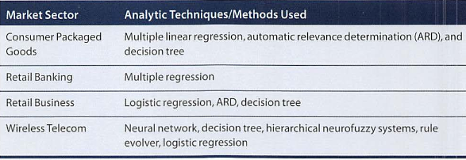
2.4 Phase 3: Model Planning Model Planning in Industry Verticals
Example of other analysts approaching a similar problem

Slide 27
2.4.1 Data Exploration and Variable Selection
Explore the data to understand the relationships among the variables to inform selection of the variables and methods
A common way to do this is to use data visualization tools
Often, stakeholders and subject matter experts may have ideas
For example, some hypothesis that led to the project
Aim for capturing the most essential predictors and variables
This often requires iterations and testing to identify key variables
If the team plans to run regression analysis, identify the candidate predictors and outcome variables of the model

Slide 28
2.4.2 Model Selection
The main goal is to choose an analytical technique, or several candidates, based on the end goal of the project
We observe events in the real world and attempt to construct models that emulate this behavior with a set of rules and conditions
A model is simply an abstraction from reality
Determine whether to use techniques best suited for structured data, unstructured data, or a hybrid approach
Teams often create initial models using statistical software packages such as R, SAS, or Matlab
Which may have limitations when applied to very large datasets
The team moves to the model building phase once it has a good idea about the type of model to try

Slide 29
2.4.3 Common Tools for the Model Planning Phase
R has a complete set of modeling capabilities
R contains about 5000 packages for data analysis and graphical presentation
SQL Analysis services can perform in-database analytics of common data mining functions, involved aggregations, and basic predictive models
SAS/ACCESS provides integration between SAS and the analytics sandbox via multiple data connections

Slide 30
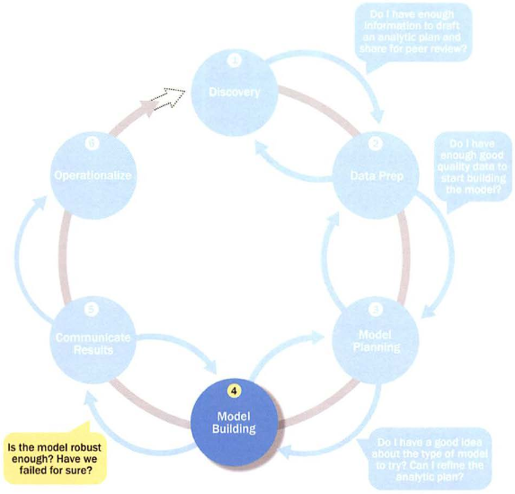
2.5 Phase 4: Model Building

Slide 31
2.5 Phase 4: Model Building
Execute the models defined in Phase 3
Develop datasets for training, testing, and production
Develop analytic model on training data, test on test data
Question to consider
Does the model appear valid and accurate on the test data?
Does the model output/behavior make sense to the domain experts?
Do the parameter values make sense in the context of the domain?
Is the model sufficiently accurate to meet the goal?
Does the model avoid intolerable mistakes? (see Chapters 3 and 7)
Are more data or inputs needed?
Will the kind of model chosen support the runtime environment?
Is a different form of the model required to address the business problem?

Slide 32
2.5.1 Common Tools for the Model Building Phase
Commercial Tools
SAS Enterprise Miner – built for enterprise-level computing and analytics
SPSS Modeler (IBM) – provides enterprise-level computing and analytics
Matlab – high-level language for data analytics, algorithms, data exploration
Alpine Miner – provides GUI frontend for backend analytics tools
STATISTICA and MATHEMATICA – popular data mining and analytics tools
Free or Open Source Tools
R and PL/R - PL/R is a procedural language for PostgreSQL with R
Octave – language for computational modeling
WEKA – data mining software package with analytic workbench
Python – language providing toolkits for machine learning and analysis
SQL – in-database implementations provide an alternative tool (see Chap 11)

Slide 33
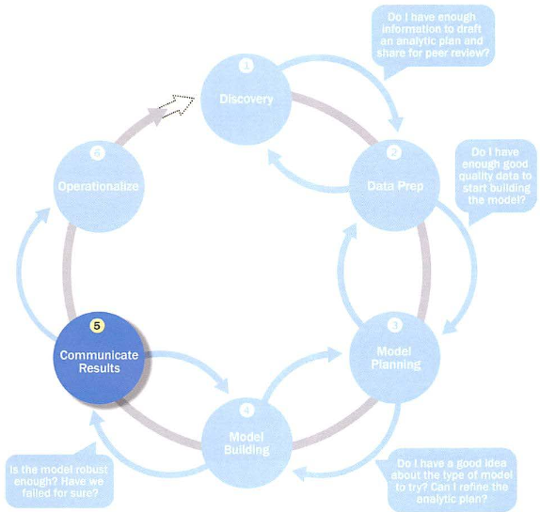
2.6 Phase 5: Communicate Results

Slide 34
2.6 Phase 5: Communicate Results
Determine if the team succeeded or failed in its objectives
Assess if the results are statistically significant and valid
If so, identify aspects of the results that present salient findings
Identify surprising results and those in line with the hypotheses
Communicate and document the key findings and major insights derived from the analysis
This is the most visible portion of the process to the outside stakeholders and sponsors

Slide 35
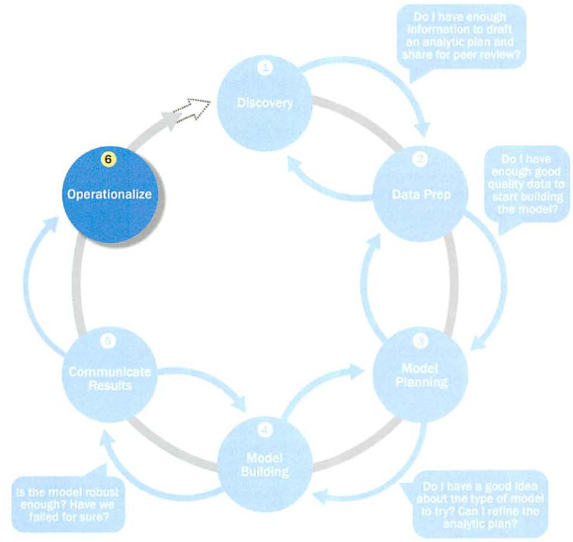
2.7 Phase 6: Operationalize

Slide 36
2.7 Phase 6: Operationalize
In this last phase, the team communicates the benefits of the project more broadly and sets up a pilot project to deploy the work in a controlled way
Risk is managed effectively by undertaking small scope, pilot deployment before a wide-scale rollout
During the pilot project, the team may need to execute the algorithm more efficiently in the database rather than with in-memory tools like R, especially with larger datasets
To test the model in a live setting, consider running the model in a production environment for a discrete set of products or a single line of business
Monitor model accuracy and retrain the model if necessary

Slide 37
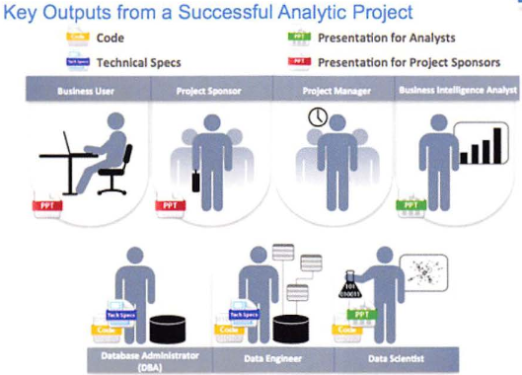
2.7 Phase 6: Operationalize Key outputs from successful analytics project

Slide 38
2.7 Phase 6: Operationalize Key outputs from successful analytics project
Business user – tries to determine business benefits and implications
Project sponsor – wants business impact, risks, ROI
Project manager – needs to determine if project completed on time, within budget, goals met
Business intelligence analyst – needs to know if reports and dashboards will be impacted and need to change
Data engineer and DBA – must share code and document
Data scientist – must share code and explain model to peers, managers, stakeholders

Slide 39
2.7 Phase 6: Operationalize Four main deliverables
Although the seven roles represent many interests, the interests overlap and can be met with four main deliverables
Presentation for project sponsors – high-level takeaways for executive level stakeholders
Presentation for analysts – describes business process changes and reporting changes, includes details and technical graphs
Code for technical people
Technical specifications of implementing the code

Slide 40
2.8 Case Study: Global Innovation Network and Analysis (GINA)
In 2012 EMC’s new director wanted to improve the company’s engagement of employees across the global centers of excellence (GCE) to drive innovation, research, and university partnerships
This project was created to accomplish
Store formal and informal data
Track research from global technologists
Mine the data for patterns and insights to improve the team’s operations and strategy

Slide 41
2.8.1 Phase 1: Discovery
Team members and roles
Business user, project sponsor, project manager – Vice President from Office of CTO
BI analyst – person from IT
Data engineer and DBA – people from IT
Data scientist – distinguished engineer

Slide 42
2.8.1 Phase 1: Discovery
The data fell into two categories
Five years of idea submissions from internal innovation contests
Minutes and notes representing innovation and research activity from around the world
Hypotheses grouped into two categories
Descriptive analytics of what is happening to spark further creativity, collaboration, and asset generation
Predictive analytics to advise executive management of where it should be investing in the future

Slide 43
2.8.2 Phase 2: Data Preparation
Set up an analytics sandbox
Discovered that certain data needed conditioning and normalization and that missing datasets were critical
Team recognized that poor quality data could impact subsequent steps
They discovered many names were misspelled and problems with extra spaces
These seemingly small problems had to be addressed

Slide 44
2.8.3 Phase 3: Model Planning
The study included the following considerations
Identify the right milestones to achieve the goals
Trace how people move ideas from each milestone toward the goal
Tract ideas that die and others that reach the goal
Compare times and outcomes using a few different methods

Slide 45
2.8.4 Phase 4: Model Building
Several analytic method were employed
NLP on textual descriptions
Social network analysis using R and Rstudio
Developed social graphs and visualizations

Slide 46
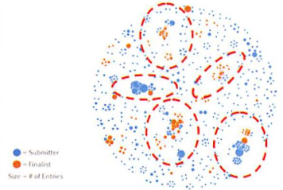
2.8.4 Phase 4: Model Building Social graph of data submitters and finalists

Slide 47
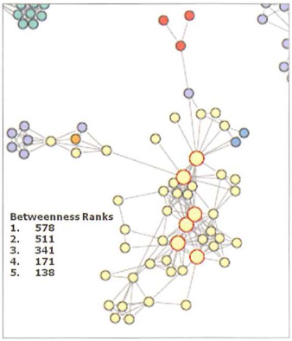
2.8.4 Phase 4: Model Building Social graph of top innovation influencers

Slide 48
2.8.5 Phase 5: Communicate Results
Study was successful in in identifying hidden innovators
Found high density of innovators in Cork, Ireland
The CTO office launched longitudinal studies

Slide 49
2.8.6 Phase 6: Operationalize
Deployment was not really discussed
Key findings
Need more data in future
Some data were sensitive
A parallel initiative needs to be created to improve basic BI activities
A mechanism is needed to continually reevaluate the model after deployment

Slide 50
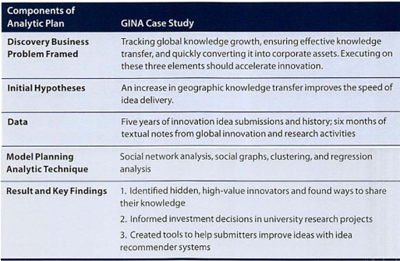
2.8.6 Phase 6: Operationalize

Slide 51
Summary
The Data Analytics Lifecycle is an approach to managing and executing analytic projects
Lifecycle has six phases
Bulk of the time usually spent on preparation – phases 1 and 2
Seven roles needed for a data science team
Review the exercises

