Slide 1
Towards a Greater Understanding of Platelet Metabolism
Rachel LeCover
Biokinetics 2017

Slide 2
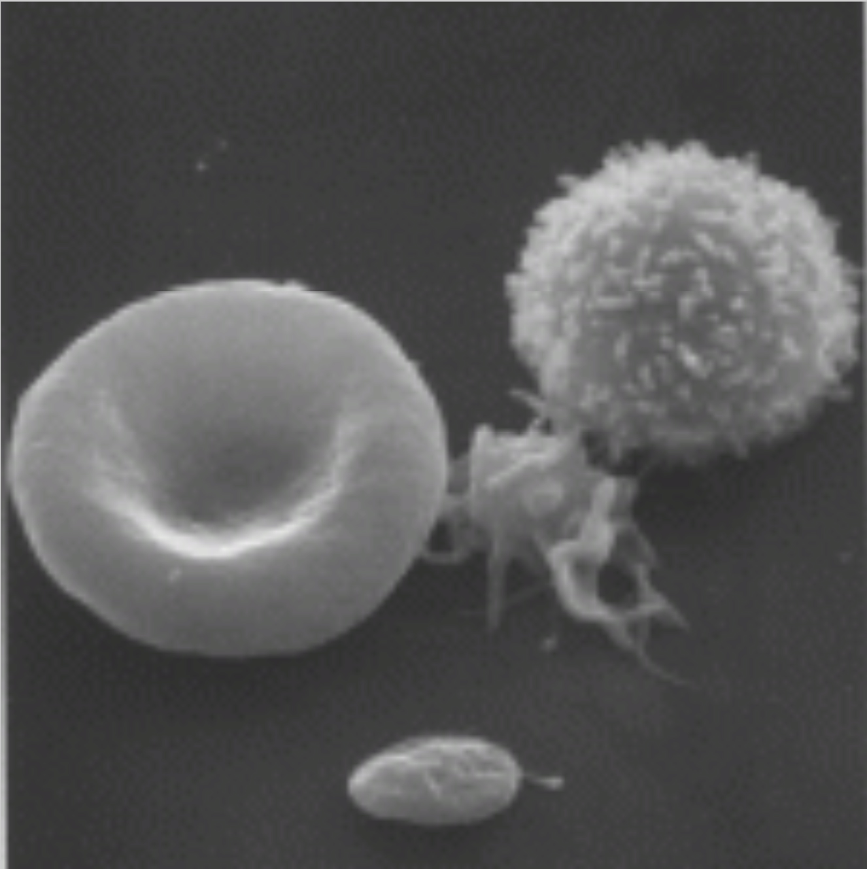
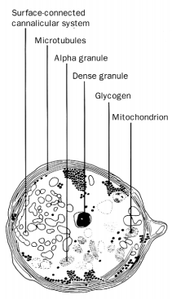
What is a Platelet?
Left: http://artchester.net/2014/07/platelets-stem-cells-investing-blood/
Right: Platelets. Haematology James N George

Slide 3
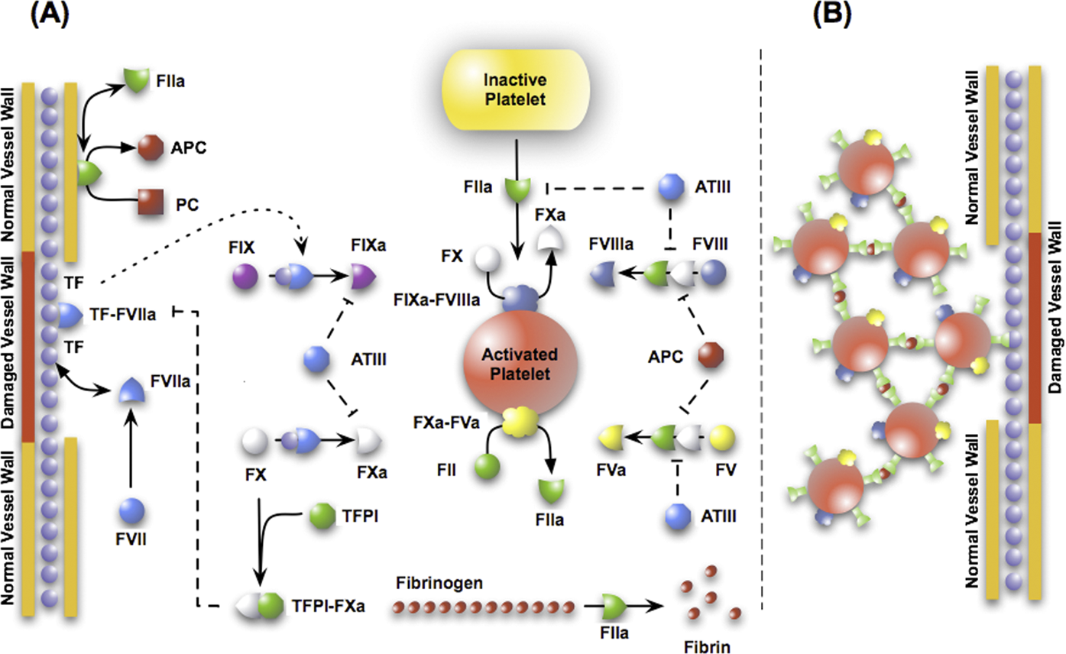
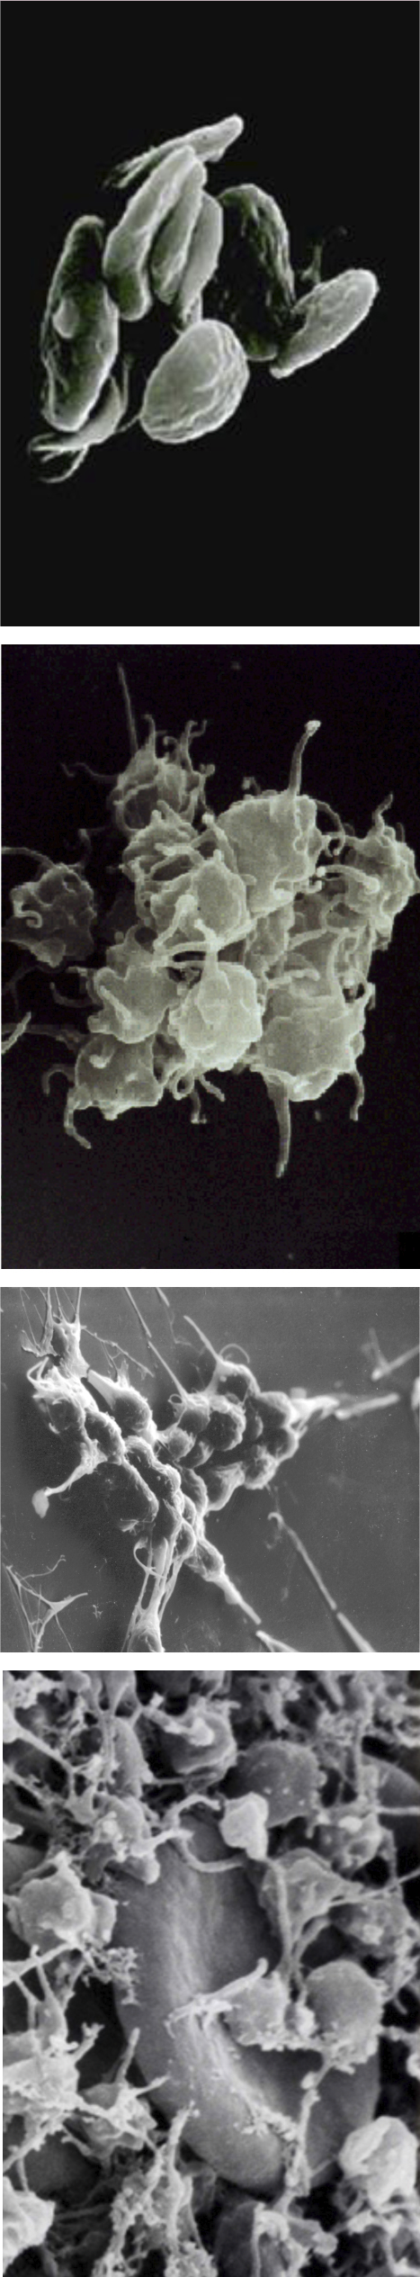
The Importance of Platelets
Left: http://artchester.net/wp-content/uploads/2014/07/Platelets-4-images-from-James-George.jpg
Top: Computationally Derived Points of Fragility of a Human Cascade Are Consistent with Current Therapeutic Strategies
Deyan Luan Michael Zai Jeffrey D Varner

Slide 4
Previous Work
1675-Leewenhoeck looks at platelets through his microscope and shares his observations with the Royal Society of London
1882-Bizzozzero identifies platelets as being a separate component of blood (not a red or a white cell), that they change shape, and form clots
1960-Hellem and Owren discover that ADP causes platelets to activate
1989-Asby publishes a model of cAMP metabolism in platelets
2008-Diamond publishes a kinetic model of platelet activation
2014-Palsson publishes his network reconstruction of platelet metabolism
The discovery of platelets and their function. Gazzaniga and Ottinit, 2001

Slide 5
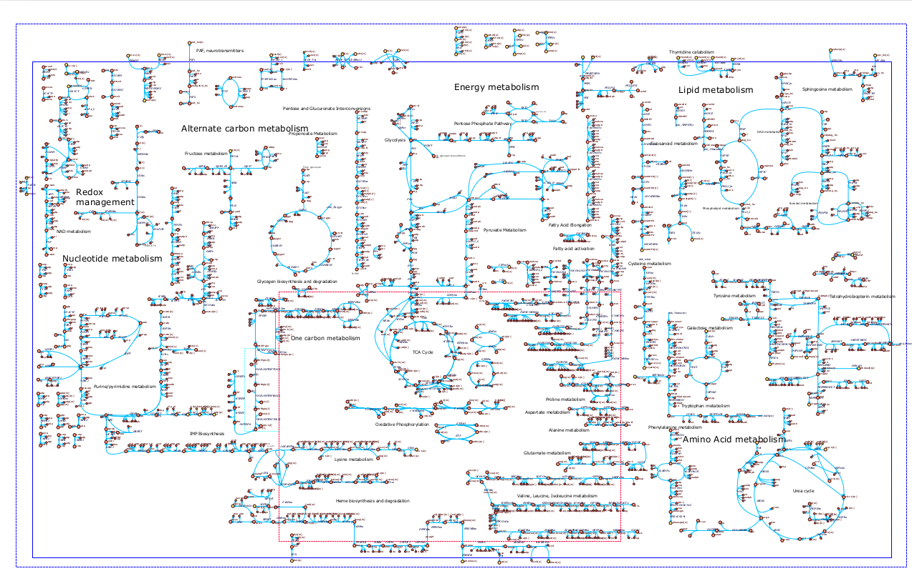
Palsson’s Platelet Model

Slide 6
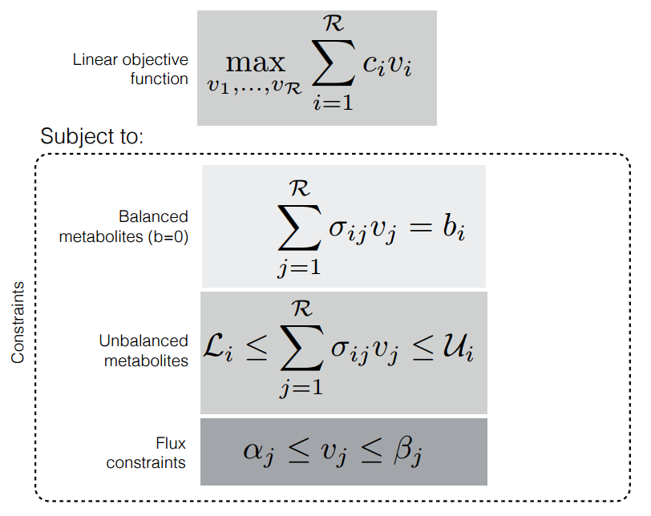
FBA

Slide 7
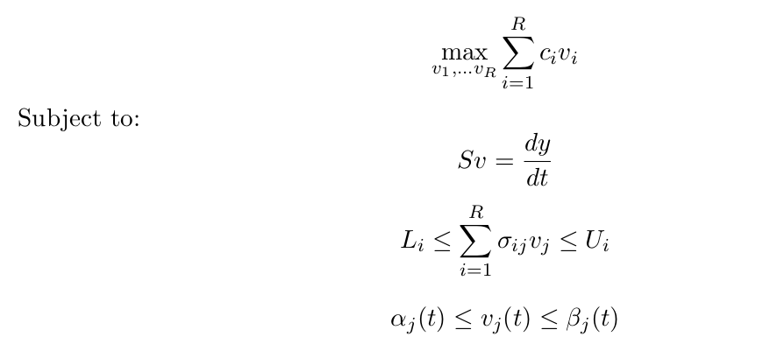
dFBA

Slide 8
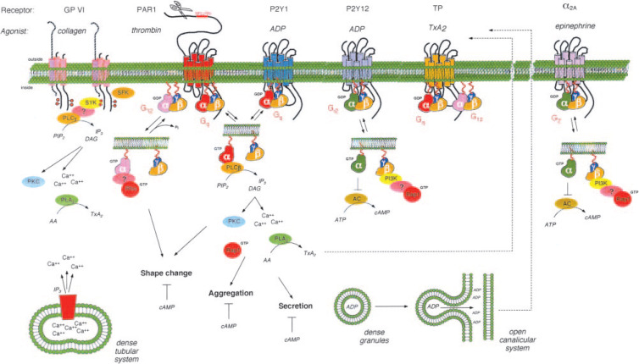
Platelet Activation
Thrombin and Platelet Activation
Lawrence F. Brass, 2003
https://doi.org/10.1378/chest.124.3_suppl.18S

Slide 9
Adding Logical Rules
If (external concentration of calcium is high)
  Import calcium (until it reaches 1 microMolar, then export)
  Increase flux through reactions producing IP₃
  Decrease flux through reactions producing cAMP though adenylate cyclase
  Increase flux through reactions producing TXA₂

Slide 10
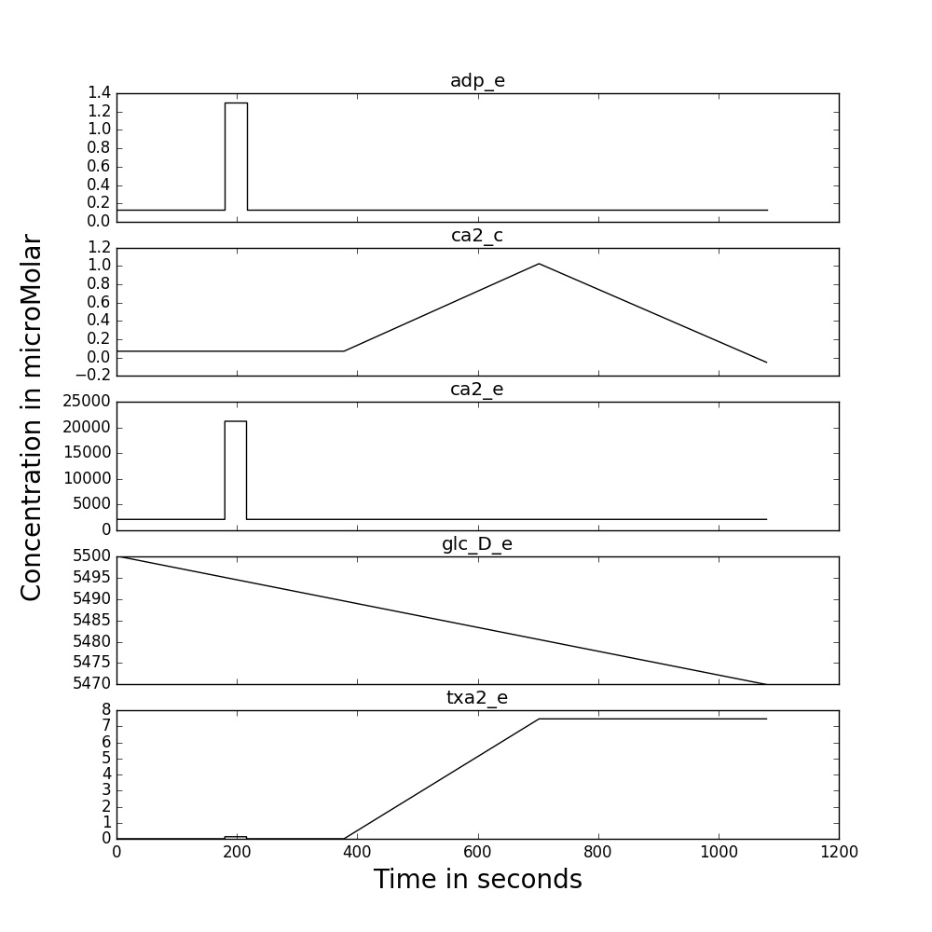
Activating the Platelet
To simulate activating the platelet, I spiked the external calcium, ADP, and TXA₂ levels

Slide 11
Steady State Exchange Fluxes

Slide 12
Post Activation Exchange Fluxes

Slide 13
Limitations of the model
This model doesn’t contain reactions for the synthesis of any structural proteins (like actin) which play key roles in platelet shape change post activation
It’s missing granules, the organelles that release the agents of platelet activation
Most of the signaling mechanisms are absent

Slide 14
Future Directions
Add a more comprehensive regulatory layer to capture platelet signaling
Incorporate cytoskeleton metabolism
Include granules as separate compartments
More accurately capture calcium dynamics

