Slide 1
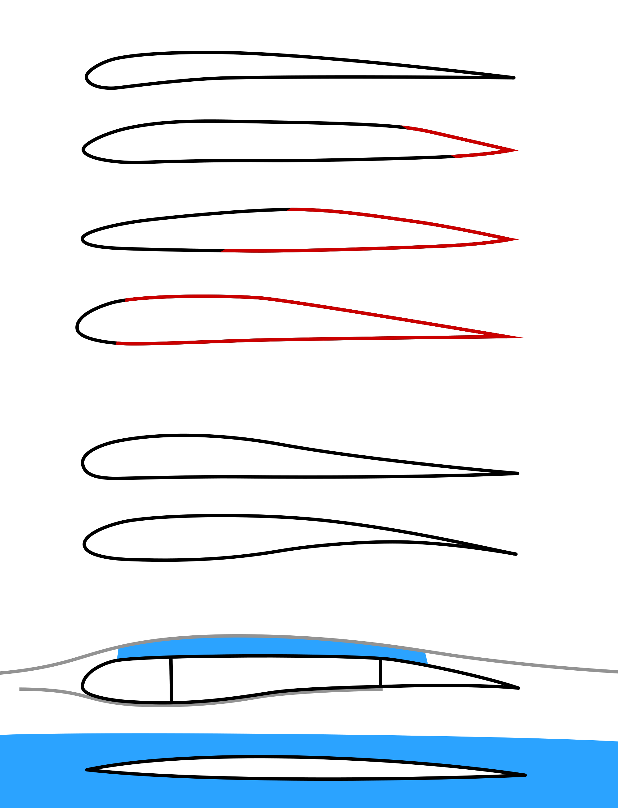

Slide 2
Far upstream
At the airfoil
Far downstream

