Slide 1





Team DC: - Elizabeth Taillon - Jorge Castaneda - Matthew Erler - Phani Daraprueddy - Sonia Patterson - Stephanie Weaver
Connacht University

Slide 2

Business Requirements
Due to Covid-19, Connacht University needs a fast solution to move all courses to an online offering. Services are also provided to local small businesses and startups. The request is to design a solution for an online repository to these customers.
Design to include:
Clean and simple design
User access levels (client, administrator)
Includes at least one self developed API and one webservice
To be run over Amazon AWS
Notes:
When conducting research, it is easy to go to one source: Wikipedia. However, you need to include a variety of sources in your research. Consider the following sources:
Who can I interview to get more information on the topic?
Is the topic current and will it be relevant to my audience?
What articles, blogs, and magazines may have something related to my topic?
Is there a YouTube video on the topic? If so, what is it about?
What images can I find related to the topic?

Slide 3
Key Project Components (Application Development)
Notes:
After consulting a variety of sources, you will need to narrow your topic. For example, the topic of internet safety is huge, but you could narrow that topic to include internet safety in regards to social media apps that teenagers are using heavily. A topic like that is more specific and will be relevant to your peers. Some questions to think about to help you narrow your topic:
What topics of the research interest me the most?
What topics of the research will interest my audience the most?
What topics will the audience find more engaging? Shocking? Inspiring?

Slide 4
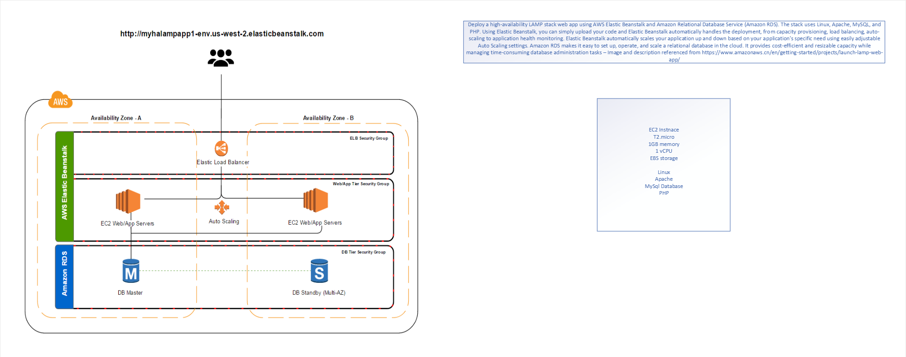
Architectural Diagram
Notes:
Once you find your sources, you will want to evaluate your sources using the following questions:
Author:
Who is the author?
Why should I believe what he or she has to say on the topic?
Is the author seen as an expert on the topic? How do you know?
Current:
How current is the information in the source?
When was the source published?
Is the information out-of-date?
Accuracy:
Is the content accurate?
Is the information presented objectively? Do they share the pros and cons?

Slide 5
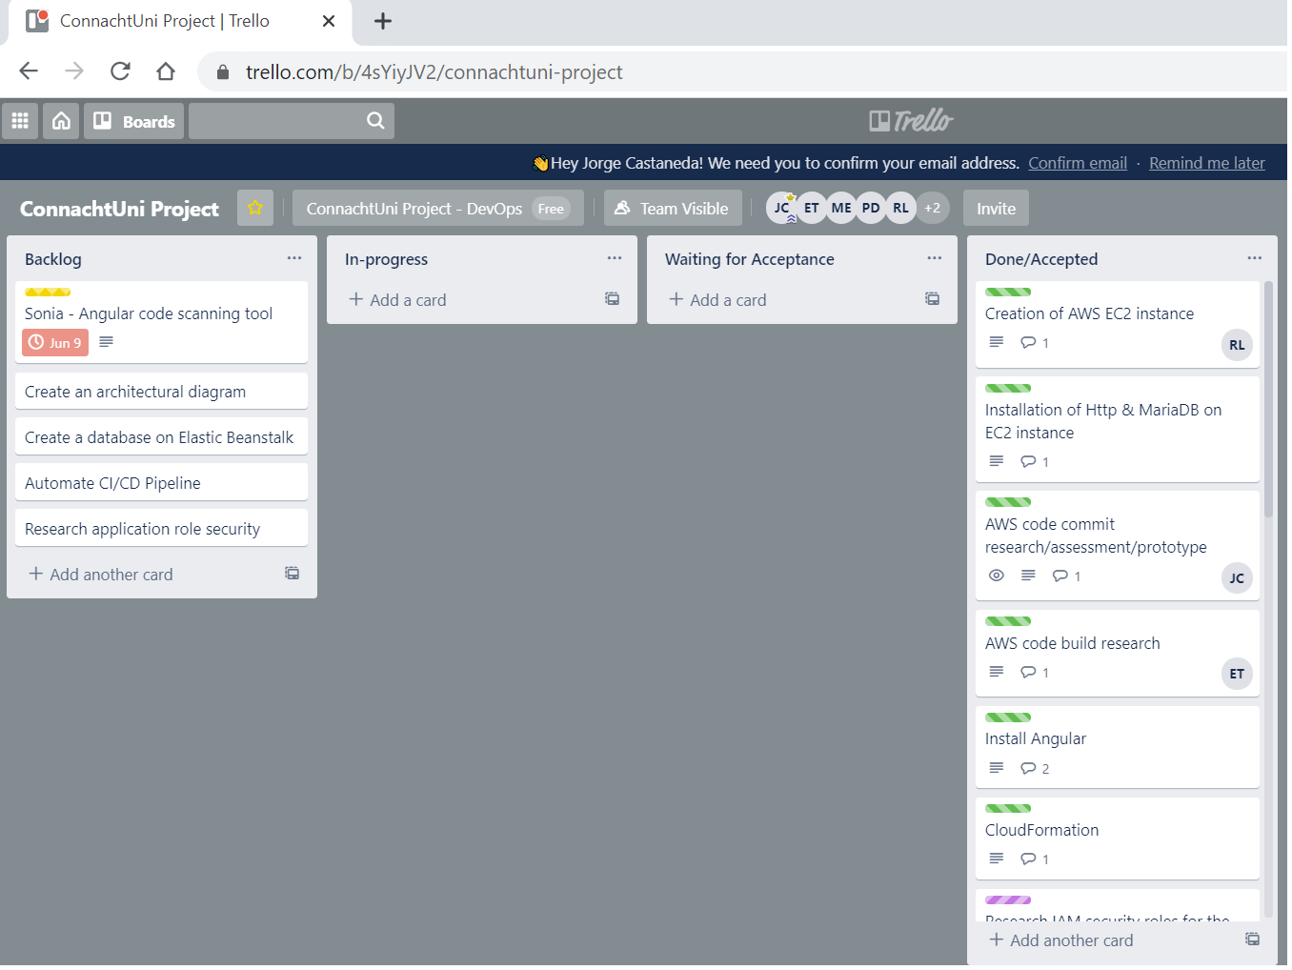
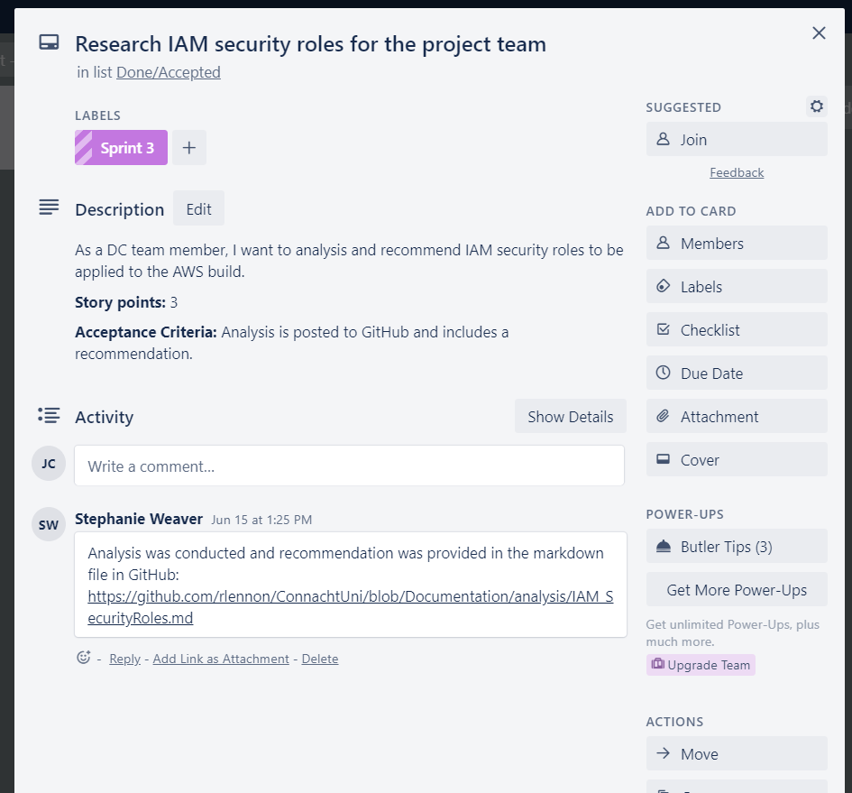
Trello
User Stories captured in color-coded cards
Labeled with related Sprint
Includes Story Points, Acceptance Criteria, etc.
Sprint Planning – Issue/Project Management
Kanban Style through Trello
Backlog, In-progress, Waiting for Acceptance and Accepted
Notes:
Once you find your sources, you will want to evaluate your sources using the following questions:
Author:
Who is the author?
Why should I believe what he or she has to say on the topic?
Is the author seen as an expert on the topic? How do you know?
Current:
How current is the information in the source?
When was the source published?
Is the information out-of-date?
Accuracy:
Is the content accurate?
Is the information presented objectively? Do they share the pros and cons?

Slide 6
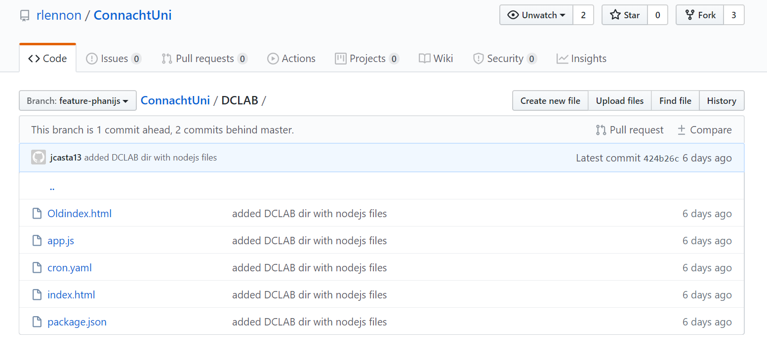
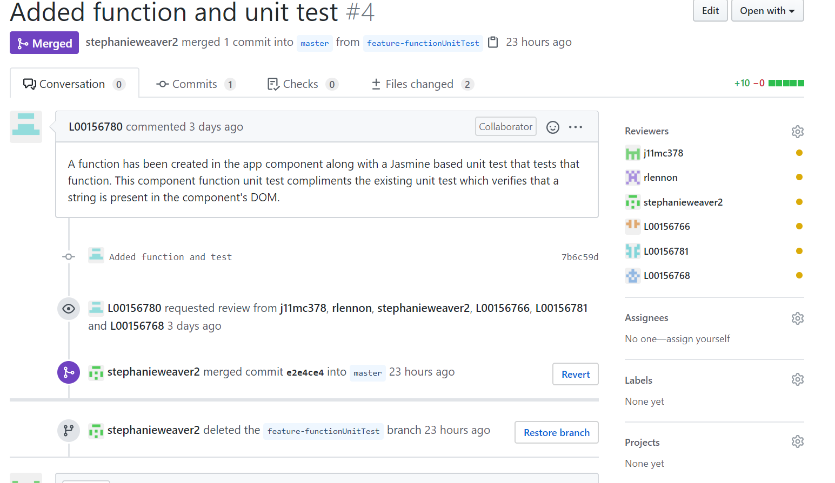
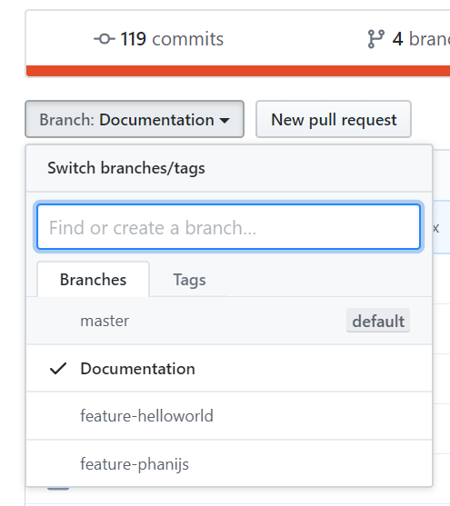
GitHub
Documentation and Master persistent branches
Branching strategy documented
Pull Requests, Code Reviews, and Merging to master
Notes:
Once you find your sources, you will want to evaluate your sources using the following questions:
Author:
Who is the author?
Why should I believe what he or she has to say on the topic?
Is the author seen as an expert on the topic? How do you know?
Current:
How current is the information in the source?
When was the source published?
Is the information out-of-date?
Accuracy:
Is the content accurate?
Is the information presented objectively? Do they share the pros and cons?

Slide 7
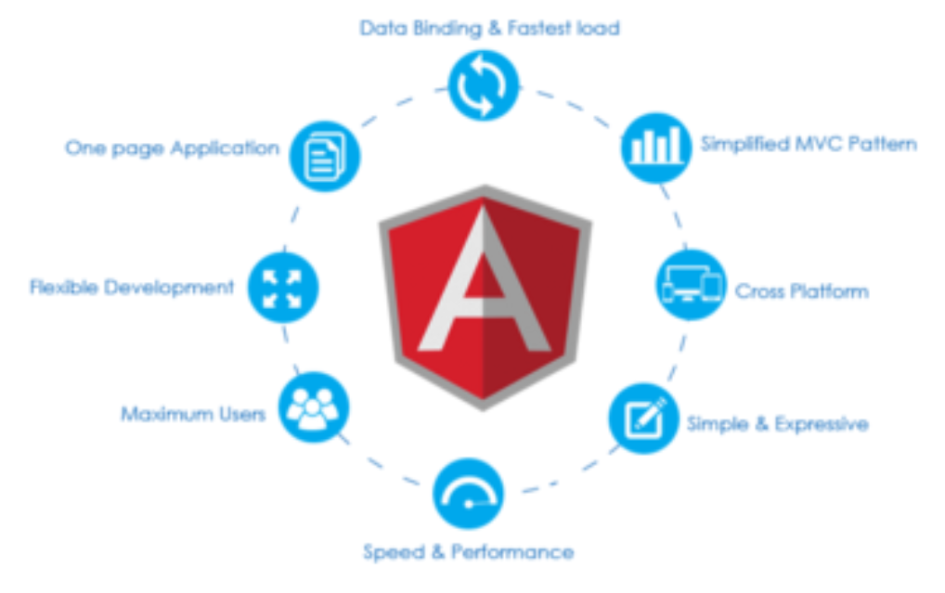

Angular code build/Unit test
Angular code build/Unit test
Angular is a JavaScript based client-side framework for building performant web apps
A fully functioning starter application can be created with a single command: ng new project-name
Built in testing support
Simple unit test execution via “ng test”
Notes:
Once you find your sources, you will want to evaluate your sources using the following questions:
Author:
Who is the author?
Why should I believe what he or she has to say on the topic?
Is the author seen as an expert on the topic? How do you know?
Current:
How current is the information in the source?
When was the source published?
Is the information out-of-date?
Accuracy:
Is the content accurate?
Is the information presented objectively? Do they share the pros and cons?

Slide 8
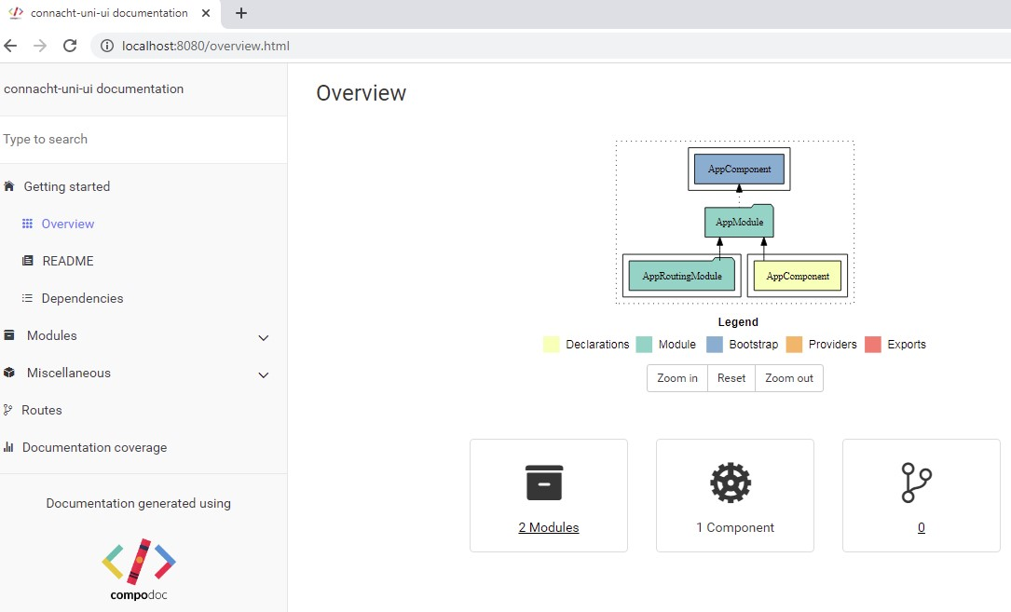
Automated documentation
Automated documentation
Project documentation via Compodoc
Code and comments are parsed for full documentation coverage
Documentation is part of the software project
Notes:
Once you find your sources, you will want to evaluate your sources using the following questions:
Author:
Who is the author?
Why should I believe what he or she has to say on the topic?
Is the author seen as an expert on the topic? How do you know?
Current:
How current is the information in the source?
When was the source published?
Is the information out-of-date?
Accuracy:
Is the content accurate?
Is the information presented objectively? Do they share the pros and cons?

Slide 9
Code Scanning
Requirements for the tool selection:
Shows vulnerabilities (password, security, etc.)
Safeguards for open source code and tools (no backdoors)
Integrates with all functions within the pipeline
Options that are currently in review for Angular code:
Synk
SonarQube
VeraCode
These cover Static and Dynamic Security Testing (SAST and DAST)
Notes:
Once you find your sources, you will want to evaluate your sources using the following questions:
Author:
Who is the author?
Why should I believe what he or she has to say on the topic?
Is the author seen as an expert on the topic? How do you know?
Current:
How current is the information in the source?
When was the source published?
Is the information out-of-date?
Accuracy:
Is the content accurate?
Is the information presented objectively? Do they share the pros and cons?

Slide 10
Security Roles
IAM users are granted the least privilege access and added to user groups that were related to their job function, instead of granting individual permissions.
We utilized user groups for more streamlined access management. If needed, changes can be made at the group level in one-place.
AWS defined access level classifications for the actions in a services as: List, Read, Write, Tagging, Permissions Management
The following groups would be created: Admin, Developer, User
AWS Managed Policies would also be attached to each of the roles, as they are already available, and are maintained and updated by AWS.
Source: https://docs.aws.amazon.com/IAM/latest/UserGuide/best-practices.html
Notes:
Once you find your sources, you will want to evaluate your sources using the following questions:
Author:
Who is the author?
Why should I believe what he or she has to say on the topic?
Is the author seen as an expert on the topic? How do you know?
Current:
How current is the information in the source?
When was the source published?
Is the information out-of-date?
Accuracy:
Is the content accurate?
Is the information presented objectively? Do they share the pros and cons?

Slide 11
Performance Testing
For performance testing our Angular application code, we have chosen to use Apache JMeter.
JMeter is an open-source tool that is a Java application designed to load test functional behavior and measure performance.
According to our research, it is the most friendly option for beginners.
There is no programming language knowledge required; test cases can be created in GUI form
While there are several open source tools available to test Angular applications, Apache JMeter was chosen based on the cost and availability, shorter learning curve, and the functionality it provides. A close second tool was Selenium, which provided many of the same features as Apache JMeter, but did not offer the same accuracy.
Source: https://jmeter.apache.org/index.html
Notes:
Once you find your sources, you will want to evaluate your sources using the following questions:
Author:
Who is the author?
Why should I believe what he or she has to say on the topic?
Is the author seen as an expert on the topic? How do you know?
Current:
How current is the information in the source?
When was the source published?
Is the information out-of-date?
Accuracy:
Is the content accurate?
Is the information presented objectively? Do they share the pros and cons?

Slide 12
Demo (Application provision & deployment)
Notes:
After consulting a variety of sources, you will need to narrow your topic. For example, the topic of internet safety is huge, but you could narrow that topic to include internet safety in regards to social media apps that teenagers are using heavily. A topic like that is more specific and will be relevant to your peers. Some questions to think about to help you narrow your topic:
What topics of the research interest me the most?
What topics of the research will interest my audience the most?
What topics will the audience find more engaging? Shocking? Inspiring?

Slide 13
Mock-ups
AWS Service choices
Elastic Beanstalk
PaaS
Auto scaling, load balancing, health monitoring, configurable critical updates
Nginx, Node JS
Uses CloudFormation
One application, multiple Cloned environments
Template can be checked into GitHub for provisioning other environments
Used with CodePipeline
Stand alone EC2 instance using LAMP technology
Linux, Apache, Mysql/MariaDB, PHP, Angular, Node JS
Used with Code Deploy
S3 bucket
Static website
Notes:
Once you find your sources, you will want to evaluate your sources using the following questions:
Author:
Who is the author?
Why should I believe what he or she has to say on the topic?
Is the author seen as an expert on the topic? How do you know?
Current:
How current is the information in the source?
When was the source published?
Is the information out-of-date?
Accuracy:
Is the content accurate?
Is the information presented objectively? Do they share the pros and cons?

Slide 14
Mock-ups
AWS Service choices
Automated Pipeline
Code Pipeline
Source: GitHub
Deploy: AWS Elastic Beanstalk
Artifact stored in S3 bucket
Code Commit
GitHub using oAuth
Repository using S3 bucket
Code Build
Build Projects for packaging code, executing test cases
Code Deploy
Deploy on EC2
Deployment Groups, rolling changes
IAM roles
Code Pipeline
Source: GitHub
Deploy: AWS Elastic Beanstalk
Artifact sored in S3 bucket
Code Commit
GitHub using oAuth
Repository using S3 bucket
Code Build
Build Projects for packaging code, executing test cases
Code Deploy
Deploy on EC2
Deployment Groups, rolling changes
IAM roles
Notes:
Once you find your sources, you will want to evaluate your sources using the following questions:
Author:
Who is the author?
Why should I believe what he or she has to say on the topic?
Is the author seen as an expert on the topic? How do you know?
Current:
How current is the information in the source?
When was the source published?
Is the information out-of-date?
Accuracy:
Is the content accurate?
Is the information presented objectively? Do they share the pros and cons?

Slide 15
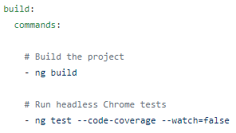
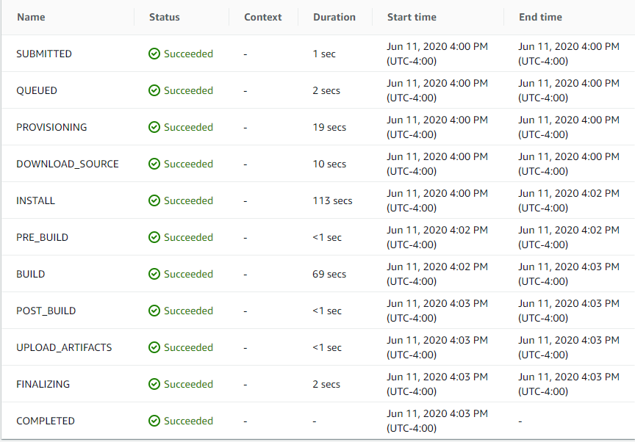
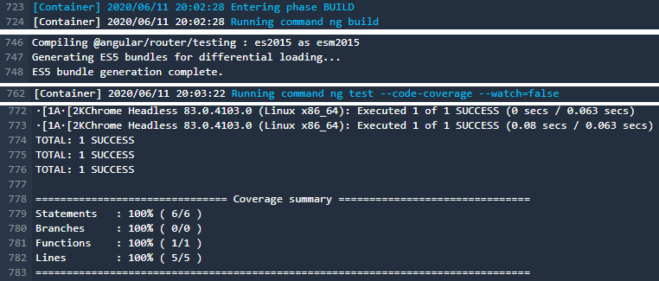
AWS CodeBuild
AWS CodeBuild
AWS CodeBuild is a build service, which compiles source code, runs tests, and produces artifacts. ^{Source} The team decided to use AWS CodeBuild because it supports the programming languages and build tools that will be used in this project, and easily integrates with AWS CodePipeline.
Build service, which compiles source code, runs tests, and produces artifacts
Pulls source code from CodeCommit, Amazon S3, GitHub, or Bitbucket
Supports popular programming languages and build tools, and can be customized
Run via AWS CodeBuild console, AWS CLI, AWS SDKs, or AWS CodePipeline
Ability to view the overall status of the build, build phase details, and build logs
Build specifications are written using a specific syntax, in a yaml format
Pricing is based on the number of build minutes, and there is a free tier option
Team decided to use AWS CodeBuild because of the easy integration with AWS CodePipeline
(Source: https://docs.aws.amazon.com/codebuild/latest/userguide/welcome.html)
Build specifications written in a yaml format:
View the overall status of each build phase:
View detailed build logs:
Notes:
Once you find your sources, you will want to evaluate your sources using the following questions:
Author:
Who is the author?
Why should I believe what he or she has to say on the topic?
Is the author seen as an expert on the topic? How do you know?
Current:
How current is the information in the source?
When was the source published?
Is the information out-of-date?
Accuracy:
Is the content accurate?
Is the information presented objectively? Do they share the pros and cons?

Slide 16
Questions?
Notes:
You can use this slide as your opening or closing slide. Should you choose to use it as a closing, make sure you review the main points of your presentation. One creative way to do that is by adding animations to the various graphics on a slide. This slide has 4 different graphics, and, when you view the slideshow, you will see that you can click to reveal the next graphic. Similarly, as you review the main topics in your presentation, you may want each point to show up when you are addressing that topic.
Add animation to images and graphics:
Select your image or graphic.
Click on the Animations tab.
Choose from the options. The animation for this slide is “Split”. The drop-down menu in the Animation section gives even more animations you can use.
If you have multiple graphics or images, you will see a number appear next to it that notes the order of the animations.
Note: You will want to choose the animations carefully. You do not want to make your audience dizzy from your presentation.

Slide 17
Appendix
Notes:
After consulting a variety of sources, you will need to narrow your topic. For example, the topic of internet safety is huge, but you could narrow that topic to include internet safety in regards to social media apps that teenagers are using heavily. A topic like that is more specific and will be relevant to your peers. Some questions to think about to help you narrow your topic:
What topics of the research interest me the most?
What topics of the research will interest my audience the most?
What topics will the audience find more engaging? Shocking? Inspiring?

Slide 18
Change/Release Management
All changes will be prioritized, scheduled, and deployed accordingly.
Production deployments will occur monthly
Break fix deployments will occur bi-monthly (every other week)
Emergency break fix deployments will occur on an ad-hoc basis
Production deployments will be approved via CAB, with the following considerations:
All deployments must follow audit guidelines (including deployment change ticket)
All changes must be tested in the non-production environments
All changes must be presented in a demo
Must have business/customer approval
Notes:
Once you find your sources, you will want to evaluate your sources using the following questions:
Author:
Who is the author?
Why should I believe what he or she has to say on the topic?
Is the author seen as an expert on the topic? How do you know?
Current:
How current is the information in the source?
When was the source published?
Is the information out-of-date?
Accuracy:
Is the content accurate?
Is the information presented objectively? Do they share the pros and cons?

Slide 19
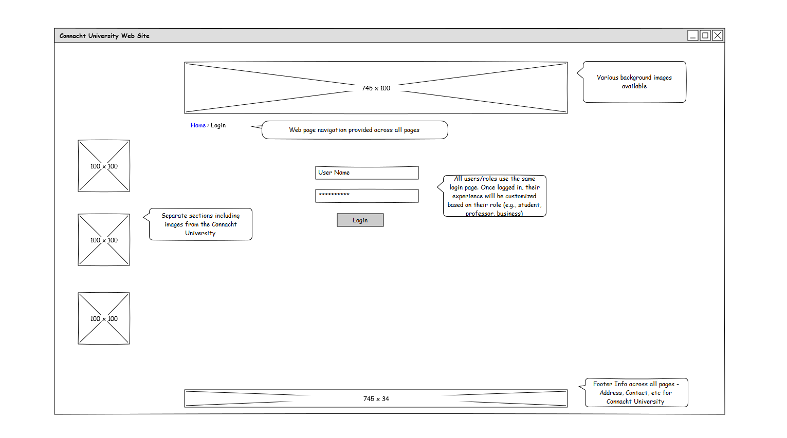
Mock-ups – Login Page
Notes:
Once you find your sources, you will want to evaluate your sources using the following questions:
Author:
Who is the author?
Why should I believe what he or she has to say on the topic?
Is the author seen as an expert on the topic? How do you know?
Current:
How current is the information in the source?
When was the source published?
Is the information out-of-date?
Accuracy:
Is the content accurate?
Is the information presented objectively? Do they share the pros and cons?

Slide 20
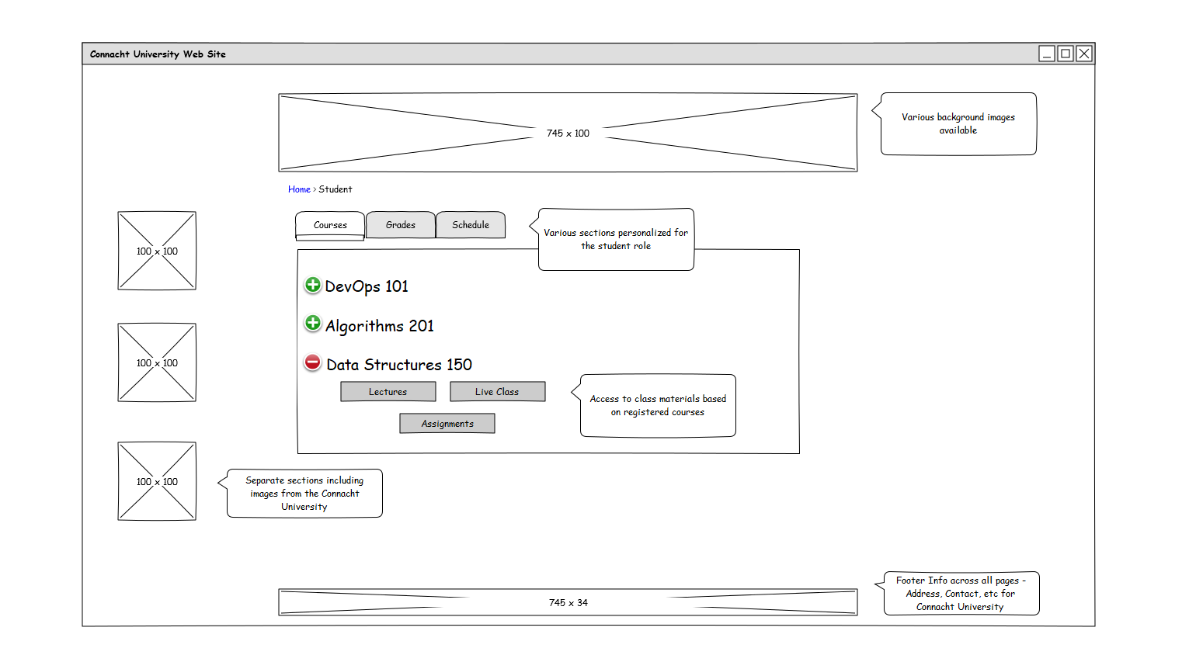
Mock-ups – Student Home Page
Notes:
Once you find your sources, you will want to evaluate your sources using the following questions:
Author:
Who is the author?
Why should I believe what he or she has to say on the topic?
Is the author seen as an expert on the topic? How do you know?
Current:
How current is the information in the source?
When was the source published?
Is the information out-of-date?
Accuracy:
Is the content accurate?
Is the information presented objectively? Do they share the pros and cons?

Slide 21
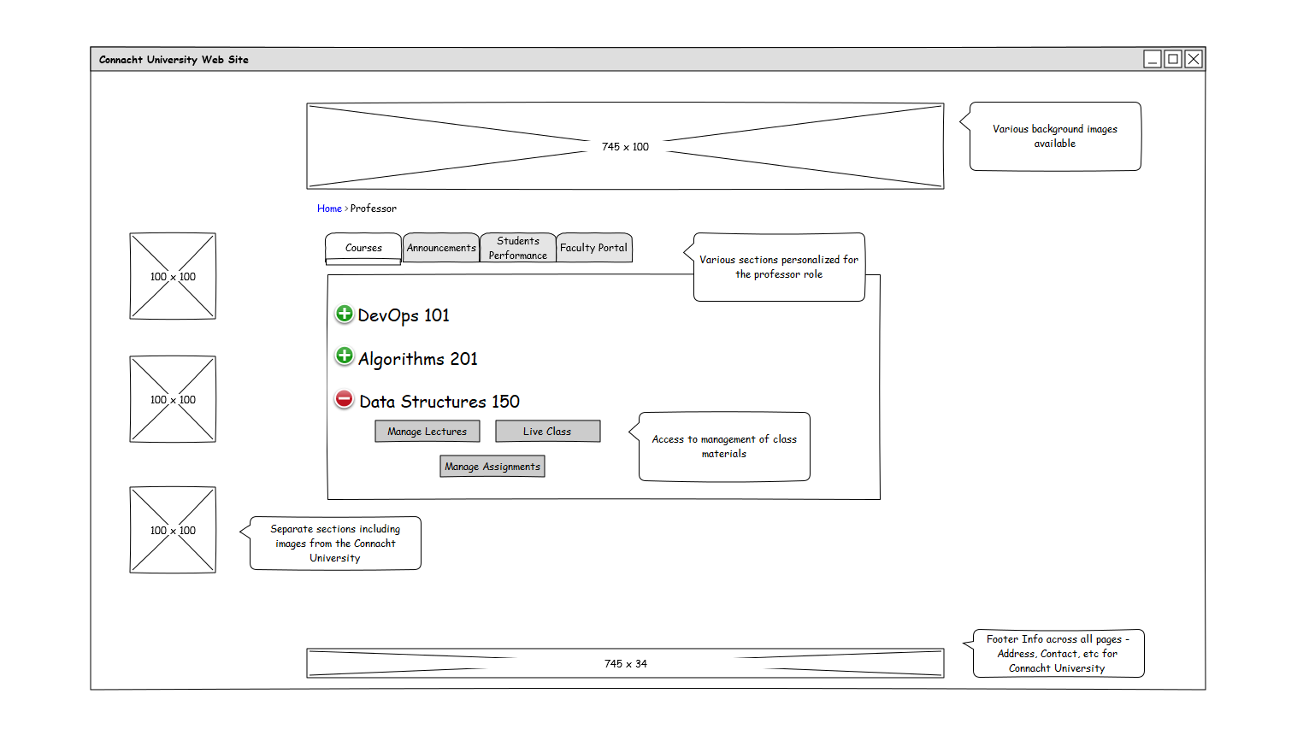
Mock-ups – Professor Home Page
Notes:
Once you find your sources, you will want to evaluate your sources using the following questions:
Author:
Who is the author?
Why should I believe what he or she has to say on the topic?
Is the author seen as an expert on the topic? How do you know?
Current:
How current is the information in the source?
When was the source published?
Is the information out-of-date?
Accuracy:
Is the content accurate?
Is the information presented objectively? Do they share the pros and cons?

Slide 22
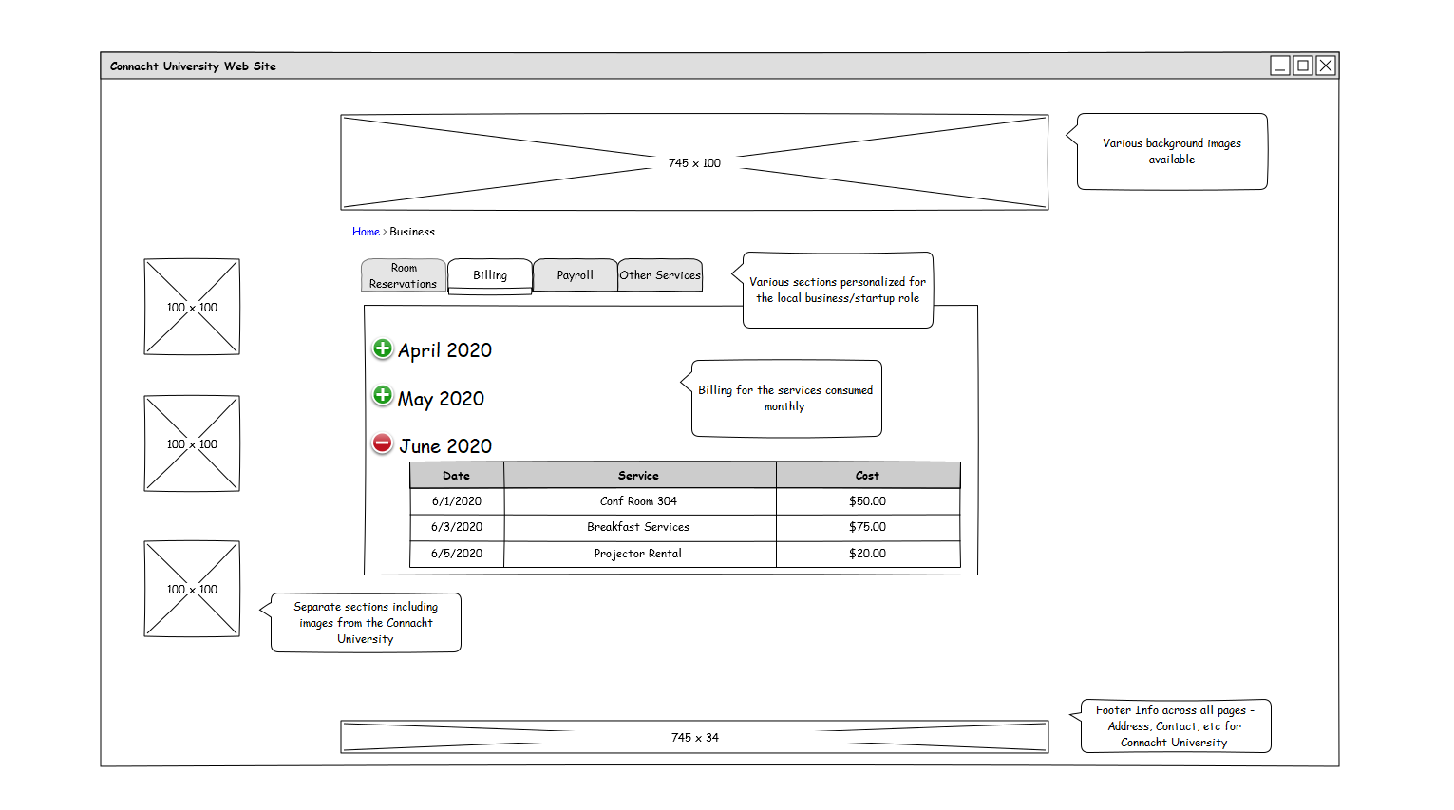
Mock-ups – Local Business Home Page
Notes:
Once you find your sources, you will want to evaluate your sources using the following questions:
Author:
Who is the author?
Why should I believe what he or she has to say on the topic?
Is the author seen as an expert on the topic? How do you know?
Current:
How current is the information in the source?
When was the source published?
Is the information out-of-date?
Accuracy:
Is the content accurate?
Is the information presented objectively? Do they share the pros and cons?

