Slide 1
CrowSoft Technologies

Slide 2
Purpose Online Business Intelligence to analyze building suitability and running costs.
Customer facing on-line system to analyse Building data
Customer will enter building information
upload files or images
Analysis features
Review similar building within a given price range
Display costs associated to each building
Maintenance projects associated to any special features
Requirement
The analysis system should be clean and simple.
simplified graphics.
administrator has access to edit detailed information
Once a client enters details it should not be able to be changed by the client.

Slide 3
Technologies:

Slide 4
Application

Slide 5
Continuous Delivery Tools:

Slide 6


Code Repository
GitHub
https://github.com/rlennon/CrowSoft

Slide 7
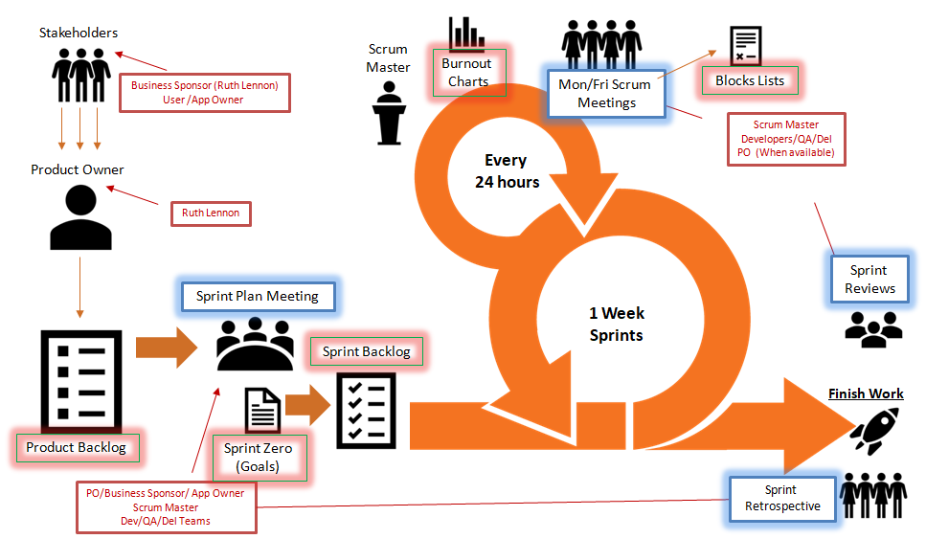
Agile Process

Slide 8





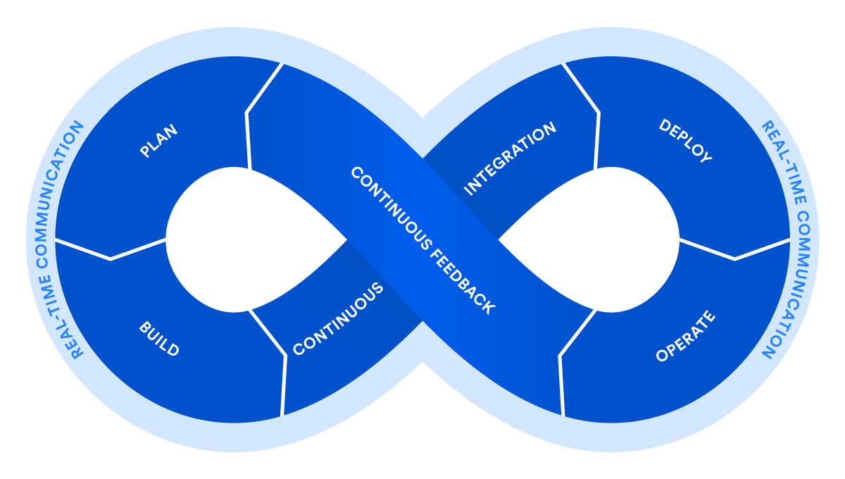










DevOps Process
Requirements & Planning
Configuration Management
Continuous Integration & Deploy
Deployment
Environments
Collaboration
Operate & Monitor
Build
Automated Testing
Wrk
Performance Tests

Slide 9
Security

Slide 10
Requirements & Planning
Configuration Management
Continuous Integration & Deploy
Deployment
Environments
Collaboration
Operate & Monitor
Build
Automated Testing
Wrk
Performance Tests

